Slide 1
Image j
免費影像分析軟體

Slide 2
Image j
Quantify protein bands
Count cell number
Measure wound healing area
Calibrate scale bar; add scale bar

Slide 3
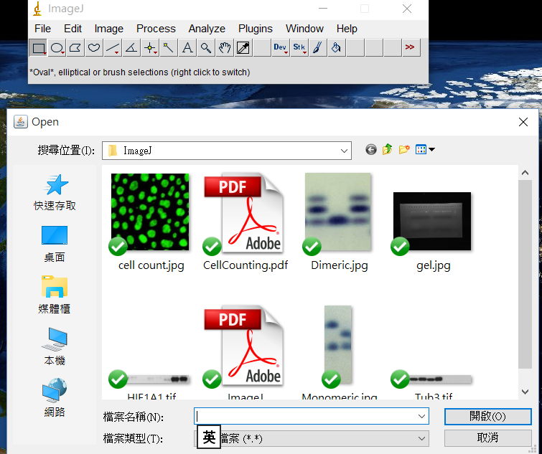
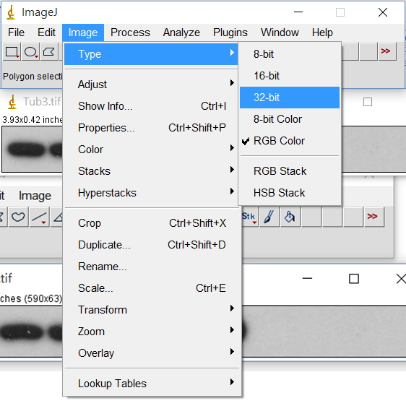
Quantify protein bands
File → Open → 開啟tif.檔
Image → Type → 32-bit

Slide 4
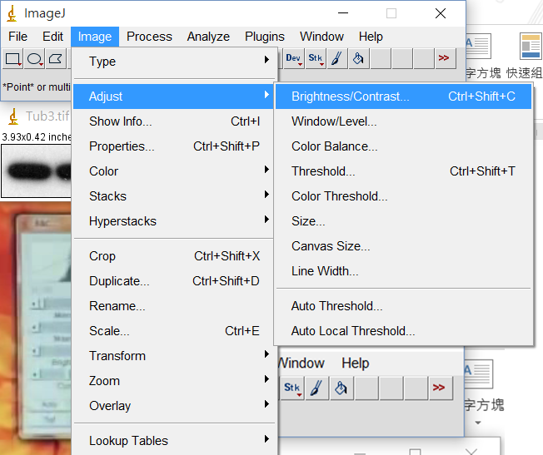
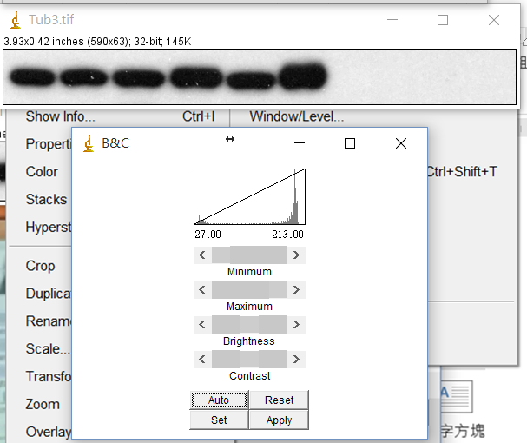
Quantify protein bands
Image → Adjust
→ Brightness/Contrast
Click “Auto

Slide 5
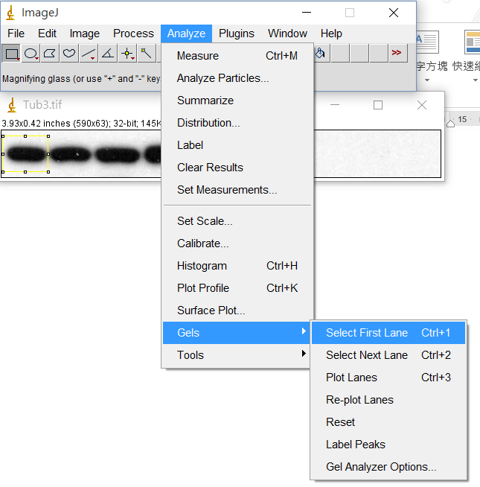
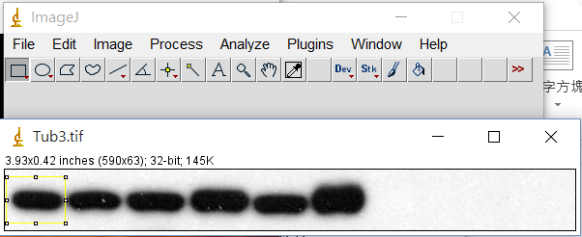
Quantify protein bands
Analyze → Gels → Select First Lane
Select the area to be analyzed

Slide 6
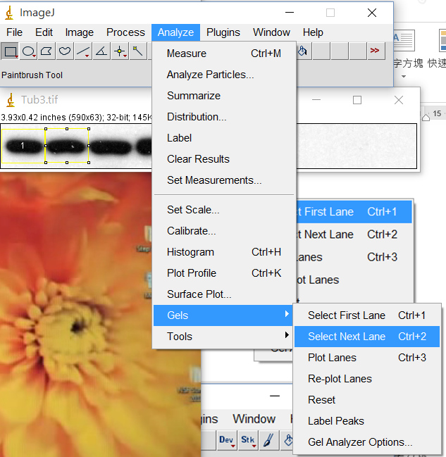
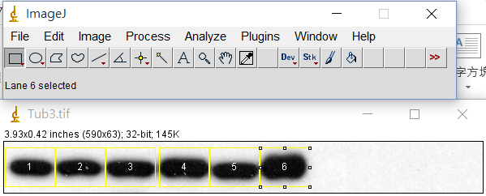
Quantify protein bands
Drag box to 2nd lane
Repeat the procedure until all bands selected

Slide 7
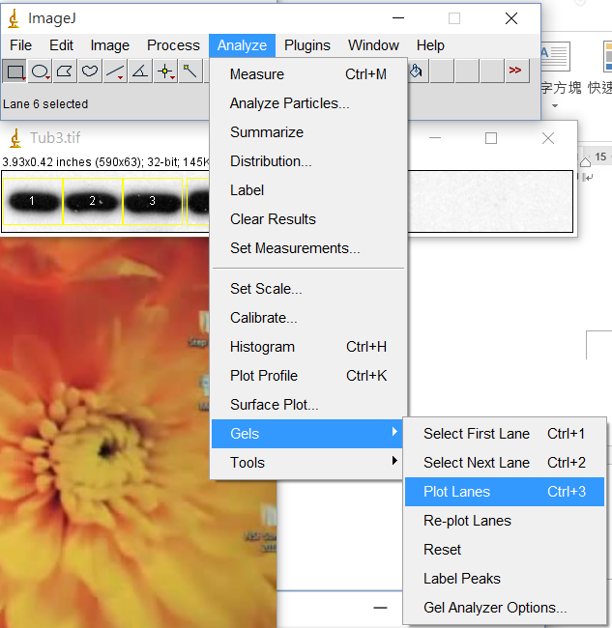
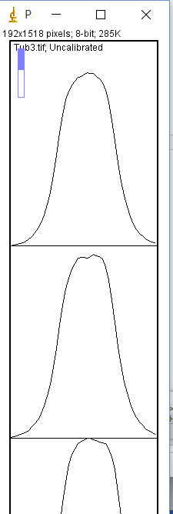
Quantify protein bands
Analyze → Gels → Plot Lanes
Isolate each peak
→

Slide 8
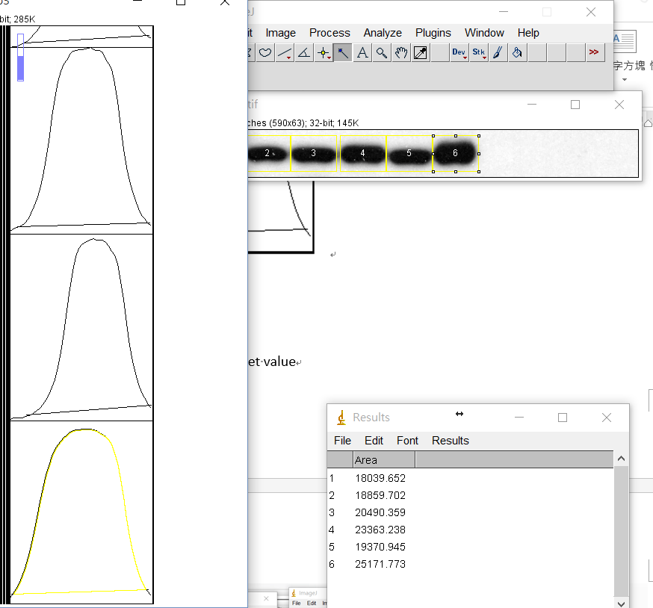
Quantify protein bands
Click each area to get value

Slide 9
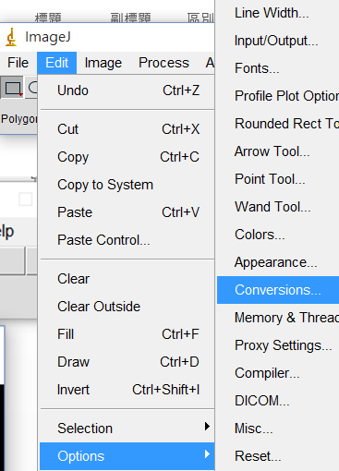
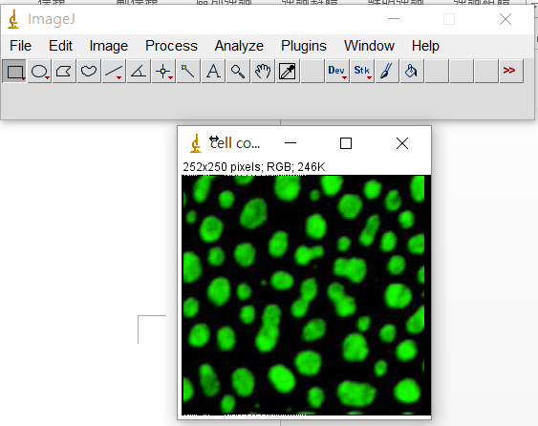
Count cell number
Edit → Options → Conversions
File → Open → cell count.jpg

Slide 10
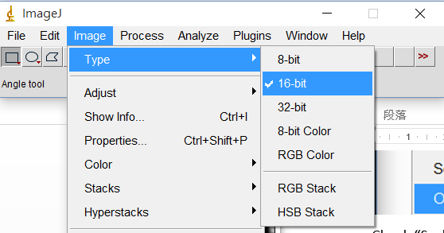
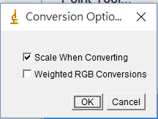
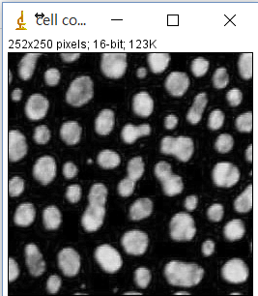
Count cell number
Image → Type → 16-bit
Check “Scale When Converting”
→OK

Slide 11
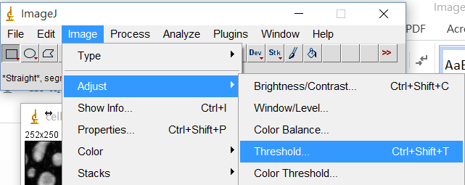
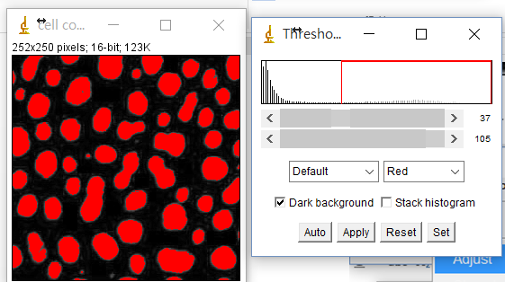
Count cell number
Image → Adjust → Threshold
Adjust threshold until you are satisfied→ Apply

Slide 12
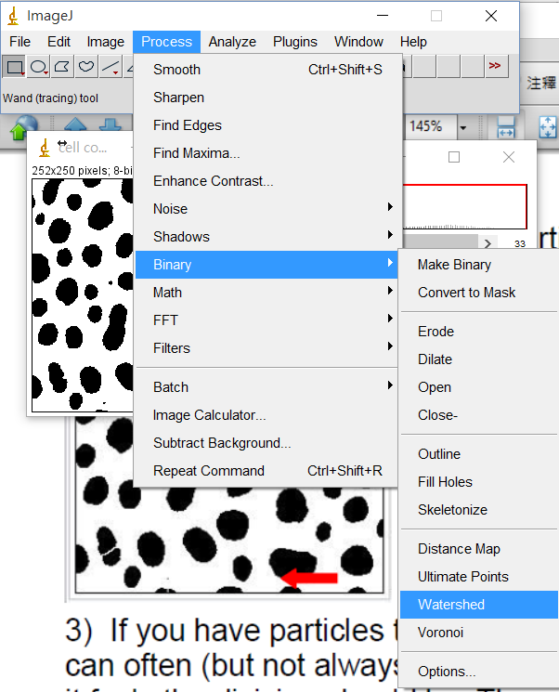
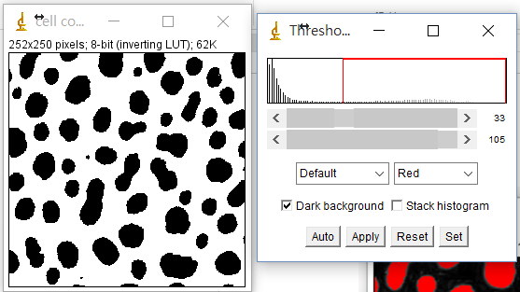
Count cell number
Process → Binary → Watershed
To separate two overlapping cells

Slide 13
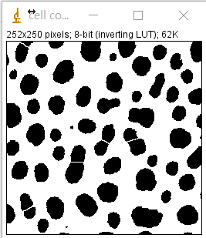
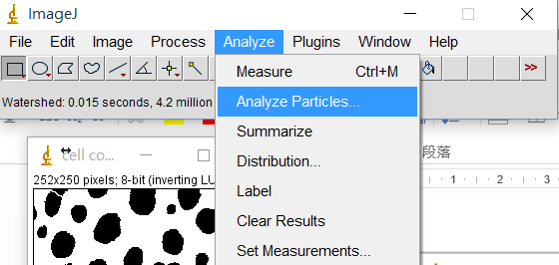
Count cell number
Analyze → Analyze Particles

Slide 14
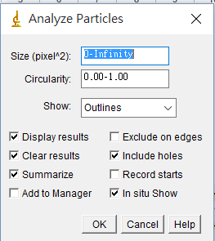
Count cell number
Check cell size and circularity

Slide 15
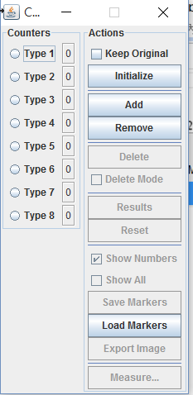
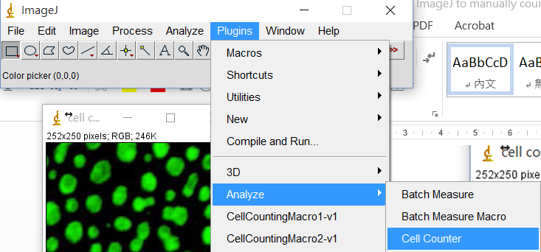
Count cell number
Plugins → Analyze → Cell Counter

Slide 16
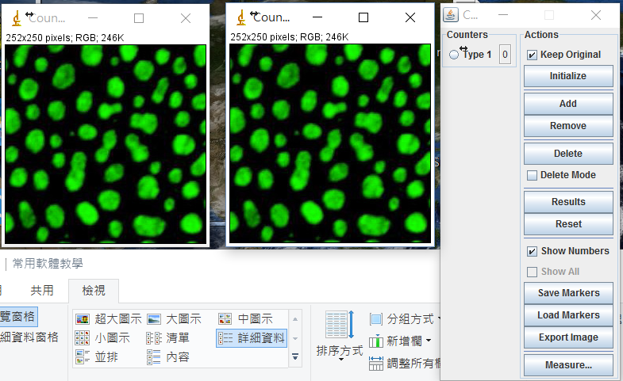
Count cell number
click “Remove” to remove other cell types.
→ Initialize → Keep Original

Slide 17
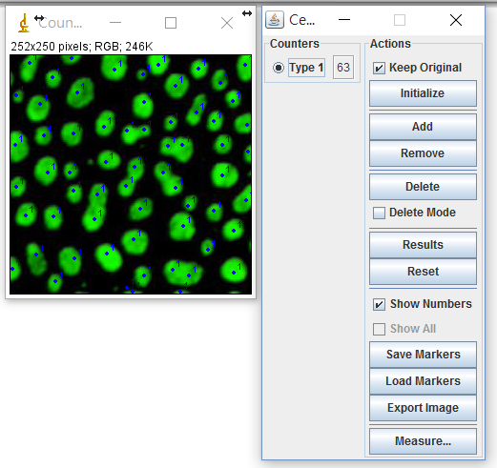
Count cell number
Click “Type 1”
Click on cells to count

Slide 18
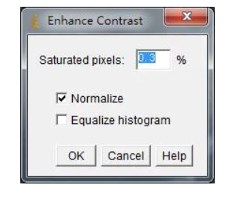
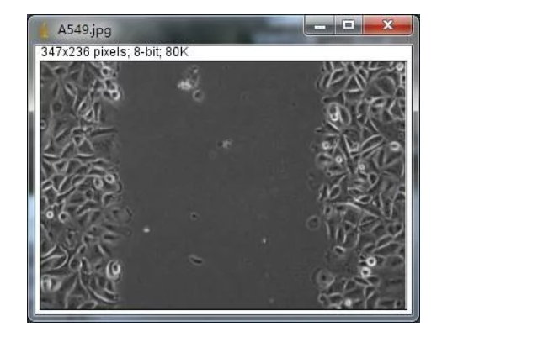
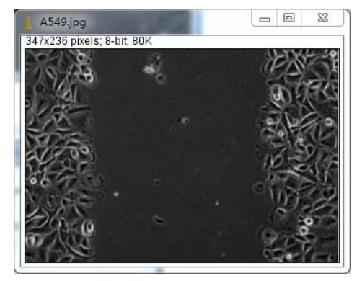
Wound healing
Process→ Enhance Contrast
File → Open jpg.

Slide 19
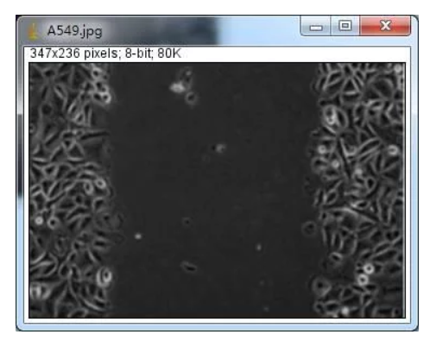
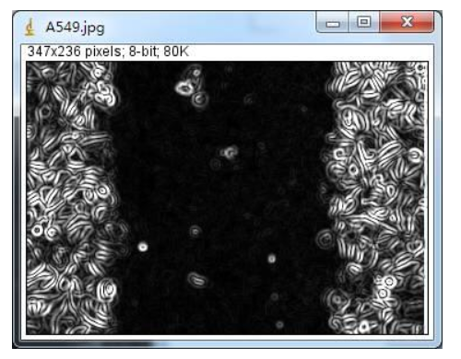
Wound healing
Process→ Smooth
Process→ Find Edges

Slide 20
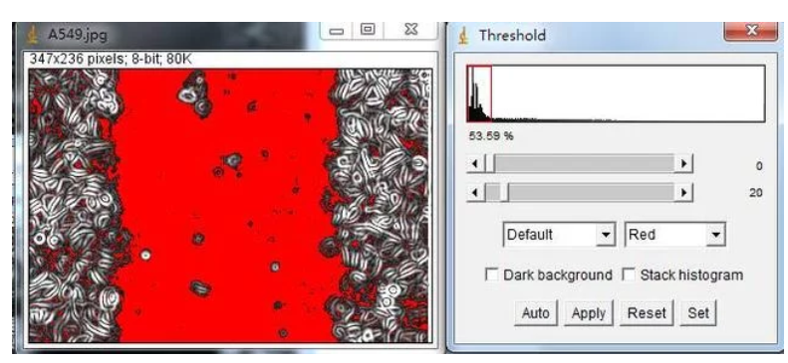
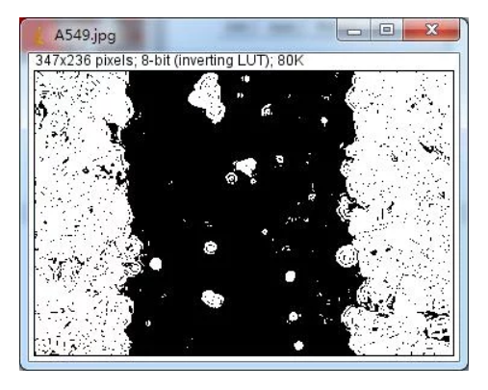
Wound healing
Image → Adjust → Threshold → Apply

Slide 21
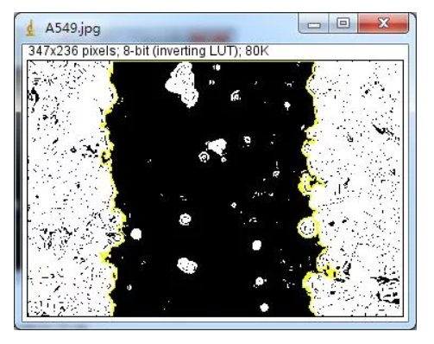
Wound healing
Click each area to get value

Slide 22
Calibrate scale bar
Zoom in → Draw the scale line
File → Open jpg.

Slide 23
Calibrate scale bar
Analize → Set Scale
Set known Distance→ Unit → OK

Slide 24
Add scale bar
Analize → Tools → Scale Bar
Set Width→ Color → Location

Slide 25
~THANK YOU~
Notes:
4

