Slide 1
How to evaluate the ranking of journal?

Slide 2
How to find journal full name and its abbreviation?
https://www.ncbi.nlm.nih.gov/nlmcatalog/journals
Q: What is the abbreviation of “Translational Cancer Research”?

Slide 3
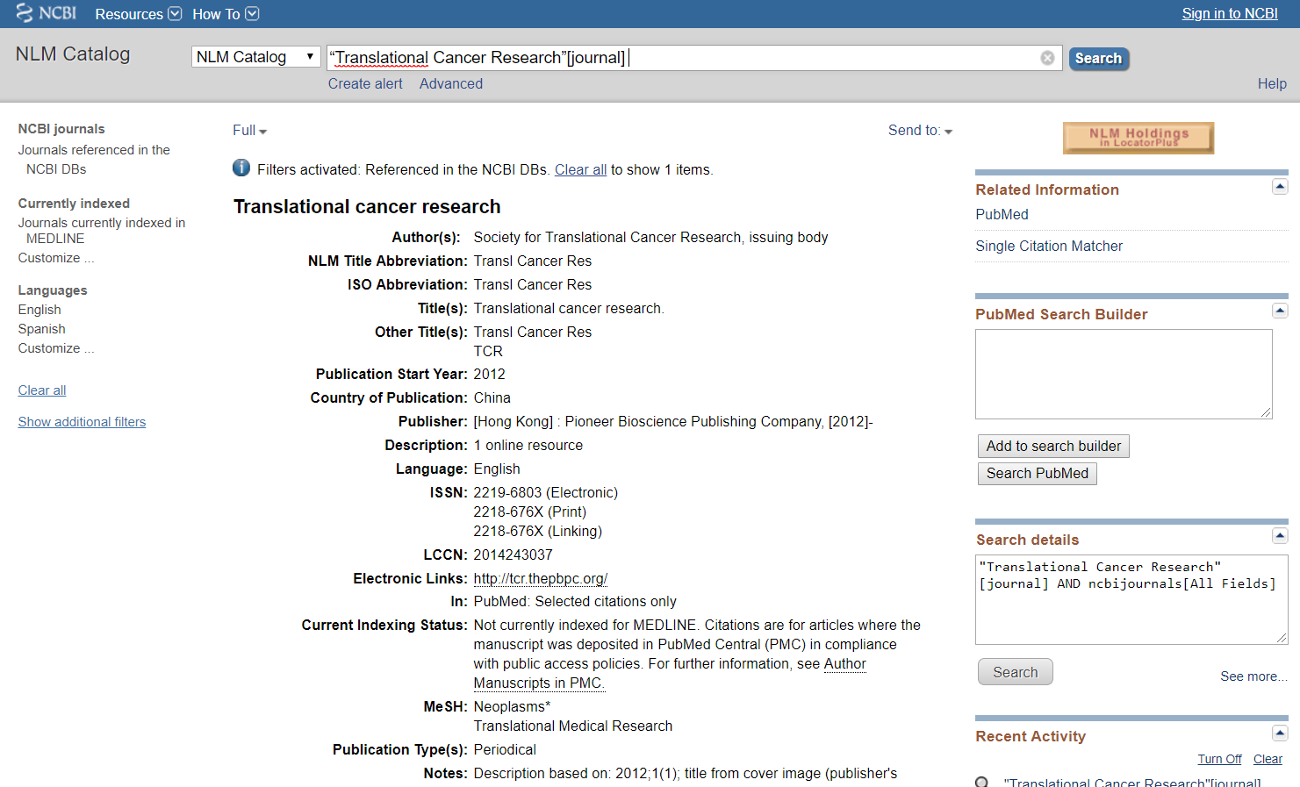
全名找縮寫

Slide 4
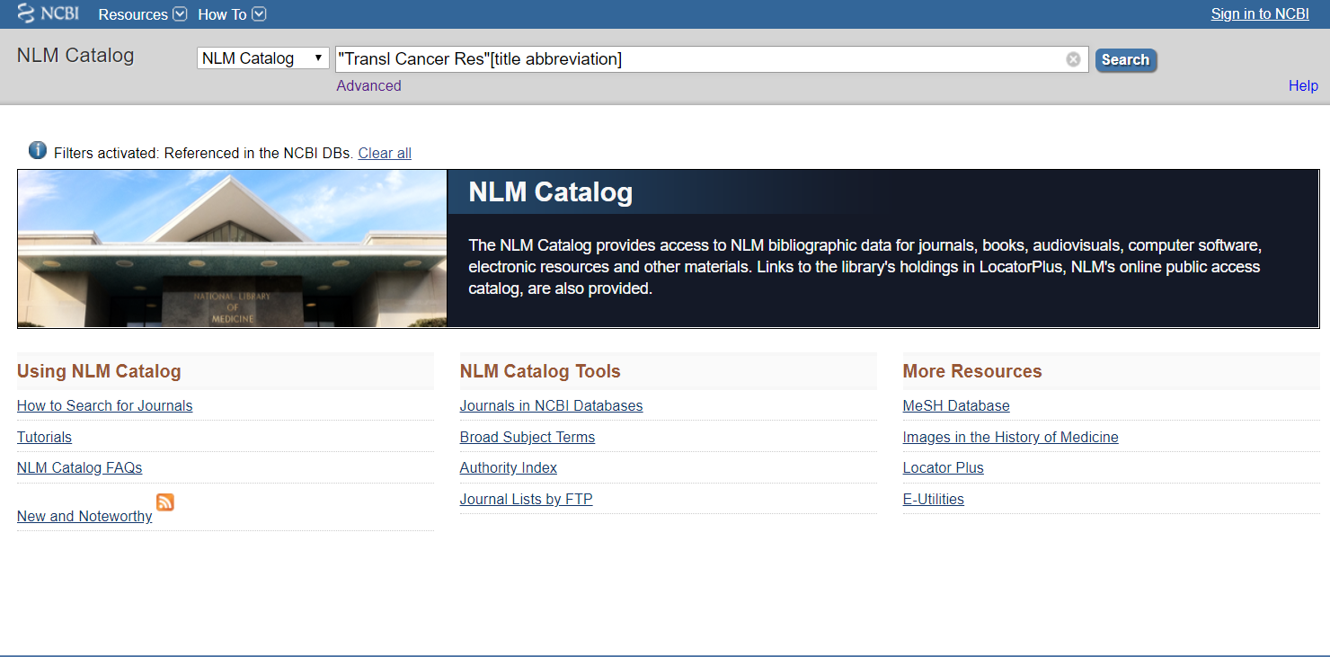
縮寫找全名

Slide 5
How to find the ranking of journal?
Impact factor
統計當年的IF=前兩年總被引次數/前兩年內發表的論文總數

Slide 6
How to find the ranking of journal?
Q: Find the 5-year impact factor and rank of “Scientific Reports”
Journal Citation Reports
https://jcr.clarivate.com
Q: Calculate the next year’s impact factor of “Scientific Reports”
https://www.scopus.com/sourceid/21100200805
Scopus
https://www.scopus.com/

Slide 7
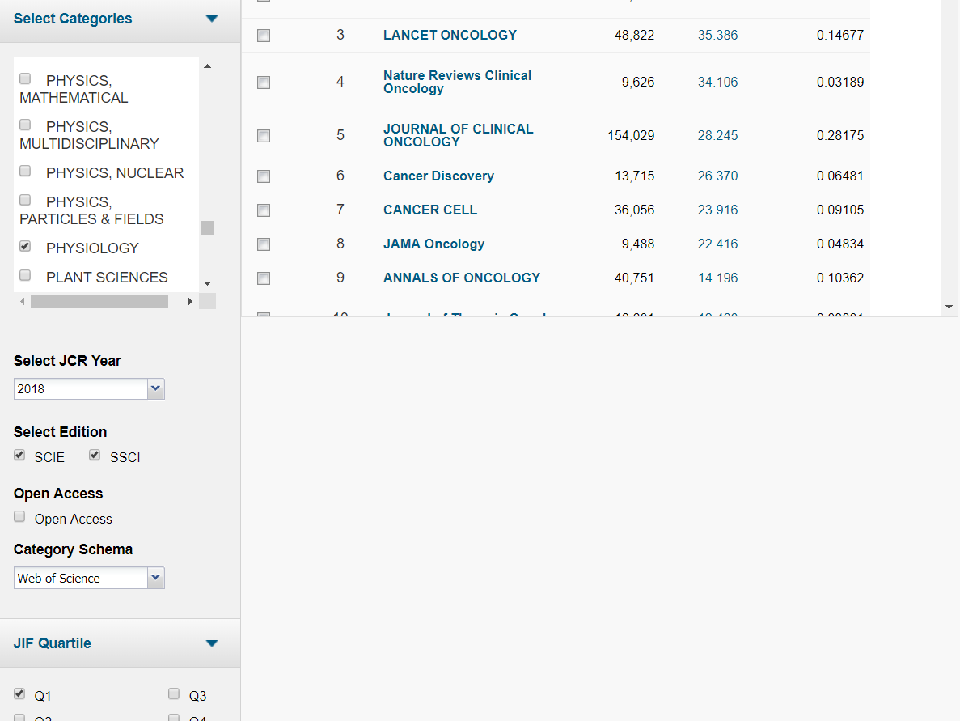
想找的領域有哪些journal的IF排名在Q1？

Slide 8
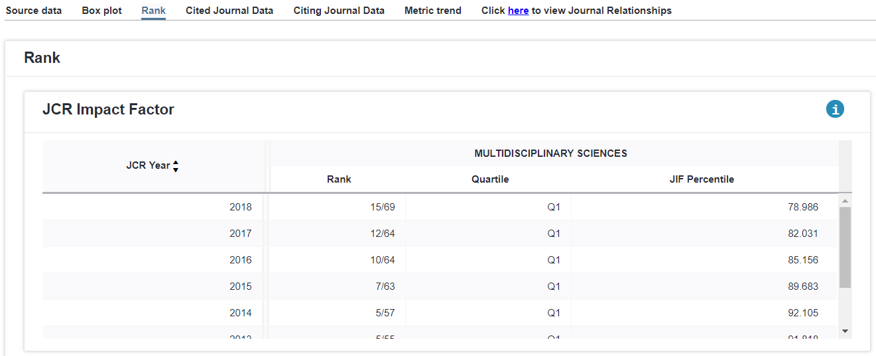
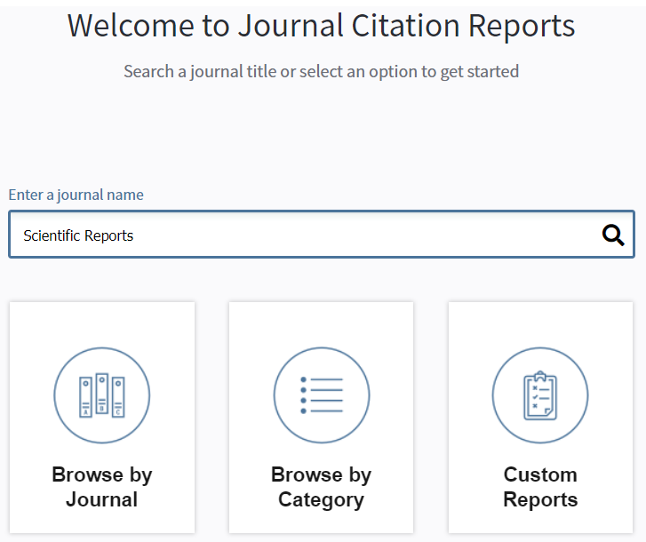
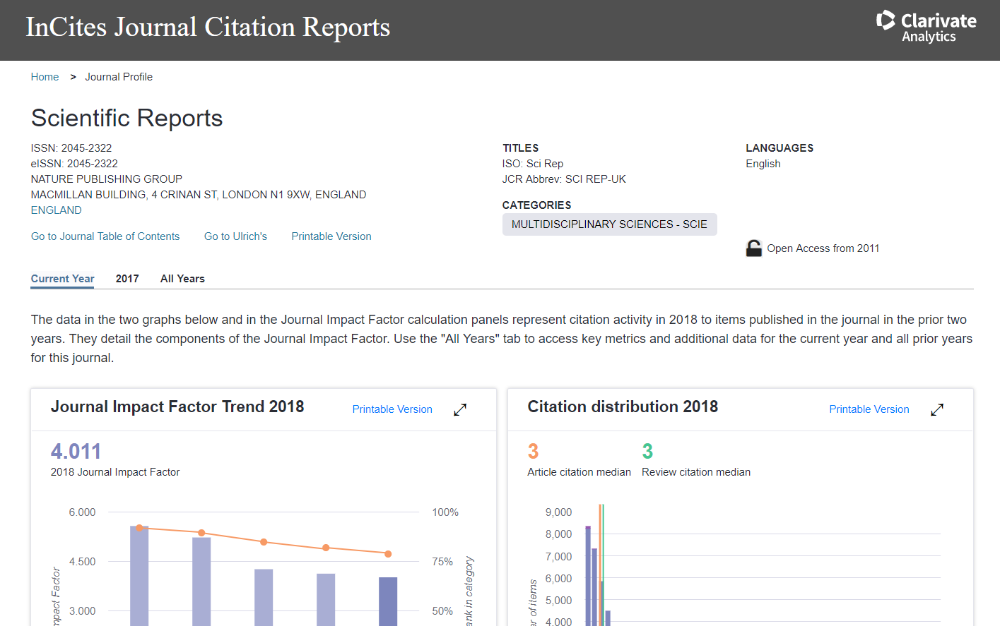
Find the 5-year impact factor and rank of “Scientific Reports”

Slide 9
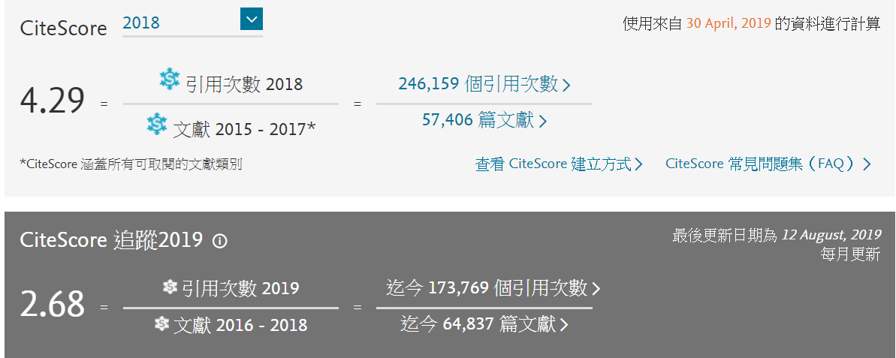
Scopus

Slide 10
H-index
將被引用的文章按照引用次數排序，引用次數高的排在最前面，引用次數少的排在最後，從排序的結果可看出被引用的文章「有h篇文章至少被引用h次」。

Slide 11
查詢臺大各學院系所在WOS收錄期刊所發表的文章
Web of Science
http://apps.webofknowledge.com
找出系所縮寫

Slide 12
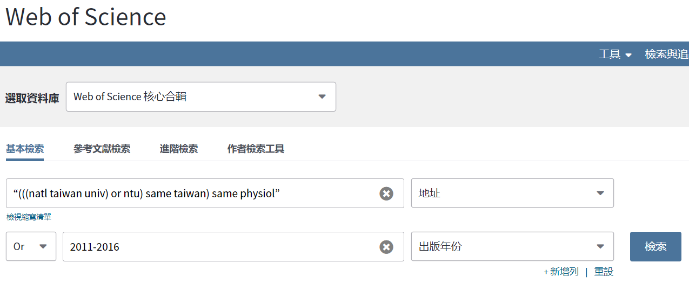
Find how many papers in our department have been published from 2011 to 2016?

Slide 13
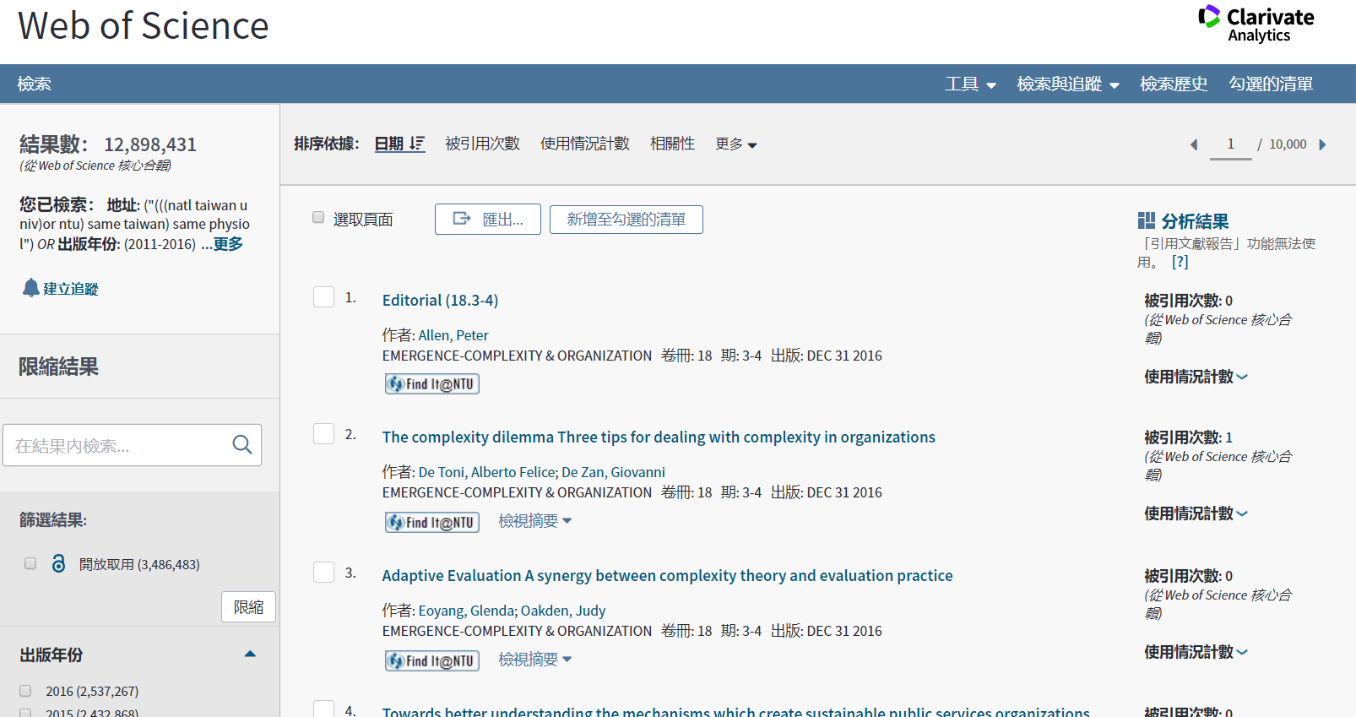
Find how many papers in our department have been published from 2011 to 2016?

Slide 14
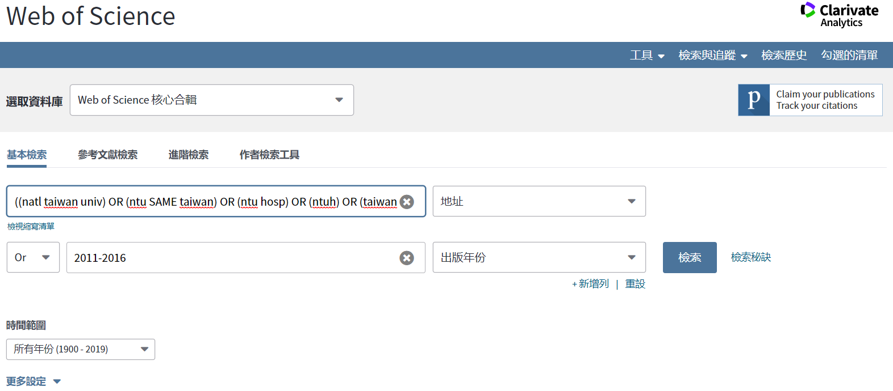
Find how many papers in our department have been published from 2011 to 2016?
((natl taiwan univ) OR (ntu SAME taiwan) OR (ntu hosp) OR (ntuh) OR (taiwan natl univ) OR (natl taiwan natl univ) OR (natl taiwan hosp) OR (Taiwan Univ Hosp) OR (nation taiwan univ) OR (Nat Taiwan Univ) OR (NTUMC)) SAME ((Dept Physiol) OR (Grad Inst Physiol) OR (Inst Physio) OR (Inst Physiol))

Slide 15
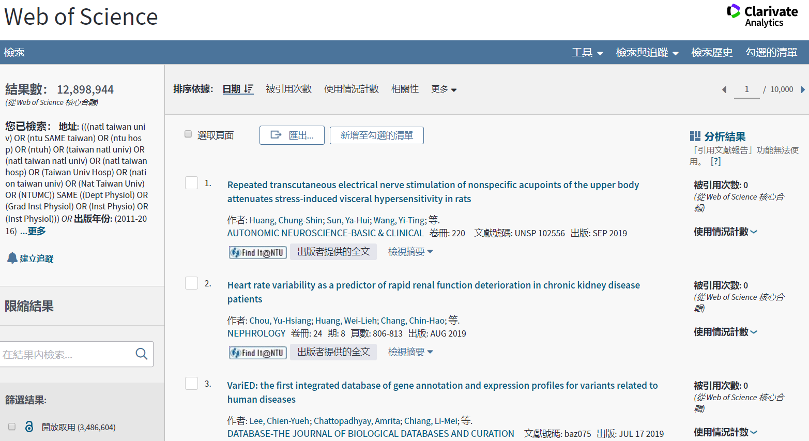
Find how many papers in our department have been published from 2011 to 2016?

Slide 16
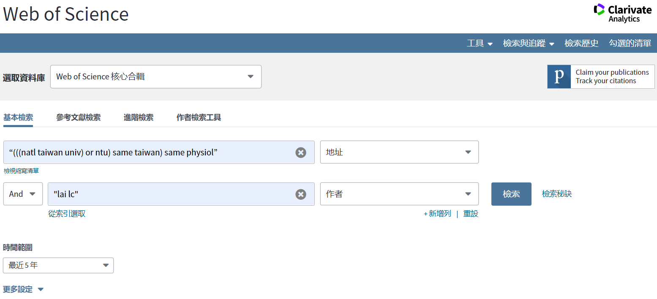
What is the H-index of Liang-Chuan Lai in past 5 years?

Slide 17
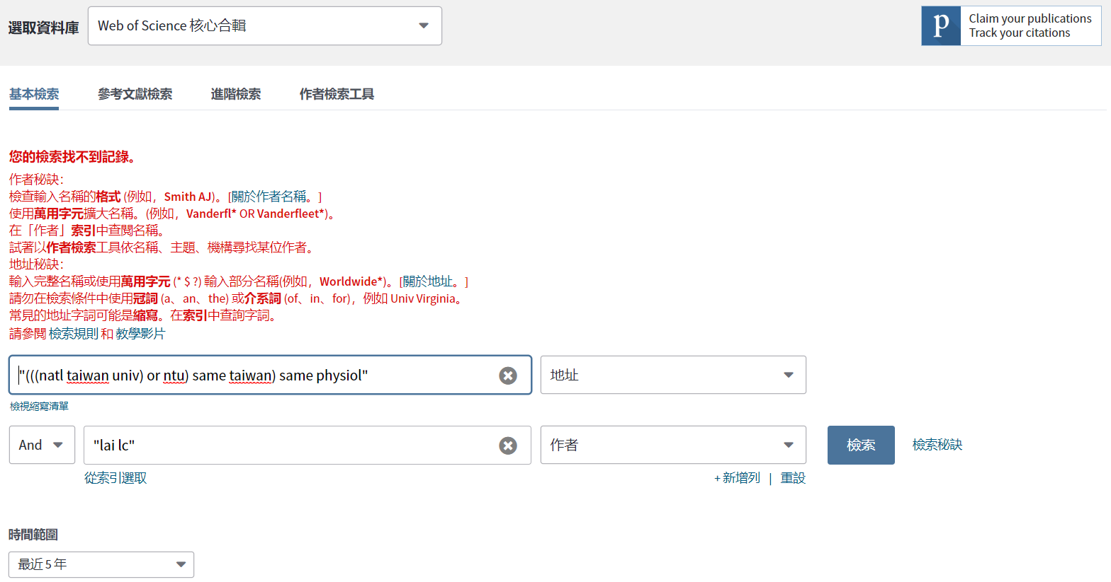
What is the H-index of Liang-Chuan Lai in past 5 years?

Slide 18
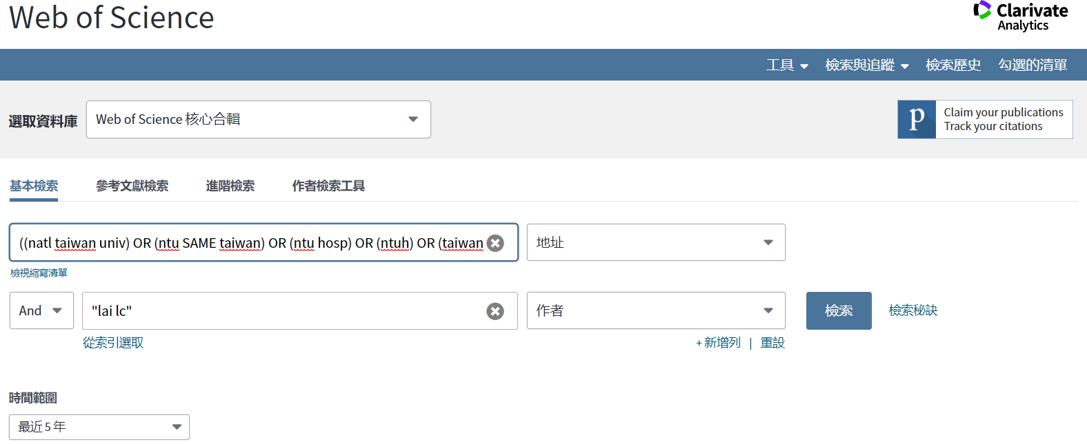
What is the H-index of Liang-Chuan Lai in past 5 years?
((natl taiwan univ) OR (ntu SAME taiwan) OR (ntu hosp) OR (ntuh) OR (taiwan natl univ) OR (natl taiwan natl univ) OR (natl taiwan hosp) OR (Taiwan Univ Hosp) OR (nation taiwan univ) OR (Nat Taiwan Univ) OR (NTUMC)) SAME ((Dept Physiol) OR (Grad Inst Physiol) OR (Inst Physio) OR (Inst Physiol))

Slide 19
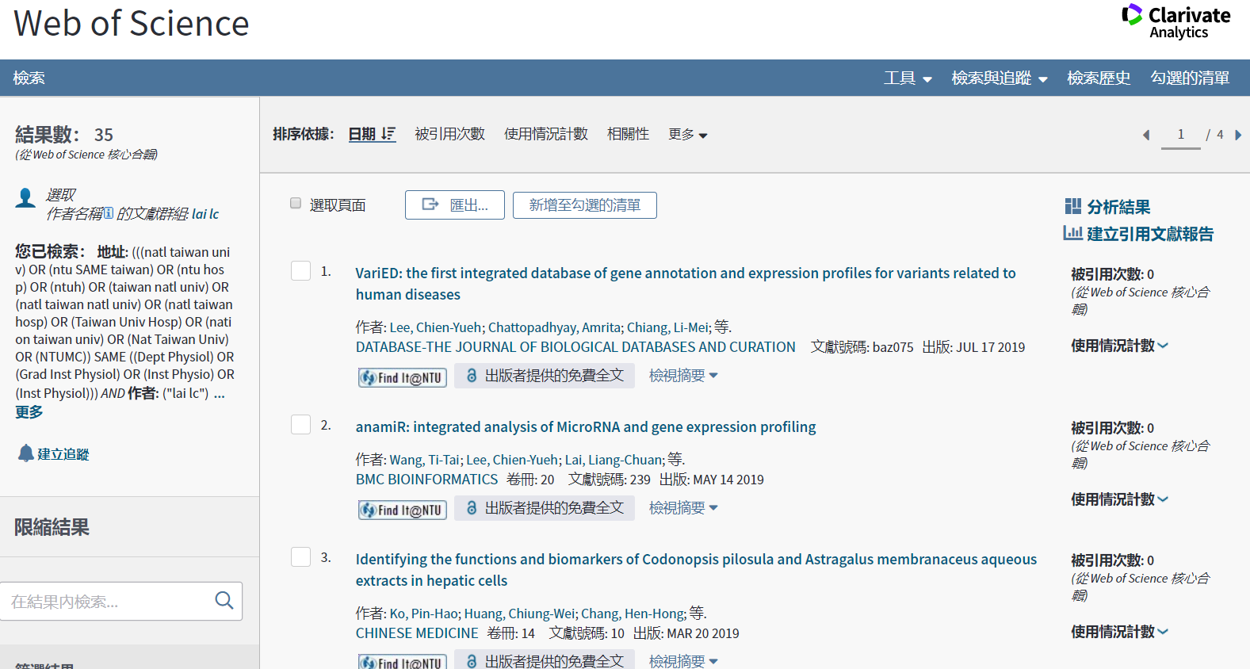
What is the H-index of Liang-Chuan Lai in past 5 years?

Slide 20
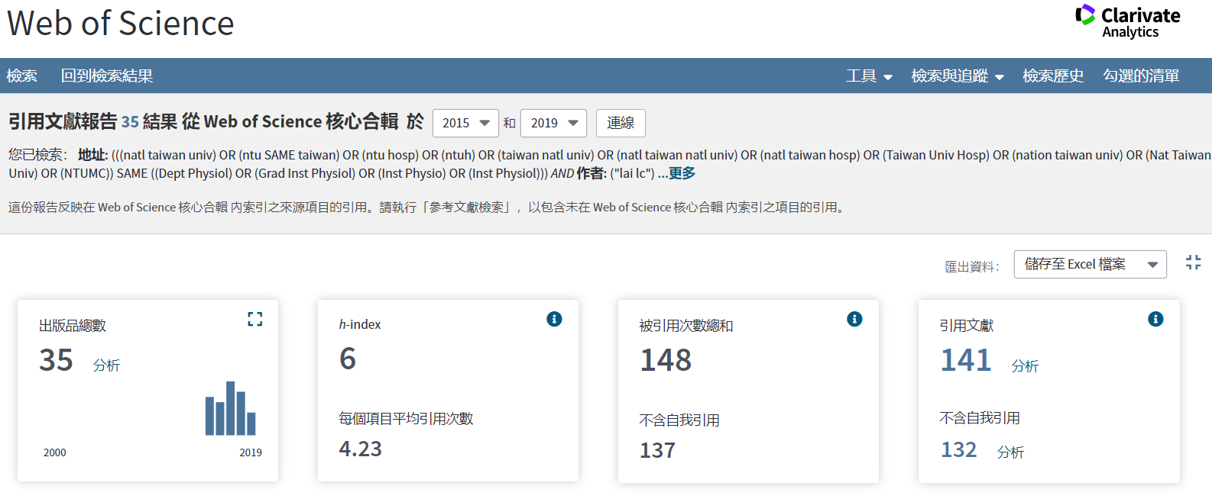
What is the H-index of Liang-Chuan Lai in past 5 years?

Slide 21
How to find the number of citation for a specific paper?
Web of Science
Scopus
Google Scholar
臺灣人文及社會科學引文索引資料庫
臺灣博碩士論文加值系統
……

Slide 22
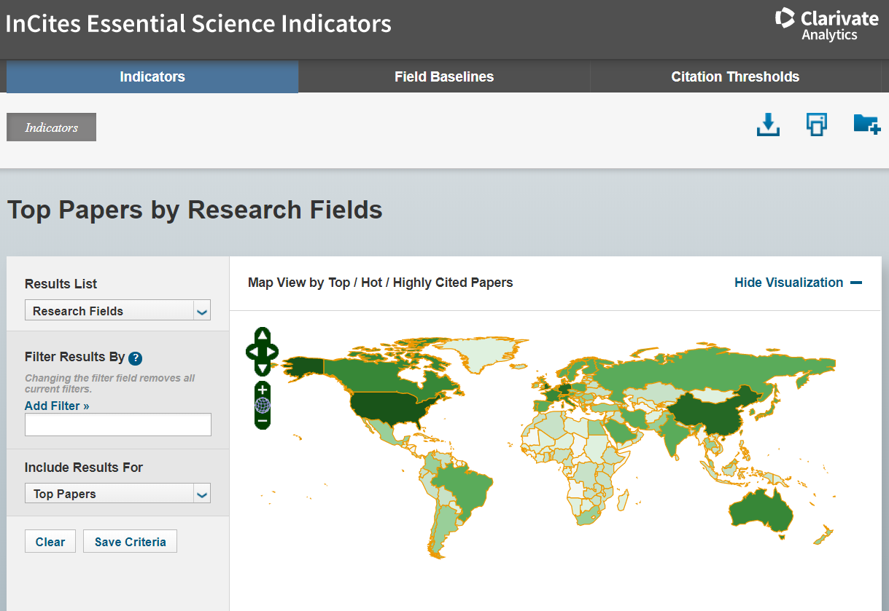
查詢各領域的研究
Essential Science Indicators
https://esi.clarivate.com

Slide 23
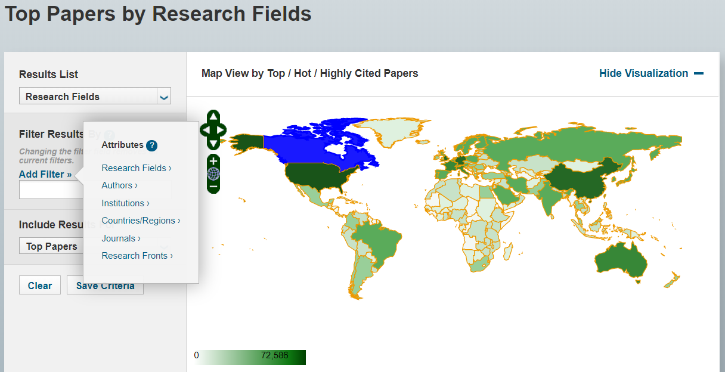
Whose paper in Clinical Medicine research field has been cited most?

Slide 24
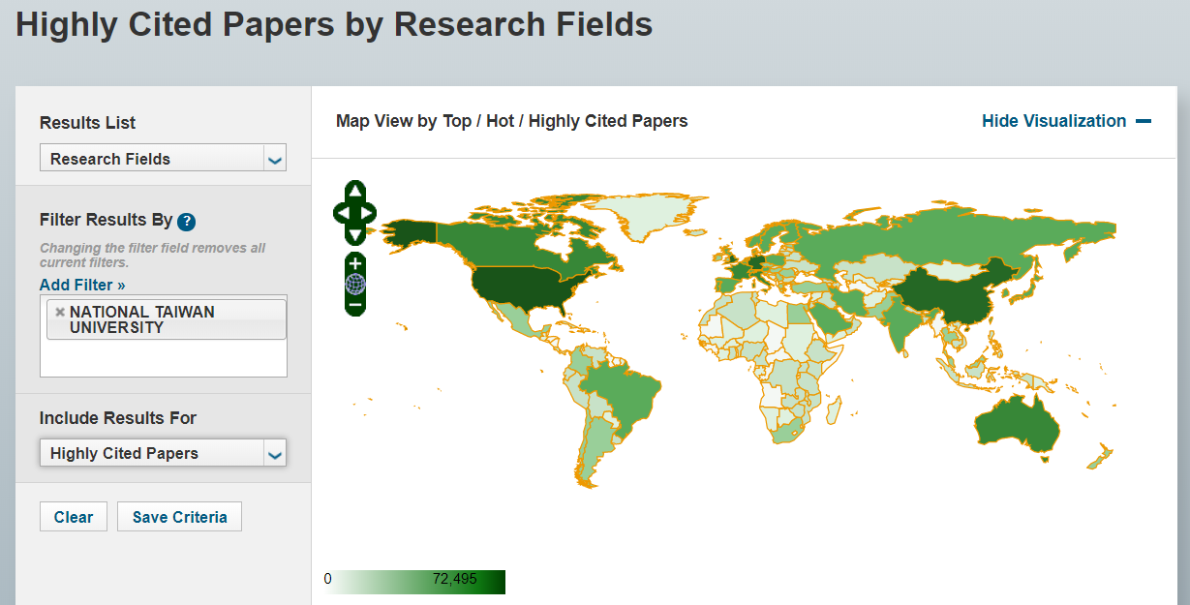
Whose paper in Clinical Medicine research field has been cited most?

Slide 25
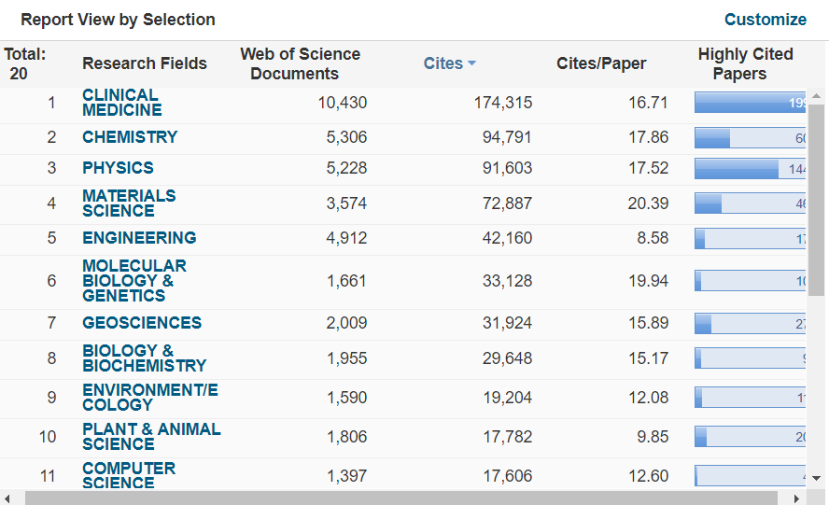
Whose paper in Clinical Medicine research field has been cited most?

Slide 26
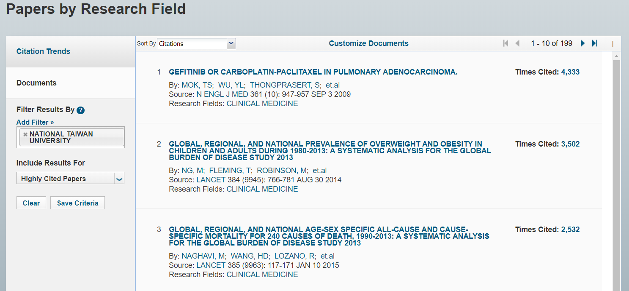
Whose paper in Clinical Medicine research field has been cited most?

Slide 27
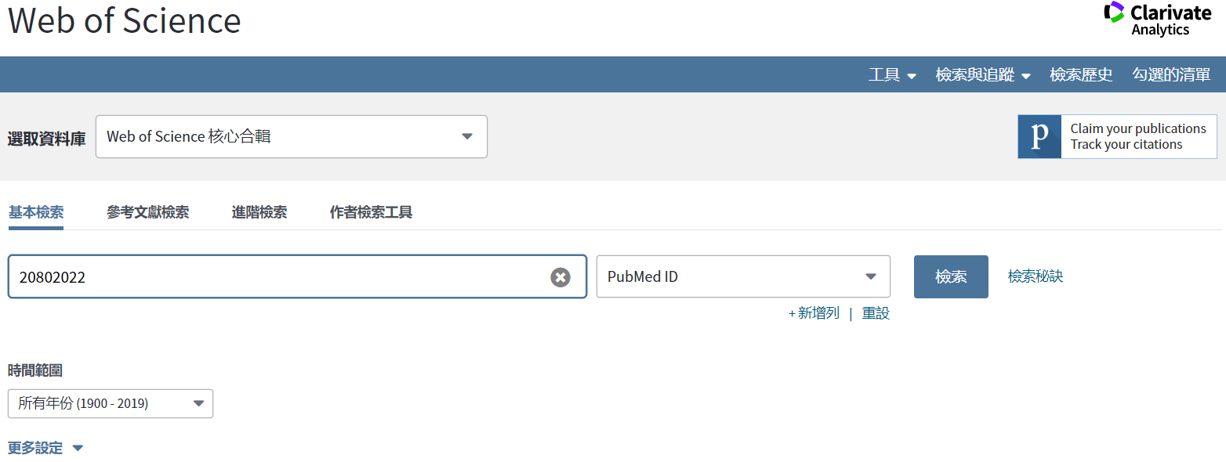
Find how many times of this paper (PMID: 20802022) have been cited including self-citation

Slide 28
Find how many times of this paper (PMID: 20802022) have been cited including self-citation

Slide 29
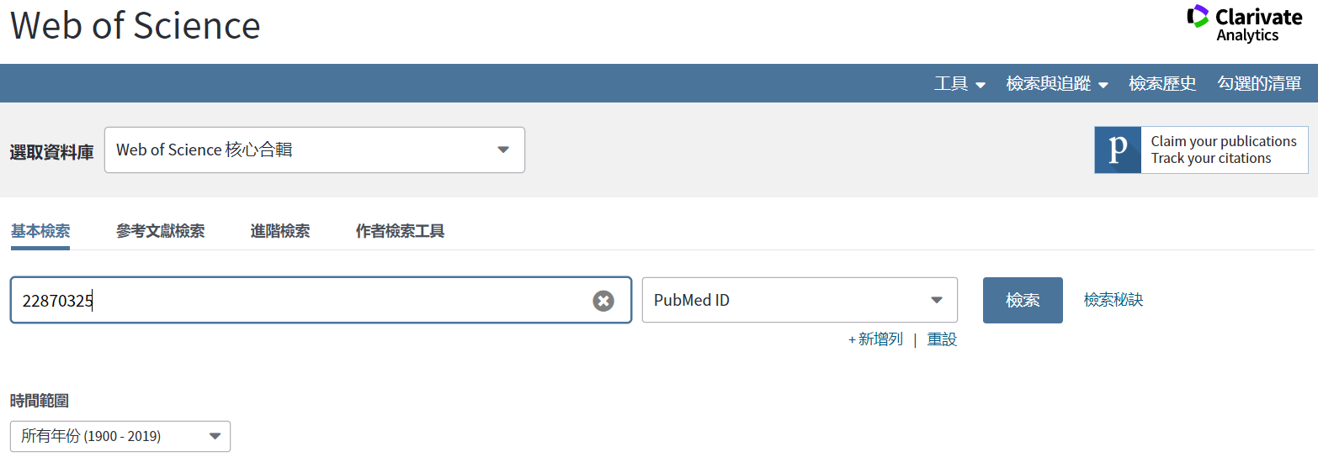
Find how many times of this paper (PMID: 22870325) have been cited without self-citation

Slide 30
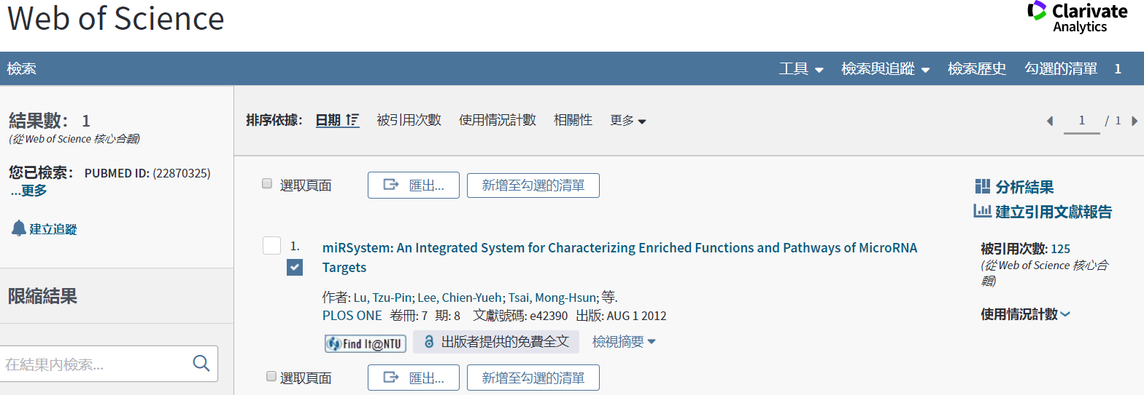
Find how many times of this paper (PMID: 22870325) have been cited without self-citation

Slide 31
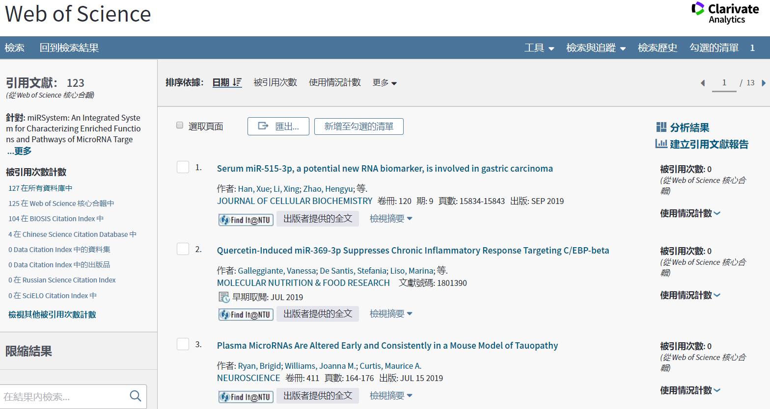
Find how many times of this paper (PMID: 22870325) have been cited without self-citation

Slide 32
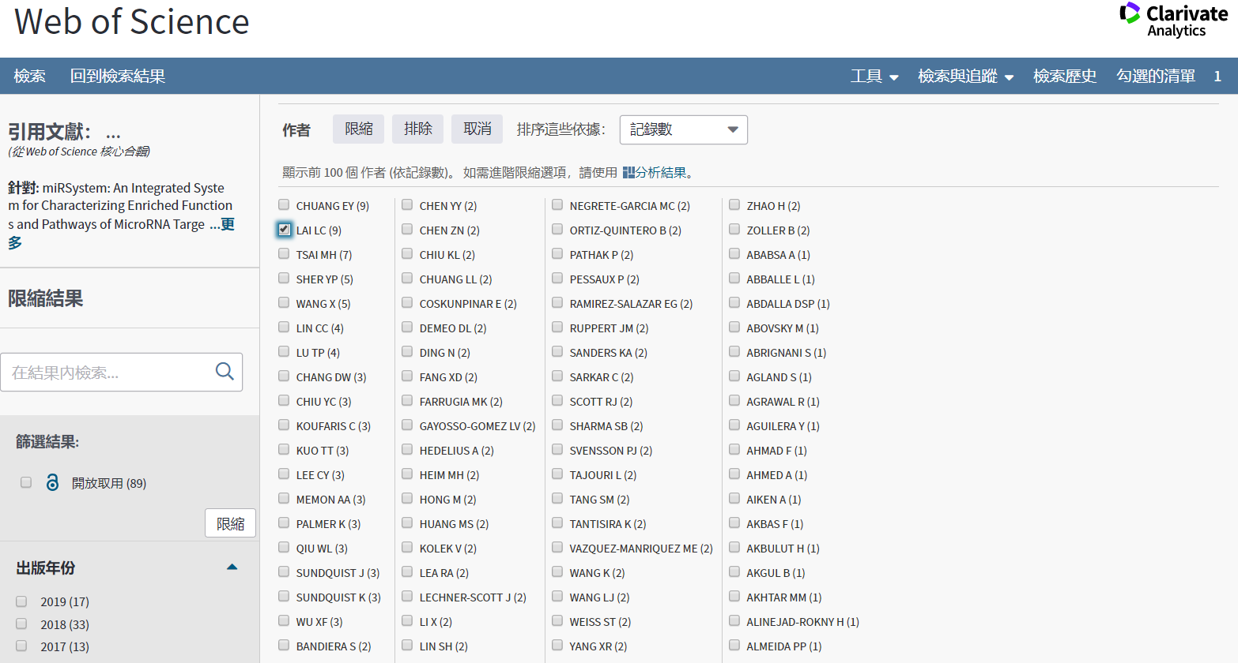
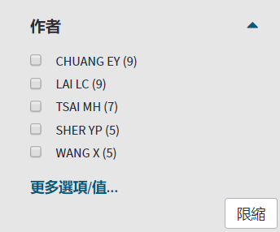
Find how many times of this paper (PMID: 22870325) have been cited without self-citation

Slide 33
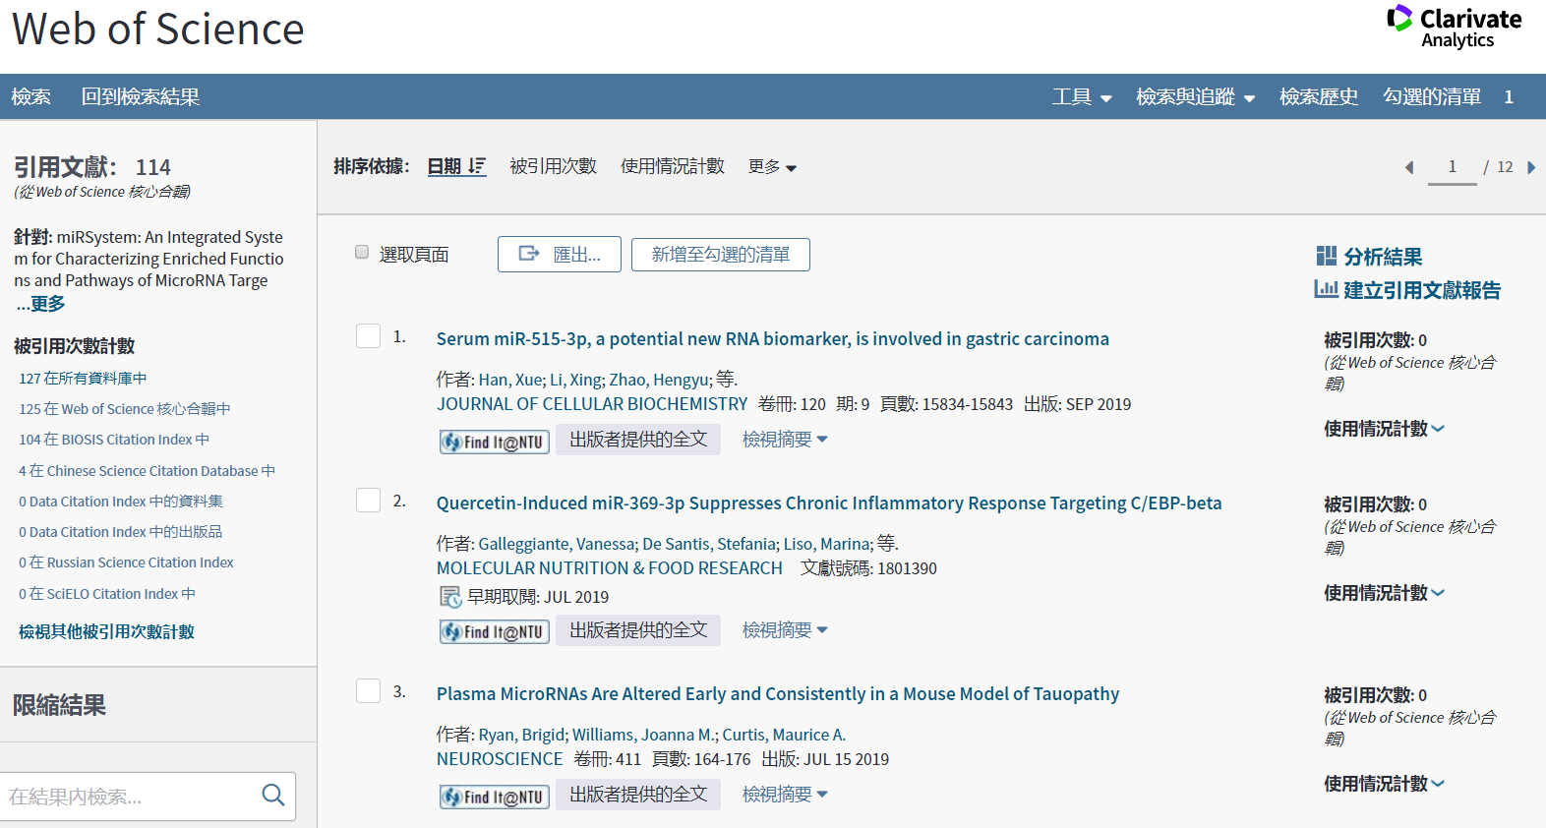
Find how many times of this paper (PMID: 22870325) have been cited without self-citation

Slide 34
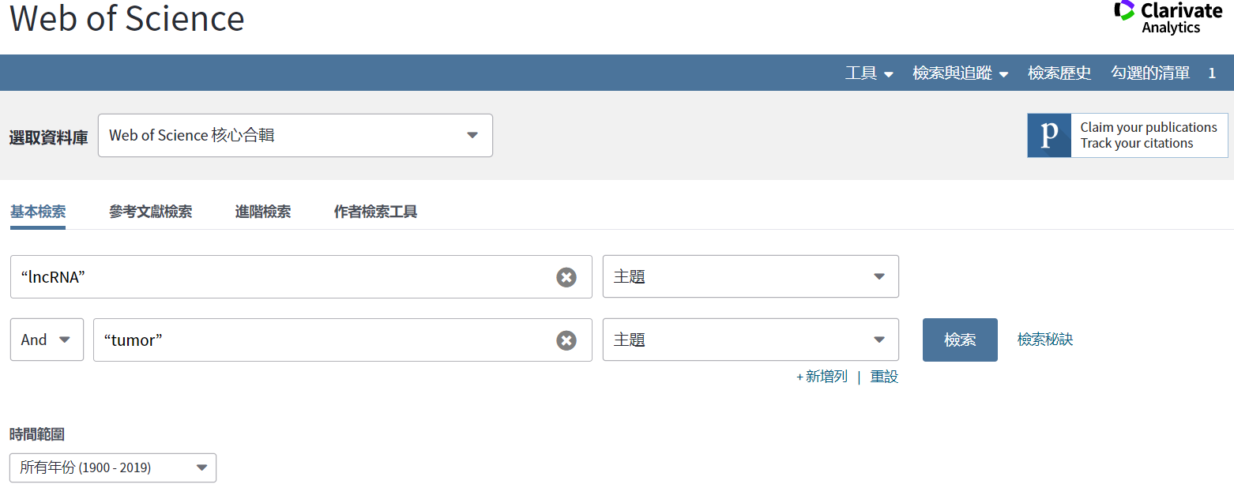
Use web of science to search journals with articles about “lncRNA” and “tumor” and visualize them

Slide 35
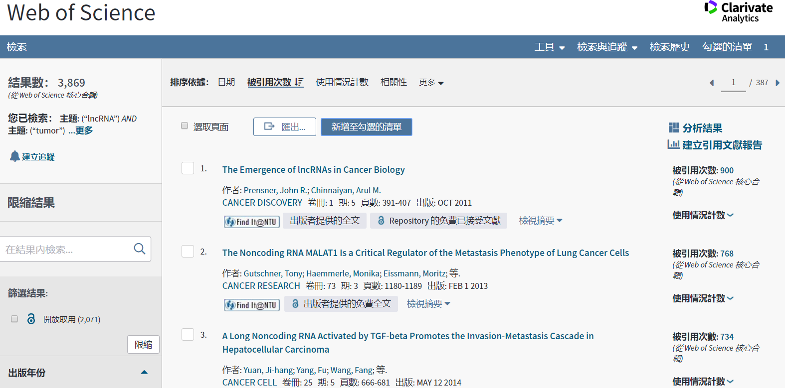
Use web of science to search journals with articles about “lncRNA” and “tumor” and visualize them

Slide 36
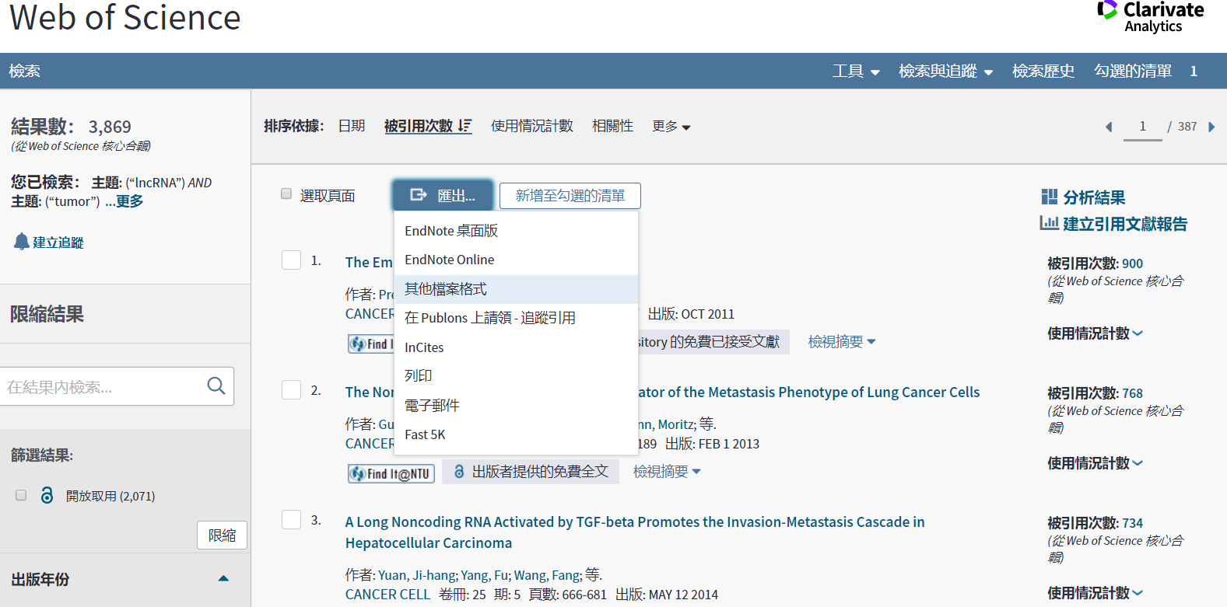
Use web of science to search journals with articles about “lncRNA” and “tumor” and visualize them

Slide 37
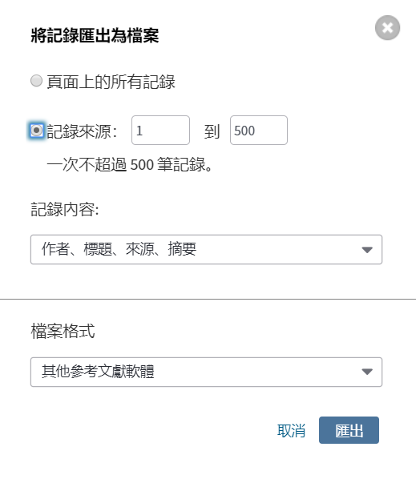
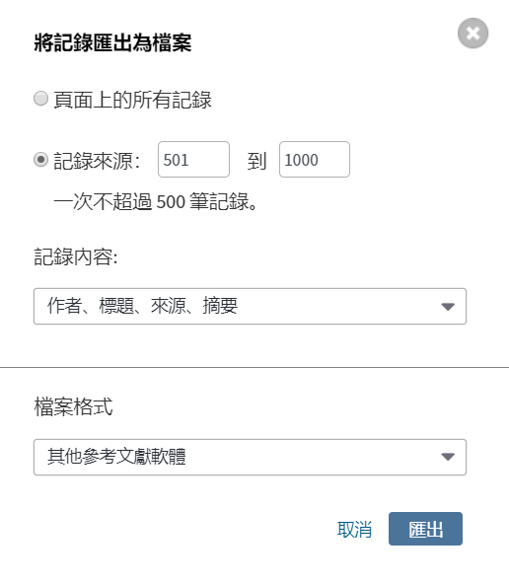
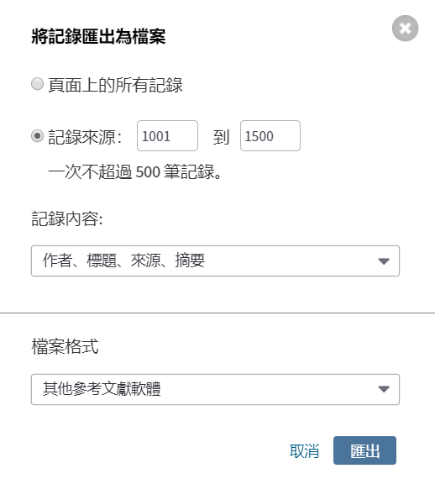
Use web of science to search journals with articles about “lncRNA” and “tumor” and visualize them

