Slide 1
- a versatile tool for creating and sharing richly annotated sequence files

Slide 2
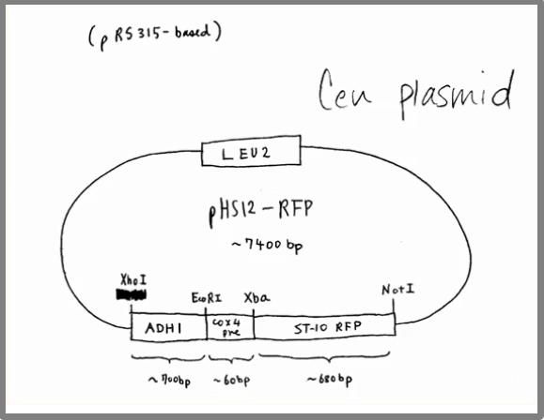
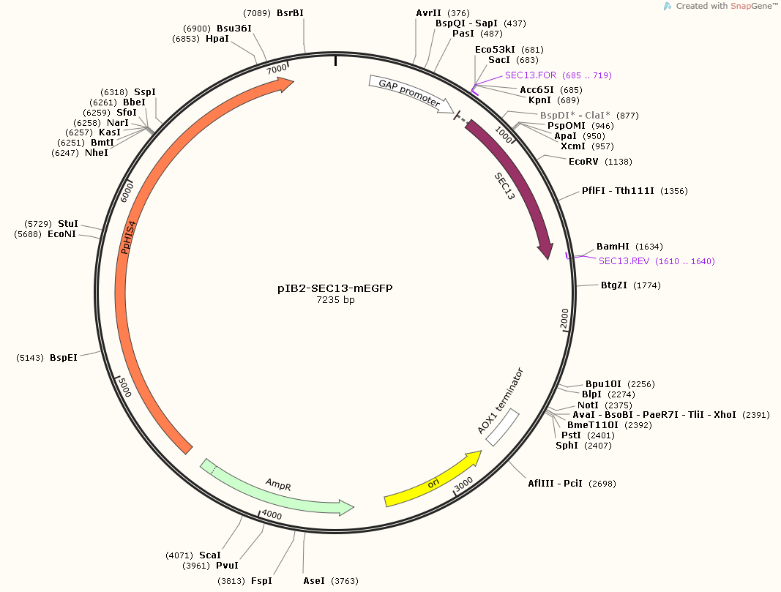
SnapGene Viewer
- DNA Visualization !!!

Slide 3
SnapGene Viewer
- Main functions
Plasmid Files
Gateway Cloning
Gibson Assembly
Cloning Tips
In-Fusion Cloning
TA & GC Cloning

Slide 4
SnapGene Viewer
- Main functions
Plasmid Files
Gateway Cloning
Gibson Assembly
Cloning Tips
In-Fusion Cloning
TA & GC Cloning

Slide 5
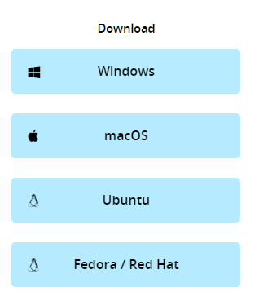
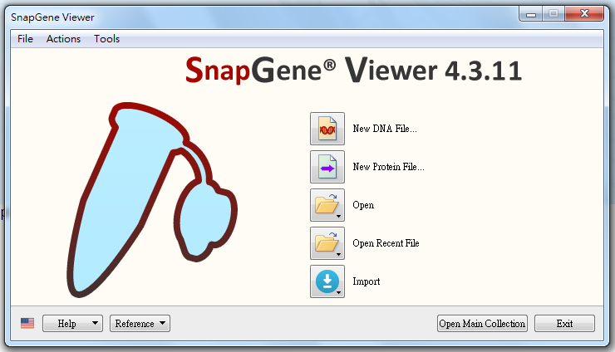
SnapGene Viewer
Free Download: https://www.snapgene.com/snapgene-viewer/

Slide 6
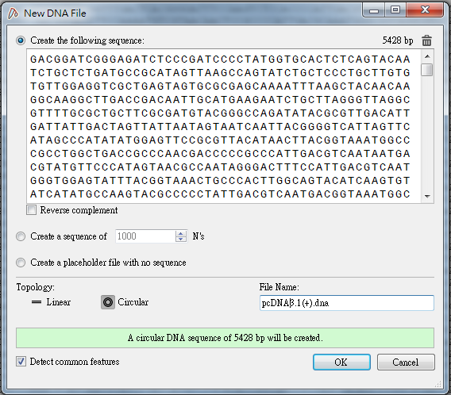
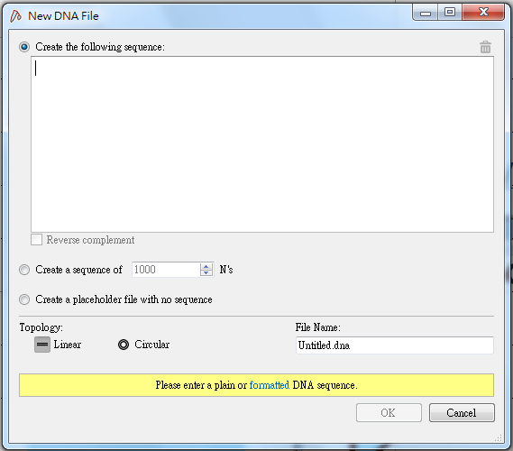
SnapGene Viewer
1
3
Paste DNA sequence
Choose topology
Name the file
Detect common features
2
4

Slide 7
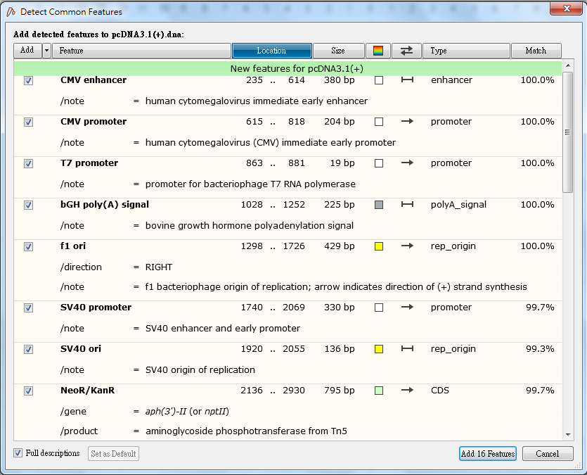
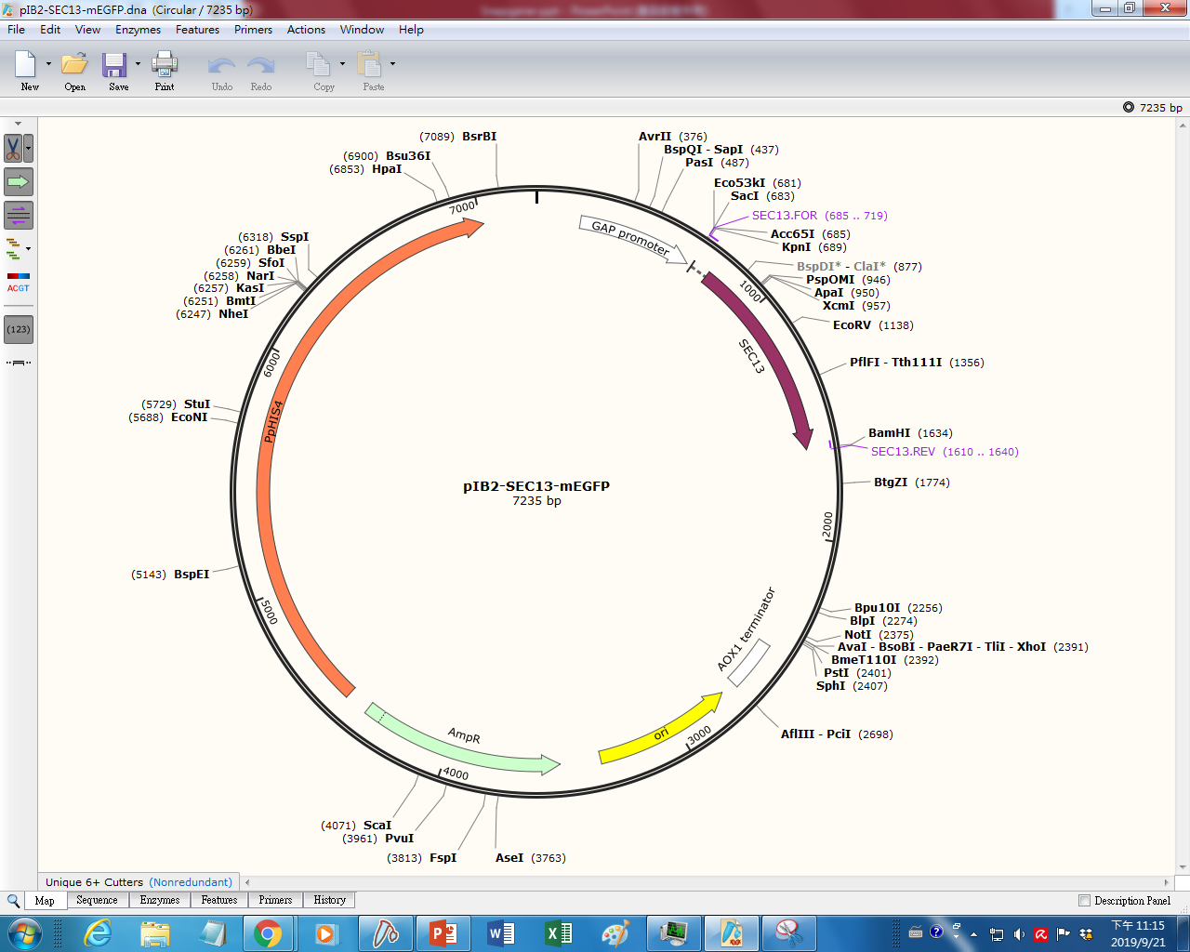
SnapGene Viewer
Add features

Slide 8
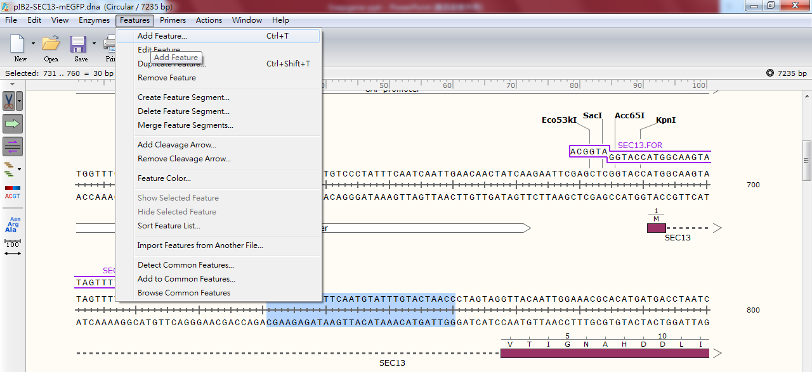
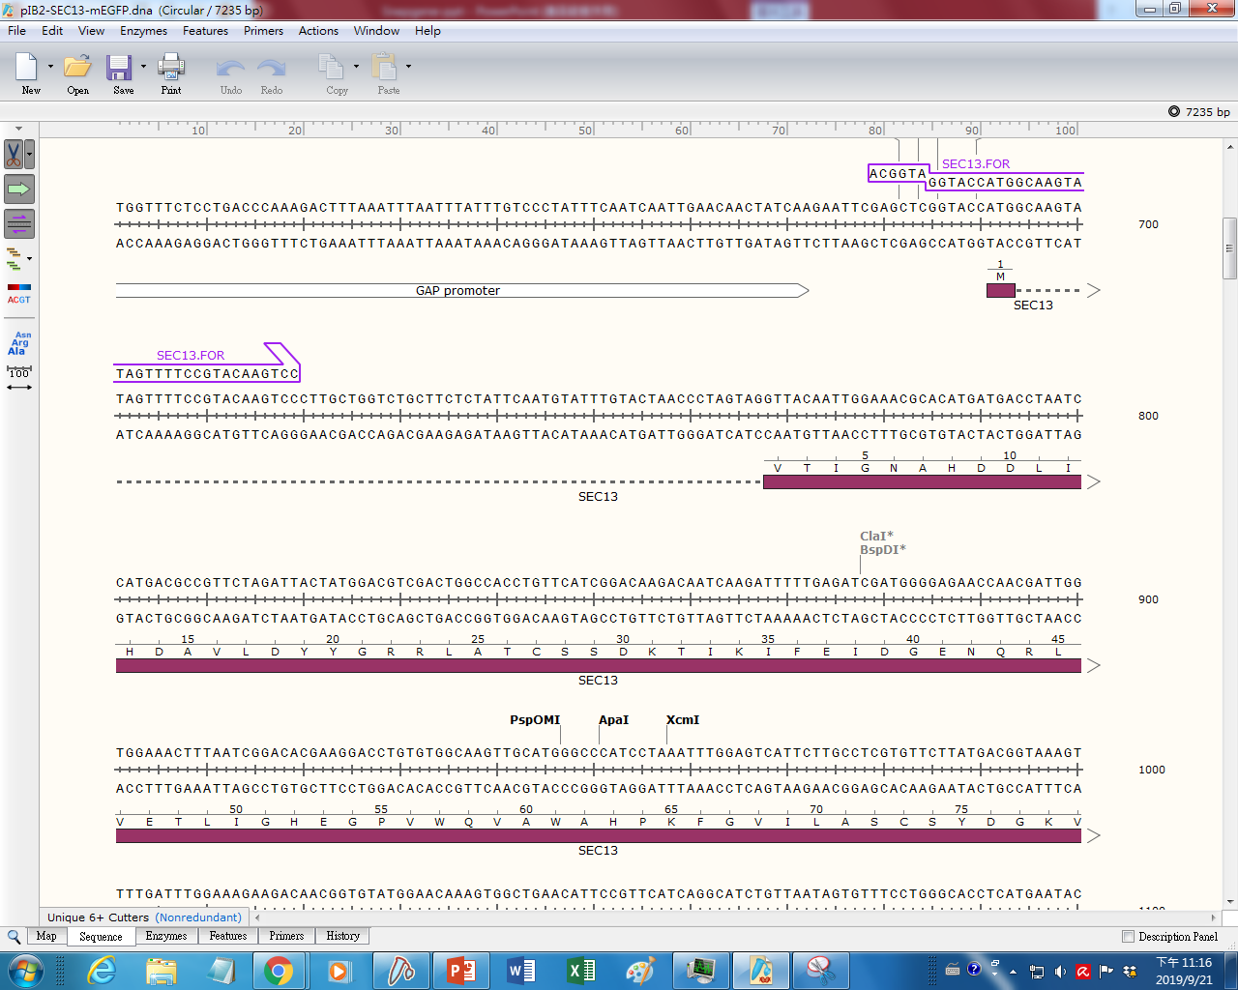
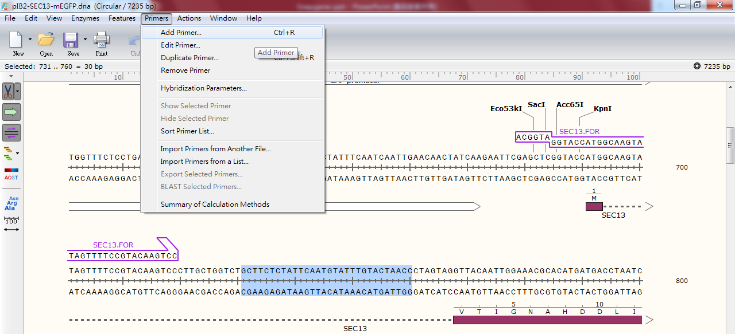
SnapGene Viewer
Show sequence
Select Sequence > Features > Add features
Select Sequence > Primers > Add primers

Slide 9
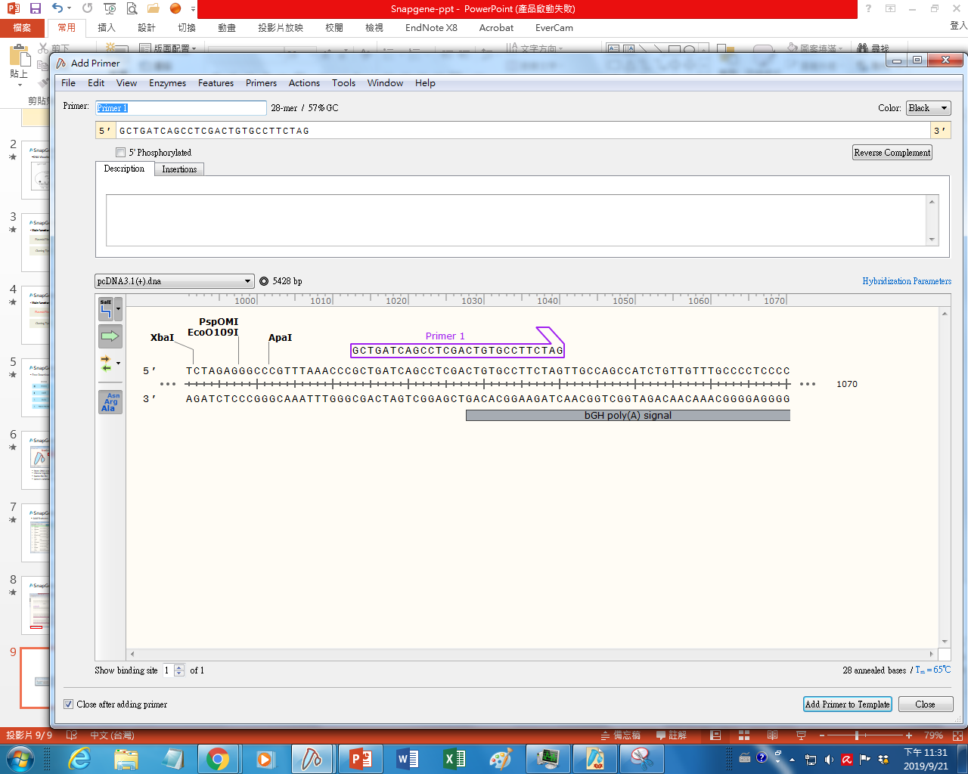
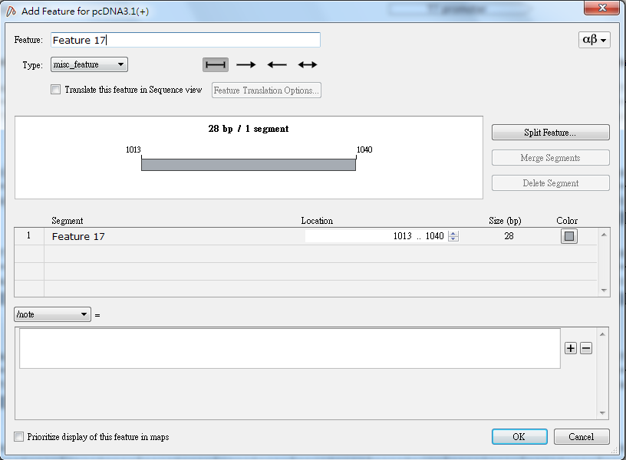
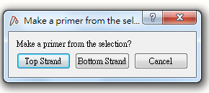
SnapGene Viewer
Add primers
Add features

Slide 10
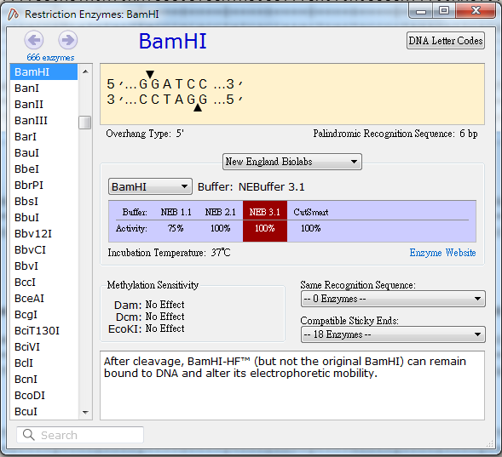
SnapGene Viewer
Base pair / Tm
Cutting site / Features

Slide 11
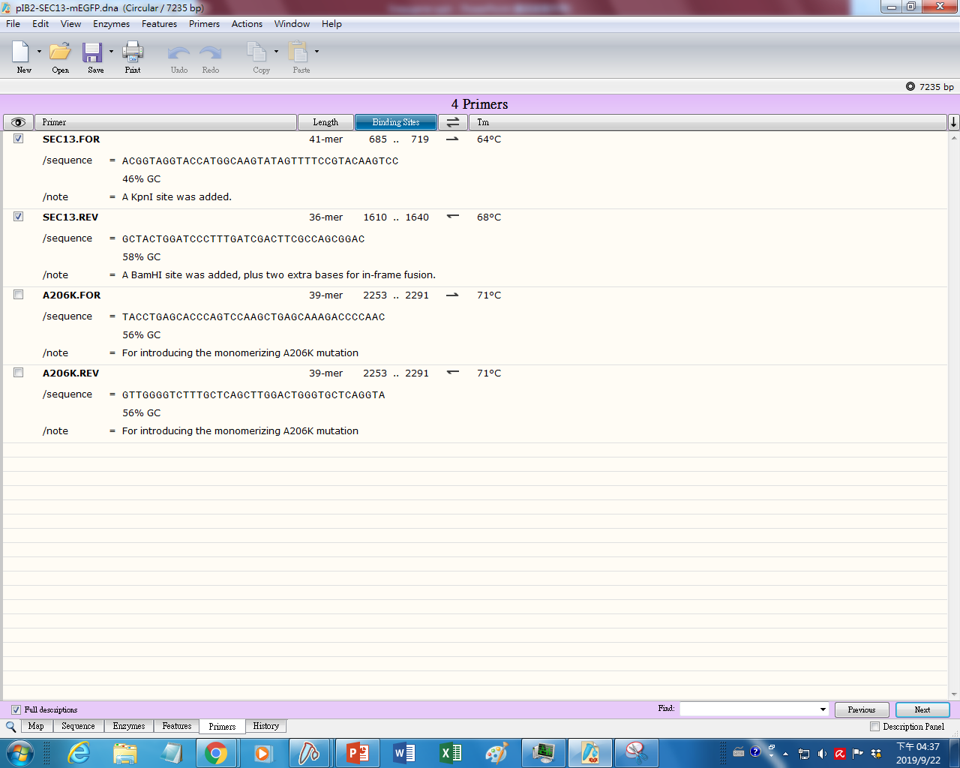
SnapGene Viewer
Enzyme list
Feature list
Primer list

Slide 12
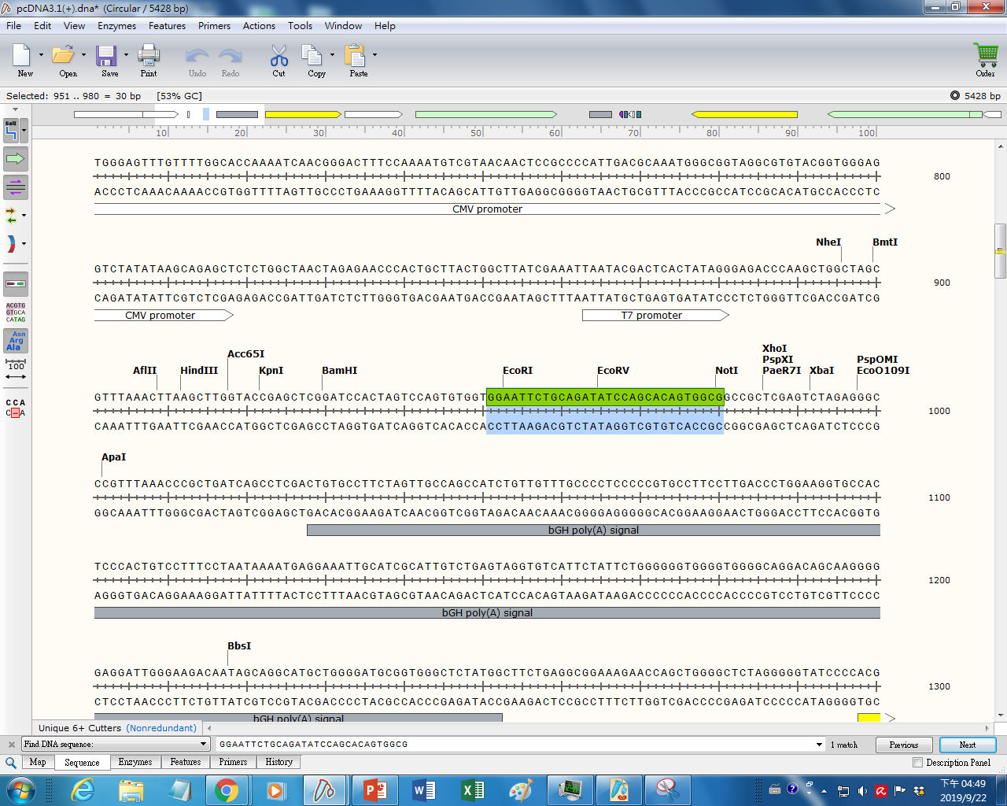
SnapGene Viewer
Finding specific sequence
Ctrl+F
Paste sequence
Enter

Slide 13
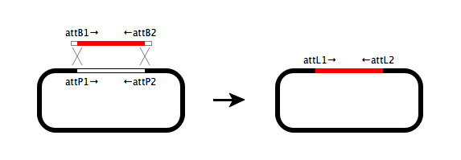
SnapGene Viewer
Gateway Cloning
https://youtu.be/kVm5rC-0Aik

Slide 14
THANK YOU

