Slide 1
How to evaluate the ranking of journal?
Date : 20210726
Speaker : Li Yu Su

Slide 2
Outline
Journal full name and its abbreviation
Journal Citation Reports (JCR)
Find the number of citation for a specific paper

Slide 3
How to find journal full name and its abbreviation?
Journal full name and its abbreviation
NCBI (National Center for Biotechnology Information)
https://www.ncbi.nlm.nih.gov/nlmcatalog/journals
Q: What is the abbreviation of “Translational Cancer Research”?

Slide 4
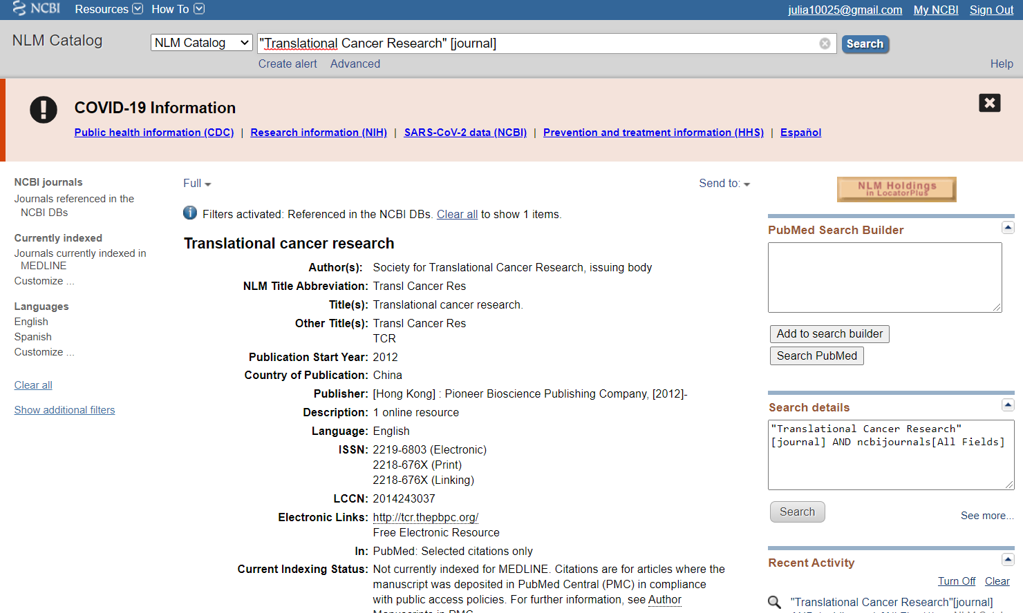
全名找縮寫"Translational Cancer Research" [journal]
Journal full name and its abbreviation

Slide 5
縮寫找全名"Transl Cancer Res" [title abbreviation]
Journal full name and its abbreviation

Slide 6
Journal Citation Reports (JCR)
Journal Citation Reports (JCR)
JCR 是期刊評鑑的必備參考工具，具完整性與獨特性，而且，是唯一提供期刊引用文獻 （Citation）數據的來源。
收錄範圍涵蓋全世界六十多個國家，七千多種學術期刊。
透過 JCR，您可得知：
1. 哪些期刊最具影響力？
2. 哪些期刊最常被使用？
3. 哪些期刊最熱門？
4. 哪些期刊出版量最大？
5. 哪些期刊最常被引用？
6. 某期刊"影響係數"（即引用率 Impact Factor）高或低？
7. 哪些期刊的"立即引用率"（Immediacy Index）最高？
8. 某期刊引用及被引用的情形？
9. 收錄期刊之詳細出版訊息。
10.收錄期刊之刊名改變情形。

Slide 7
Journal Citation Reports (JCR)中各項指標的意義？
Journal Citation Reports (JCR)
Total Cites (總引用次數) → 可看出該期刊被引用的總次數
計算方式：該期刊自被收錄進JCR後的總被引用次數。
Journal Impact Factor (JIF) (影響係數、影響因子、影響指數、衝擊因子) → 可看出該刊前二年文章影響力
計算方式：該期刊前二年所出版的文章在當年度的平均被引用次數。
Journal Impact Factor Without Self Cites (去除自引的影響係數/因子) → 可排除期刊自我引用的影響力。
計算方式：去除期刊自我引用後計算得到的影響係數。
5 Year Journal Impact Factor (5年影響係數) → 類似JIF，只是計算的時間基準由二年拉長至五年
計算方式：該期刊前五年所出版的文章在當年度的平均被引用次數。

Slide 8
How to find the ranking of journal?
Journal Citation Reports (JCR)
Impact factor
評估期刊的好壞
統計當年的IF=前兩年總被引次數/前兩年內發表的論文總數
EX: 2020年，A期刊的impact factor
(A期刊 2018-2019 年所出版的論文在2020年被引用總次數) (A期刊在 2018-2019 年所發表的論文總數)
https://jcr.clarivate.com
Q: Find the 5-year impact factor and rank of “Scientific Reports”

Slide 9
JCR

Slide 10
Journal Citation Reports (JCR)
Q: Calculate the next year’s impact factor of “Scientific Reports”
https://www.scopus.com/sourceid/21100200805
Scopus
https://www.scopus.com/

Slide 11
Scopus

Slide 12
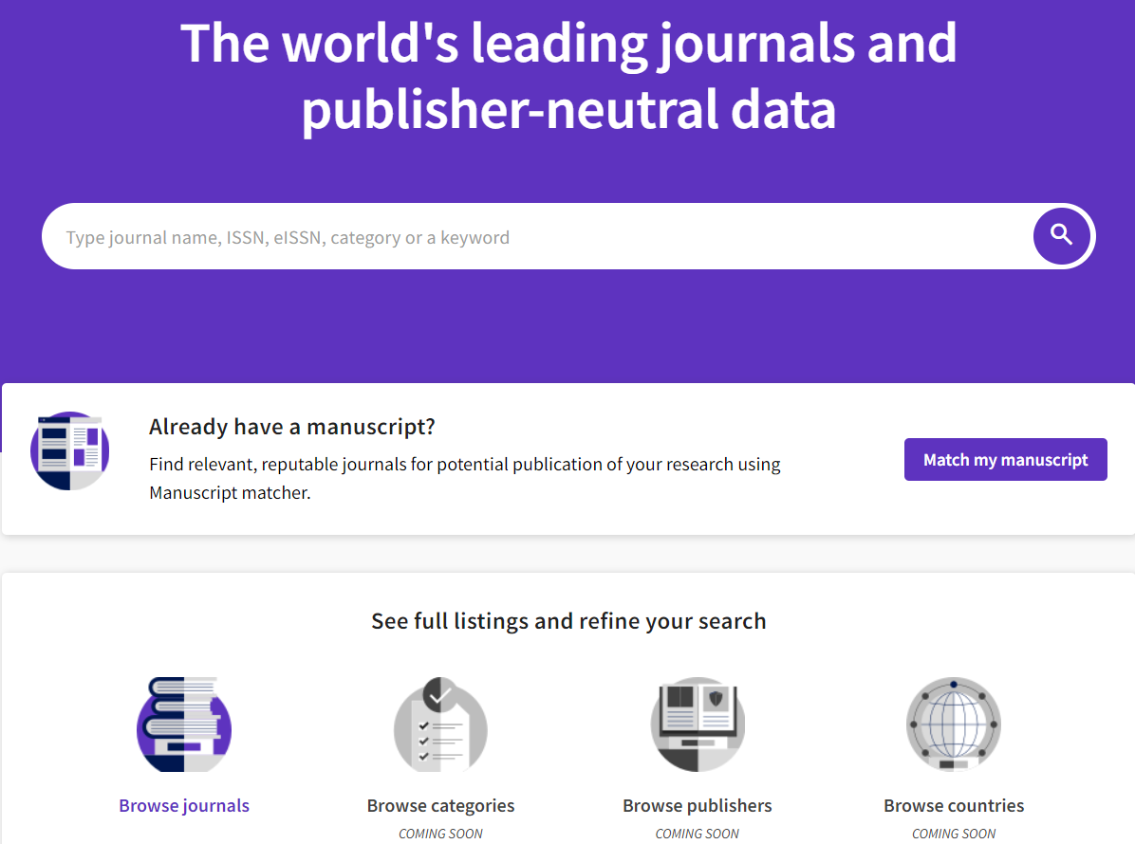
想找的領域有哪些journal的IF排名在Q1？
Journal Citation Reports (JCR)

Slide 13
查詢臺大各學院系所在WoS收錄期刊所發表的文章
Journal Citation Reports (JCR)
Web of Science
http://apps.webofknowledge.com
找出系所縮寫

Slide 14
Find how many papers in our department have been published from 2011 to 2016?
((natl taiwan univ) OR (ntu SAME taiwan) OR (ntu hosp) OR (ntuh) OR (taiwan natl univ) OR (natl taiwan natl univ) OR (natl taiwan hosp) OR (Taiwan Univ Hosp) OR (nation taiwan univ) OR (Nat Taiwan Univ) OR (NTUMC)) SAME ((Dept Physiol) OR (Grad Inst Physiol) OR (Inst Physio) OR (Inst Physiol))

Slide 15
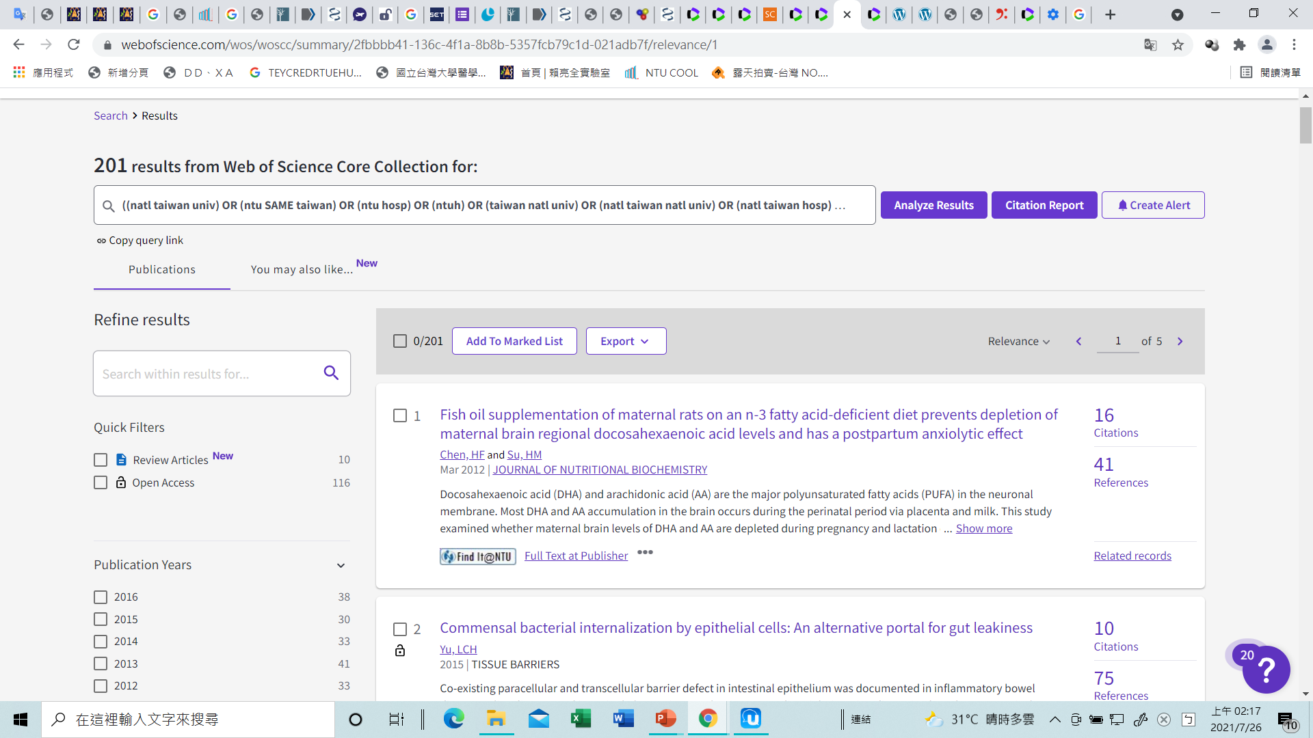
Find how many papers in our department have been published from 2011 to 2016?

Slide 16
H-index
H-index是在2005年由UCSD理論物理學者Jorge E. Hirsch教授所發表。計算方法是將學者或期刊發表論文依引用次數排序後，將序號與引用次數相互比對，會得出一個H值，代表有H篇論文至少被引用了H次以上。

Slide 17
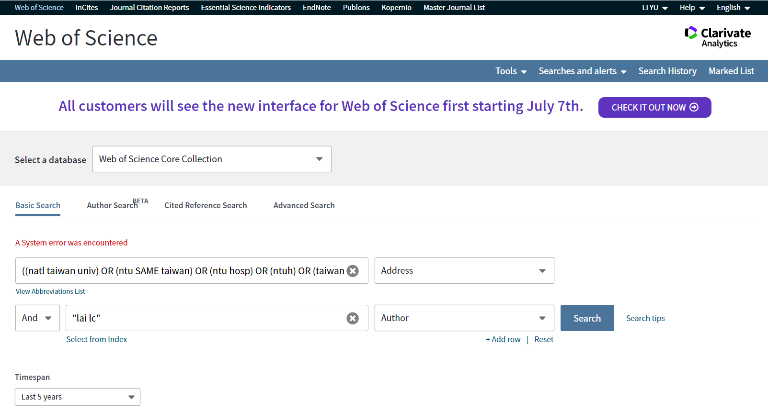
What is the H-index of Liang-Chuan Lai in past 5 years?
((natl taiwan univ) OR (ntu SAME taiwan) OR (ntu hosp) OR (ntuh) OR (taiwan natl univ) OR (natl taiwan natl univ) OR (natl taiwan hosp) OR (Taiwan Univ Hosp) OR (nation taiwan univ) OR (Nat Taiwan Univ) OR (NTUMC)) SAME ((Dept Physiol) OR (Grad Inst Physiol) OR (Inst Physio) OR (Inst Physiol))

Slide 18
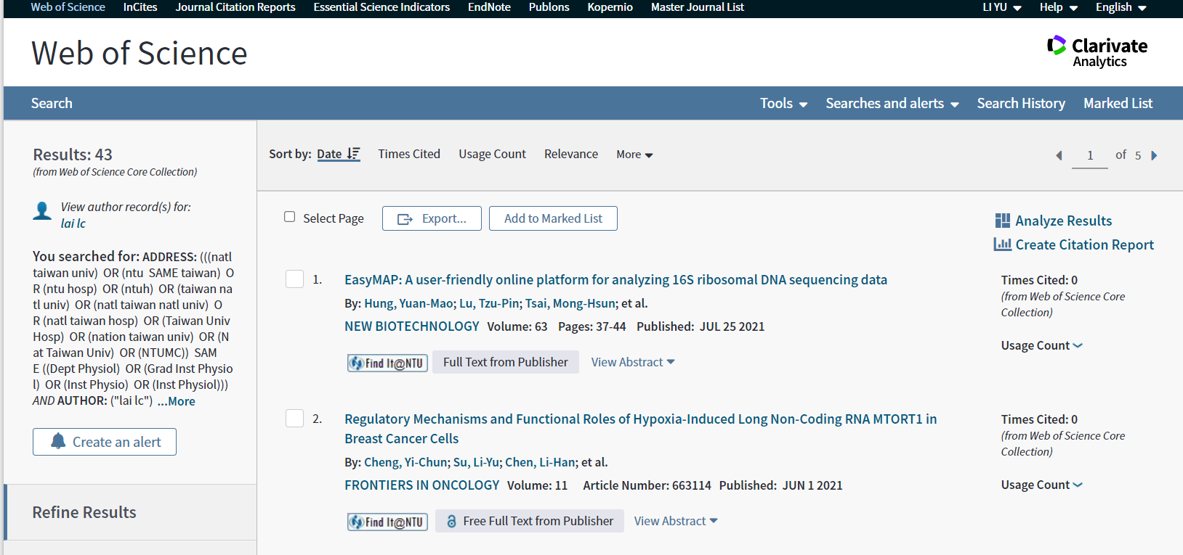
What is the H-index of Liang-Chuan Lai in past 5 years?

Slide 19
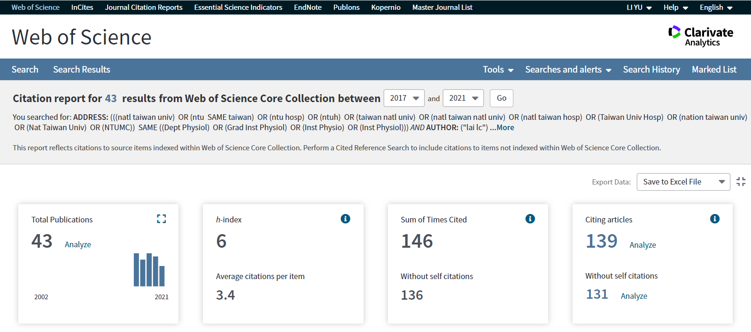
What is the H-index of Liang-Chuan Lai in past 5 years?

Slide 20
How to find the number of citation for a specific paper?
Find the number of citation for a specific paper
Web of Science
Scopus
Google Scholar
臺灣人文及社會科學引文索引資料庫
臺灣博碩士論文加值系統

Slide 21
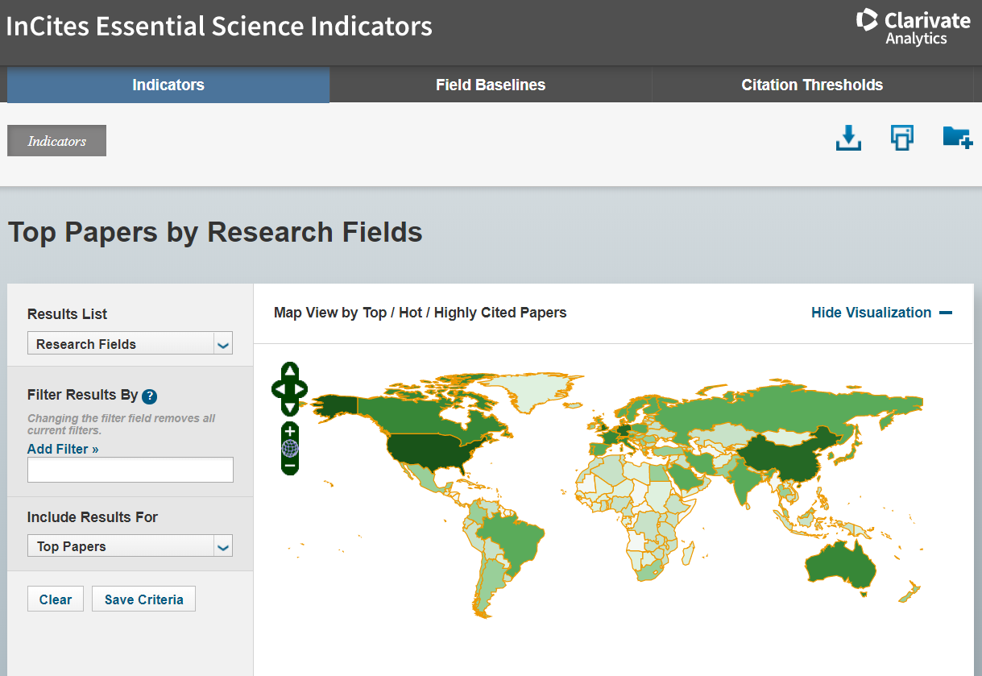
查詢各領域的研究
Find the number of citation for a specific paper
Essential Science Indicators
https://esi.clarivate.com

Slide 22
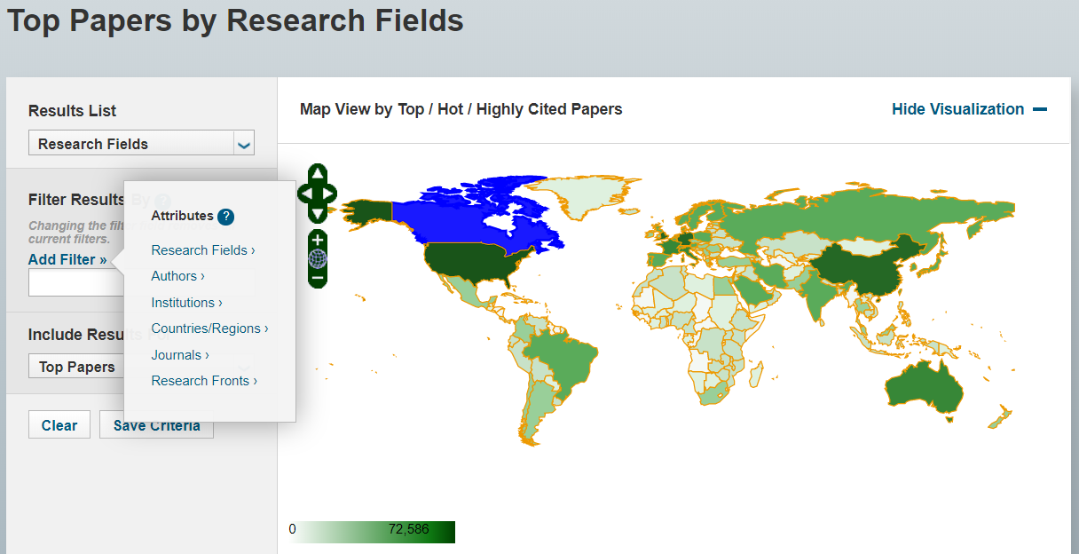
Whose paper in Clinical Medicine research field has been cited most?
Find the number of citation for a specific paper

Slide 23
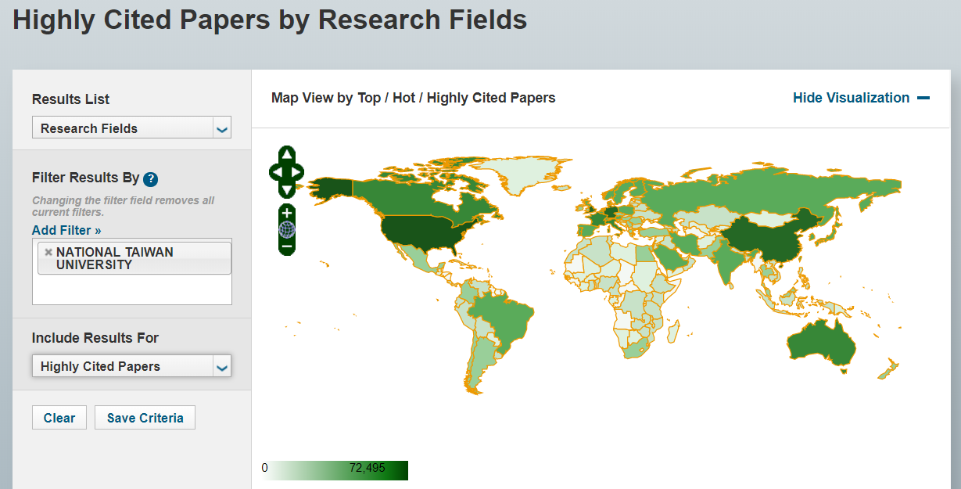
Find the number of citation for a specific paper
Whose paper in Clinical Medicine research field has been cited most?

Slide 24
Find the number of citation for a specific paper
Whose paper in Clinical Medicine research field has been cited most?

Slide 25
Find the number of citation for a specific paper
Whose paper in Clinical Medicine research field has been cited most?

Slide 26
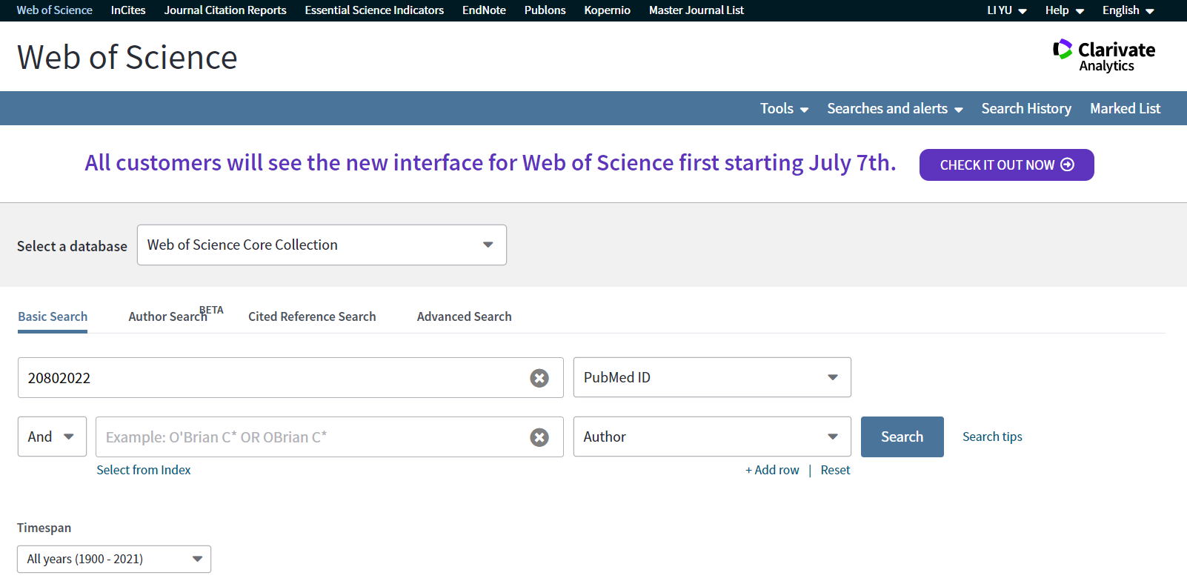
Find how many times of this paper (PMID: 20802022) have been cited including self-citation
Find the number of citation for a specific paper

Slide 27
Find how many times of this paper (PMID: 20802022) have been cited including self-citation
Find the number of citation for a specific paper

Slide 28
Find how many times of this paper (PMID: 20802022) have been cited without self-citation
Find the number of citation for a specific paper

Slide 29
Find how many times of this paper (PMID: 20802022) have been cited without self-citation
Find the number of citation for a specific paper

Slide 30
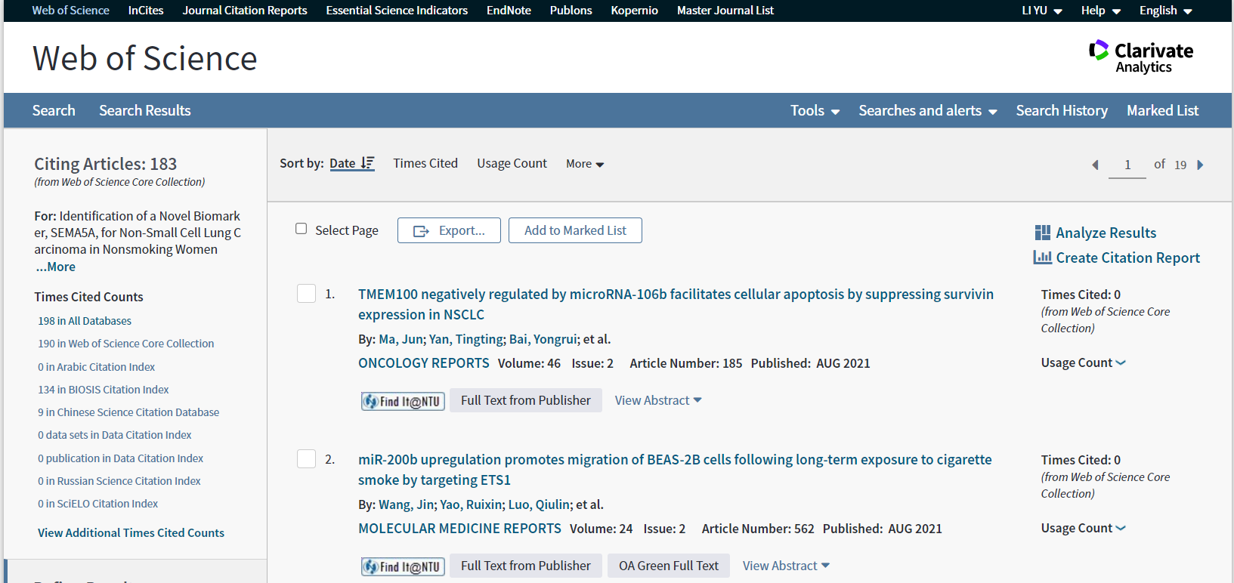
Find how many times of this paper (PMID: 20802022) have been cited without self-citation
Find the number of citation for a specific paper

Slide 31
Find how many times of this paper (PMID: 20802022) have been cited without self-citation
Find the number of citation for a specific paper

Slide 32
Find how many times of this paper (PMID: 20802022) have been cited without self-citation
Find the number of citation for a specific paper

Slide 33
Find the number of citation for a specific paper

Slide 34
Find the number of citation for a specific paper

Slide 35
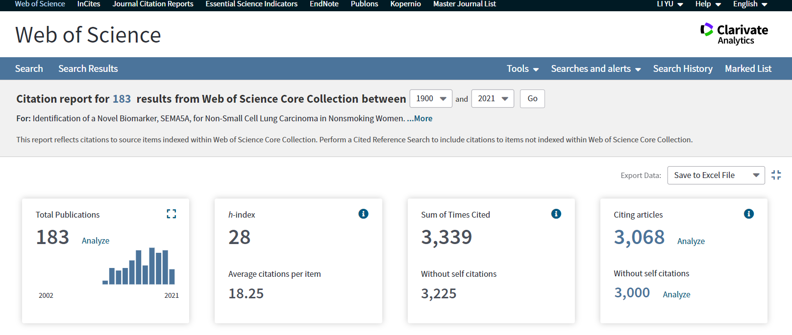
Find the number of citation for a specific paper

Slide 36
Use web of science to search journals with articles about “lncRNA” and “tumor” and visualize them
Find the number of citation for a specific paper

Slide 37
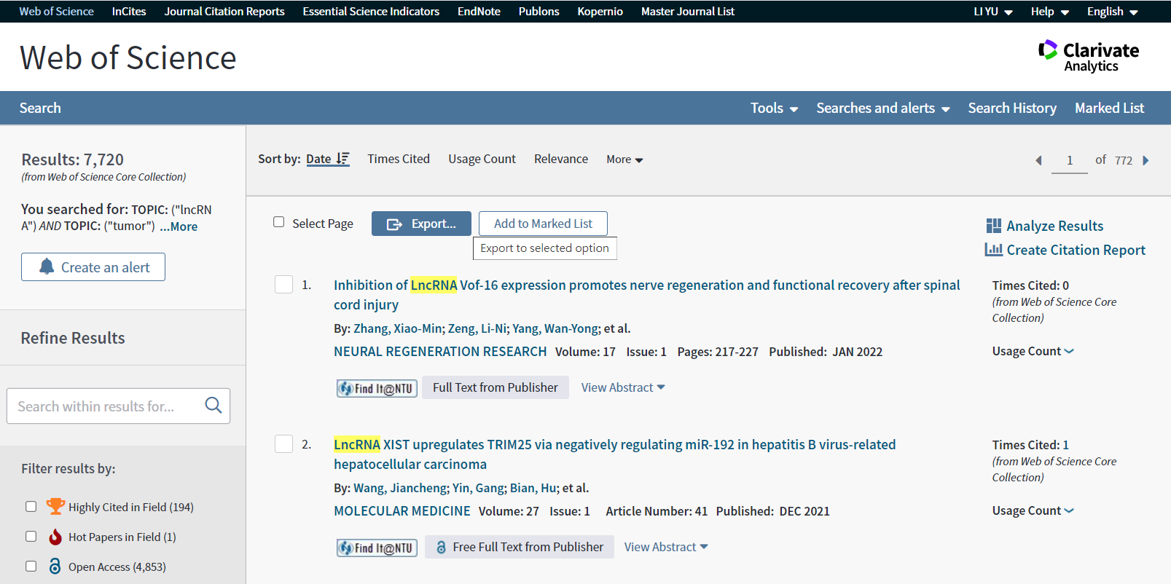
Use web of science to search journals with articles about “lncRNA” and “tumor” and visualize them
Find the number of citation for a specific paper

Slide 38
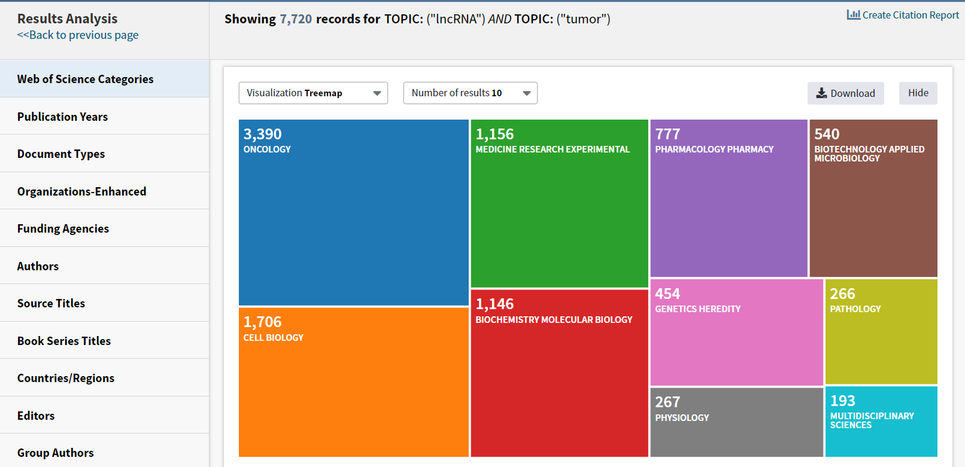
Use web of science to search journals with articles about “lncRNA” and “tumor” and visualize them
Find the number of citation for a specific paper

Slide 39
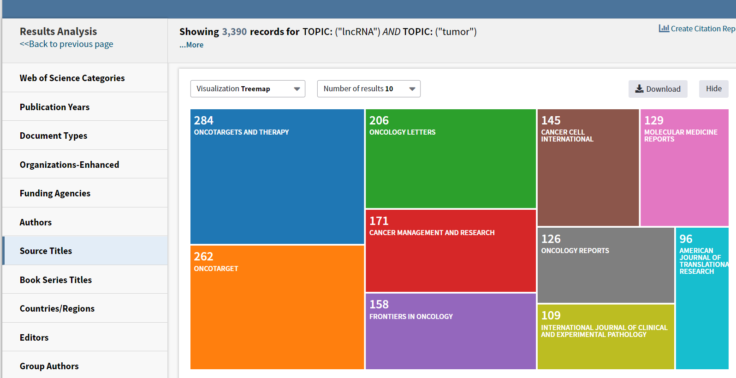
Use web of science to search journals with articles about “lncRNA” and “tumor” and visualize them
Find the number of citation for a specific paper

Slide 40
Q&A

Slide 41
用NLM catalog找cancer research的縮寫要如何搜尋？
cancer research
“cancer research”
[cancer research]”journal”
“cancer research”[journal]

Slide 42
用NLM catalog找Transl Cancer Res的全名要如何搜尋？
Transl Cancer Res
“Transl Cancer Res”
[Transl Cancer Res]”title abbreviation”
“Transl Cancer Res”[title abbreviation]

Slide 43
哪個網站可以查到impact factor？
Journal Citation Reports (JCR)
Scopus
以上皆是
以上皆非

Slide 44
哪個網站有計算journal下一年IF的功能？
ESI
Scopus
JCR
WOS

Slide 45
什麼指標將被引用的文章按照引用次數排序，從排序的結果可看出被引用的文章有h篇文章至少被引用h次？
I index
D index
H index
A index

Slide 46
下列哪個網站不能查詢文章的被引用次數？
Web of Science (WOS)
Scopus
YouTube
Google Scholar

Slide 47
想在有興趣的領域中找學校引用次數高的paper要去哪個網站？
PubMed
NCBI
EndNote
Essential Science Indicators(ESI)

Slide 48
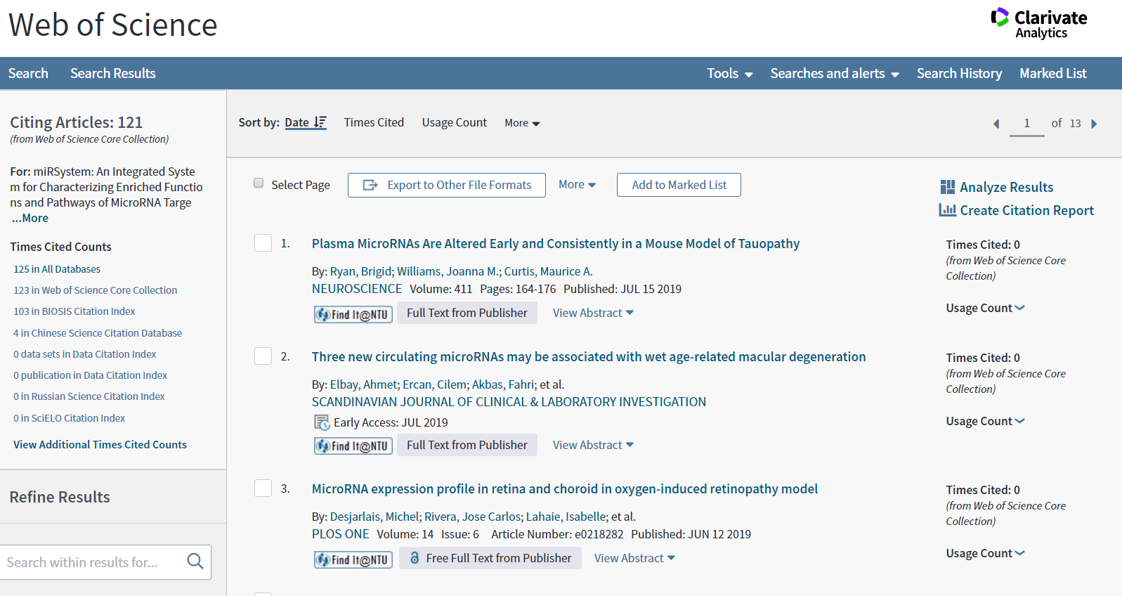
當我搜尋到這一頁，我想要去除self-citation，下一步要點哪一個鍵？
A.
B.
C.
D.

Slide 49
台大目前哪個研究領域的paper引用次數最高？
Molecular biology & genetics
Chemistry
Biology & biochemistry
Clinical medicine

Slide 50
想要看哪個期刊收錄最多我想要找的主題？
Ａ
Ｂ
Ｃ
Ｄ

Slide 51
台大醫學院生理所檢索Adress
((natl taiwan univ) OR (ntu SAME taiwan) OR (ntu hosp) OR (ntuh) OR (taiwan natl univ) OR (natl taiwan natl univ) OR (natl taiwan hosp) OR (Taiwan Univ Hosp) OR (nation taiwan univ) OR (Nat Taiwan Univ) OR (NTUMC)) SAME ((Dept Physiol) OR (Grad Inst Physiol) OR (Inst Physio) OR (Inst Physiol))

