Slide 1
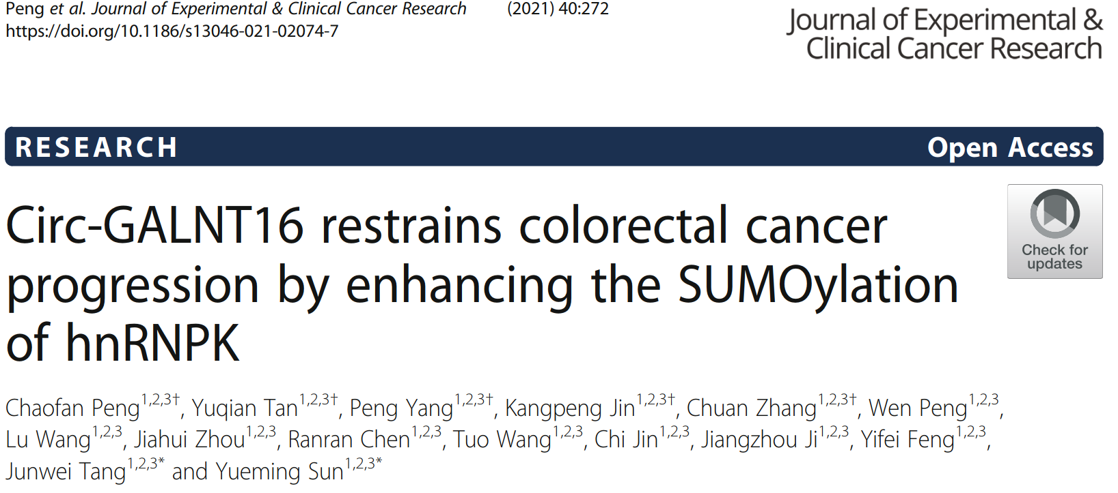

Slide 2
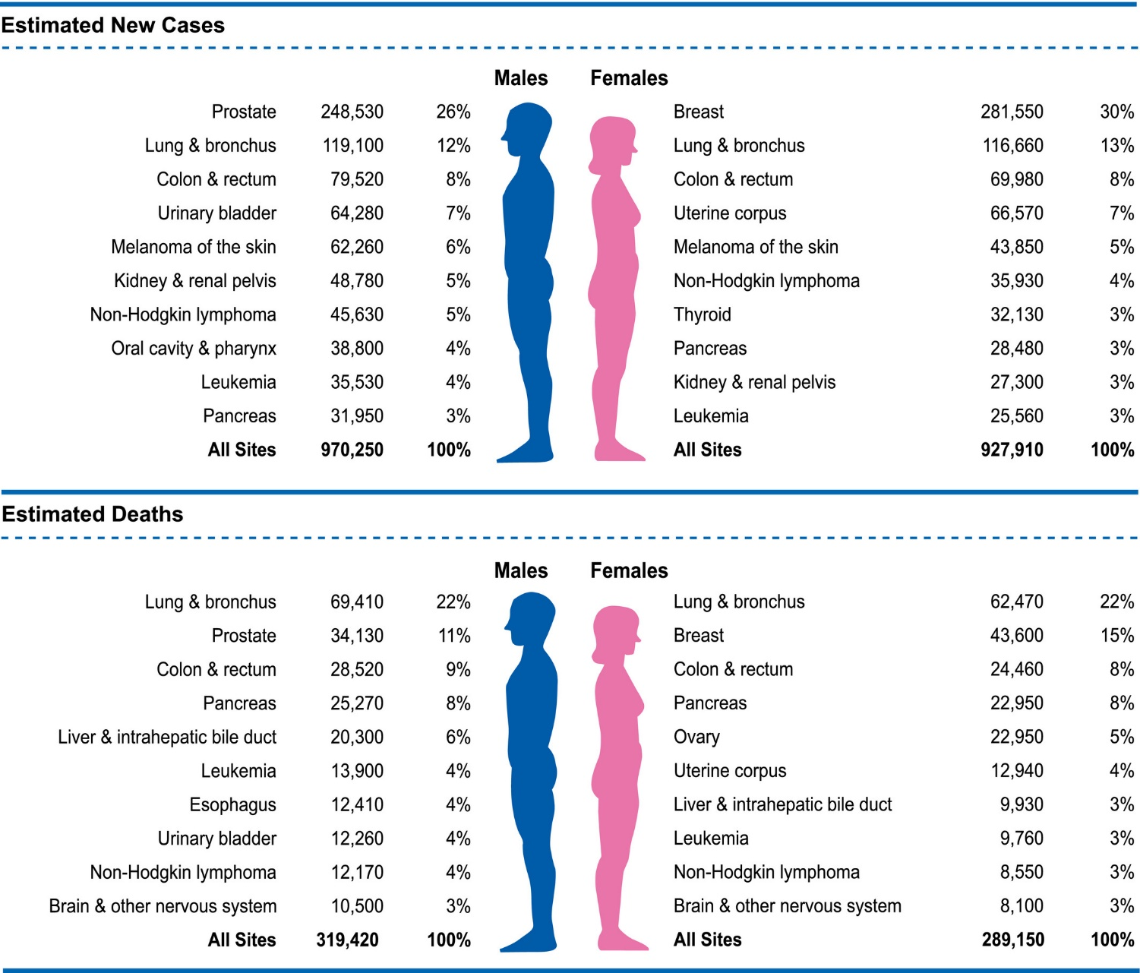
Introduction
Cancer Statistics
CA: A Cancer Journal for Clinicians 71: 1: 7-33 (2021)

Slide 3
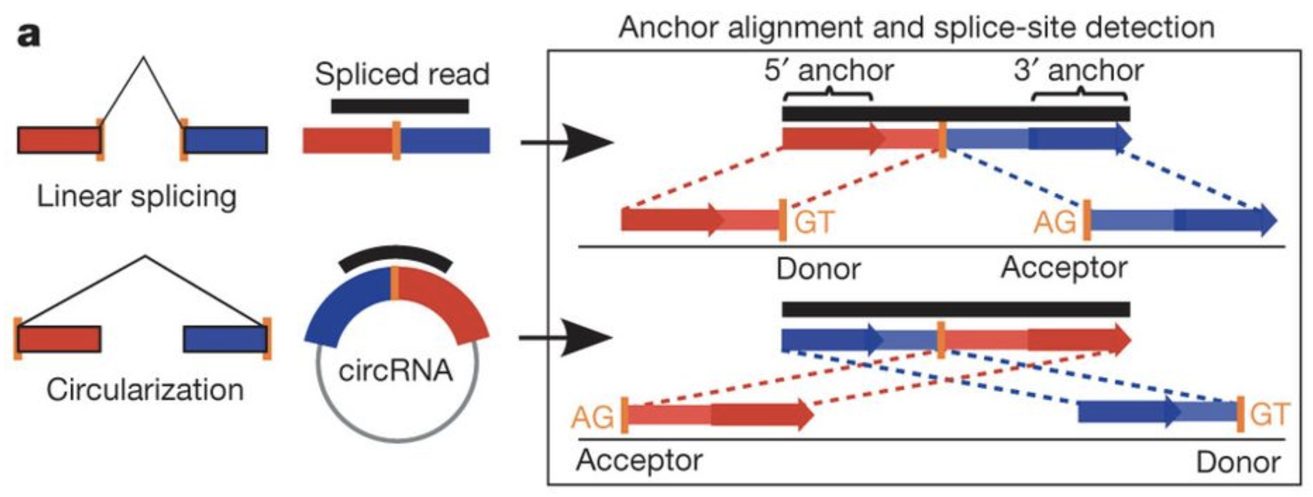
Introduction
Circular RNA (circRNA)
CircRNAs are formed by back-splicing of pre-mRNA transcripts with canonical splicing sites : AG-GT (U)
Nature 495:333-338. (2013)

Slide 4
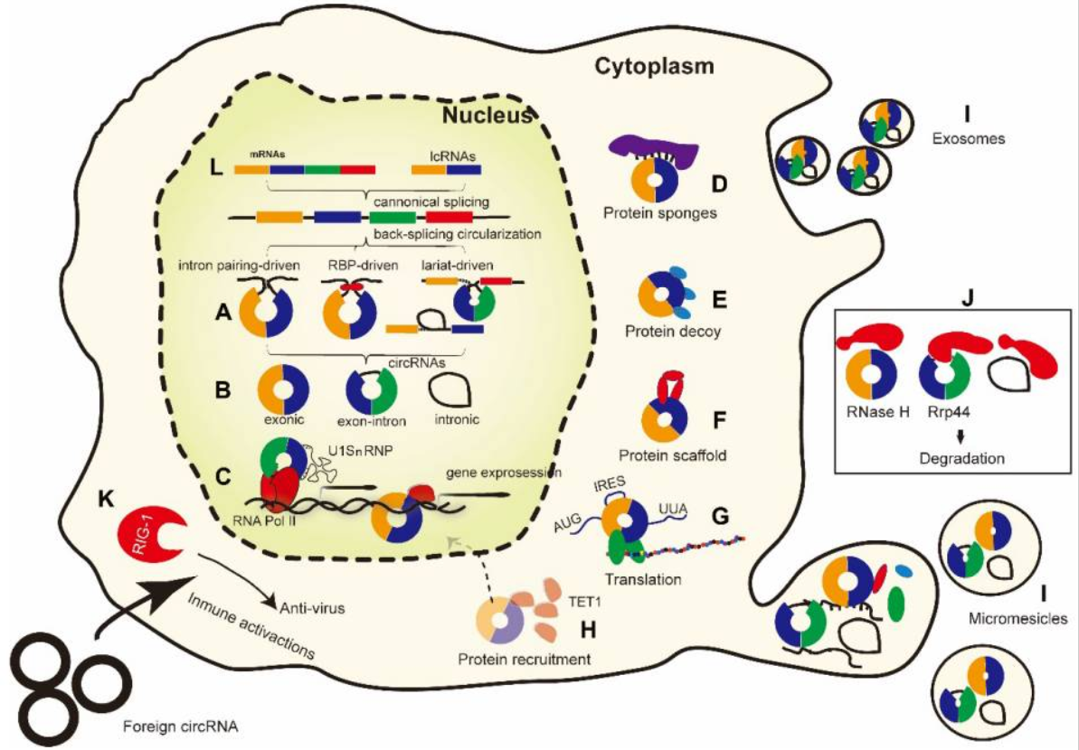
Introduction
Function of CircRNA
Theranostics 10, 3503-3517, (2020)

Slide 5
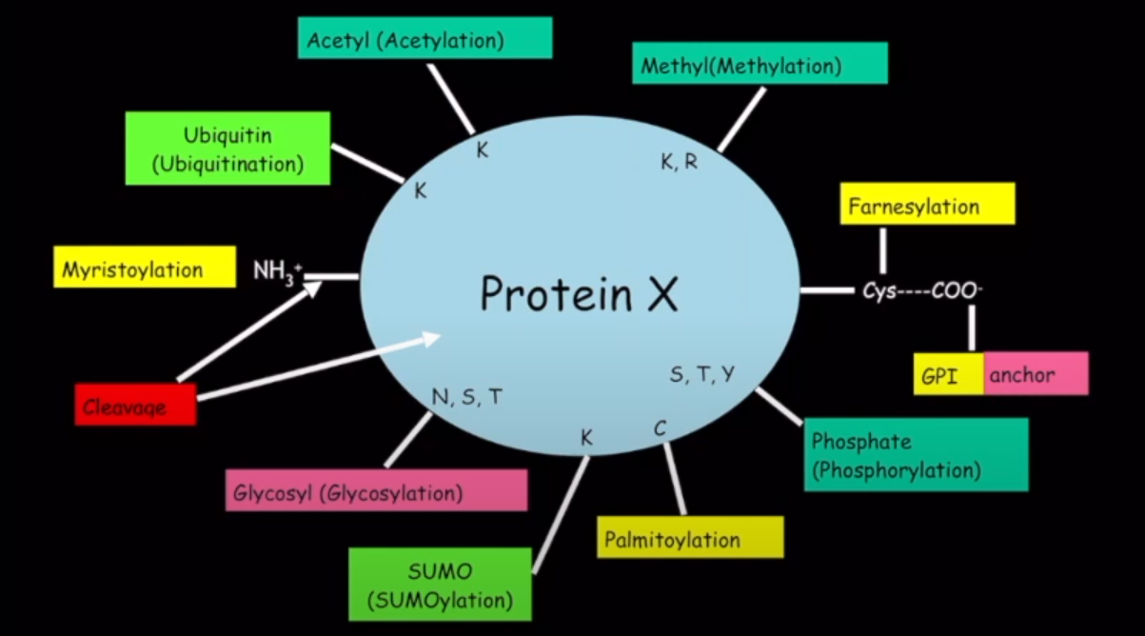
Introduction
Post-translational modification

Slide 6
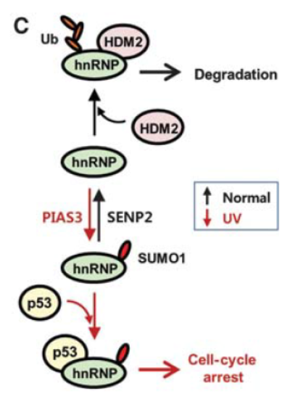
Introduction
SUMOylation
hnRNPK : Heterogeneous ribonucleoprotein-K
HDM2 : Double minute 2 protein , MDM2
SUMO : small ubiquitin-like modifier
SENP2 : SUMO-specific peptidase 2
PIAS3 : SUMO-E3 ligase
EMBO J 31, 4441-4452, (2012)

Slide 7
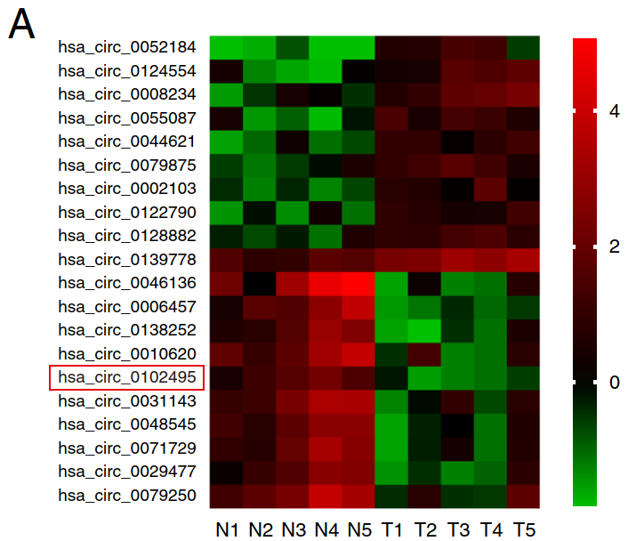
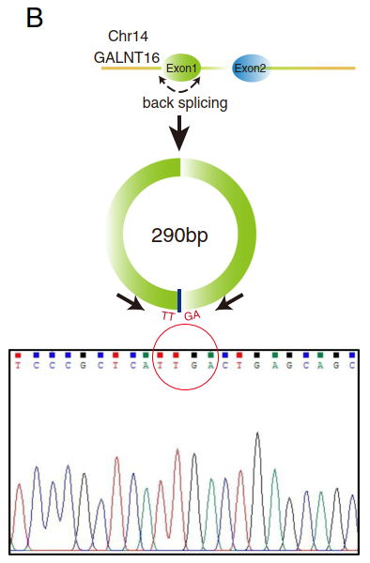
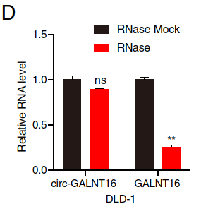
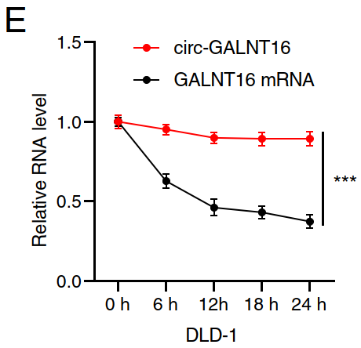
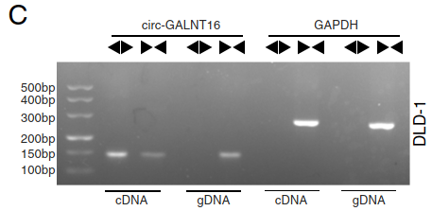
Results
Validation circGALNT16 in CRC cells

Slide 8
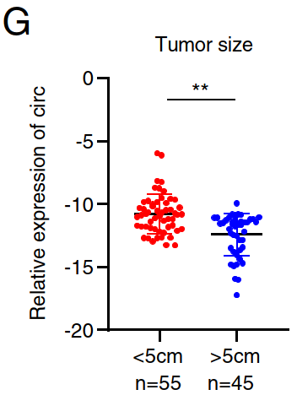
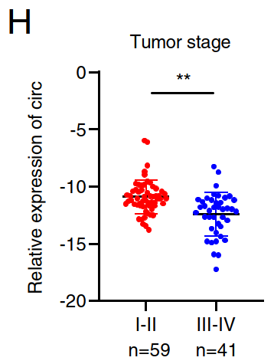
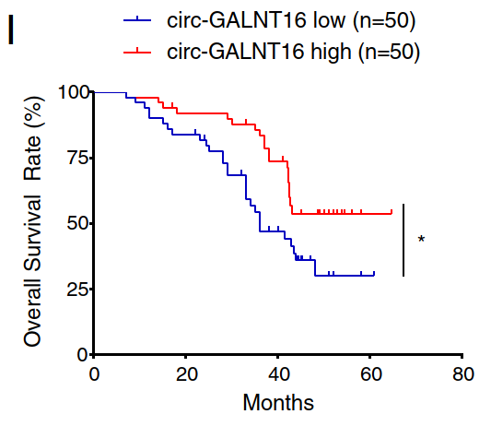
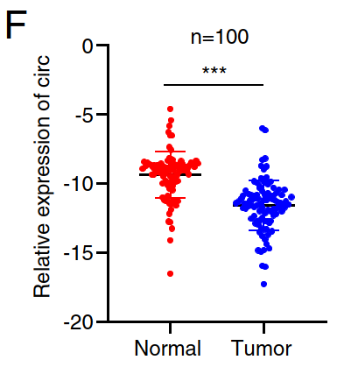
Results
Expression of circGALNT16 in CRC tissues

Slide 9
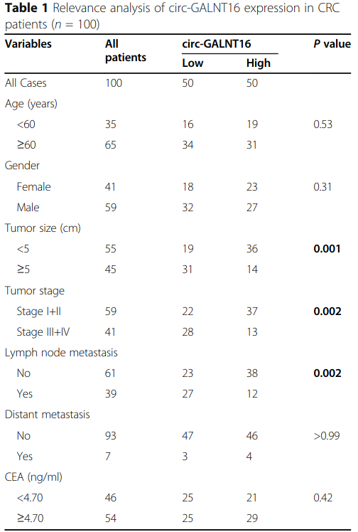
Results
Relevance analysis of circGALNT16 expression in CRC patients

Slide 10
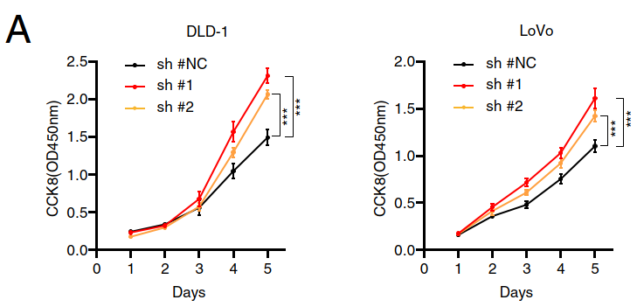
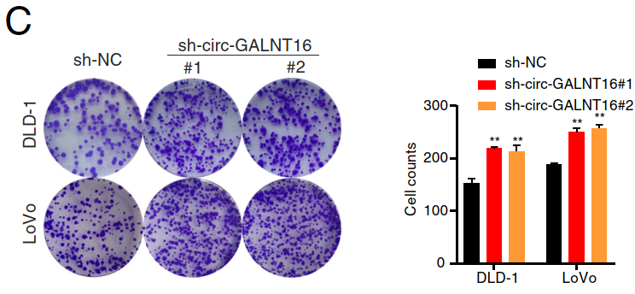
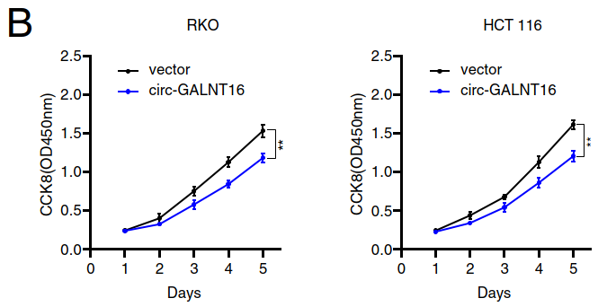
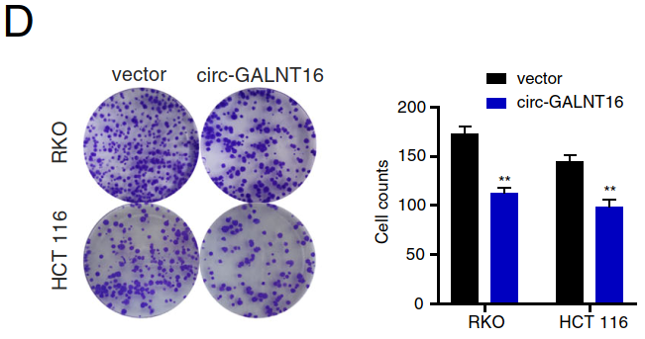
Results
CircGALNT16 suppressed tumor proliferation

Slide 11
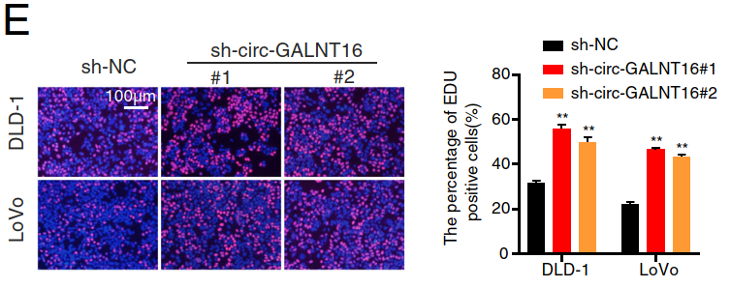
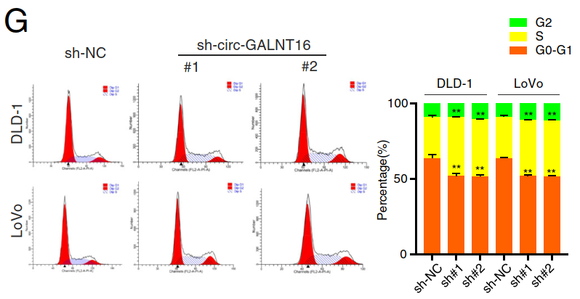
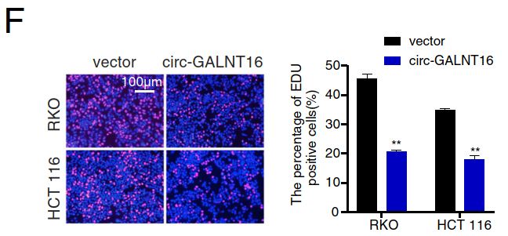
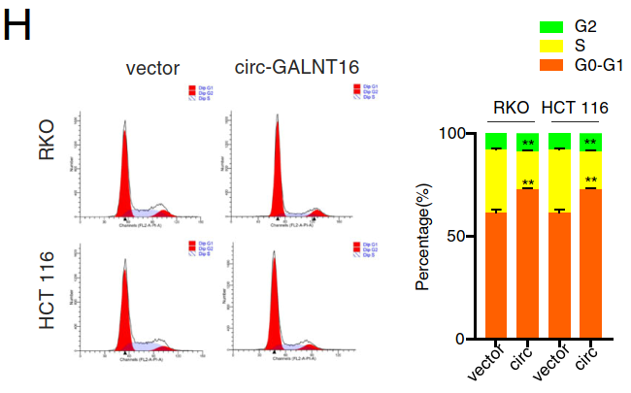
Results
CircGALNT16 suppressed tumor proliferation and caused G1 arrest

Slide 12
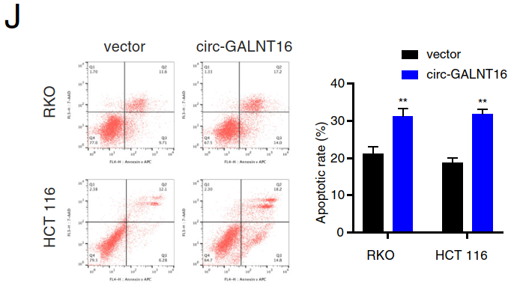
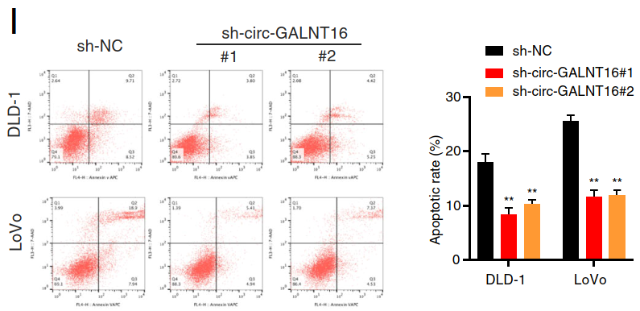
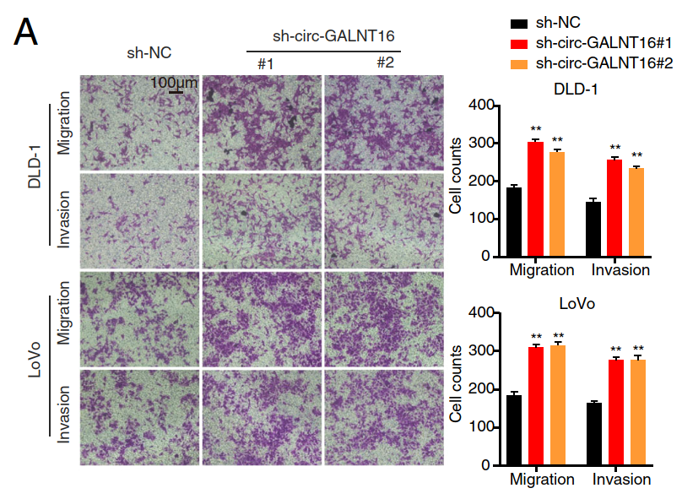
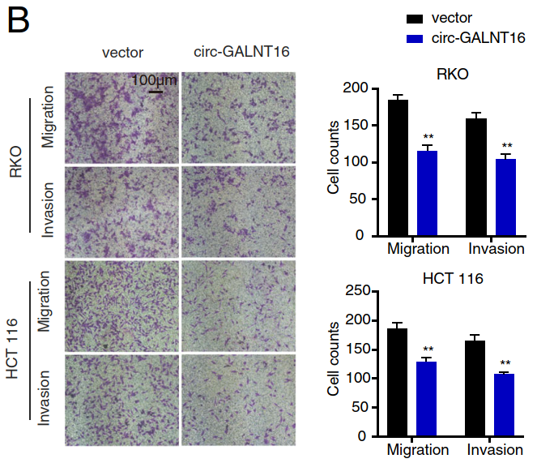
Results
CircGALNT16 enhanced tumor apoptosis and suppressed migration/invasion

Slide 13
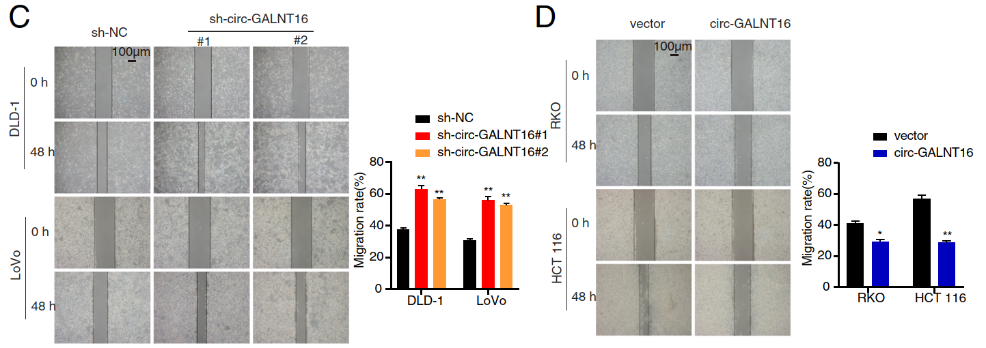
Results
CircGALNT16 suppressed tumor migration

Slide 14
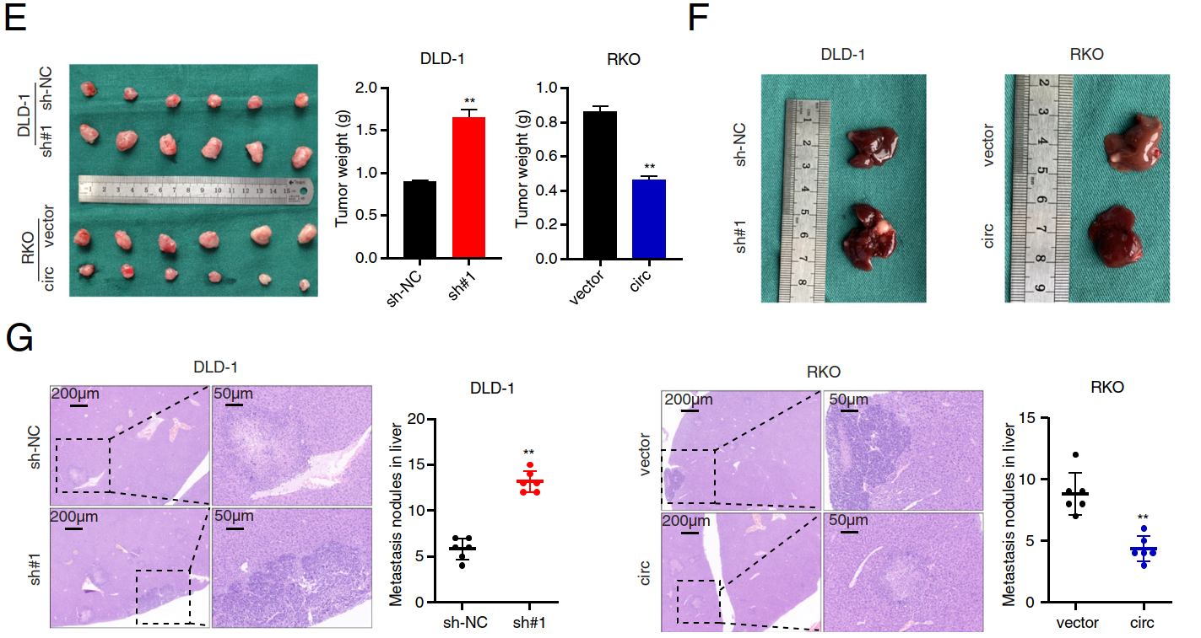
Results
CircGALNT16 suppressed tumor volume and cause less liver metastasis

Slide 15
Summary
Functional assay
Colorectal cancer
In vitro
In vivo
Proliferation
Tumor weight
CircGALNT16
Cell cycle
Metastasis
Apoptosis
Migration
Invasion

Slide 16
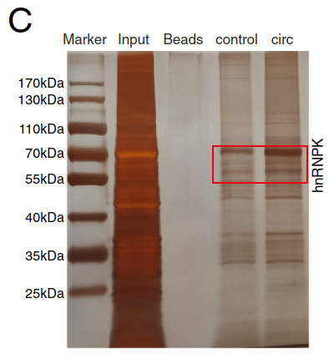
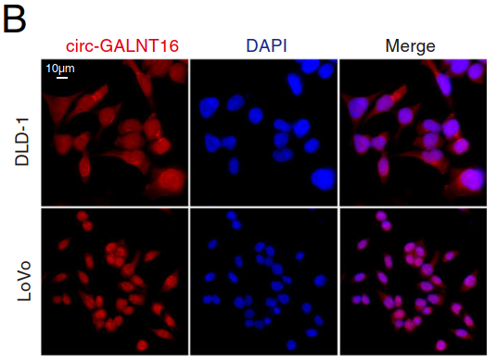
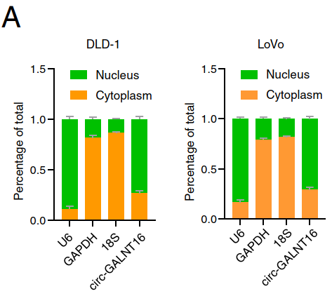
Results
CircGALNT16 located in nucleus and potential binding with hnRNPK

Slide 17
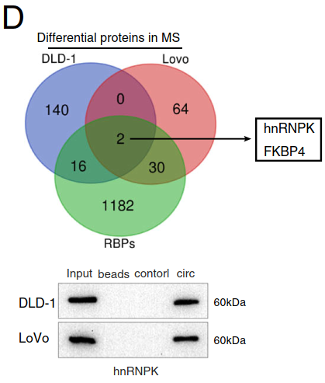
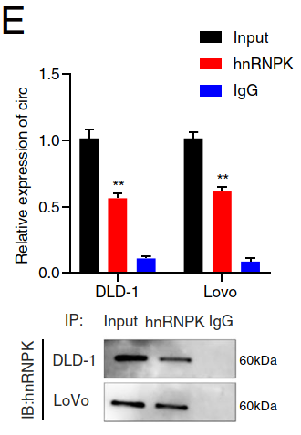
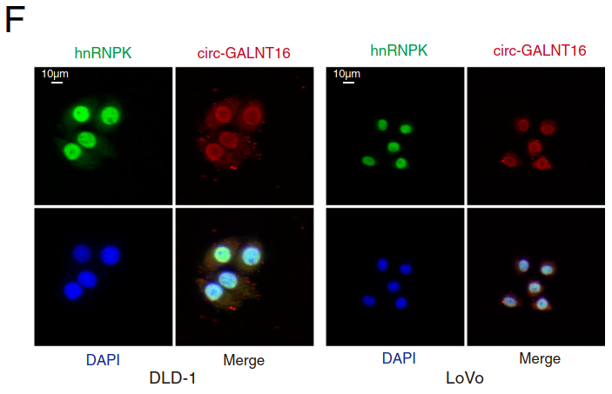
Results
CircGALNT16 were binding with hnRNPK in nucleus

Slide 18
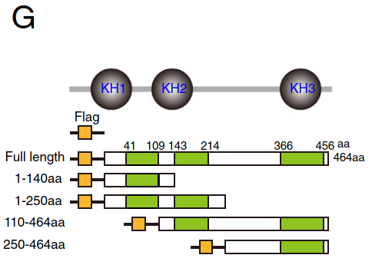
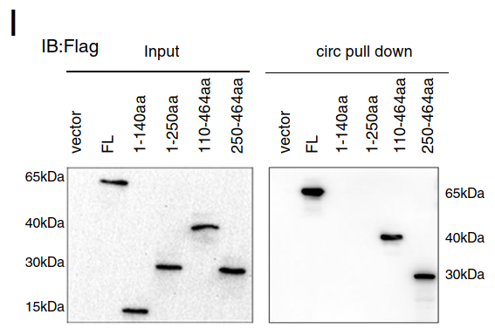
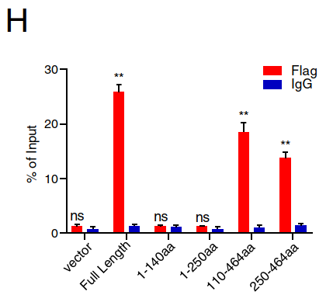
Results
Detected hnRNPK binding site with circGALNT16

Slide 19
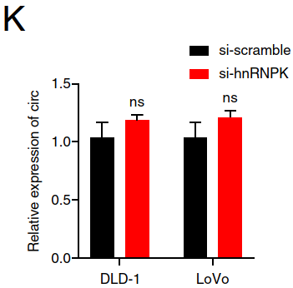
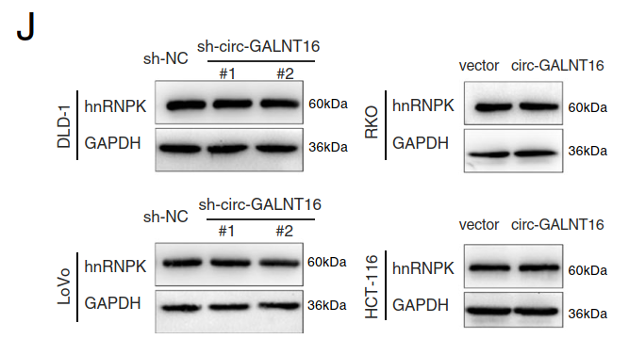
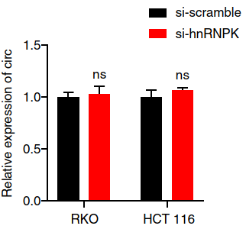
Results
The level of hnRNPK unchanged while circGALNT16 overexpressed

Slide 20
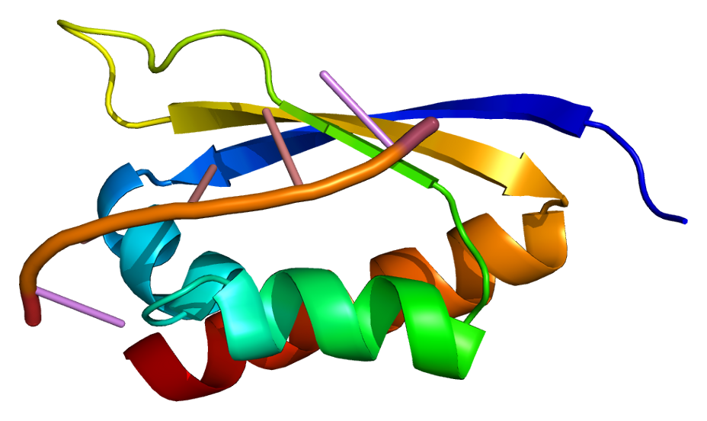
Summary
CircGALNT16
hnRNPK
?

Slide 21
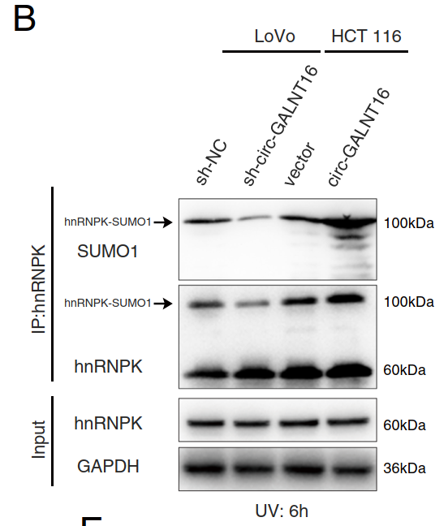
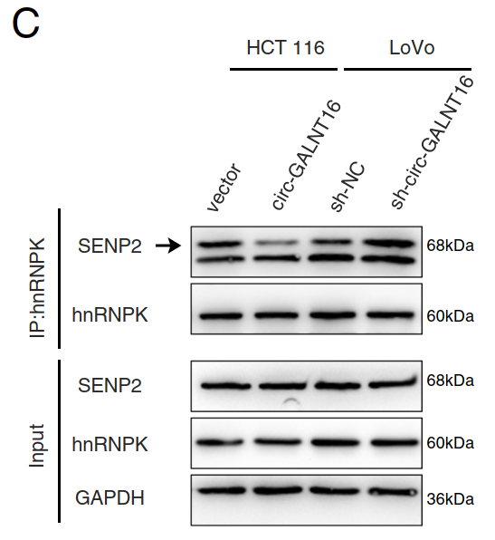
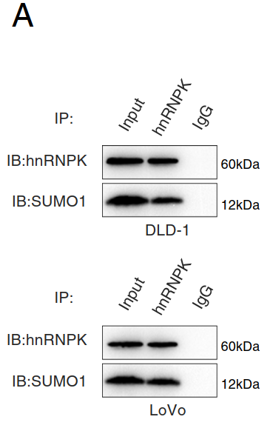
Results
CircGALNT16 enhanced hnRNPK SUMOylation through SENP2

Slide 22
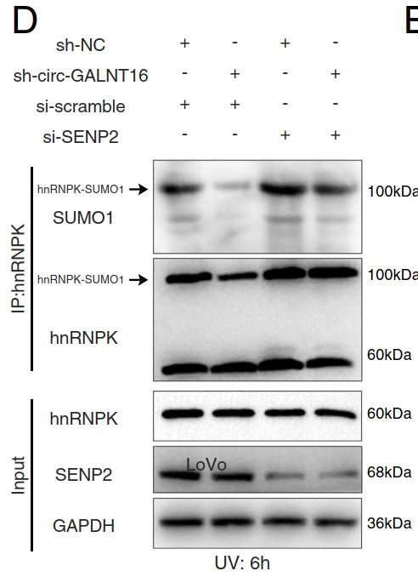
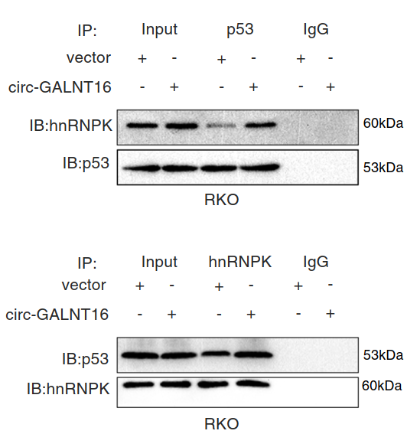
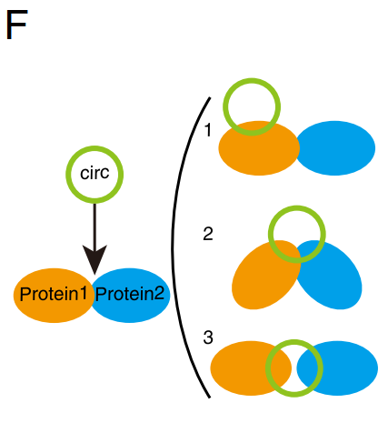
Results
hnRNPK SUMOylation enhanced the interaction with p53

Slide 23
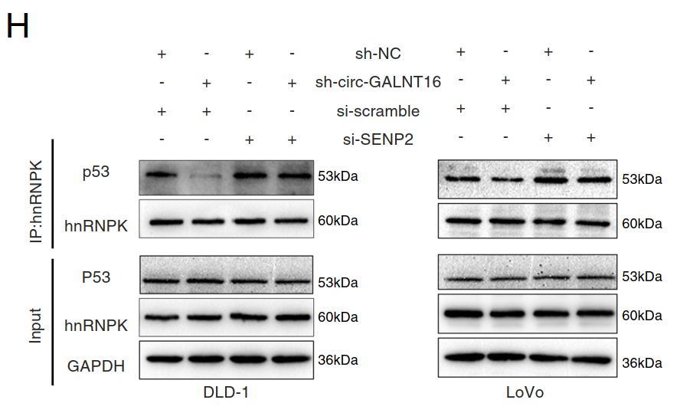
Results
hnRNPK SUMOylation enhanced the interaction with p53

Slide 24
Summary
SENP2
SUMO
CircGALNT16
hnRNPK
p53

Slide 25
Results
The downstream genes influenced by circGALNT16

Slide 26
Results
The level of Serpine1 was downregulated by circGALNT16

Slide 27
Results
CircGALNT16 regulated cell cycle through Serpine1

Slide 28
Results
CircGALNT16 regulated apoptosis through Serpine1

Slide 29
Results
CircGALNT16 regulated cell cycle and apoptosis through Serpine1

Slide 30
Summary
CircGALNT16
Serpine1
SUMO
p53
hnRNPK

Slide 31
Results
CircGALNT16 inhibited Serpine1 through the SUMOylation of hnRNPK and p53
CircGALNT16
hnRNPK
SUMOylation
Serpine1

Slide 32
Results
CircGALNT16 regulated Serpine1 through the SUMOylation of hnRNPK and p53
CircGALNT16
SENP2
hnRNPK
SUMOylation
Serpine1

Slide 33
Results
CircGALNT16 regulated Serpine1 through the SUMOylation of hnRNPK and p53
CircGALNT16
hnRNPK
SUMOylation
Promoter
of
Serpine1
Serpine1

Slide 34
Conclusion

