Slide 1
LCAT3, a novel m6A‑regulated long non‑coding RNA, plays an oncogenic role in lung cancer
via binding with FUBP1 to activate c‑MYC
Speaker: Yi-An Chen
Advisor: Liang-Chuan Lai, Ph.D.
Date: 2021.10.04

Slide 2
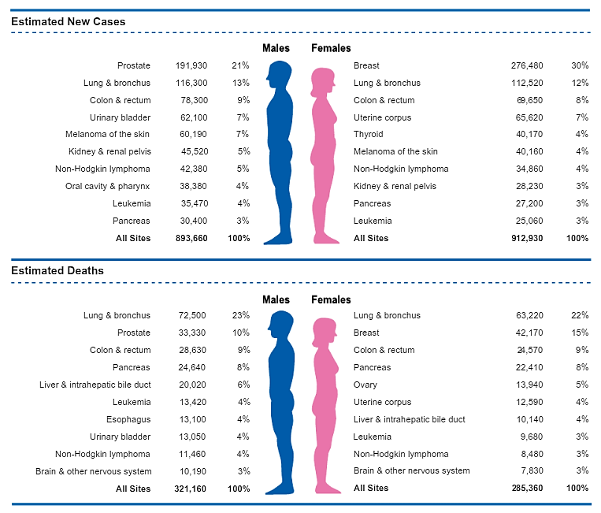
Lung Cancer
Most commonly diagnosed cancer
It’s the leading cause of cancer death in both men and women
Small cell lung cancer (SCLC)
Non-small cell lung cancer (NSCLC)
CA CANCER J CLIN , 2020

Slide 3
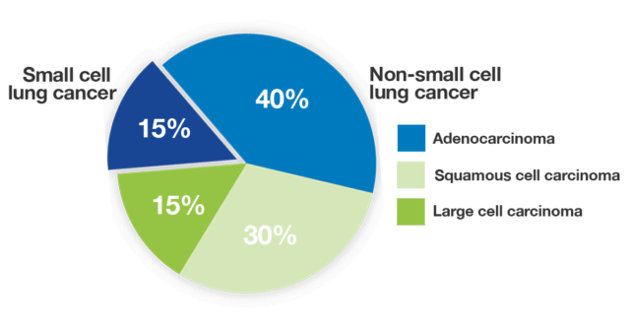
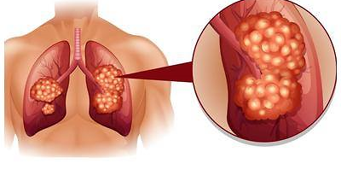
Subclasses of lung cancer
Small cell
lung cncer
Non-small cell
lung cncer
Notes:
NSCLC constitutes about 85% of all lung cancer cases, lung adenocarcinomas (LUAD) are the most common subtype,
accounting for more than 40% of cases.

Slide 4
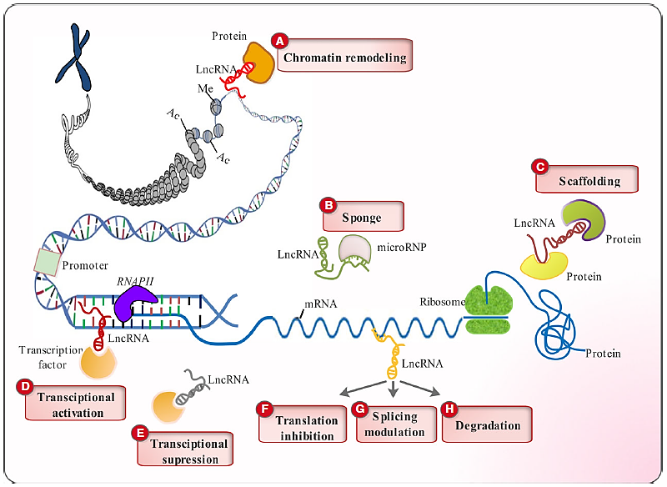
Long non-coding RNA (lncRNA)
More then 200 nucleotide
Some lncRNAs are induced
by hypoxia
Regulate cancer progression
LCAT3
J Cell Mol Med. 2017 Dec;21(12):3120-3140.

Slide 5
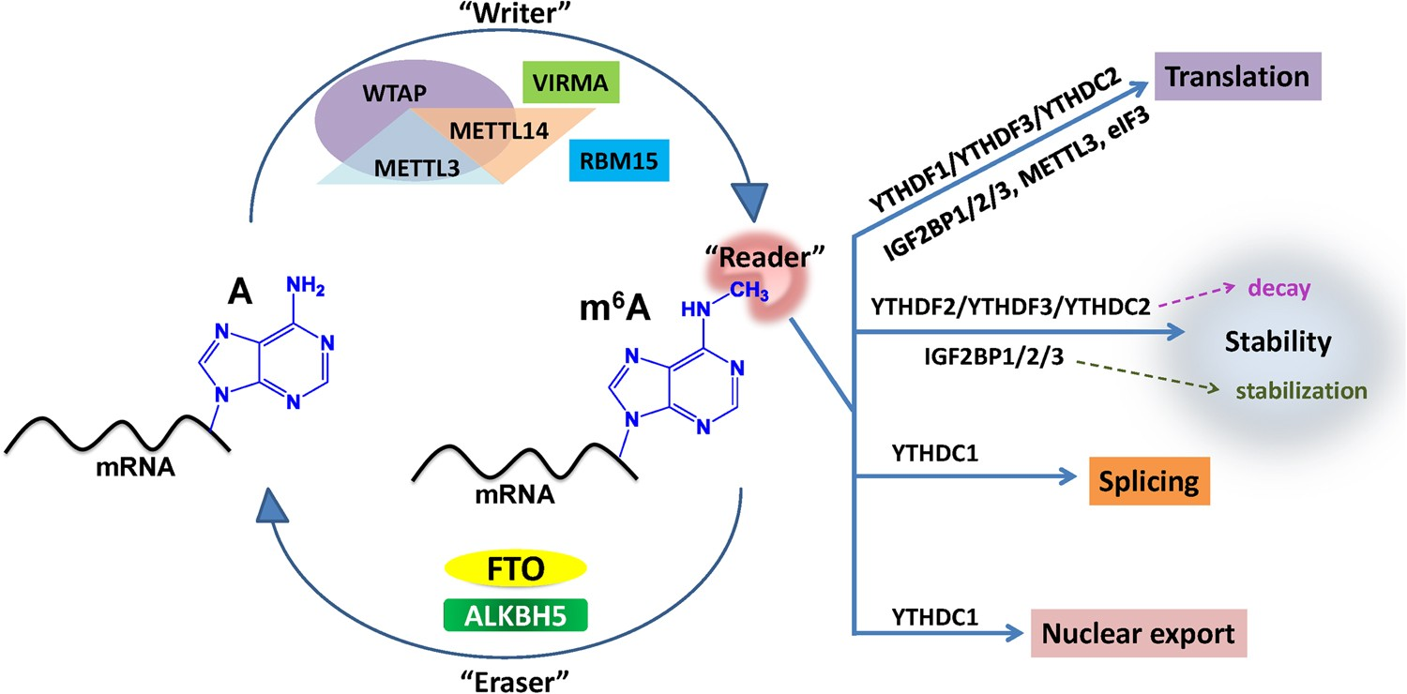
RNA methylation (m6A)
N6-adenosine-
methyltransferase complex
METTL3: Methyltransferase-like 3
METTL14: Methyltransferase-like 14
Cell Research , 2018

Slide 6
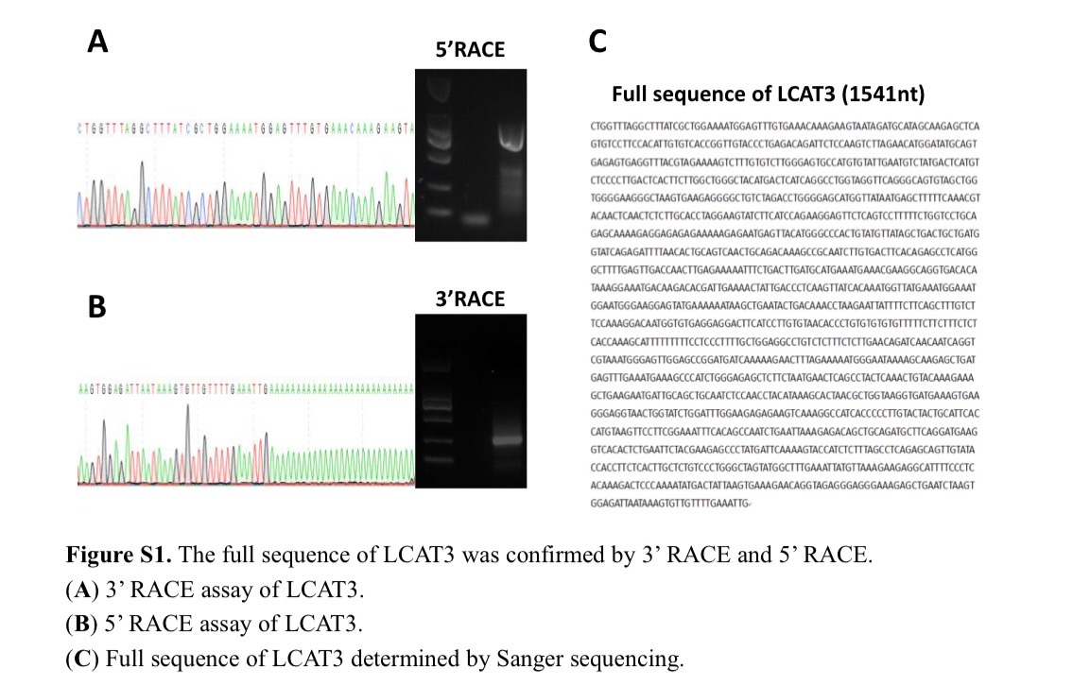
LCAT3 is associated with poor prognosis of LUAD

Slide 7
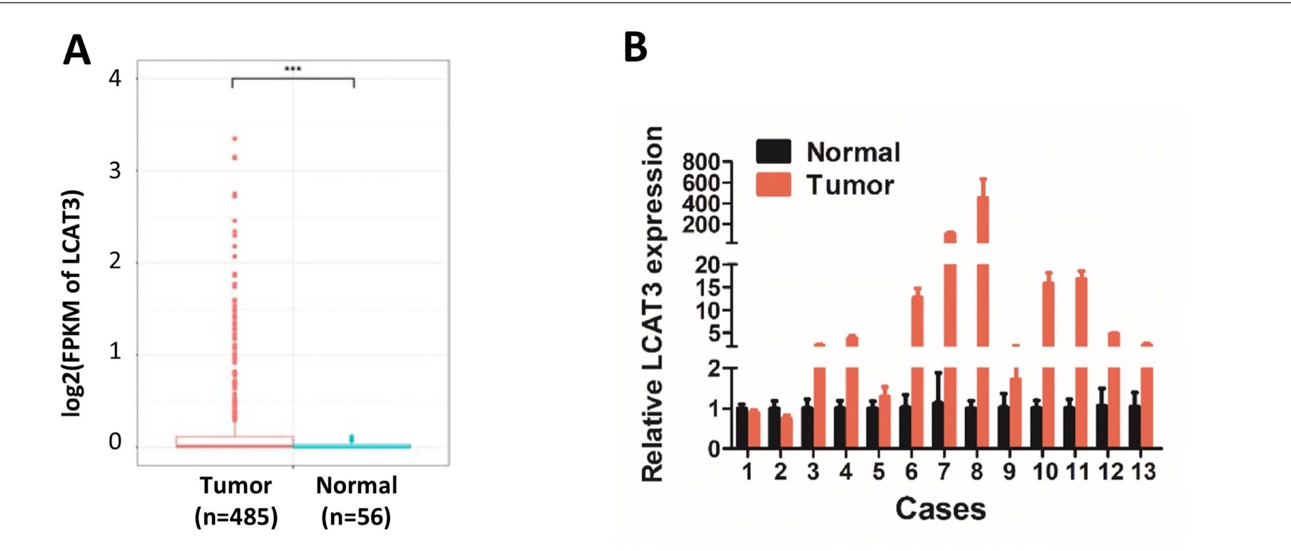
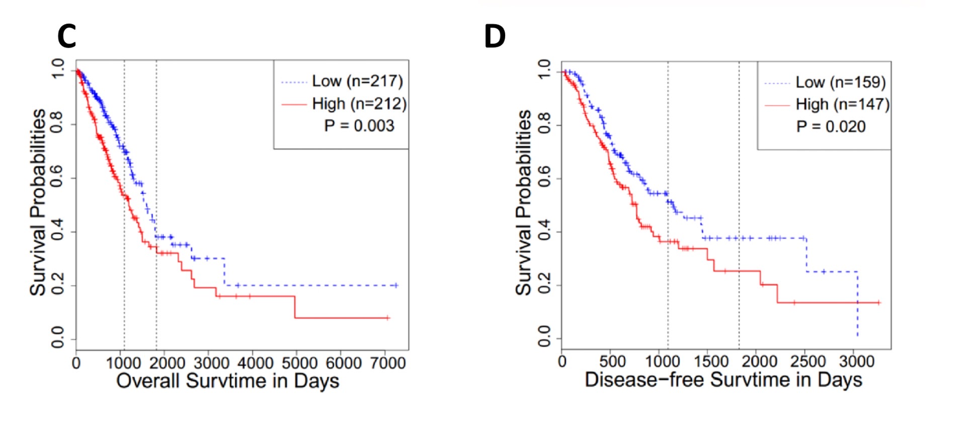
LCAT3 is associated with poor prognosis of LUAD

Slide 8
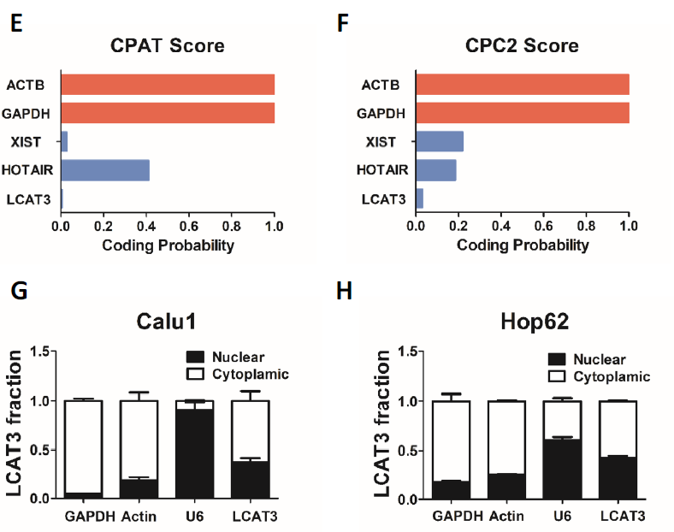

Slide 9
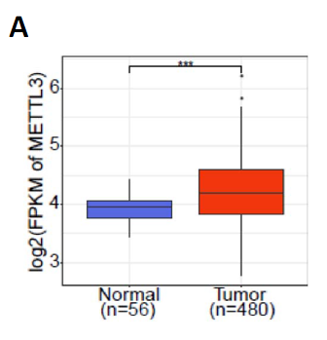
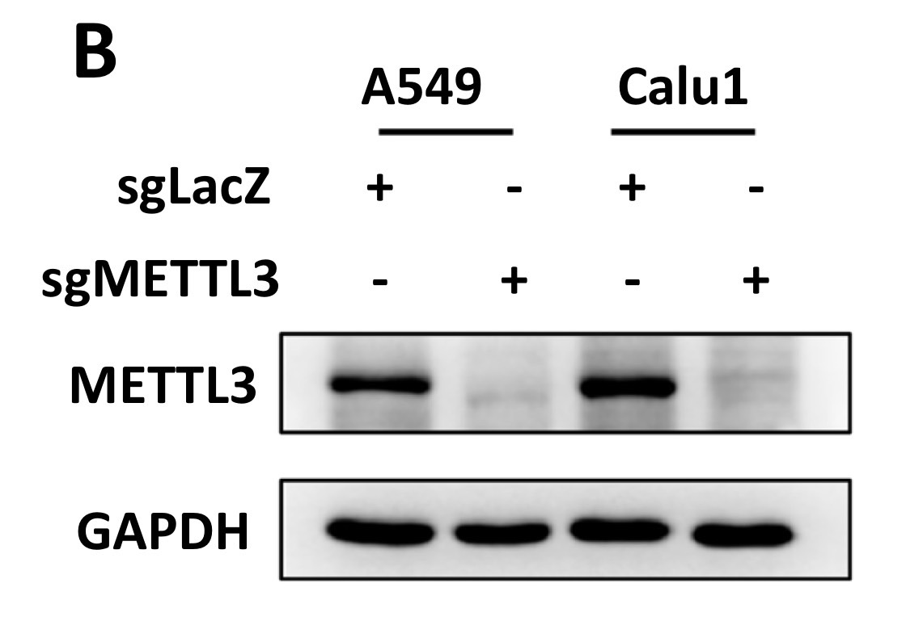
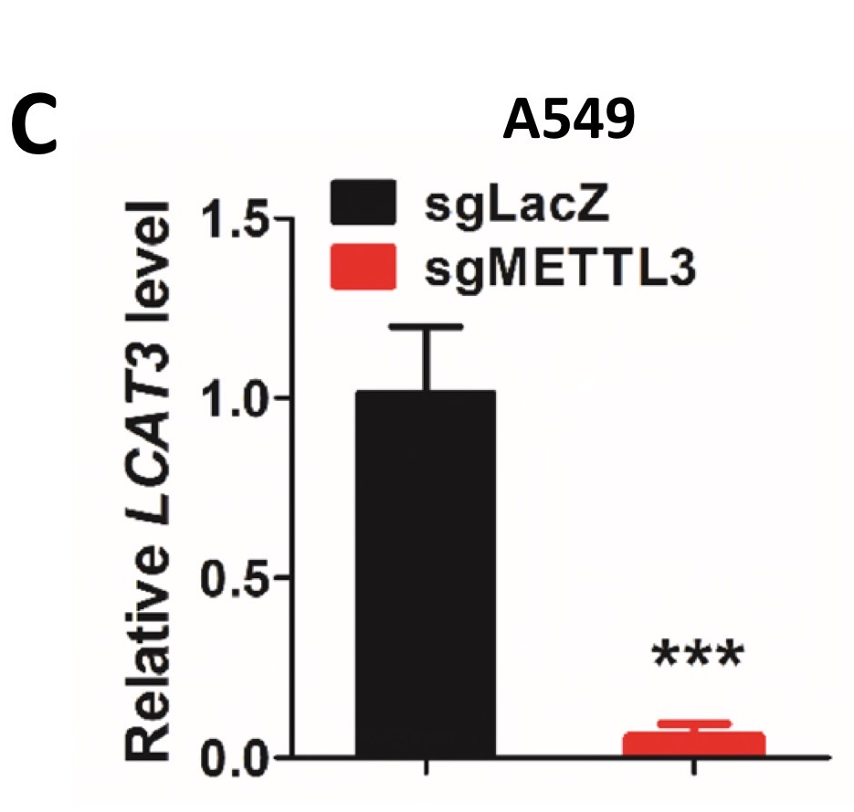
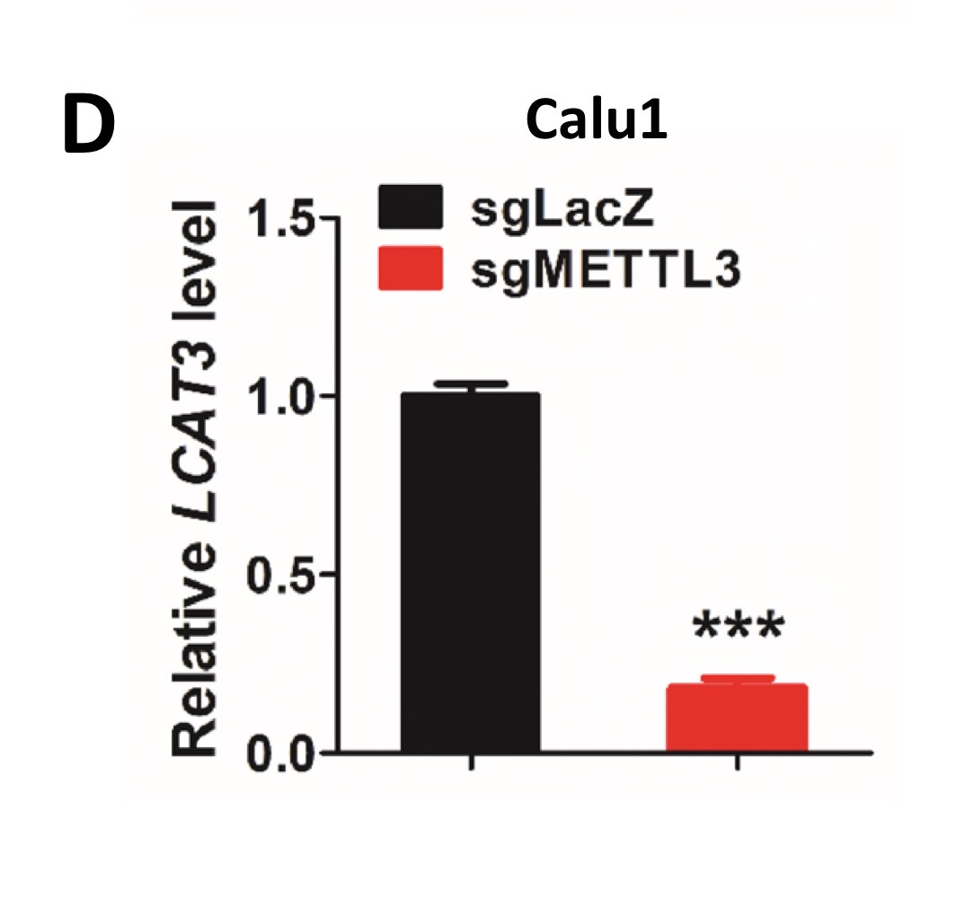
LCAT3 is upregulated by METTL3 through m6A modification
CRISPR Cas9

Slide 10
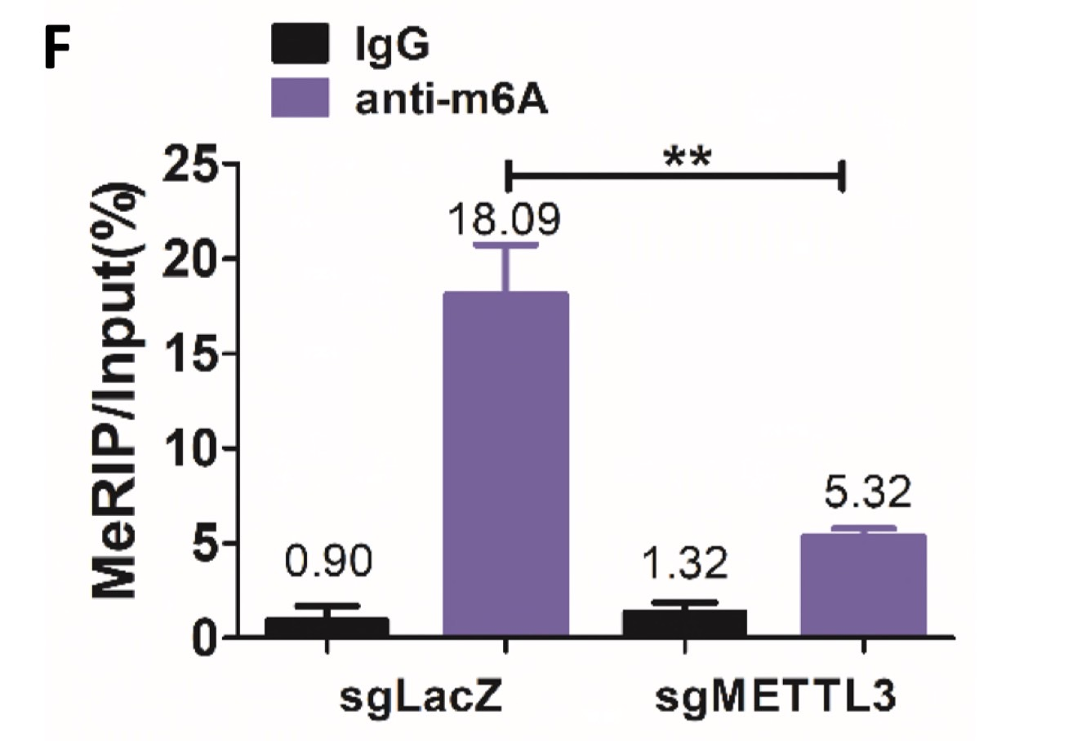
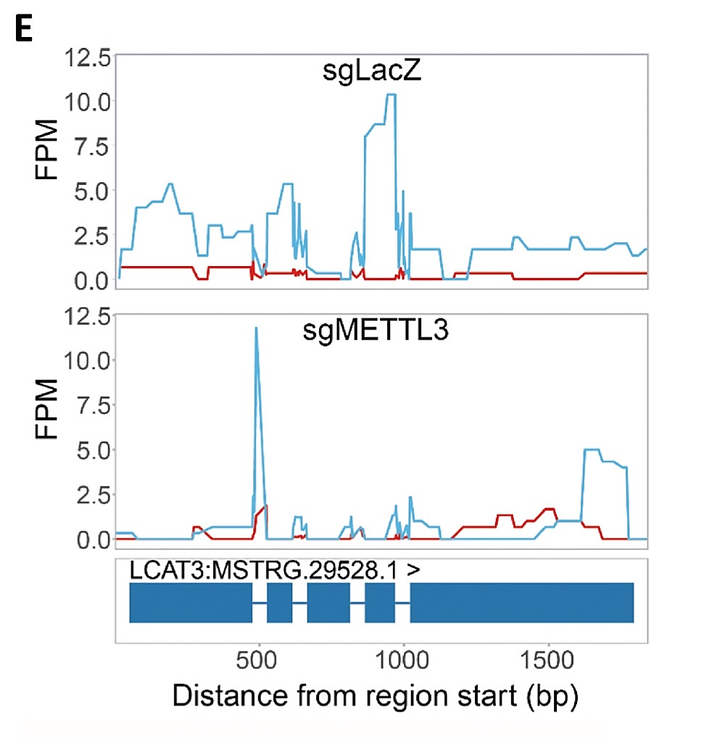
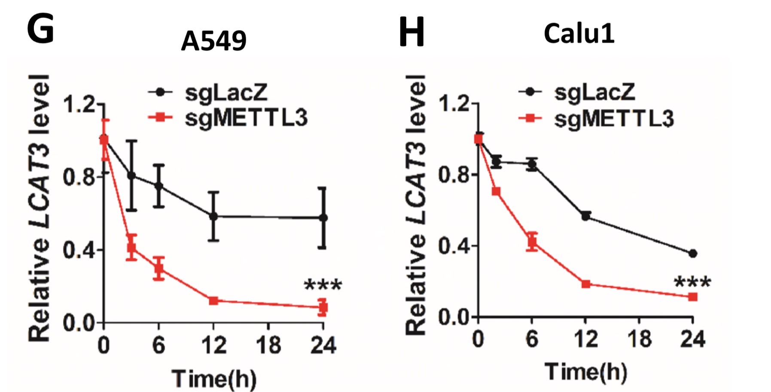
meRIP-qPCR
meRIP-Seq
Actinomycin D treatment

Slide 11
Lung cancer cell
METTL3
LCAT3
METTL3
METTL3
m6A
m6A

Slide 12
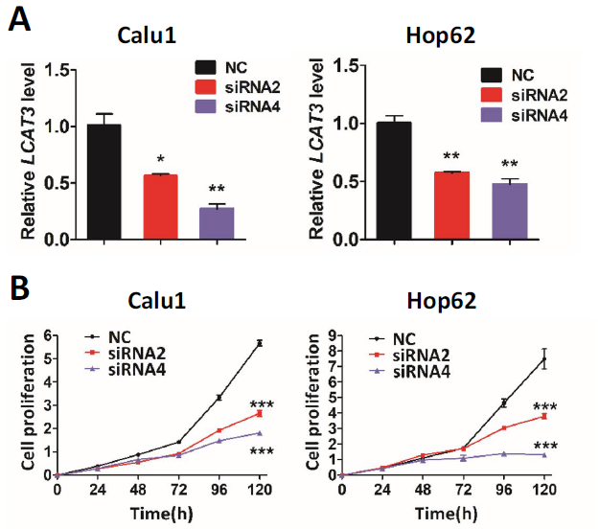
LCAT3 promotes proliferation of lung cancer cells both in vitro and in vivo
CCK-8 assay

Slide 13
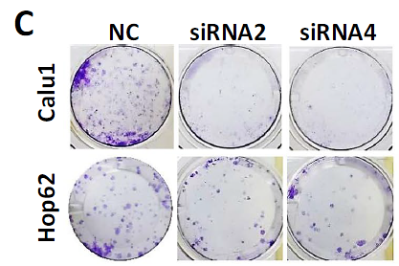
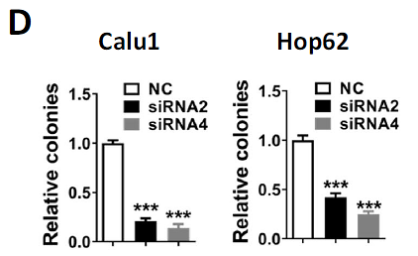
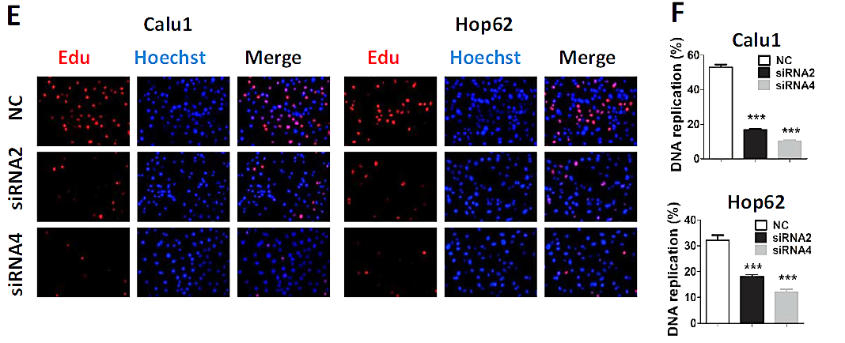
Colony formation assay
EdU assay

Slide 15
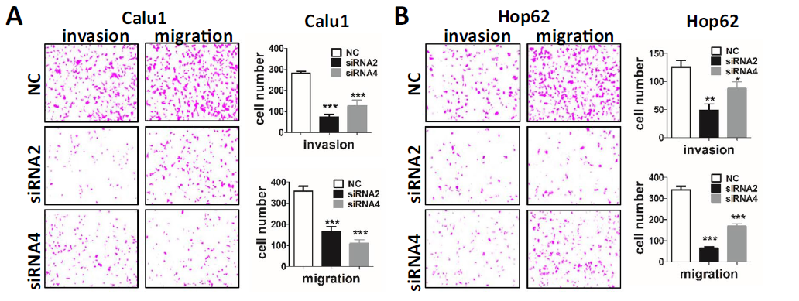
Effects of LCAT3 on migration, invasion, and cell cycle of lung cancer cells

Slide 16
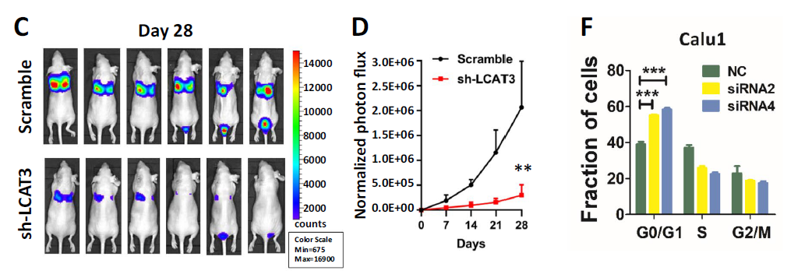
Flow cytometry

Slide 18
Lung cancer cell
METTL3
Cancer cell
proliferation ,
metastasis
LCAT3
METTL3
METTL3
m6A
m6A
Tumor progression

Slide 19
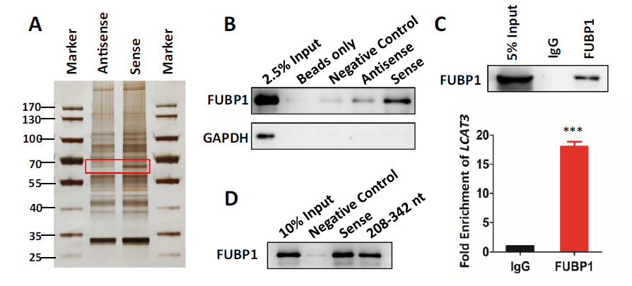
LCAT3 physically interacts with FUBP1
RIP
RNA pulldown
RNA pulldown

Slide 20
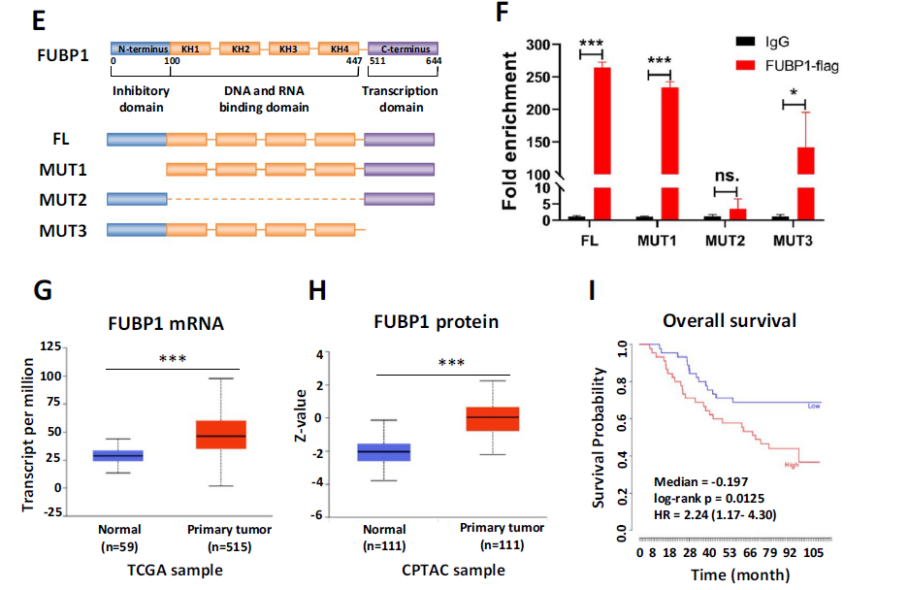

Slide 21
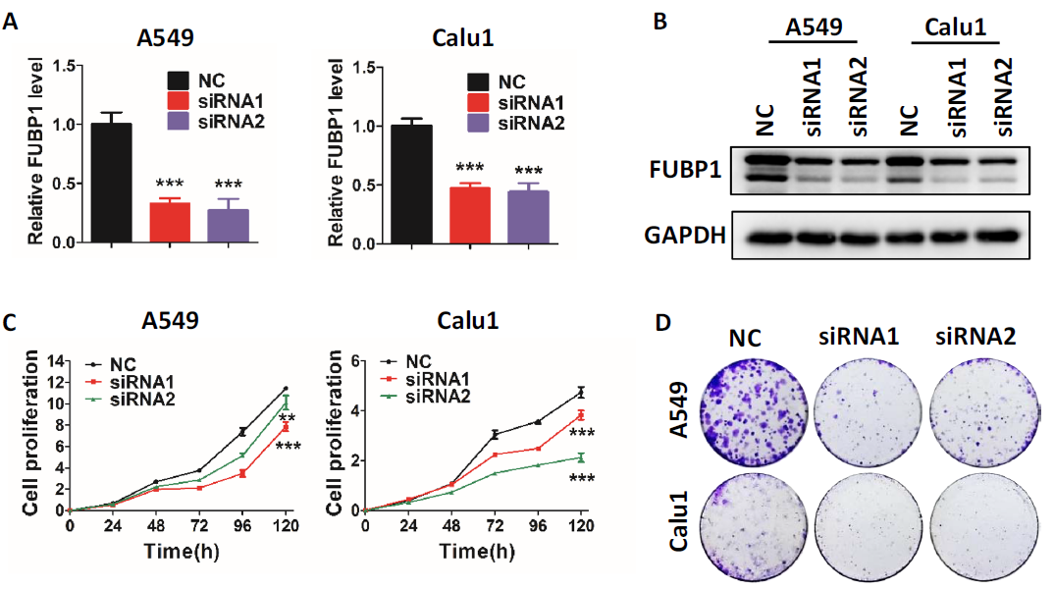
FUBP1 knockdown inhibits proliferation, migration,
and the cell cycle of lung cancer cells
CCK-8 assay

Slide 22
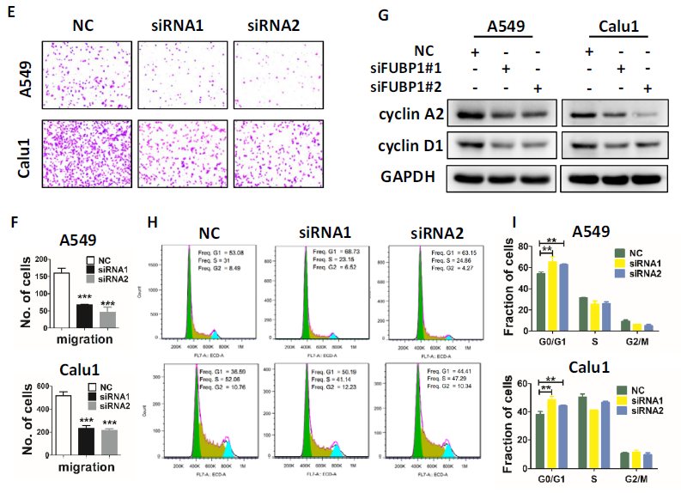
Transwell migration

Slide 23
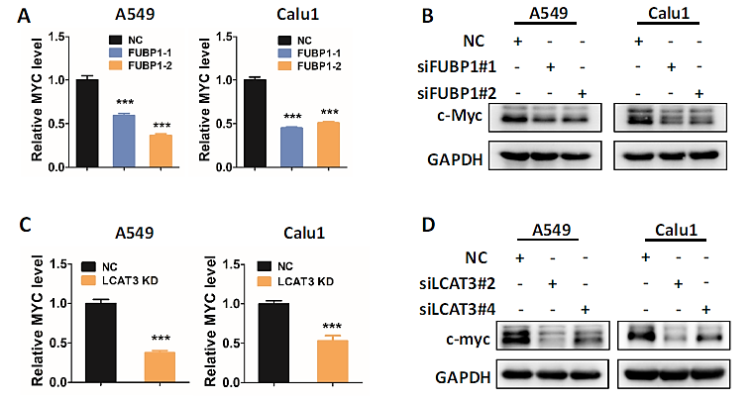
LCAT3 and FUBP1 co-regulate the expression of c-Myc

Slide 24
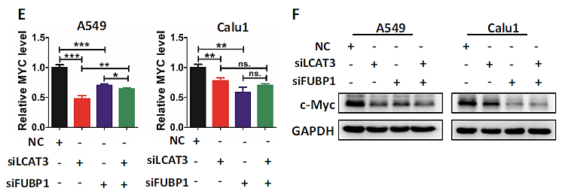

Slide 25
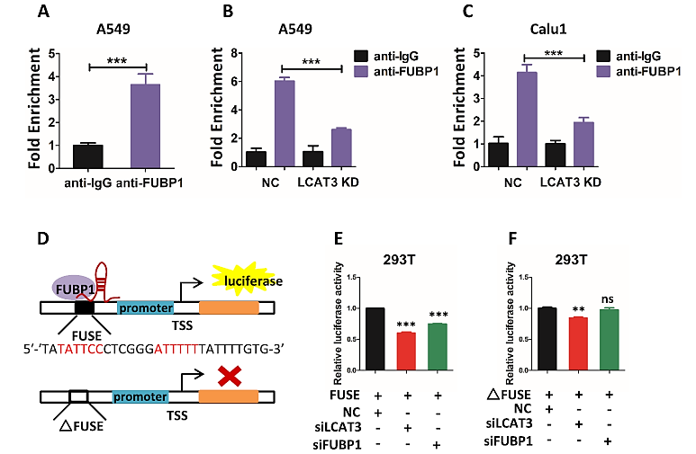
LCAT3 recruits FUBP1 to activate MYC expression
Luciferase reporter assay

Slide 26
