Slide 1
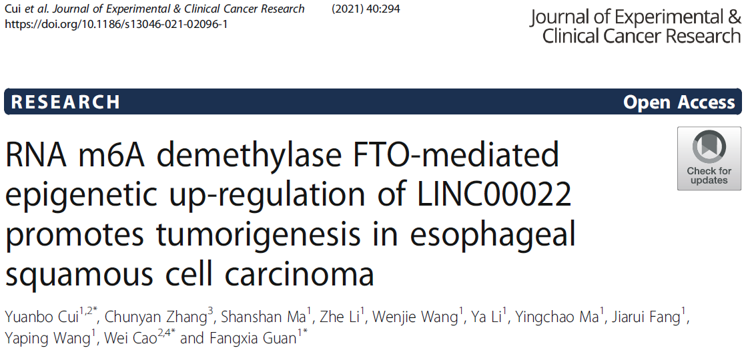
Speaker: Yi-An Chen
Advisor: Liang-Chuan Lai, Ph.D.
Date: 2022.02.21

Slide 2
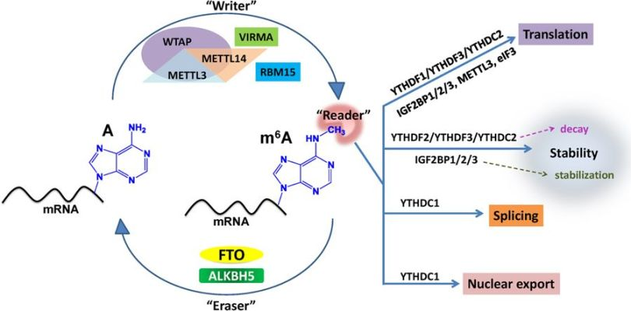
RNA methylation (m6A)

Slide 3
RNA methylation (m6A)

Slide 4
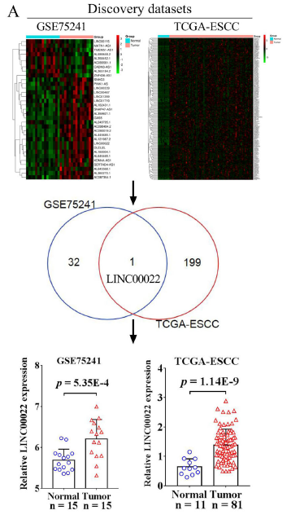
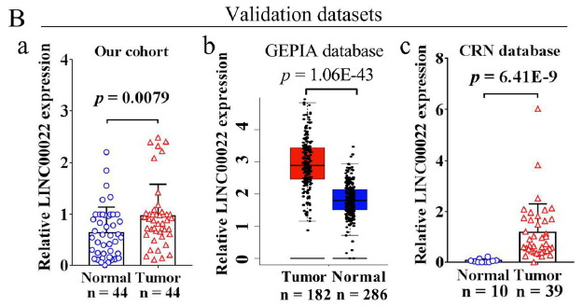
Fig1. Up-regulated LINC00022 predicts poor prognosis of ESCC patients

Slide 5
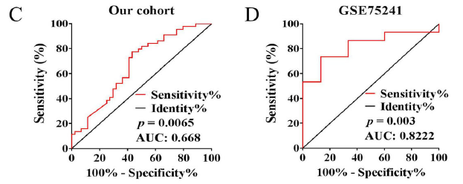
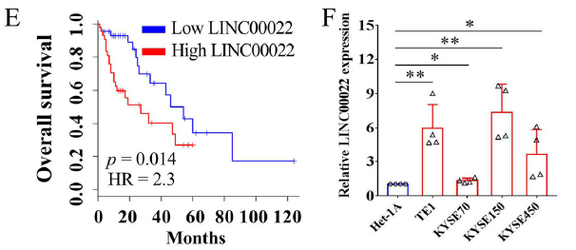
Fig1. Up-regulated LINC00022 predicts poor prognosis of ESCC patients

Slide 6
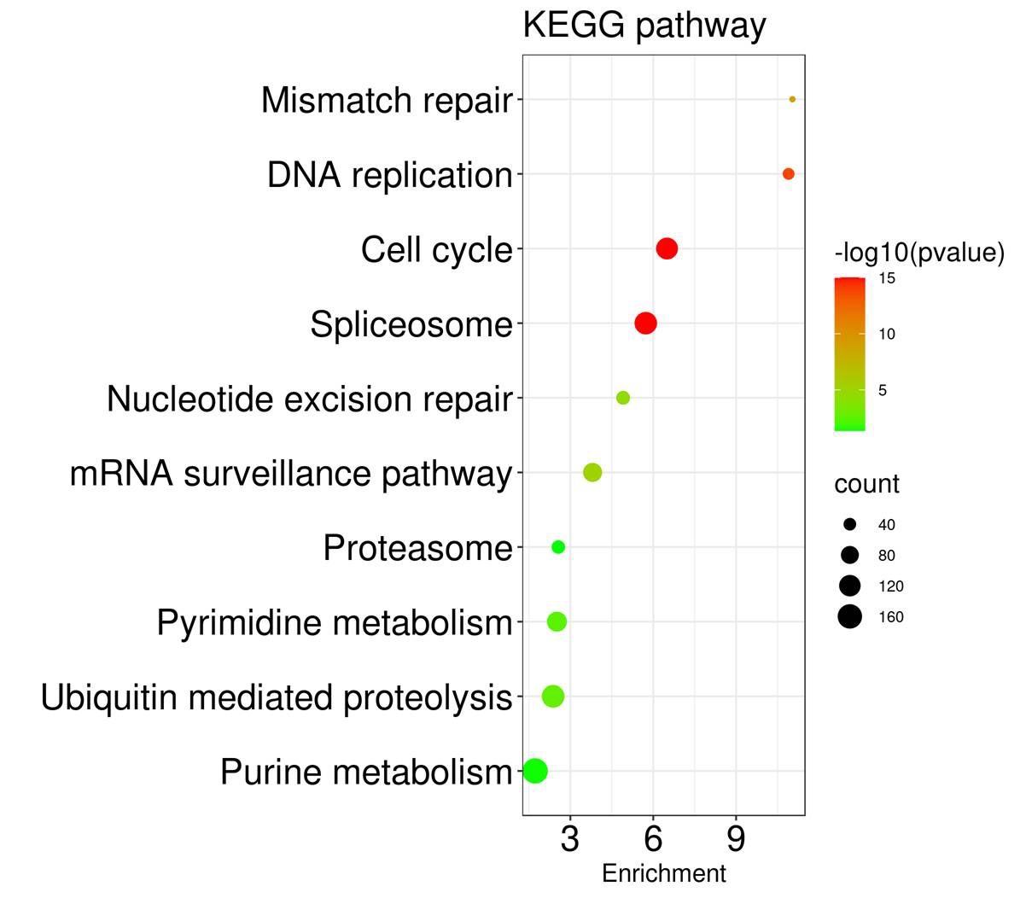

Slide 7
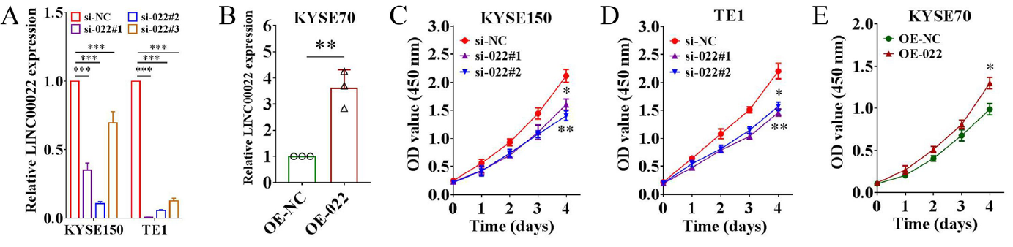
Fig 2. LINC00022 facilitates ESCC proliferation in vitro

Slide 8
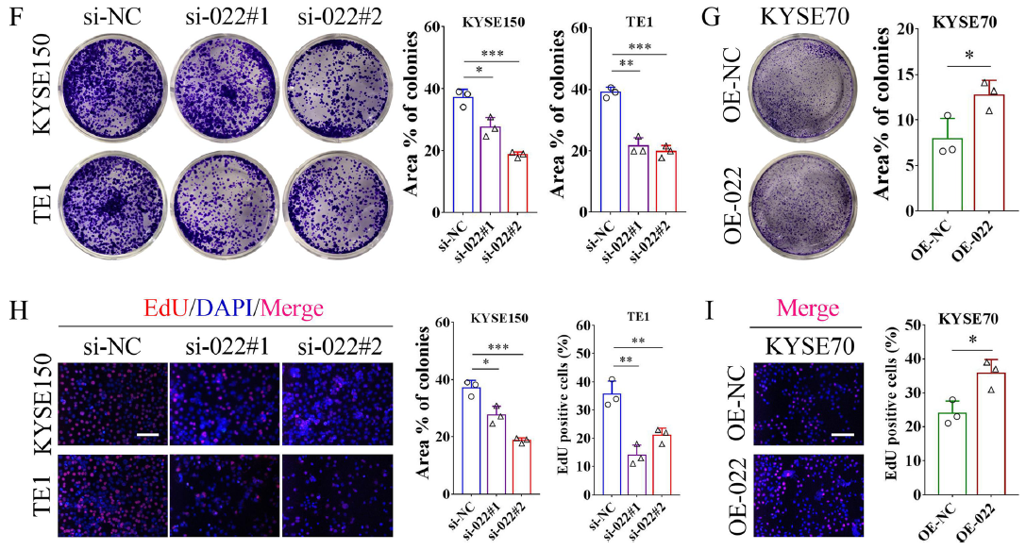
Fig 2. LINC00022 facilitates ESCC proliferation in vitro

Slide 9
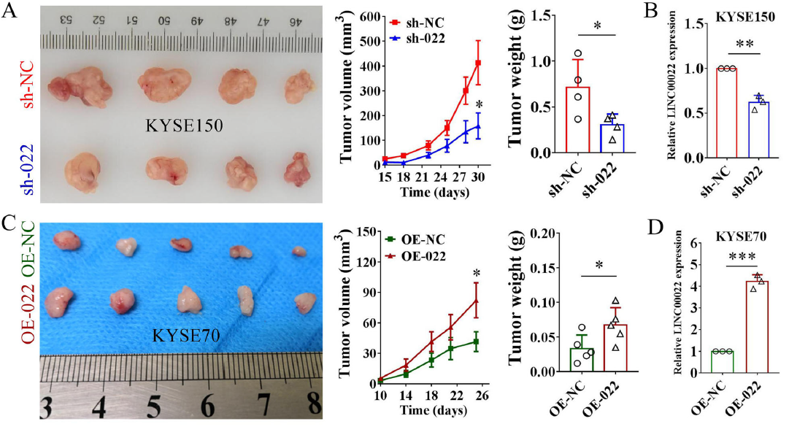
Fig 3. LINC00022 promotes tumorigenesis of ESCC in vivo

Slide 10
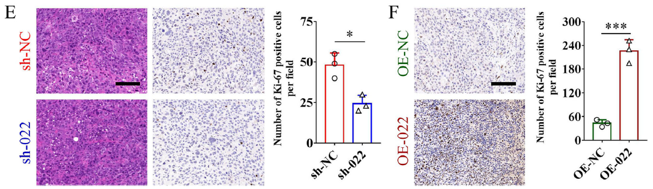
Fig 3. LINC00022 promotes tumorigenesis of ESCC in vivo

Slide 11
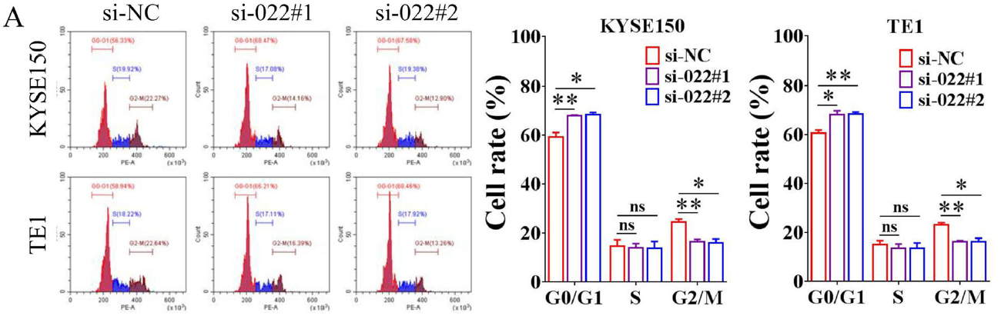
Fig. 4 LINC00022 promotes cell-cycle progression in ESCC cells

Slide 12
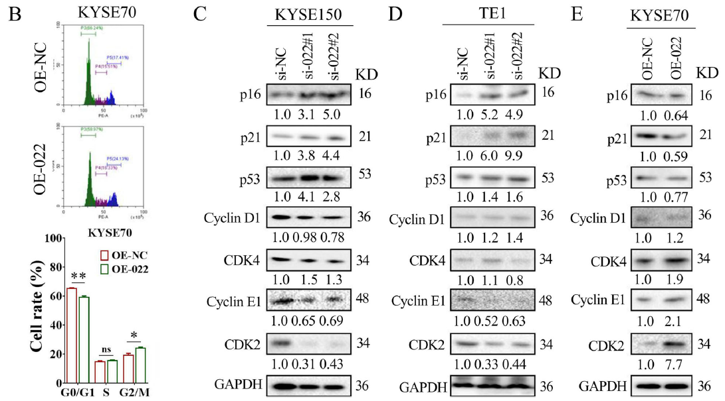
Fig 4. LINC00022 promotes cell-cycle progression in ESCC cells

Slide 13
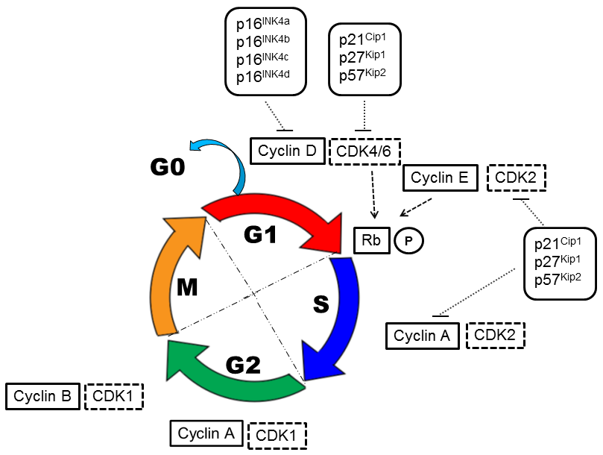
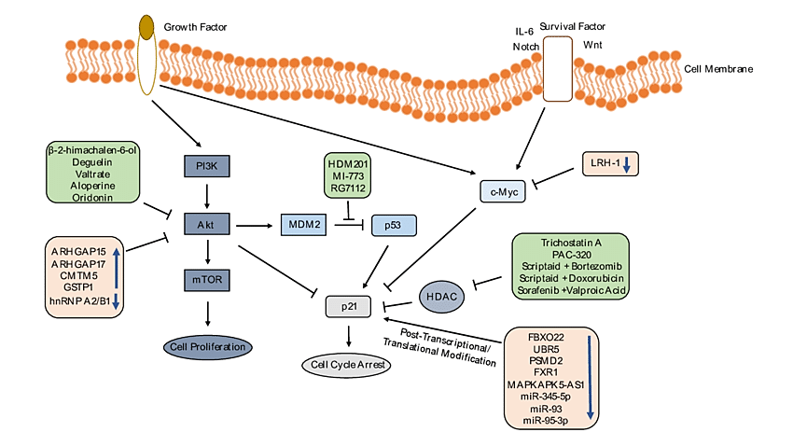

Slide 14
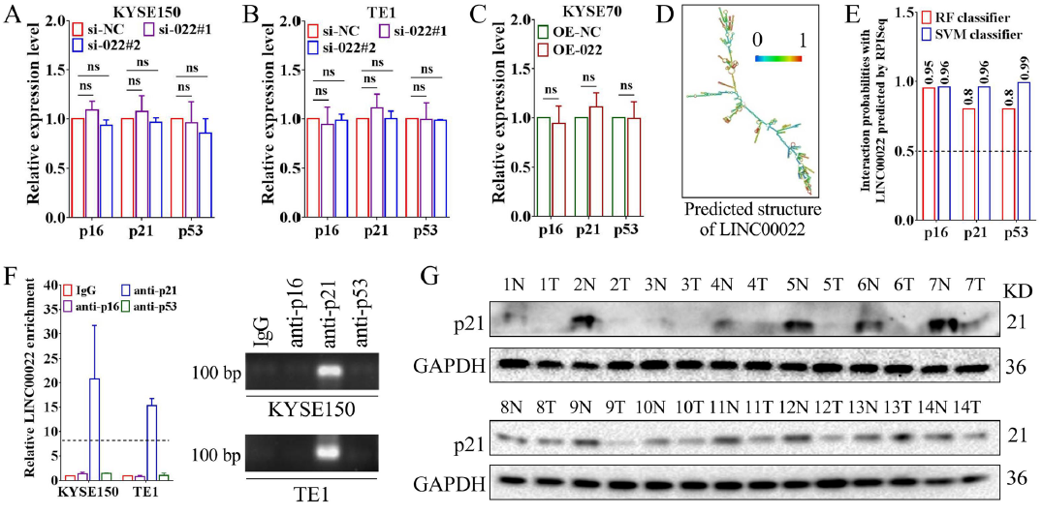
Fig 5. LINC00022 promotes ubiquitin-mediated p21 protein instability

Slide 15
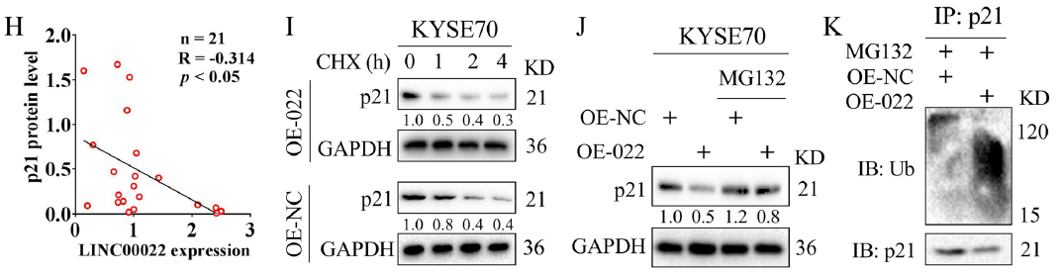
Fig 5. LINC00022 promotes ubiquitin-mediated p21 protein instability

Slide 16
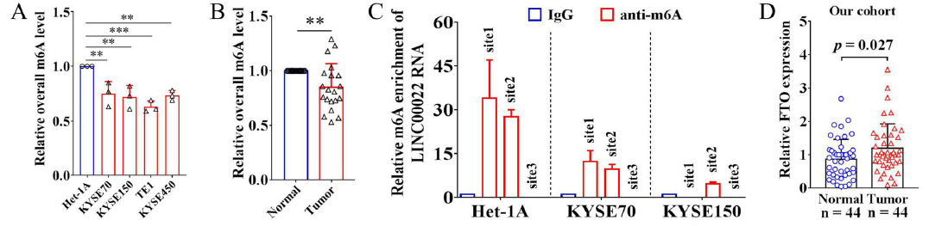
Fig 6. FTO mediates m6A demethylation of LINC00022 and promotes its up-regulation

Slide 17
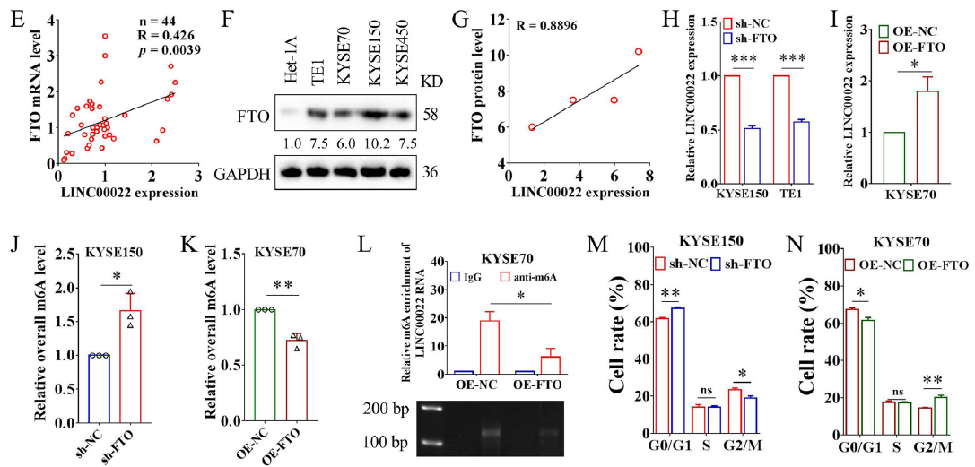
Fig 6. FTO mediates m6A demethylation of LINC00022 and promotes its up-regulation

Slide 18
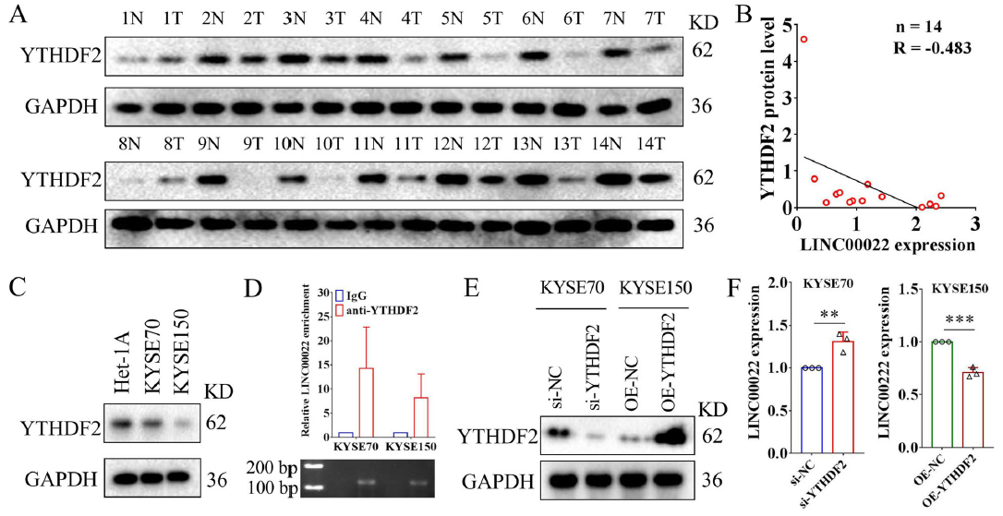
Fig. 7 FTO-induced epigenetic up-regulation of LINC00022 is YTHDF2-dependent

Slide 19
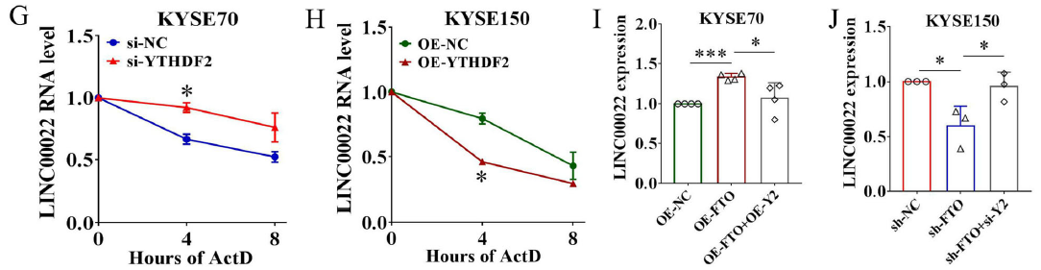
Fig. 7 FTO-induced epigenetic up-regulation of LINC00022 is YTHDF2-dependent

Slide 20
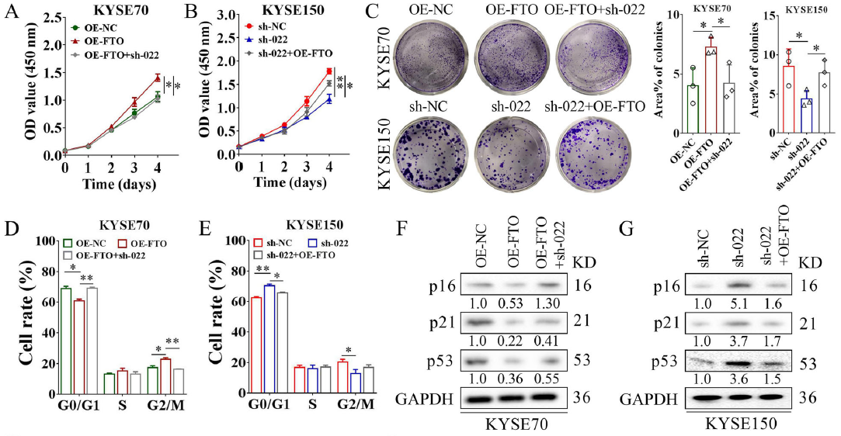
Fig 8. FTO/LINC00022 axis drives ESCC tumorigenesis

Slide 21
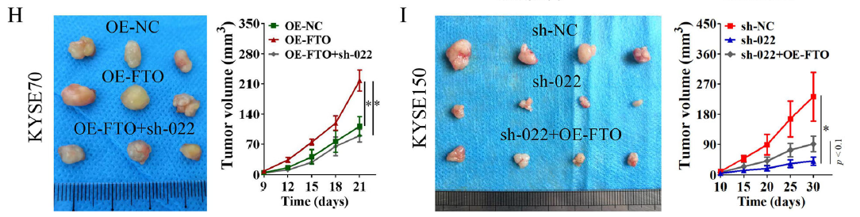
Fig 8. FTO/LINC00022 axis drives ESCC tumorigenesis

