Slide 1
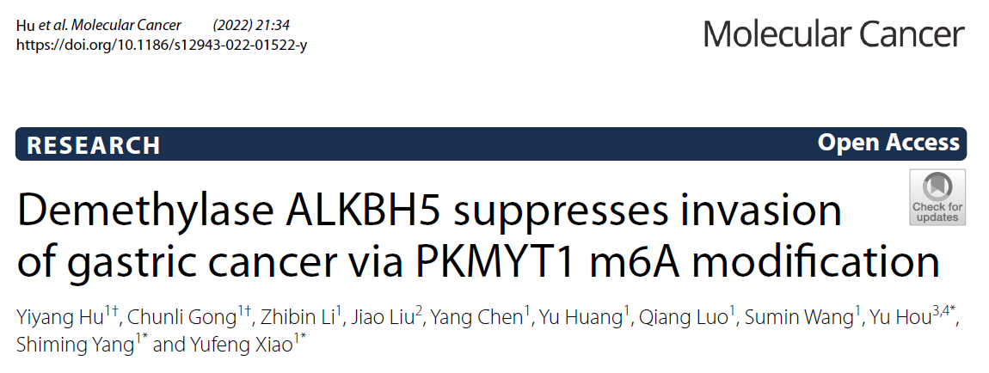
Speaker: Yi-An Chen
Advisor: Liang-Chuan Lai, Ph.D.
Date: 2022.03.07

Slide 2
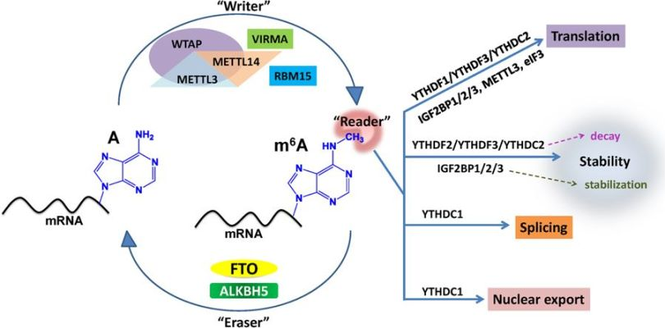
RNA methylation (m6A)
In gastric cancer
PKMYT1
IGF2BP3
ALKBH5
Gastric cancer

Slide 3
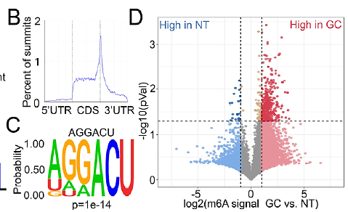
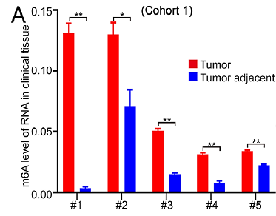
Fig. 1 MeRIP-seq reveals correlation between m6A and cell adhesion,
and ALKBH5 is associated with GC prognosis
Stop coden

Slide 4
m6A motif
RRACH
G / A
A / C / U
Notes:
R : 只要是嘌呤都可以 (A,G)
H : 可以是A、C、T (少了G ，而G的下一個單字是“H”，所以用“H”命名)

Slide 5
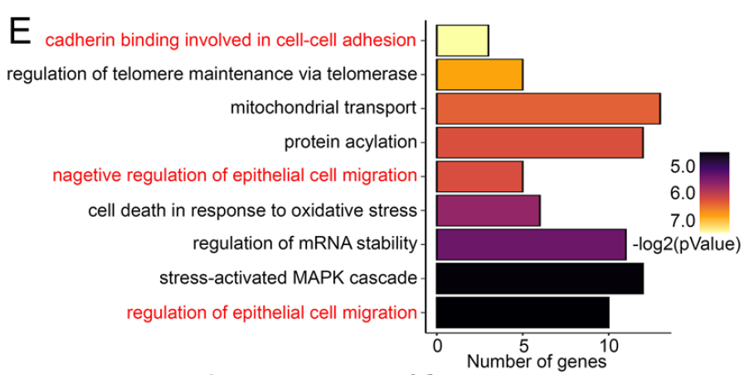
Fig. 1 MeRIP-seq reveals correlation between m6A and cell adhesion,
and ALKBH5 is associated with GC prognosis

Slide 6
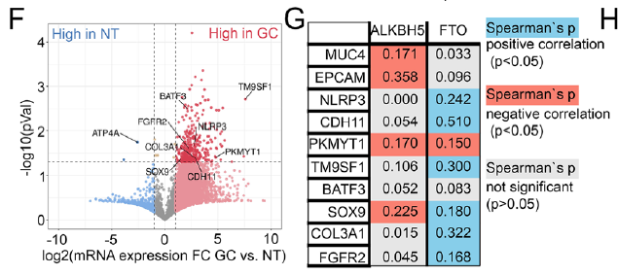
Fig. 1 MeRIP-seq reveals correlation between m6A and cell adhesion,
and ALKBH5 is associated with GC prognosis
m6A eraser
Migration
related
gene

Slide 7
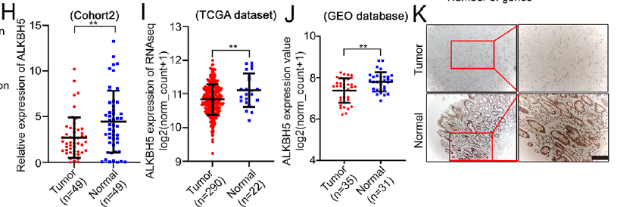
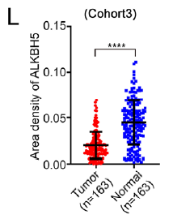
Fig. 1 MeRIP-seq reveals correlation between m6A and cell adhesion,
and ALKBH5 is associated with GC prognosis

Slide 8
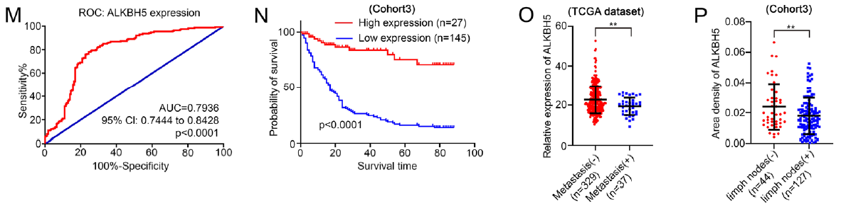
Fig. 1 MeRIP-seq reveals correlation between m6A and cell adhesion,
and ALKBH5 is associated with GC prognosis

Slide 9
Summary 1
To assess overall levels of m6A modification in gastric cancer……
Investigate total m6A level in GC
EpiQuik m6A RNA methylation quantification kit
➜
Peak calling and the distribution of peaks : MACS2
Identify m6A motif : HOMER
Gene functions : GO analysis
meRIP-seq
➜
Most genes exhibited high m6A levels
in tumor tissues
➜
Investigate expression level of ALKBH5 in gastric cancer

Slide 10
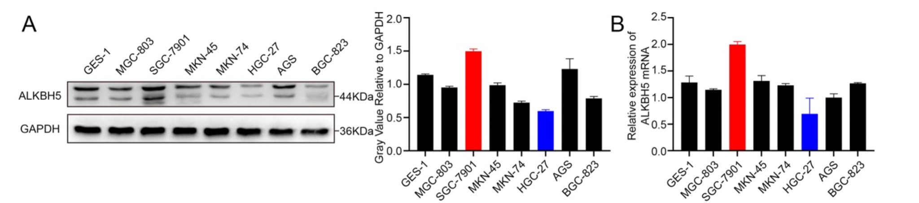
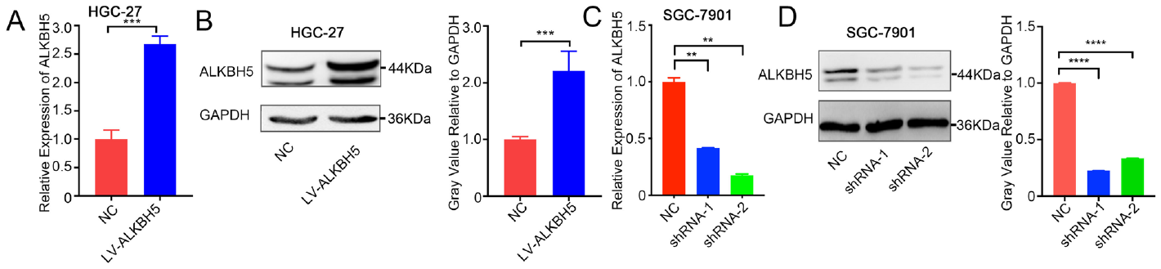
Fig. 2 ALKBH5 inhibits cell invasion in vitro
S2

Slide 11
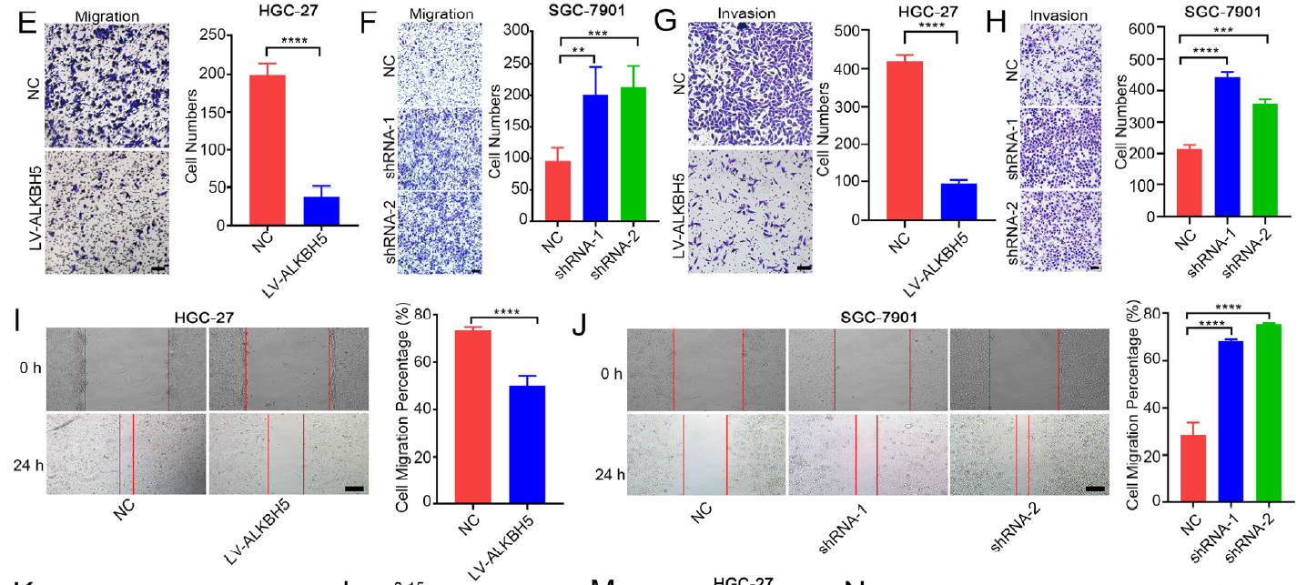
Fig. 2 ALKBH5 inhibits cell invasion in vitro

Slide 12
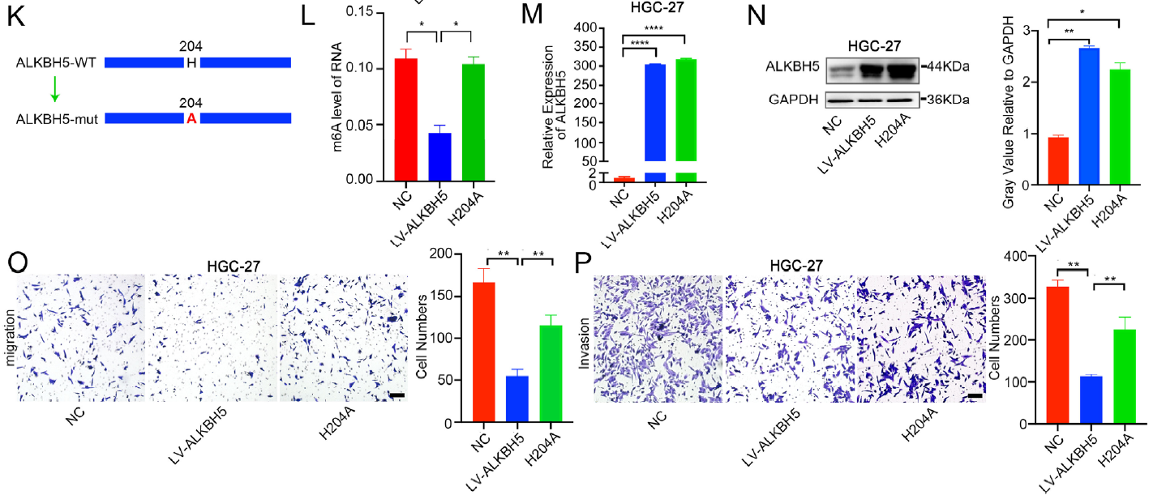
Fig. 2 ALKBH5 inhibits cell invasion in vitro

Slide 13
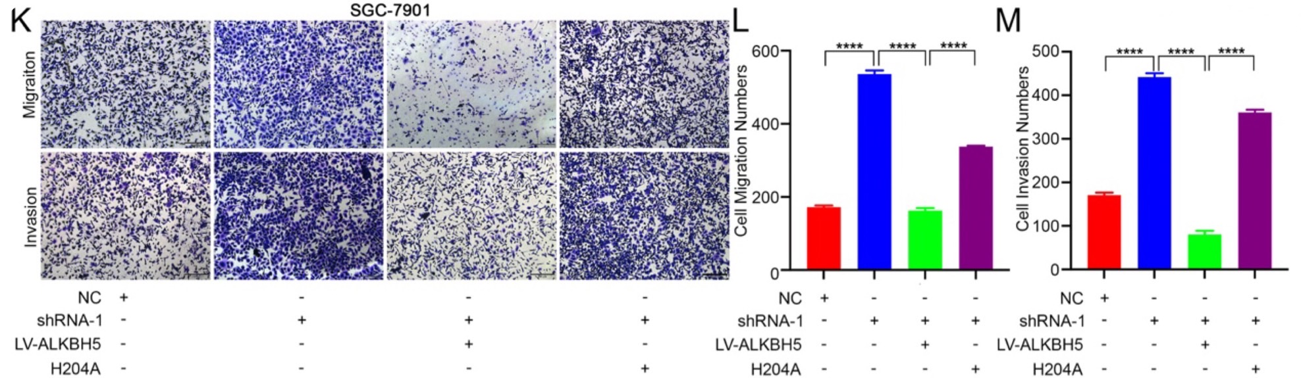
S2

Slide 14
Summary 2
To excavate the potential feature of ALKBH5 in GC progression……
Assess the expression of ALKBH5
among GC cell lines
➜
O/E or KD ALKBH5
➜
Cell migration , Invasion
Transwell , wound healing
➜
ALKBH5 H204A mutant
➜
Cell migration , Invasion
Transwell
➜
The inhibition of cell invasion by ALKBH5 overexpression
is mainly dependent on its demethylase activity

Slide 15
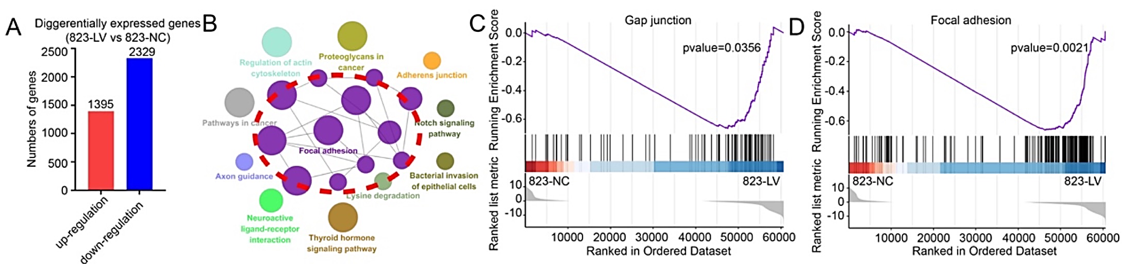
S3
RNA-seq

Slide 16
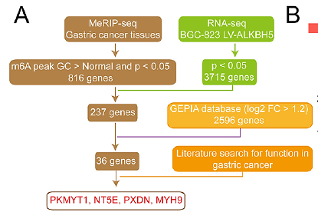
Fig. 3 PKMYT1 was identified as a downstream target of ALKBH5

Slide 17
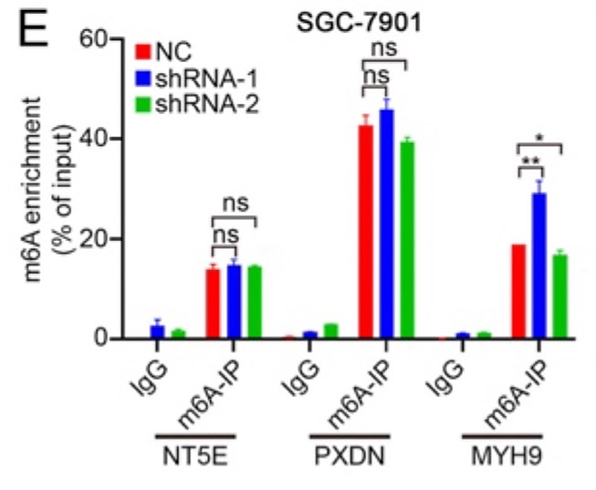
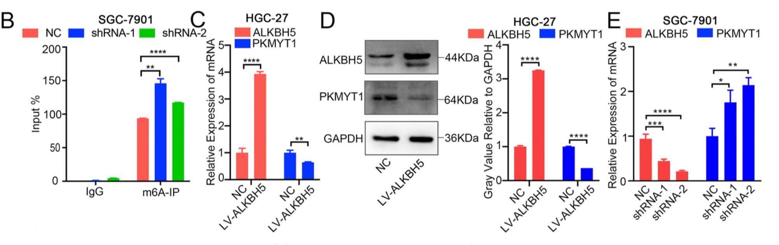
Fig. 3 PKMYT1 was identified as a downstream target of ALKBH5
S3

Slide 18
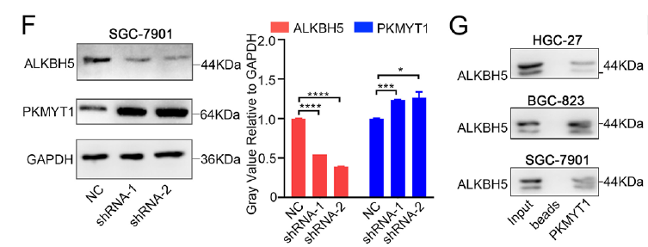
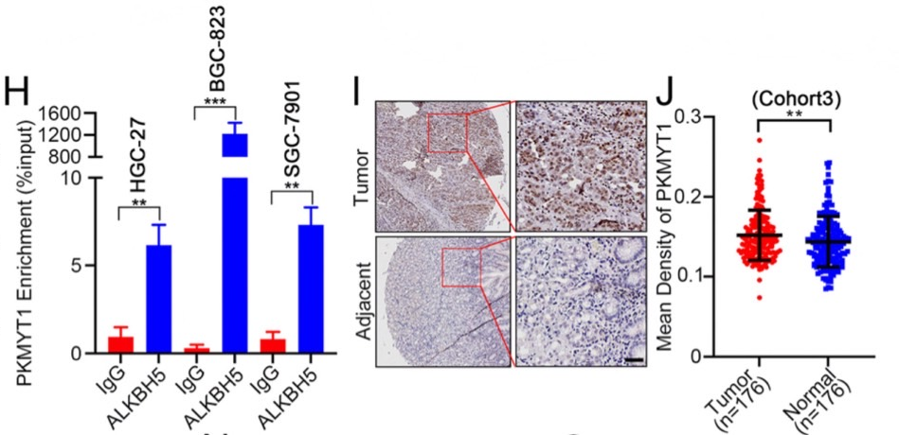
Fig. 3 PKMYT1 was identified as a downstream target of ALKBH5

Slide 19
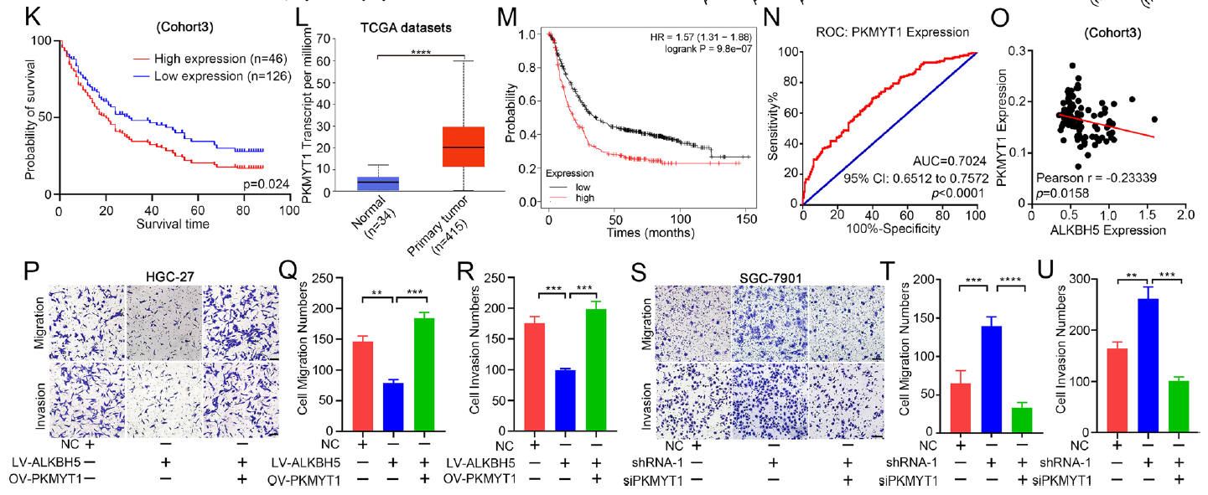
Fig. 3 PKMYT1 was identified as a downstream target of ALKBH5

Slide 20
Summary 3
To explore the potential target of ALKBH5 in GC metastasis ……
RNA-seq
(overexpress ALKBH5 , control)
➜
Compared the high expression genes among meRIP-seq , RNA-seq and GEPIA database
➜
PKMYT1 (oncogene)
➜
Investigate the relationship between ALKBH5 and PKMYT1
meRIP , qPCR , western blot , RNA pulldown , RIP
➜
Rescue experiment
➜
ALKBH5/PKMYT1

Slide 21
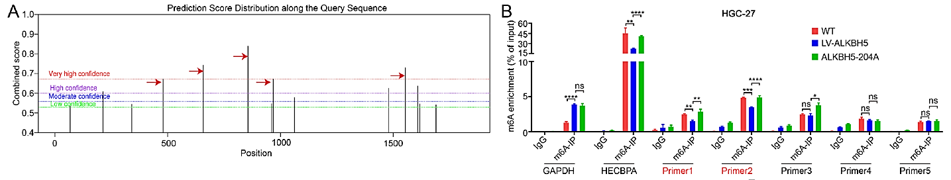
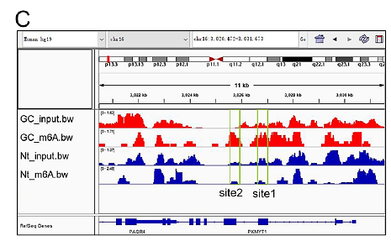
Fig. 4 ALKBH5 regulates PKMYT1 via its m6A-dependent manner

Slide 22
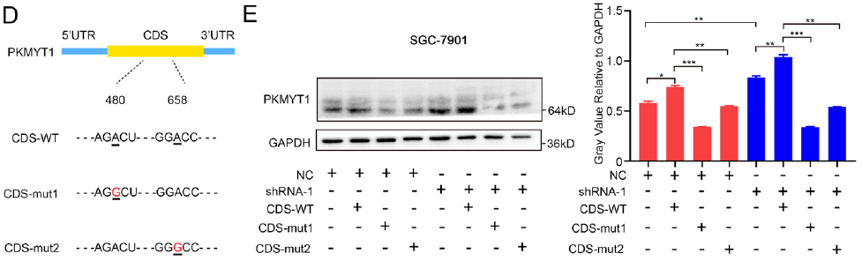
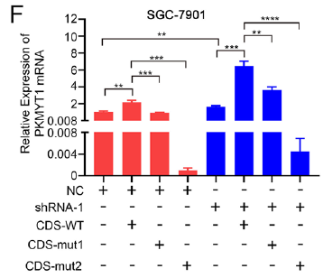
Fig. 4 ALKBH5 regulates PKMYT1 via its m6A-dependent manner

Slide 23
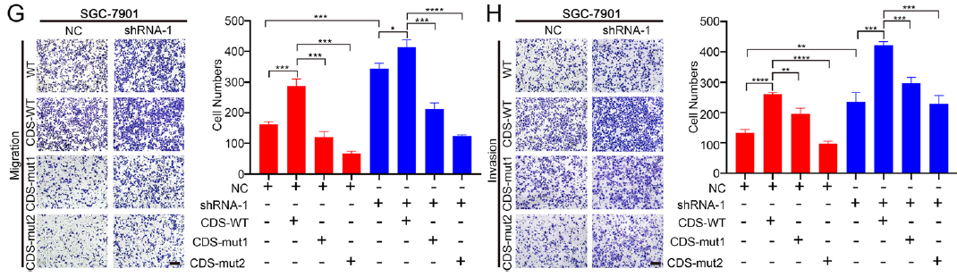
Fig. 4 ALKBH5 regulates PKMYT1 via its m6A-dependent manner

Slide 24
Summary 4
To identify the specific m6A site of SKMYT1 affected by ALKBH5……
Predict the m6A sites of SKMYT1
SRAMP website
➜
meRIP
➜
Check meRIP-seq data
IGV genome browser
➜
Mutate two m6A sites of SKMYT1
➜
Whole level of PKMYT1 and GC cell metastasis were reduced
➜
“site 1” , ”site2” of PKMYT1 might be the specific position regulated by ALKBH5

Slide 25
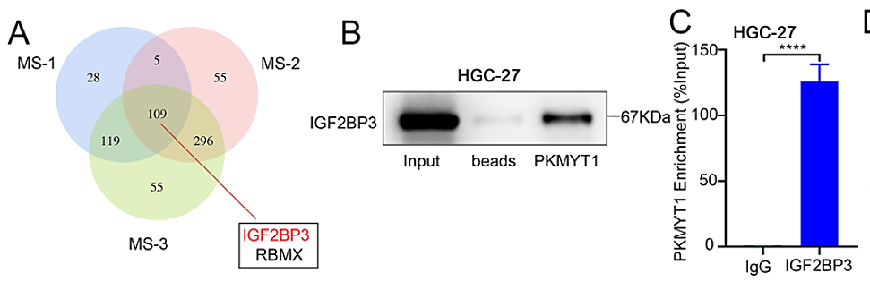
Fig. 5 ALKBH5 and IGF2BP3 together regulates
the expression of PKMYT1 via its m6A modification

Slide 26
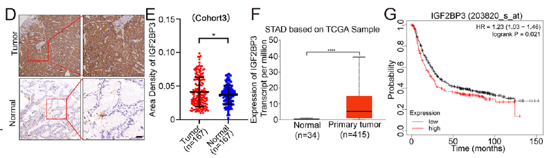
Fig. 5 ALKBH5 and IGF2BP3 together regulates
the expression of PKMYT1 via its m6A modification

Slide 27
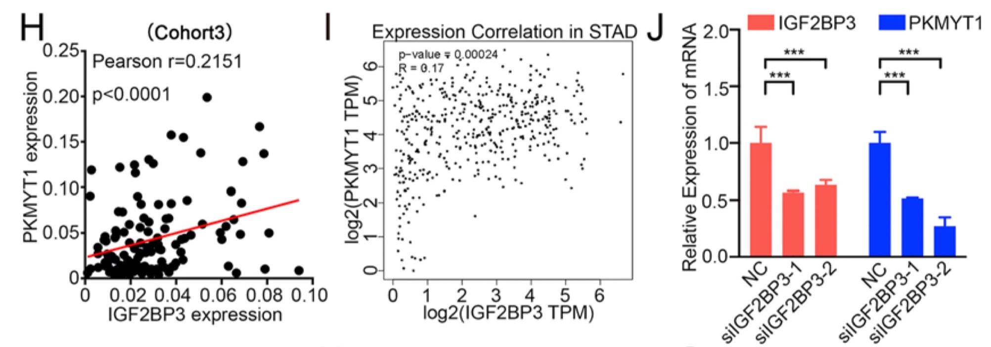
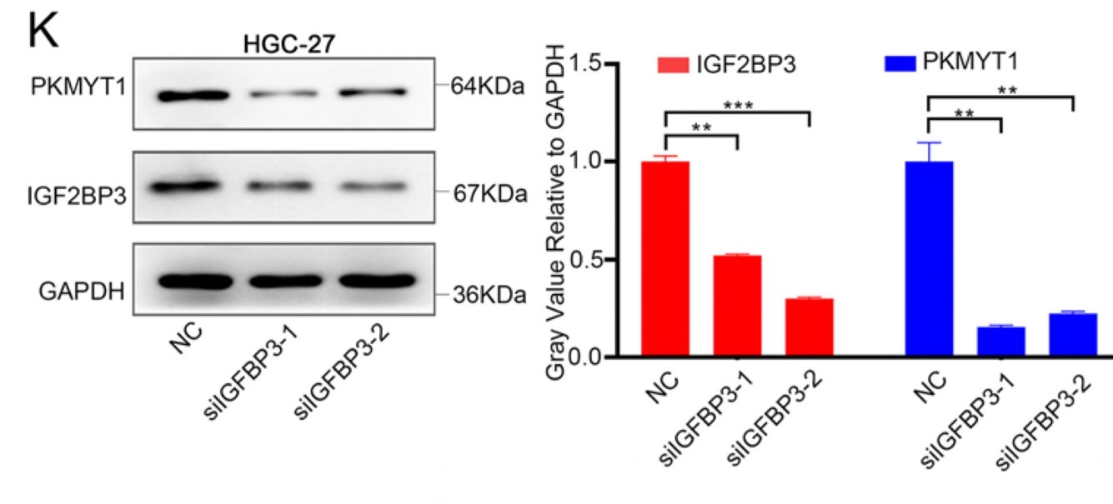
Fig. 5 ALKBH5 and IGF2BP3 together regulates
the expression of PKMYT1 via its m6A modification

Slide 28
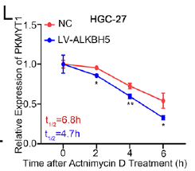
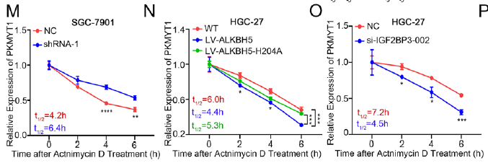
Fig. 5 ALKBH5 and IGF2BP3 together regulates
the expression of PKMYT1 via its m6A modification

Slide 29
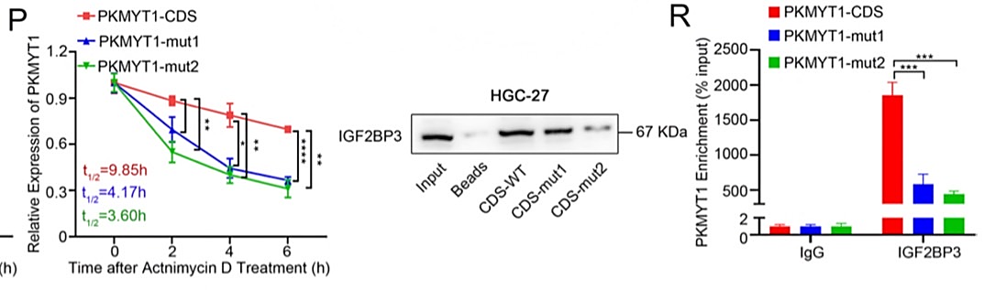
Fig. 5 ALKBH5 and IGF2BP3 together regulates
the expression of PKMYT1 via its m6A modification
Q

Slide 30
Summary 5
investigate the potential “reader” in m6A modification of PKMYT1 ……
Investigate the potential “reader” protein
RNA pulldown
Mass spectrometry assay
➜
IGF2BP3
➜
RNA pulldown
RIP
Tissue microarray (IHC)
TCGA database
Validation experiments
➜
The function of IGF2BP3 as a m6A reader
Actinomycin D
➜
IGF2BP3 can stabilize PKMYT1 stability in gastric cancer

Slide 31
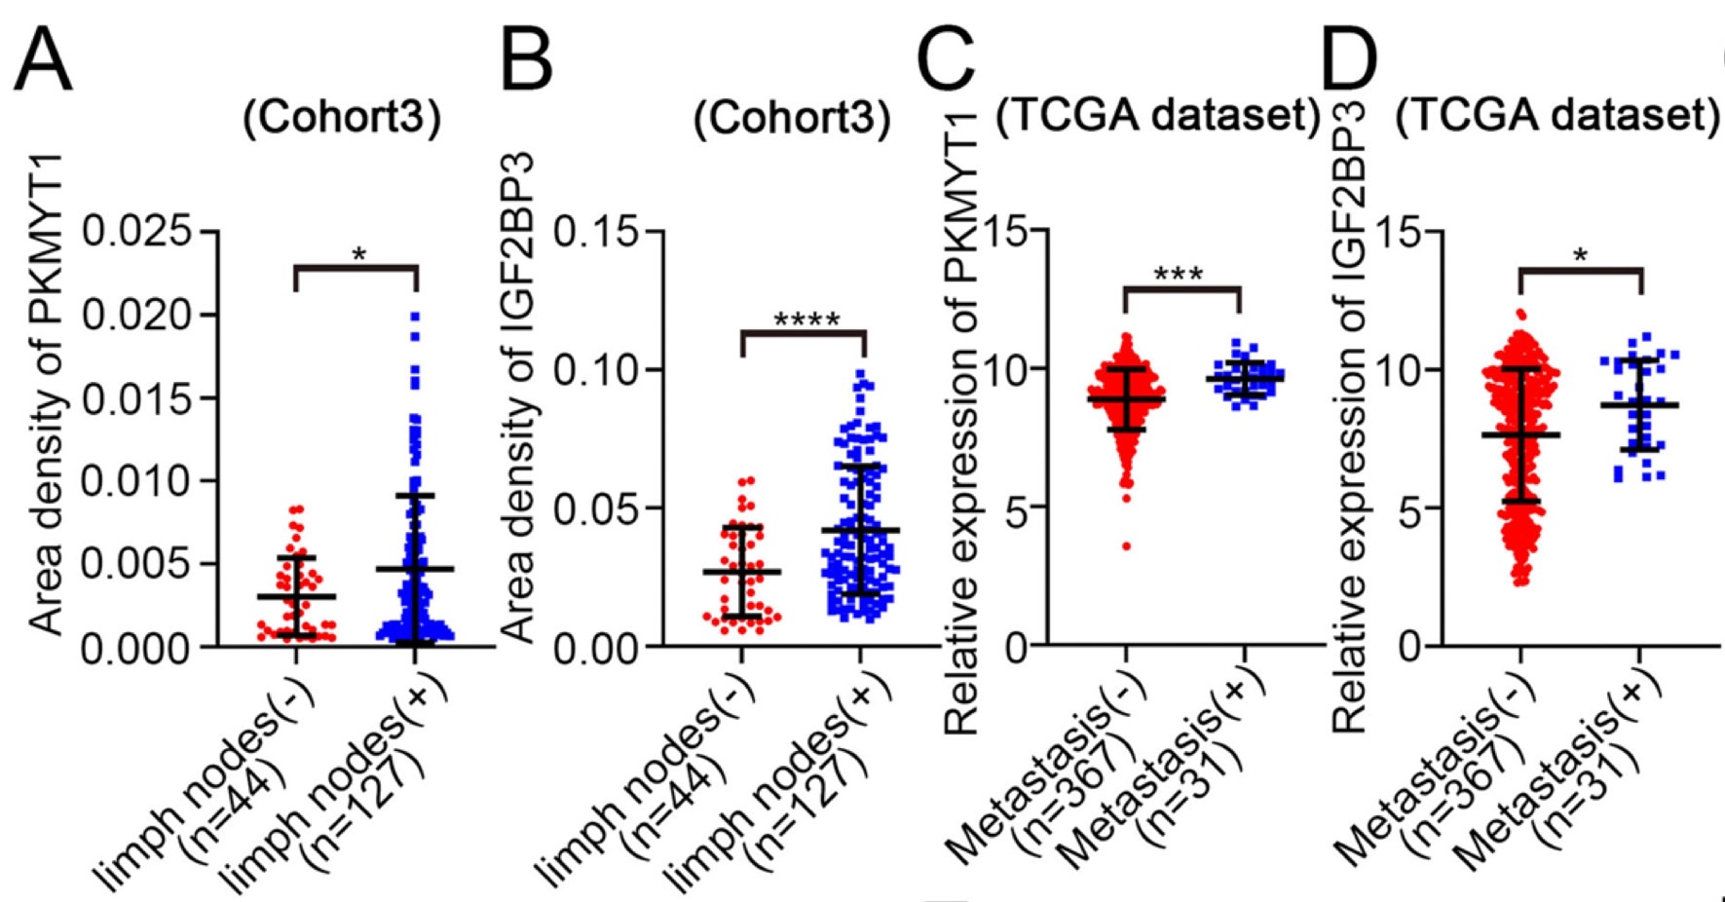
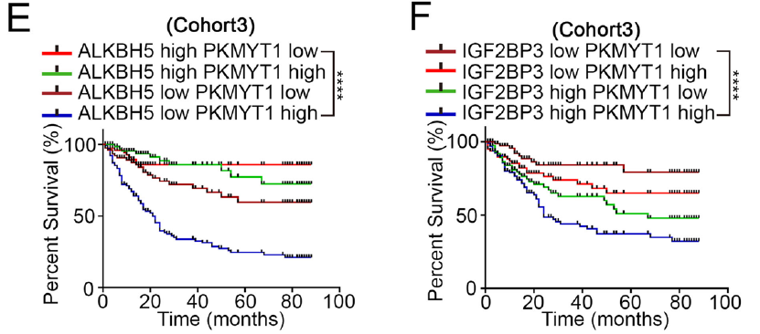
Fig. 6 ALKBH5-PKMYT1-IGF2BP3 axis inhibits invasion and migration in vivo

Slide 32
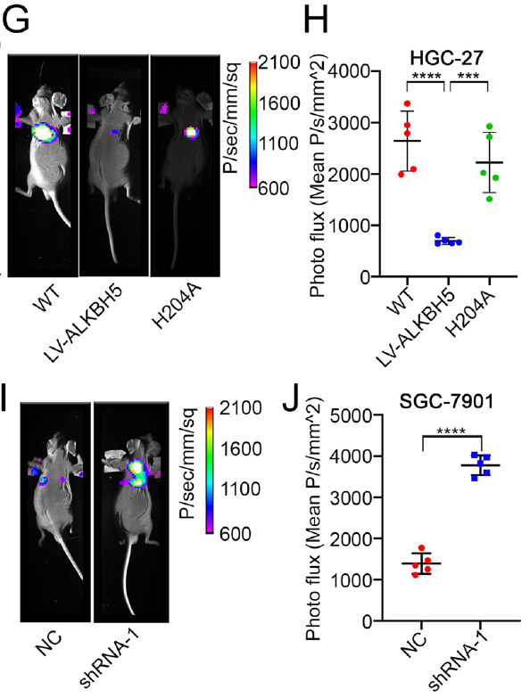
Fig. 6 ALKBH5-PKMYT1-IGF2BP3 axis inhibits invasion and migration in vivo

Slide 33
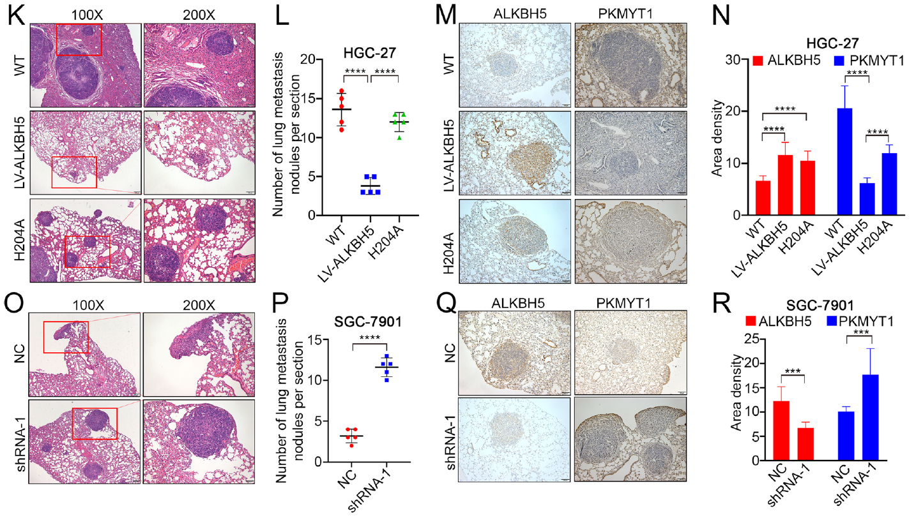
Fig. 6 ALKBH5-PKMYT1-IGF2BP3 axis inhibits invasion and migration in vivo

