Slide 1
CircHIF1A regulated by FUS accelerates triple-negative breast cancer progression by modulating NFIB expression and translocation
Speaker : Yi-Chun Ke
Advisor : Liang-Chuan Lai Ph.D.
Date : 2022.03.14

Slide 2
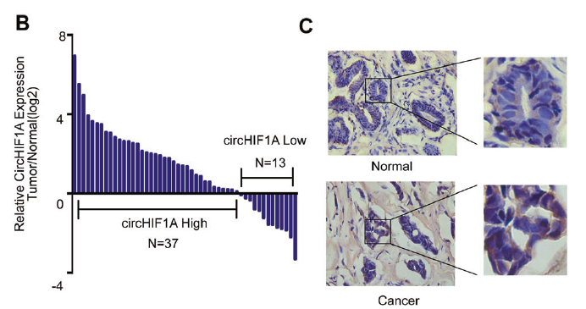
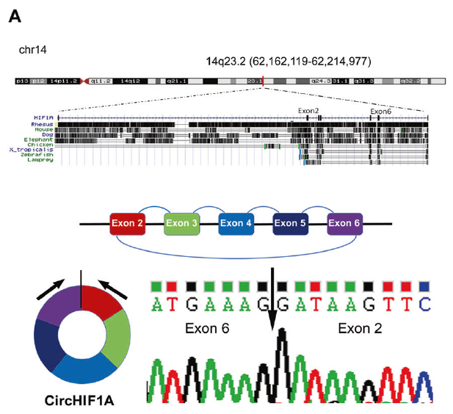
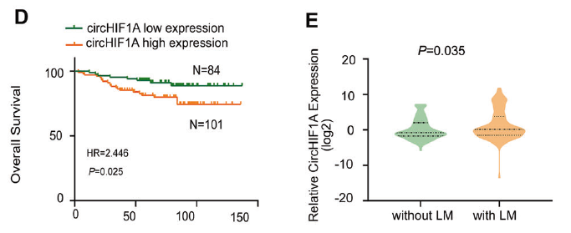
Results
CircHIF1A was upregulated in breast cancer tissues
and associated with metastasis and poor prognosis
Notes:
沒有特別講是怎麼找到這個circRNA
c圖. In situ hybridization

Slide 3
Results
CircHIF1A was upregulated in breast cancer tissues
and associated with metastasis and poor prognosis
Notes:
circHIF-1a表達量跟賀爾蒙receptor呈負相關

Slide 4
Results
CircHIF1A was upregulated in breast cancer tissues
and associated with metastasis and poor prognosis

Slide 5
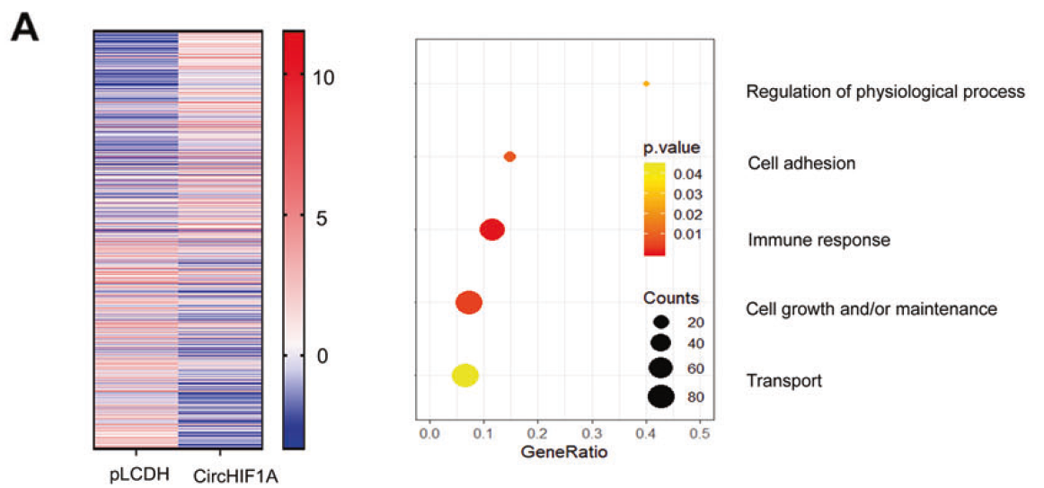
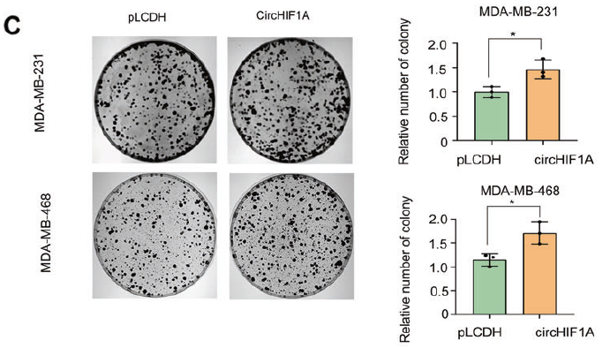
Results
CircHIF1A promoted TNBC progression both in vitro and in vivo
Notes:
A圖. GO analysis :將基因做系統性地注釋

Slide 6
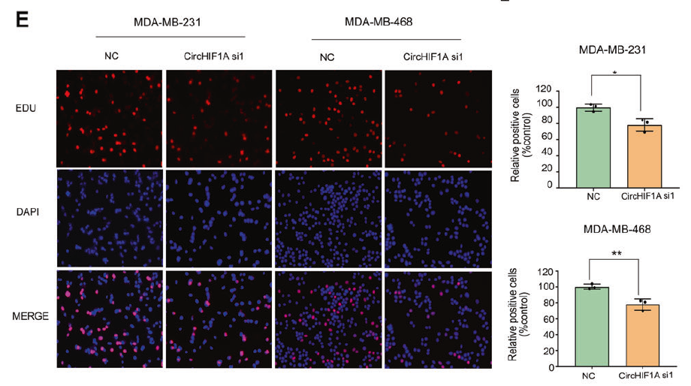
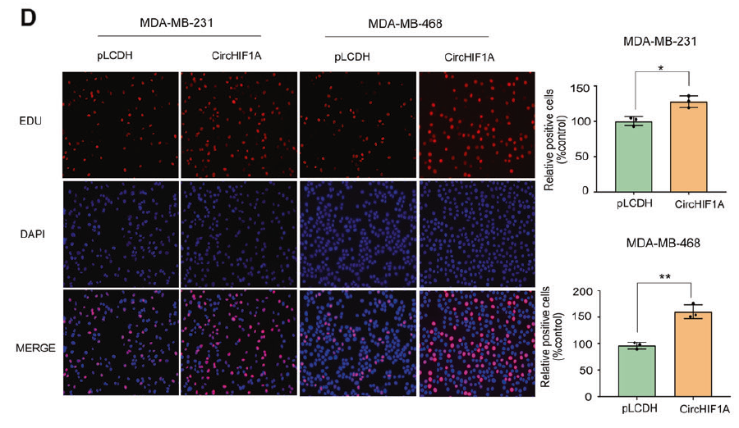
Results
CircHIF1A promoted TNBC progression both in vitro and in vivo

Slide 7
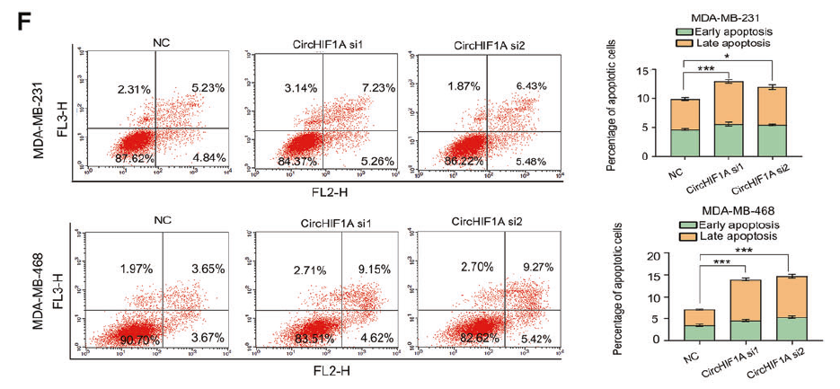
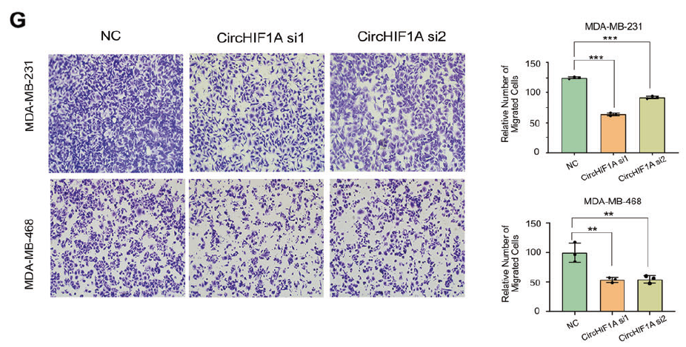
Results
CircHIF1A promoted TNBC progression both in vitro and in vivo

Slide 8
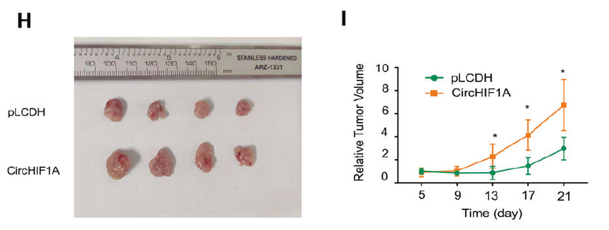
Results
CircHIF1A promoted TNBC progression both in vitro and in vivo

Slide 9
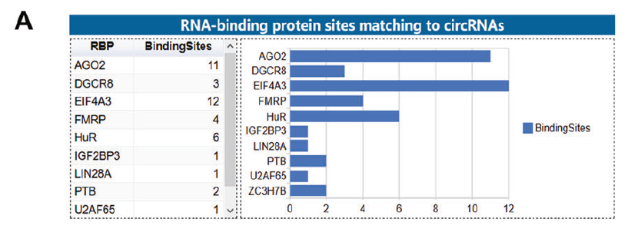
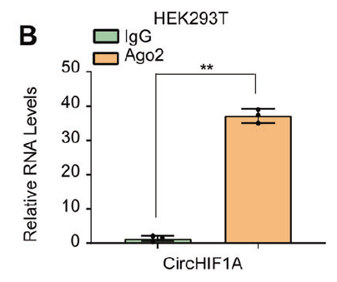
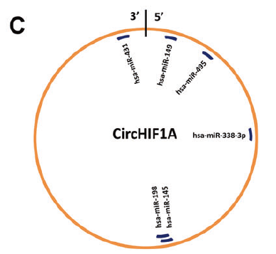
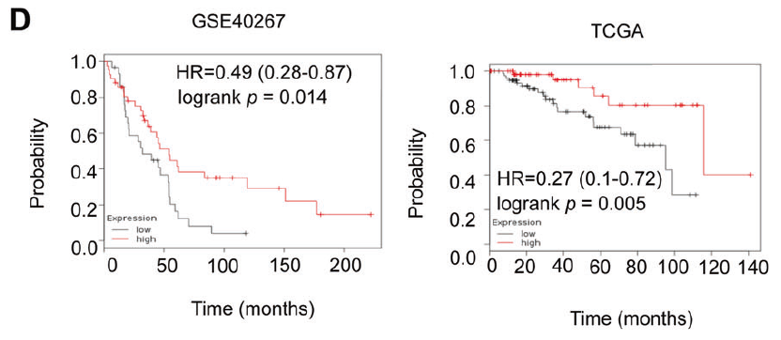
Results
CircHIF1A promoted NFIB expression and nuclear translocation
via post-transcriptional and post-translational modulation

Slide 10
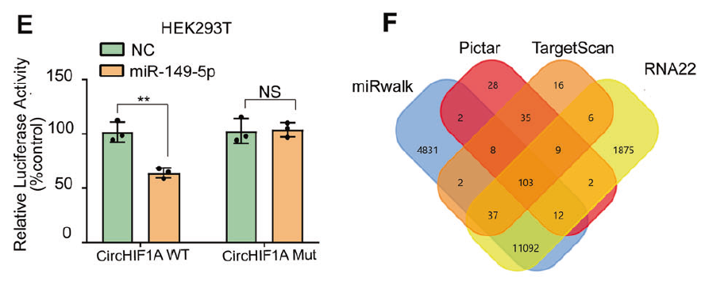
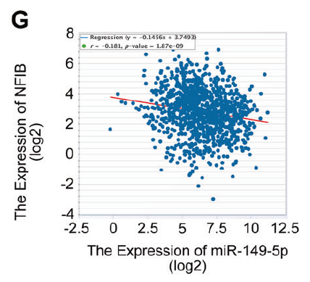
Results
CircHIF1A promoted NFIB expression and nuclear translocation
via post-transcriptional and post-translational modulation

Slide 11
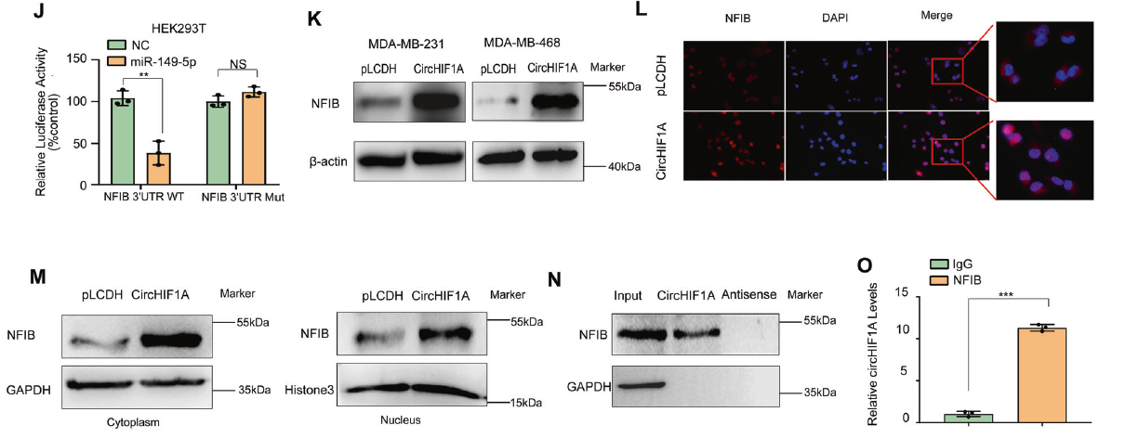
Results
CircHIF1A promoted NFIB expression and nuclear translocation
via post-transcriptional and post-translational modulation
Notes:
NFIB translocation
過去指出circRNA可以跟一些transcription factor binding，去影響這些transcription factor的位置
Antisense : 跟circHIF-1A互補的序列

Slide 12
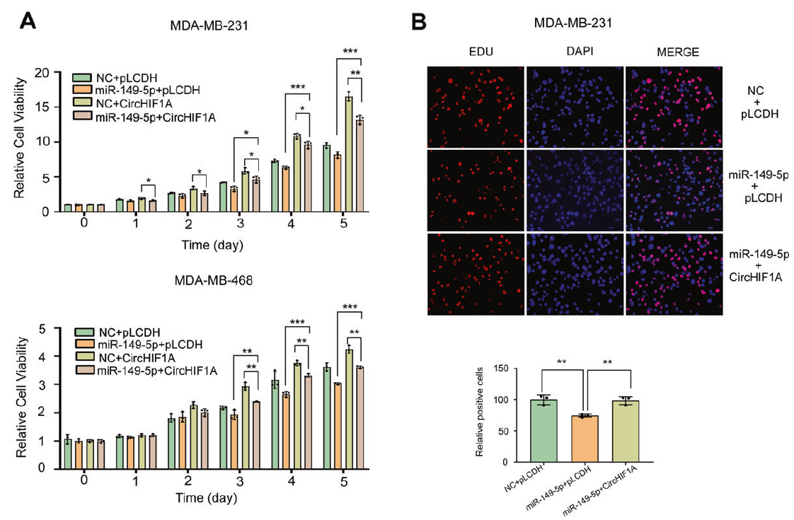
Results
CircHIF1A promoted TNBC progression through modulation
of miR-149-5p and NFIB

Slide 13
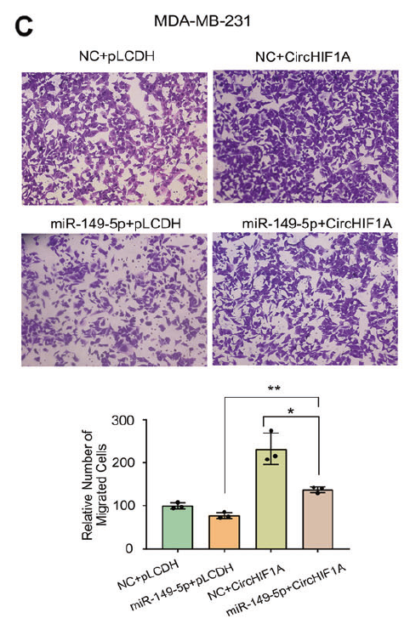
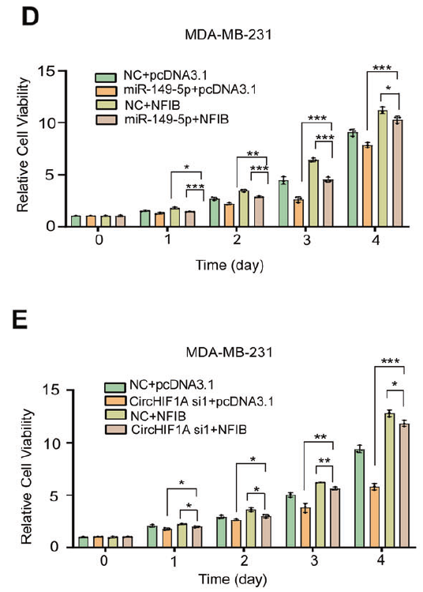
Results
CircHIF1A promoted TNBC progression through modulation
of miR-149-5p and NFIB

Slide 14
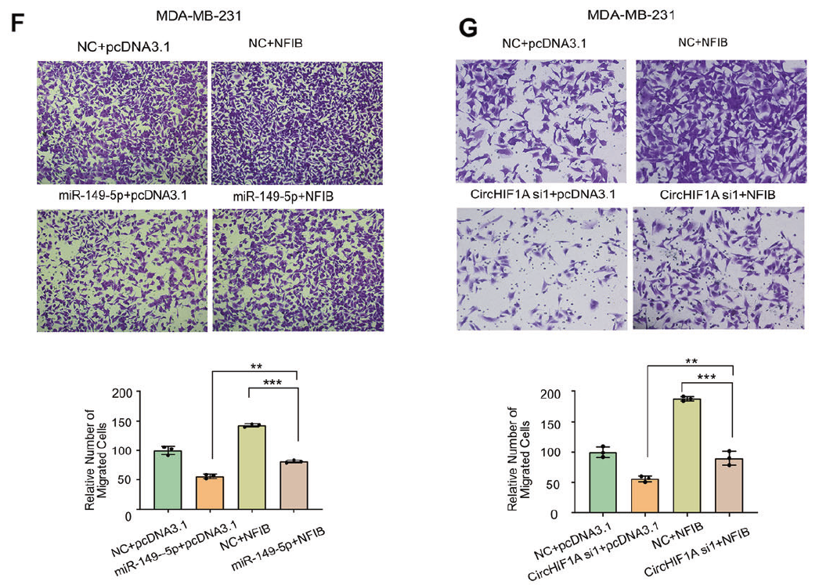
Results
CircHIF1A promoted TNBC progression through modulation
of miR-149-5p and NFIB

Slide 15
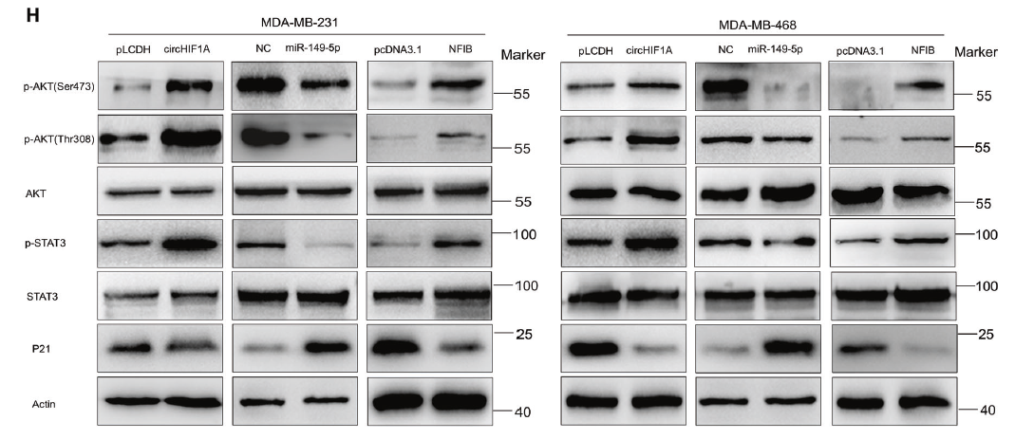
Results
CircHIF1A promoted TNBC progression through modulation
of miR-149-5p and NFIB
circHIF-1A
miR-149-5p
NFIB
Notes:
先前研究指出NFIB可以走AKT/STAT3這條signaling pathway來促進tumor的發展

Slide 16
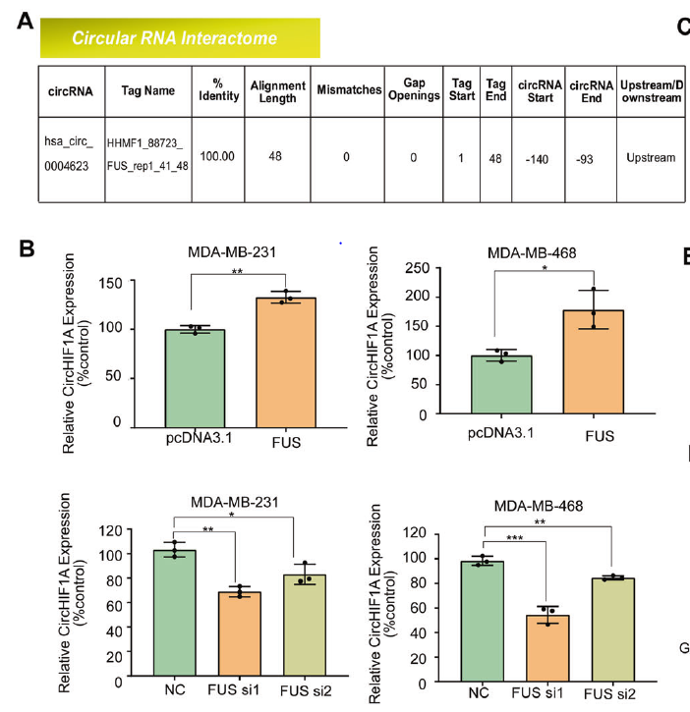
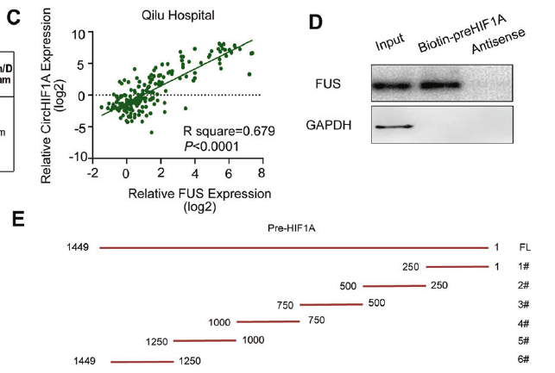
Results
FUS promoted circHIF1A biogenesis and NFIB
enhanced transcription of FUS
v
v

Slide 17
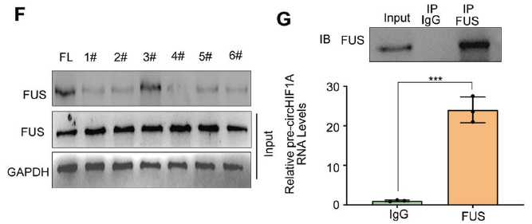
Results
FUS promoted circHIF1A biogenesis and NFIB
enhanced transcription of FUS
Notes:
FL : full length
I圖 : 原本想說是不是NFIB會去影響HIF-1A，進而影響circHIF-1A，但overexpress NFIB之後，發現HIF-1A的表現量並沒有受到影響

Slide 18
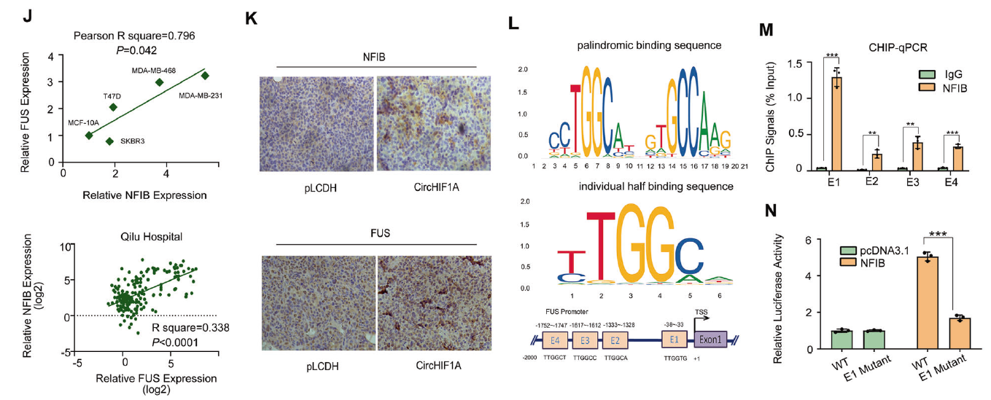
Results
FUS promoted circHIF1A biogenesis and NFIB
enhanced transcription of FUS
FUS
circHIF-1A
miR-149-5p
NFIB
Notes:
Ｊ圖：在不同cell line中或臨床乳癌檢體當中發現FUS和NFIB的表現量呈正比

Slide 19
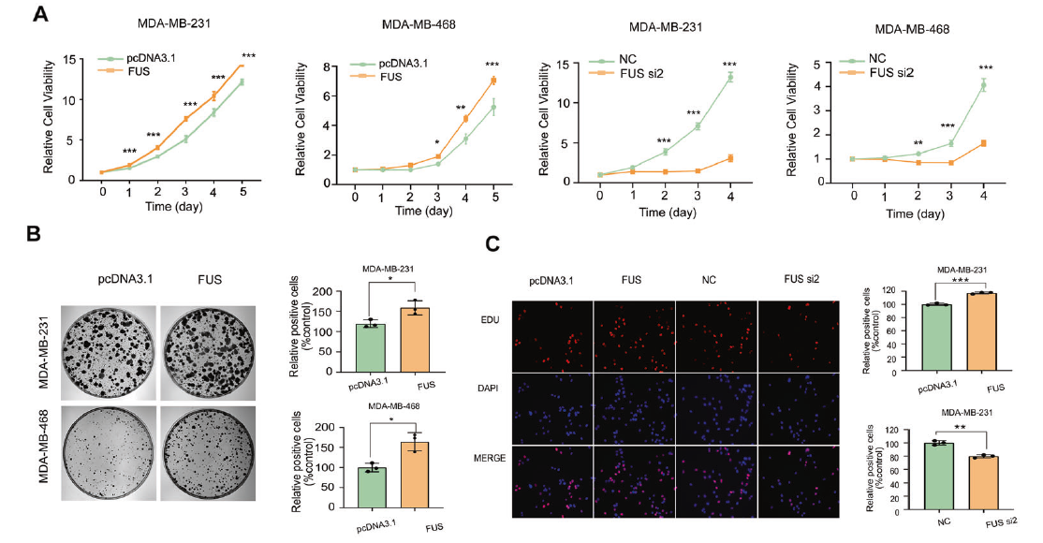
Results
FUS acted as an oncogene in TNBC cells

Slide 20
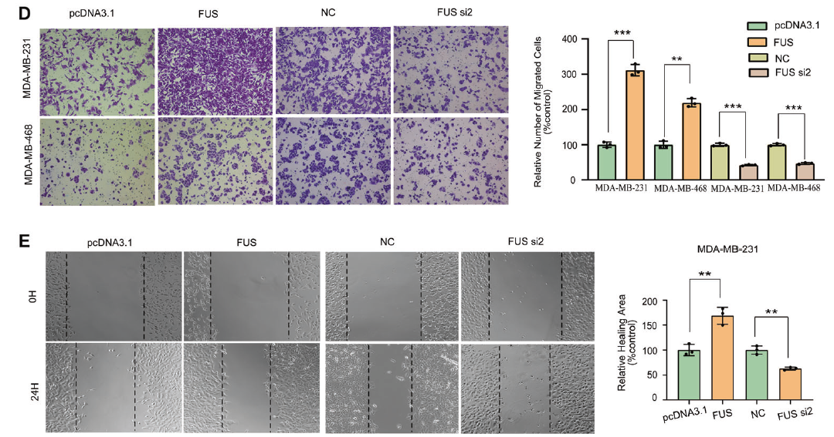
Results
FUS acted as an oncogene in TNBC cells

Slide 21
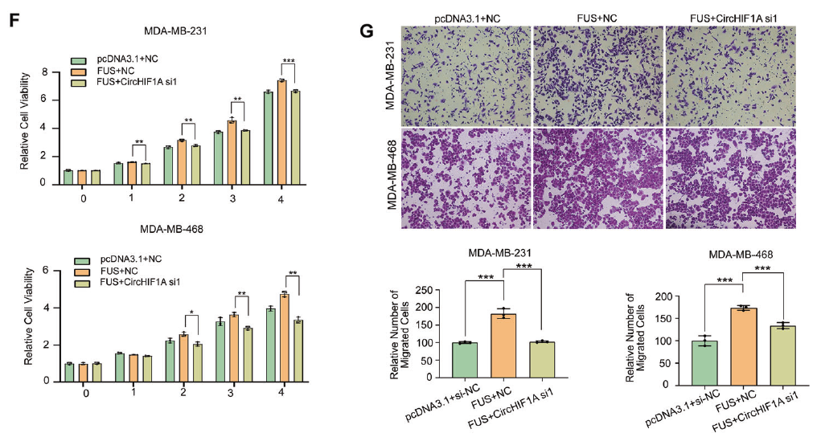
Results
FUS acted as an oncogene in TNBC cells

Slide 22
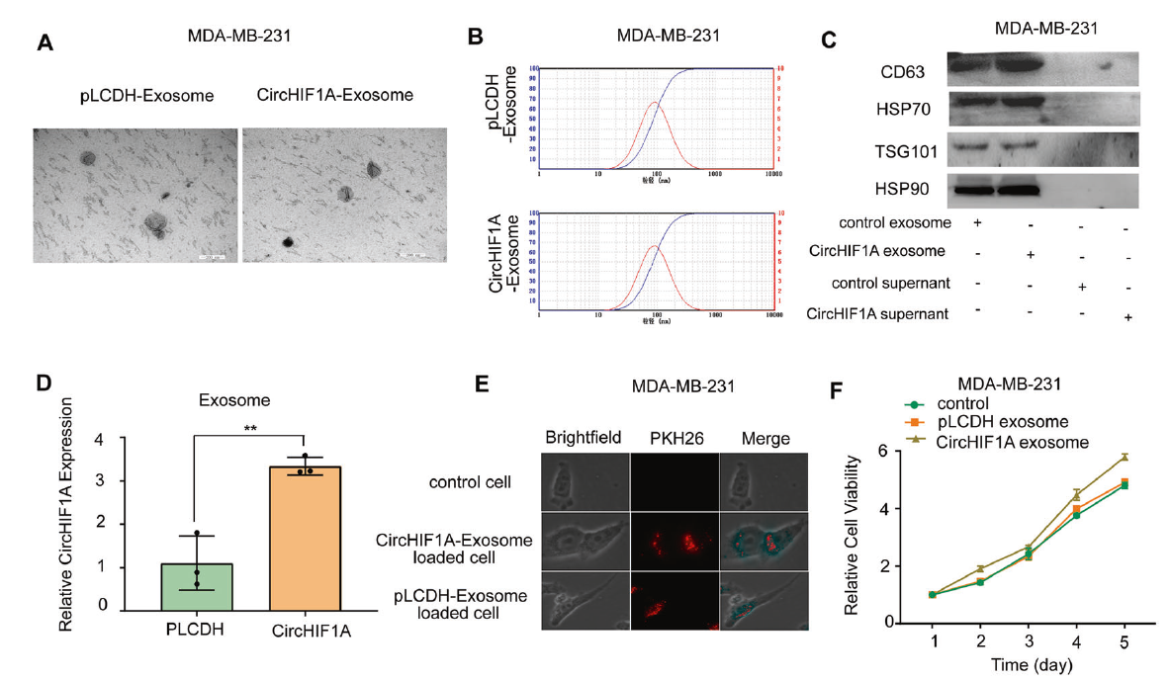
Results
CircHIF1A could be packaged into exosomes and detected in plasma

Slide 23
Results
CircHIF1A could be packaged into exosomes and detected in plasma

Slide 24
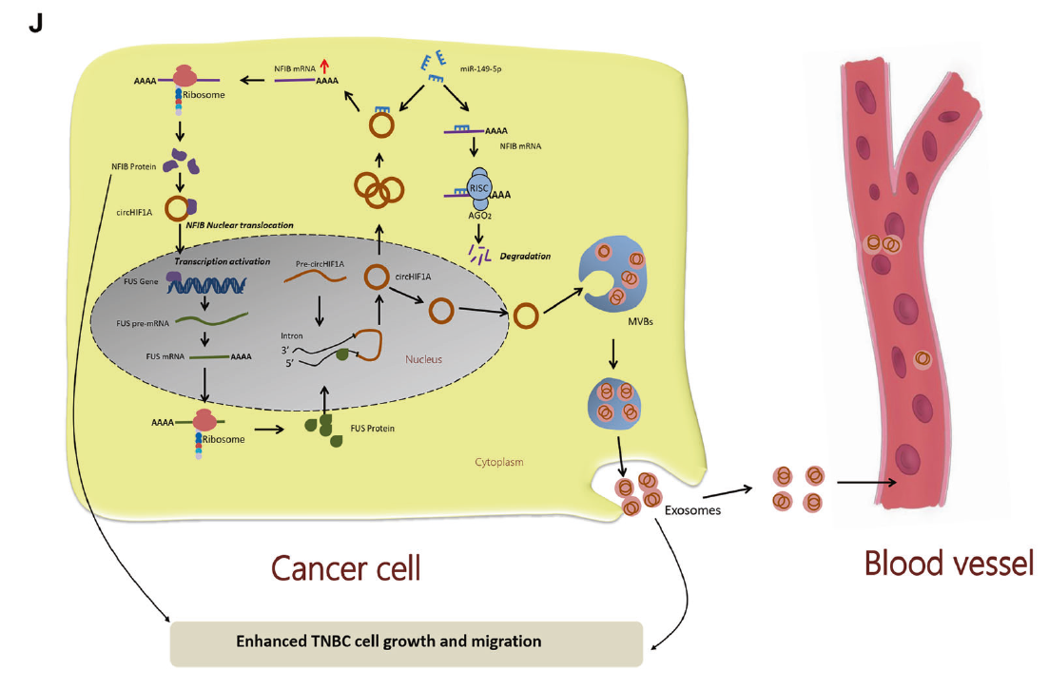
Conclusion

Slide 25
Results

Slide 26
Results

