Slide 1
Speaker: Chia-Ming Liu
Advisor: Liang-Chuan Lai, Ph.D.
Date: Mar 21st, 2022

Slide 2
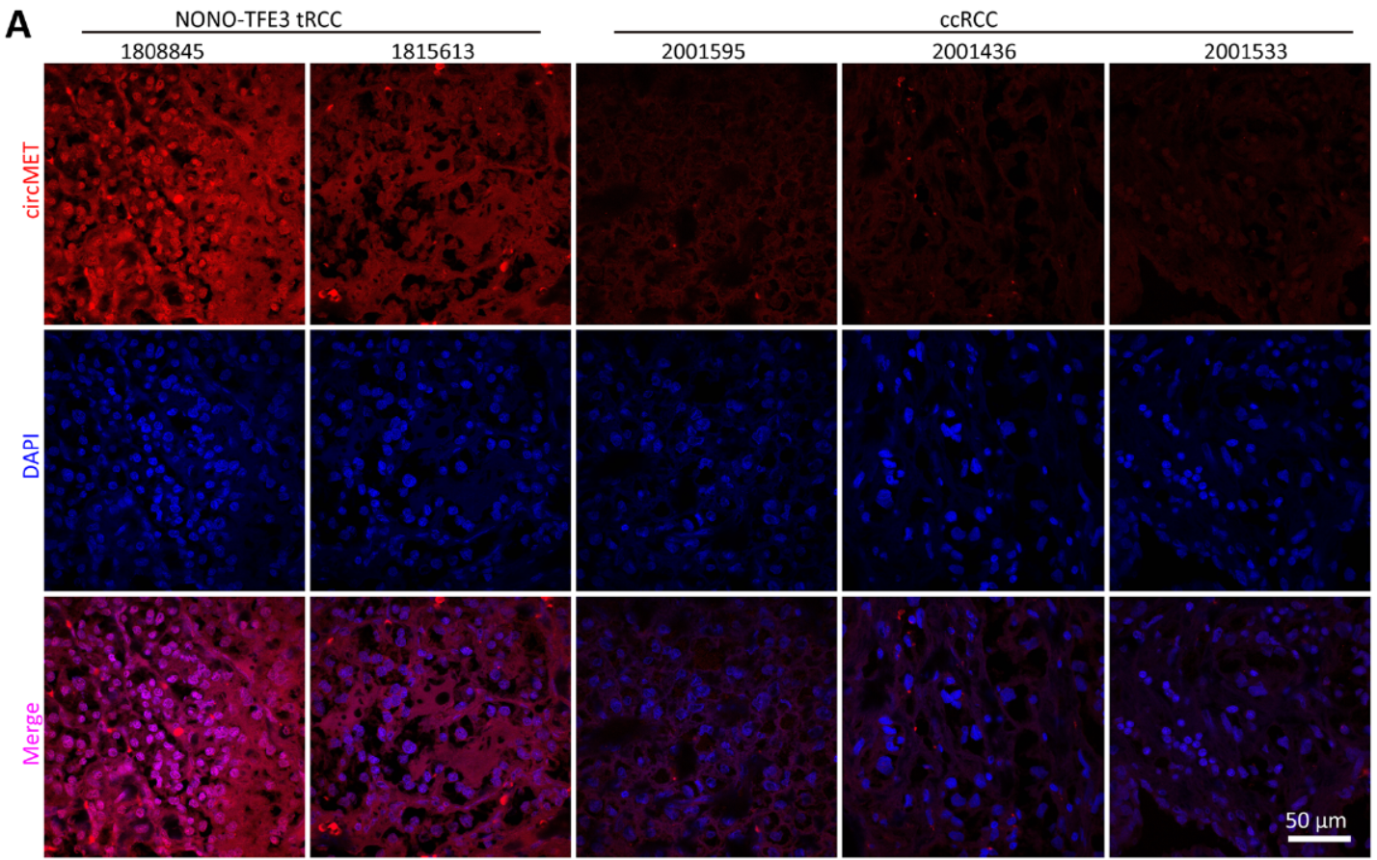
Results
CircMET expression is significantly increased in NONO‑TFE3 tRCC

Slide 3
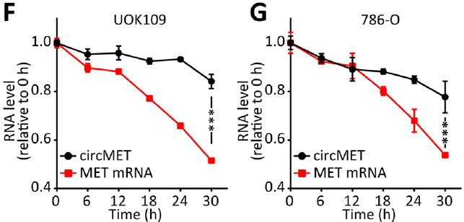
Results
Characterization of CircMET in NONO‑TFE3 tRCC
α-amanitin: an inhibitor of transcription

Slide 4
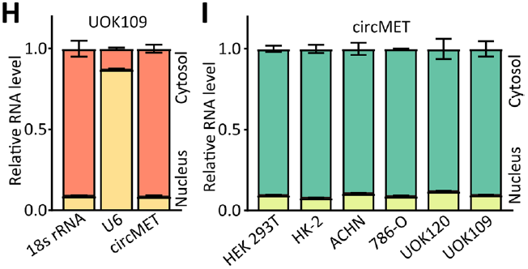
Results
CircMET is predominantly located in the cytosol

Slide 5
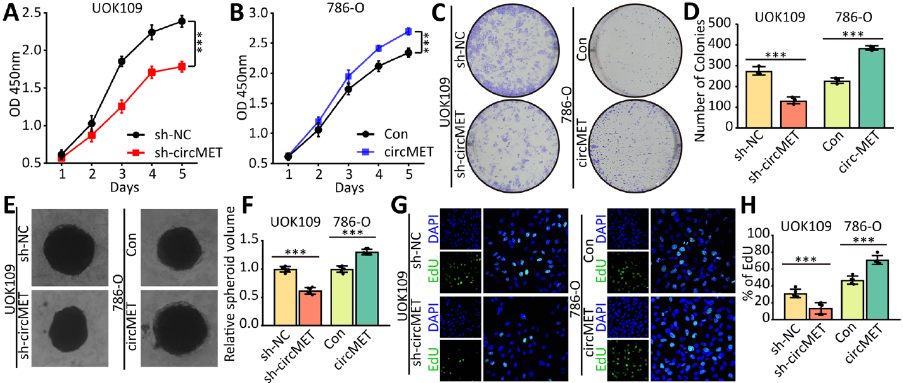
Results
CircMET accelerates proliferation of NONO‑TFE3 tRCC

Slide 6
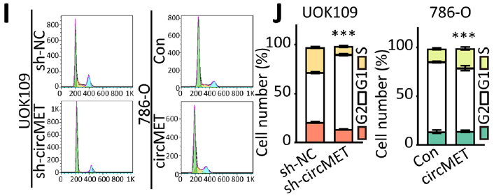
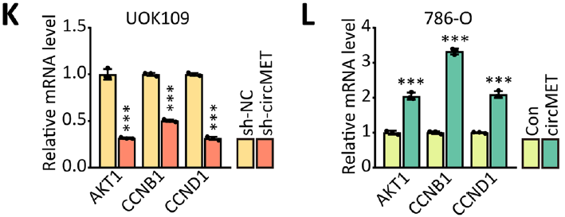
Results
CircMET accelerates proliferation of NONO‑TFE3 tRCC

Slide 7
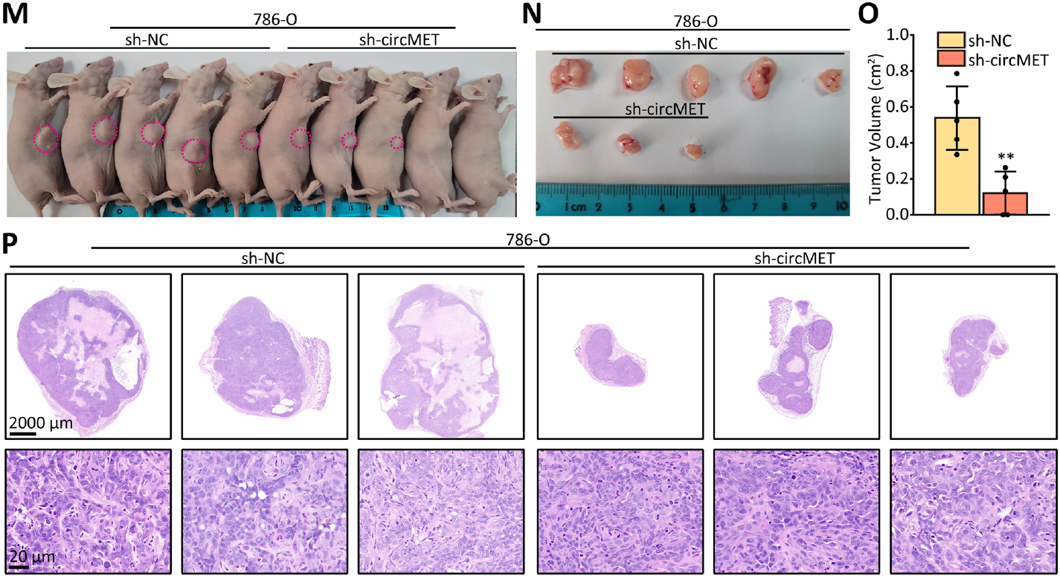
Results
CircMET accelerates proliferation of NONO‑TFE3 tRCC

Slide 8
Summary
NONO‑TFE3
CircMET
Proliferation

Slide 9
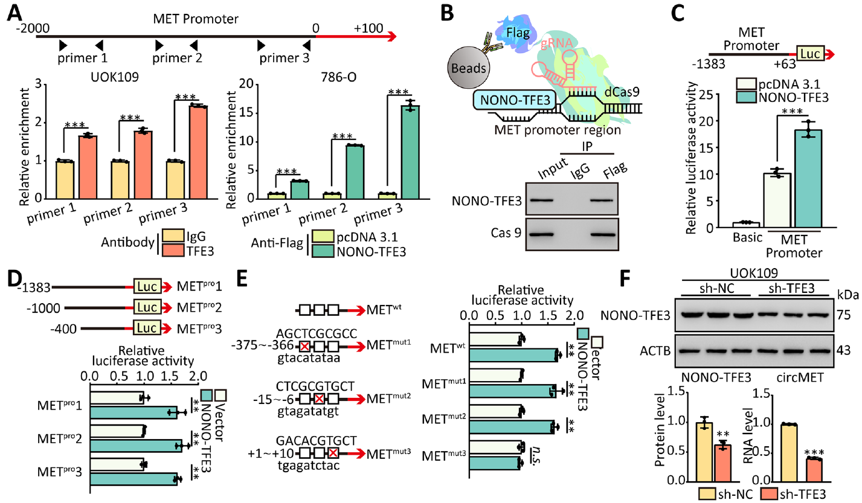
Results
NONO-TFE3 directly interacted with the promoter of MET

Slide 10
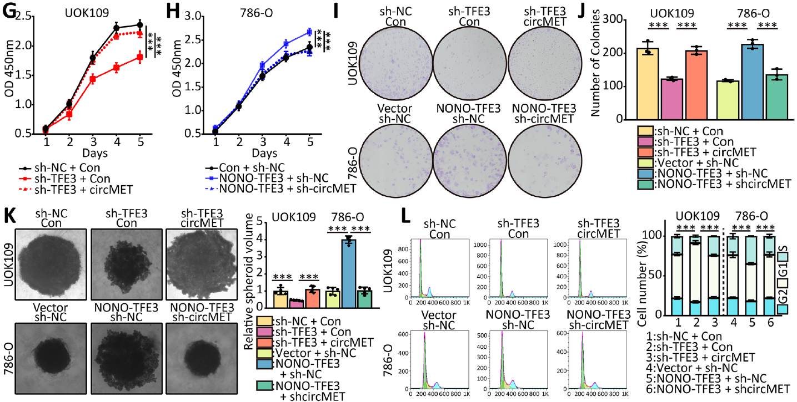
Results
NONO-TFE3 promotes tumor progression by upregulating circMET

Slide 11
Summary
CircMET
NONO‑TFE3
MET
Proliferation
Promotor

Slide 12
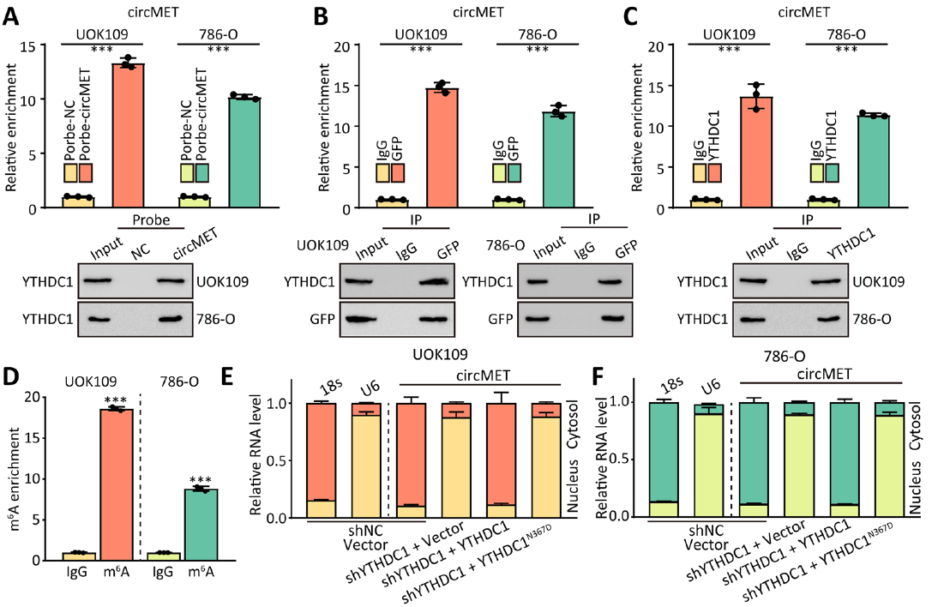
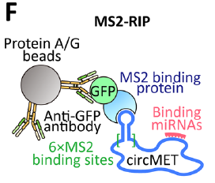
Results
CircMET is exported to cytoplasm by YTHDC1 in m6A‑depend manner

Slide 13
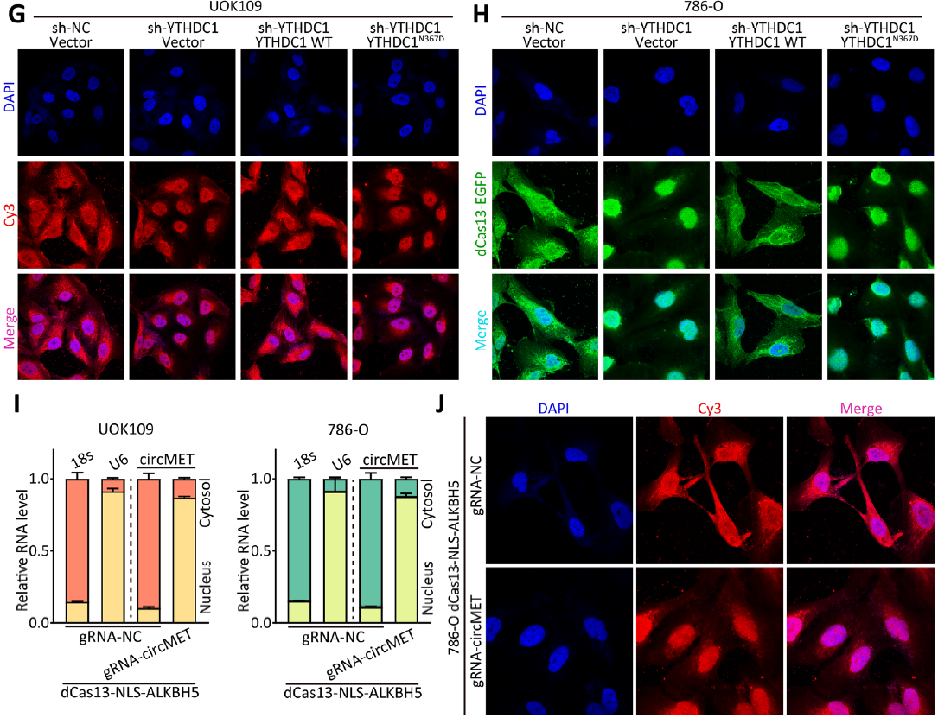
Results
CircMET is exported to cytoplasm by YTHDC1 in m6A‑depend manner

Slide 14
Summary
CircMET
NONO‑TFE3
MET
Proliferation
Promotor
m6A
YTHDC1

Slide 15
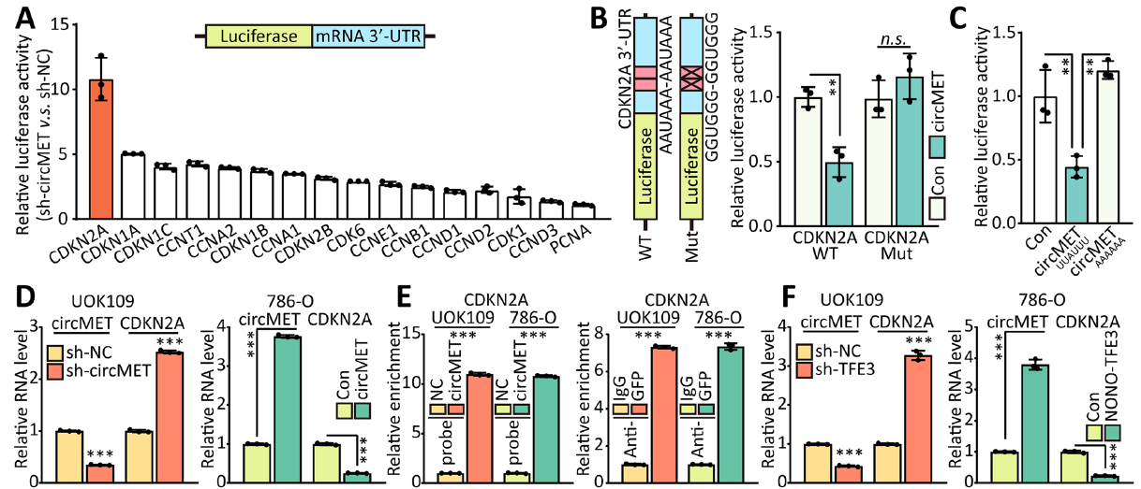
Results
CircMET downregulates CDKN2A mRNA by direct binding
CDNK2A : cyclin-dependent kinase inhibitor 2A, inhibit cell proliferation.

Slide 16
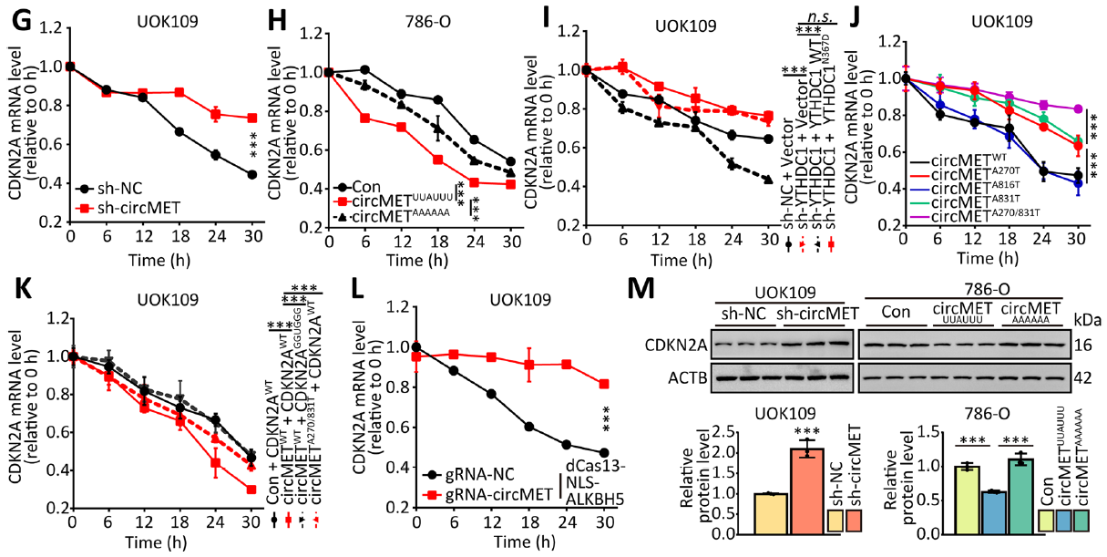
Results
CircMET downregulates CDKN2A mRNA by direct binding

Slide 17
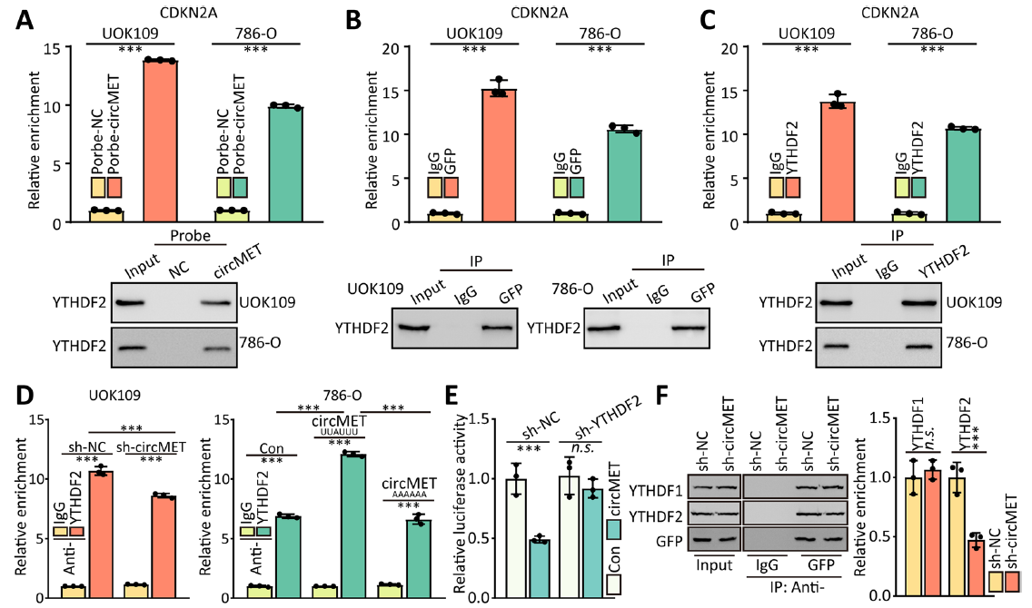
Results
CircMET accelerates the decay of CDKN2A mRNA by recruitment of YTHDF2
CDKN2A

Slide 18
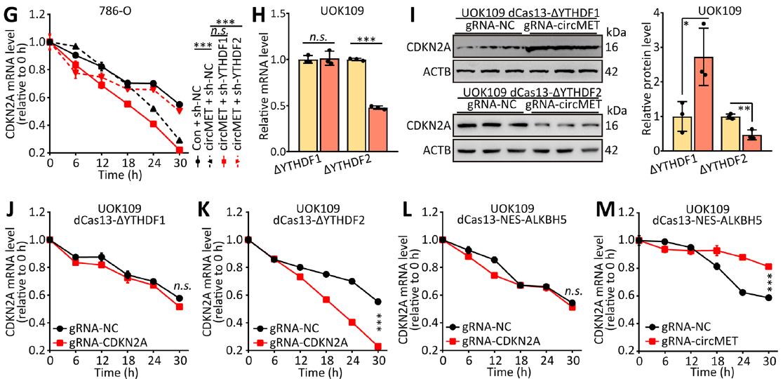
Results
CircMET accelerates the decay of CDKN2A mRNA by recruitment of YTHDF2

Slide 19
Results
Proliferation were inhibited by transfection with ΔYTHDF2 and gRNA-CDKN2A

Slide 20
Summary
YTHDF2
CDKN2A
Proliferation
3’ UTR

Slide 21
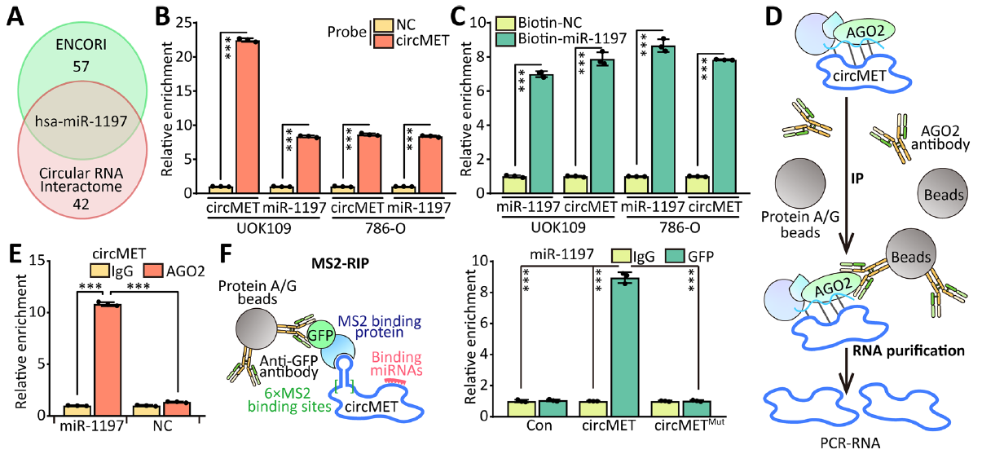
Results
CircMET functions as a ceRNA to sponge miR-1197

Slide 22
Results
CircMET functions as a ceRNA to sponge miR-1197

Slide 23
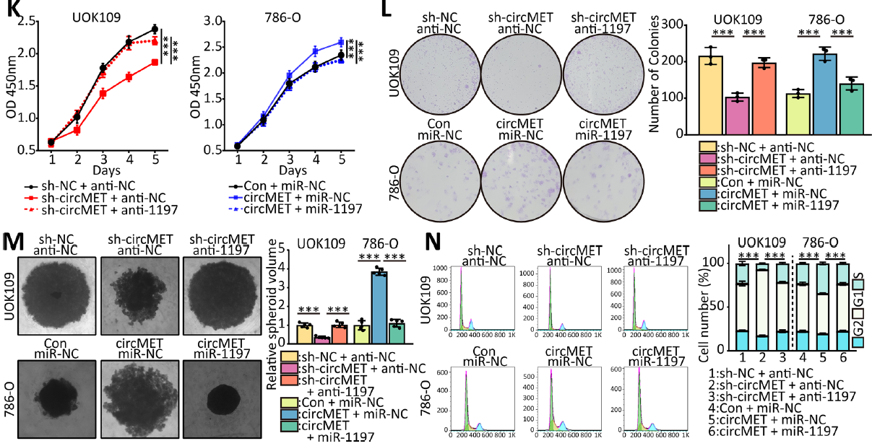
Results
CircMET functions as a ceRNA to sponge miR-1197

Slide 24
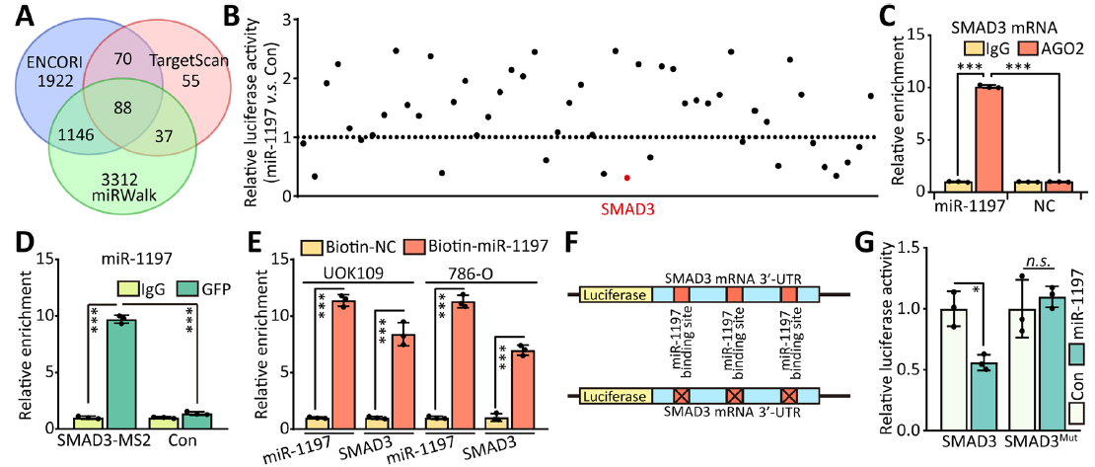
Results
miR-1197 binds to 3’-UTR of SMAD3 mRNA

Slide 25
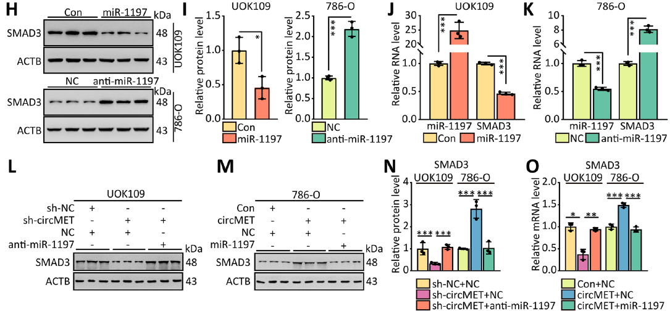
Results
CircMET promotes SMAD3 expression through post‑transcriptional regulation

Slide 26
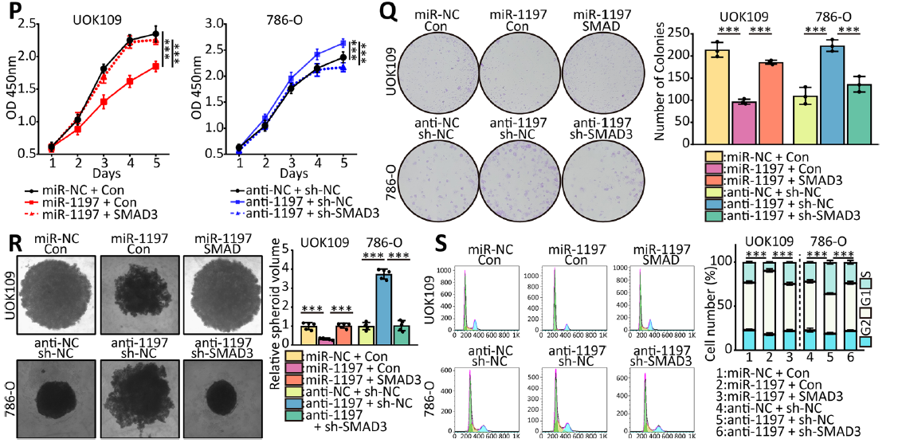
Results
miR-1197 inhibits cell proliferation by downregulated SMAD3

Slide 27
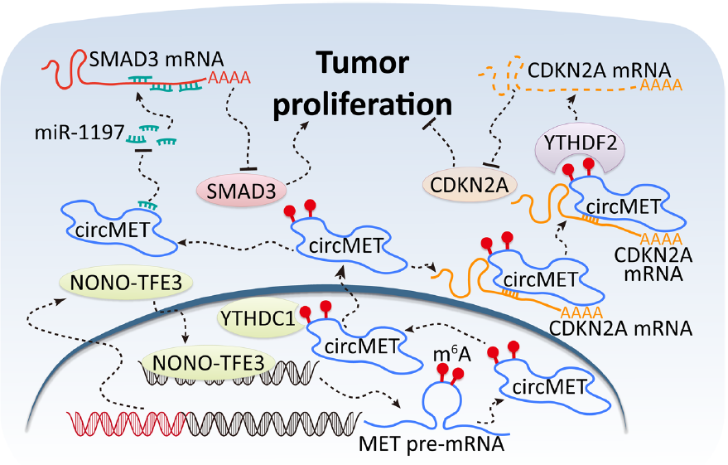
Conclusion

