Slide 1
Tumor-suppressive circRHOBTB3 is
excreted out of cells via exosome to sustain colorectal cancer cell fitness
Speaker : Yi-Chun Ke
Advisor : Liang-Chuan Lai Ph.D.
Date : 2022.03.28

Slide 2
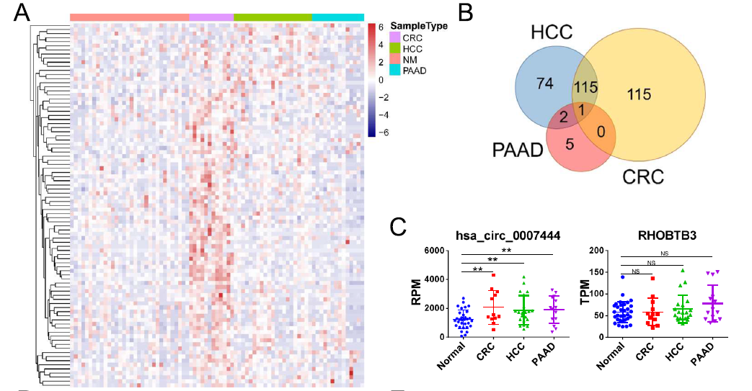
Results
circRHOBTB3 was highly expressed in exosomes
but downregulated in tumor tissues
Notes:
看大腸癌、肝癌、胰臟癌和正常人血清中exosome裡circRNA的表現量
只有circRHOBTB3在三個癌症的exosome裡都上升
reanalyzed the data of 4 GEO datasets，including total RNA-seq data of serum exosomes from 12 CRC patients, 21 HCC patients, 32 pancreatic adenocarcinoma(PAAD) patients, and 14 healthy donors, in the same sequencing platform (Fig. S1A). The results showed that a number of circRNAs were differentially expressed in tumor patient serum exosomes . However, only the circular RNA hsa_circ_0007444 was upregulated in all three types of cancer-derived exosomes

Slide 3
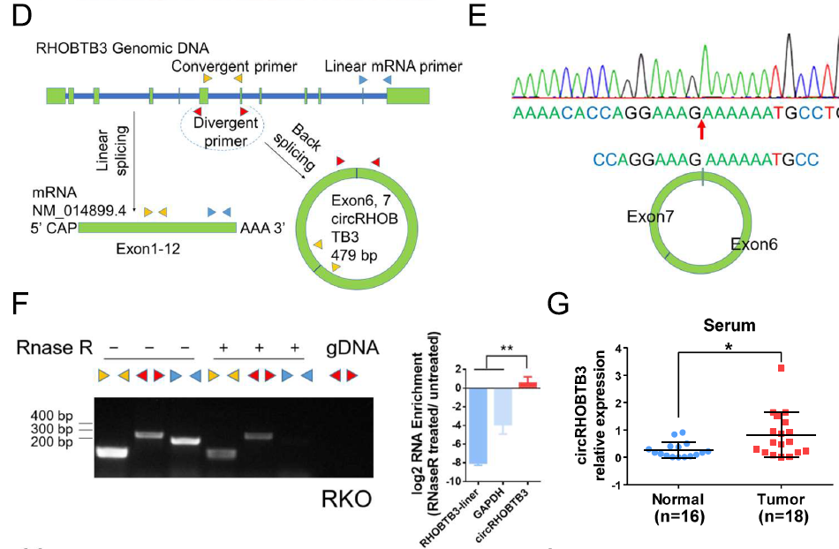
Results
circRHOBTB3 was highly expressed in exosomes
but downregulated in tumor tissues

Slide 4
Results
circRHOBTB3 was highly expressed in exosomes
but downregulated in tumor tissues
Notes:
Unexpectedly, circRHOBTB3 was significantly downregulated in CRC tissues, while the host gene RHOBTB3 was significantly upregulated. Furthermore, we detected the expression of
circRHOBTB3 in a cohort of 69 CRC tissue samples, which showed that patients with a higher level of circRHOBTB3 displayed better overall survival.

Slide 5
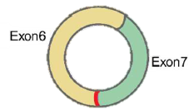
Summary
nucleus
circRHOBTB3
CRC cell
exosomes

Slide 6
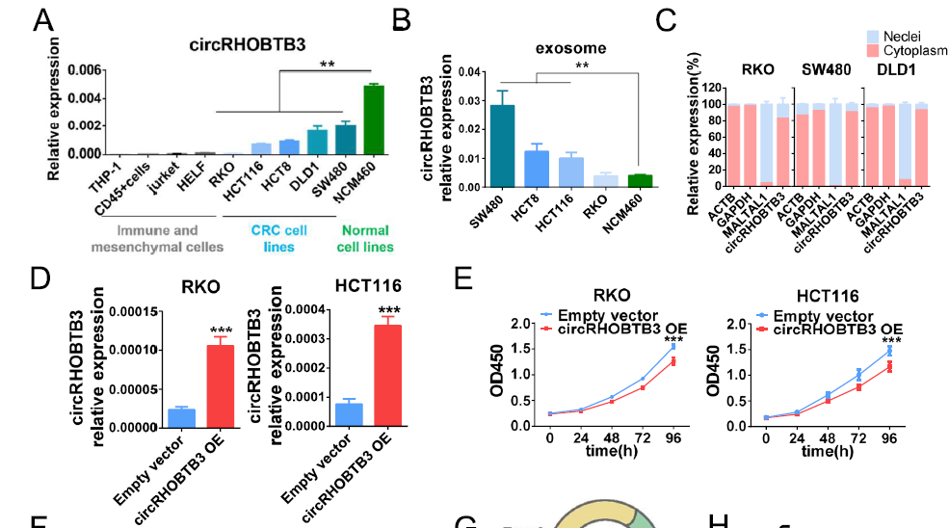
Results
circRHOBTB3 was secreted outside of tumor cells and suppressed CRC cells in vitro and in vivo
Notes:
Exosome來自tumor cell 而不是stromal cell

Slide 7
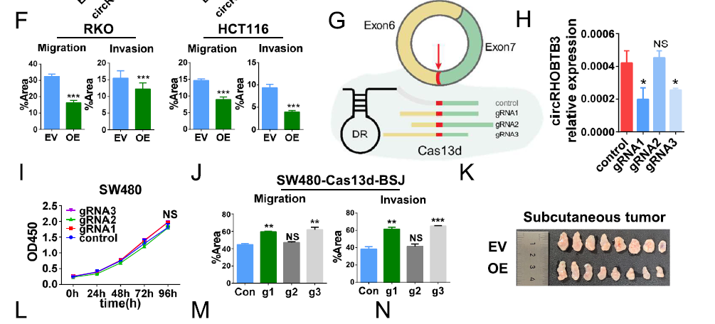
Results
circRHOBTB3 was secreted outside of tumor cells and suppressed CRC cells in vitro and in vivo

Slide 8
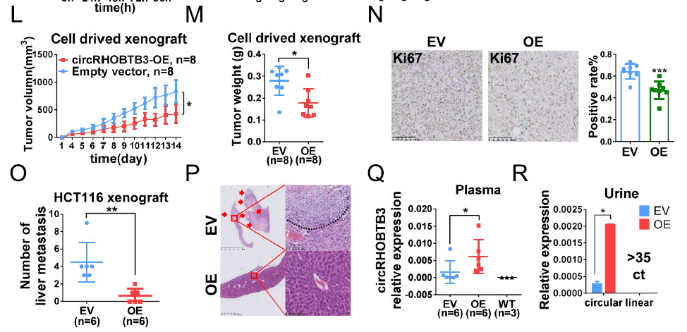
Results
circRHOBTB3 was secreted outside of tumor cells and suppressed CRC cells in vitro and in vivo

Slide 9
Summary
proliferation
CRC cell
metastasis
invasion
circRHOBTB3

Slide 10
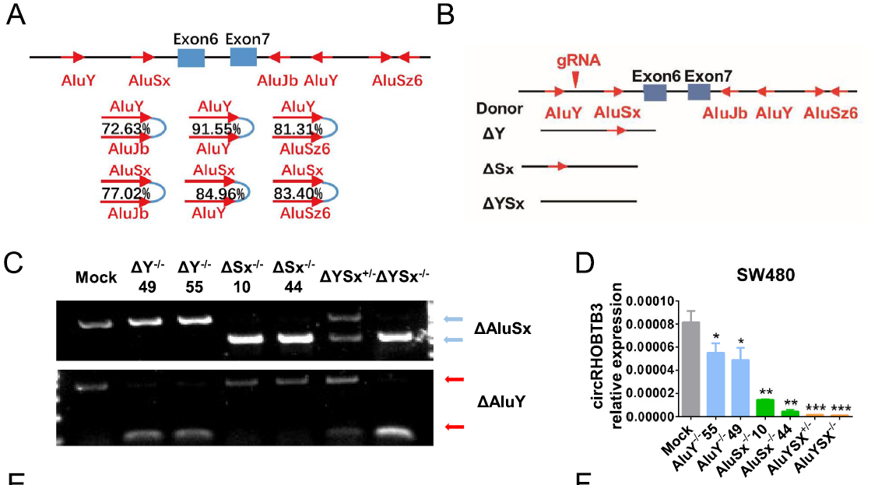
Results
The biogenesis of circRHOBTB3 was regulated by a cis-element on its own sequence

Slide 11
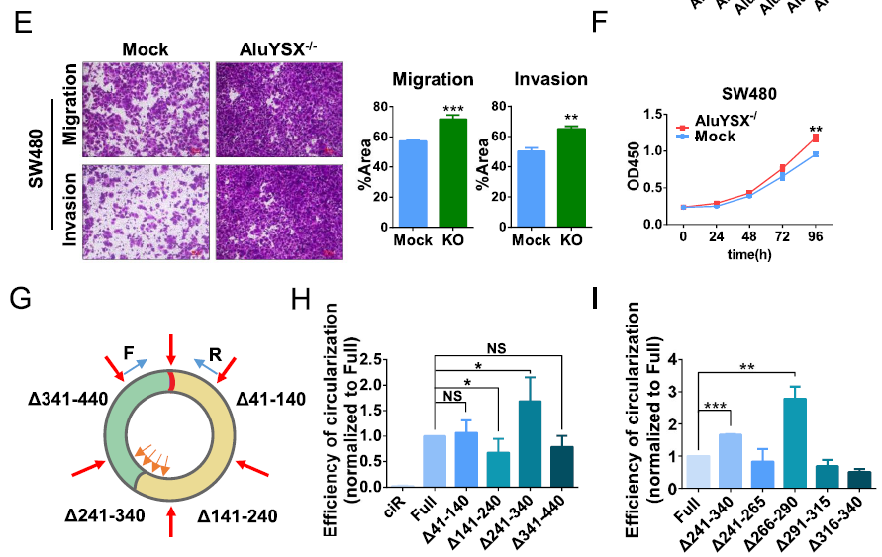
Results
The biogenesis of circRHOBTB3 was regulated by a cis-element on its own sequence
Notes:
141~240 促進
241~340 抑制

Slide 12
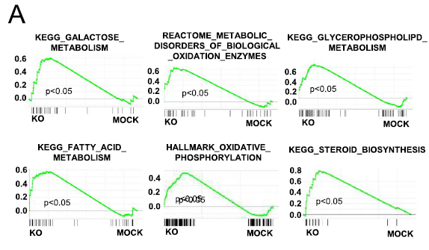
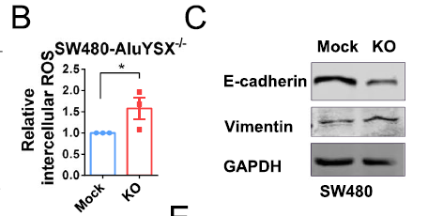
Results
circRHOBTB3 inhibited EMT by binding to metabolism-related proteins to regulate ROS
Notes:
circRHOBTB3 KO 之後做RNA-seq，然後做GSEA 發現跟代謝相關的基因呈正相關
先前研究指出代謝異常會累積體內ROS和促進EMT

Slide 13
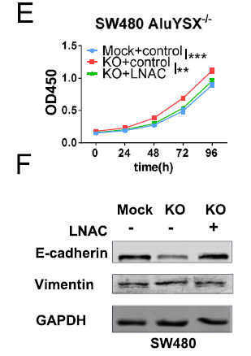
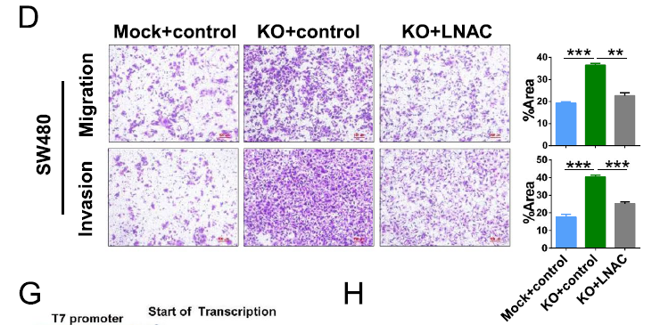
Results
circRHOBTB3 inhibited EMT by binding to metabolism-related proteins to regulate ROS
LNAC: ROS scavenger N-acetyl-L-cysteine
Notes:
LNAC: ROS scavenger N-acetyl-L-cysteine

Slide 14
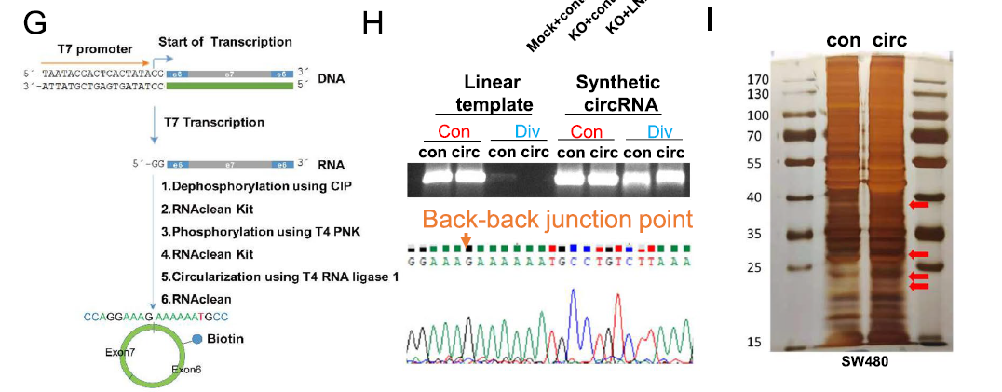
Results
circRHOBTB3 inhibited EMT by binding to metabolism-related proteins to regulate ROS
Notes:
人工合成biotin-label的circRHOBTB3，跑電泳和定序確認做出來真的是這個circRHOBTB3
RNA pull-down 打MS看與circRHOBTB3結合的protein

Slide 15
Results
circRHOBTB3 inhibited EMT by binding to metabolism-related proteins to regulate ROS
Notes:
Metabolism、RNA processing/transport、adhesion
K圖 : ClueGO analysis

Slide 16
Summary
proliferation
ROS level
CRC cell
metastasis
invasion
circRHOBTB3

Slide 17
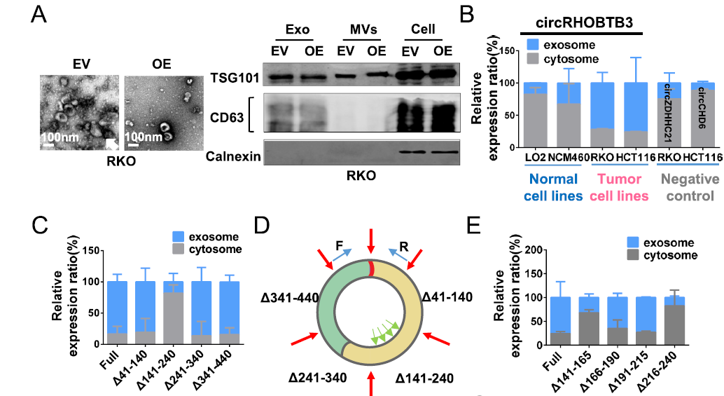
Results
circRHOBTB3 was sorted into exosomes according to its specific motif sequence
Notes:
Calnexin : negative control，內質網的biomarker
circZDHHC21、circCHD6是oncogene，在exosome裡很少
表示腫瘤細胞可以通過exosome分泌不利於癌細胞生長的circRNA。

Slide 18
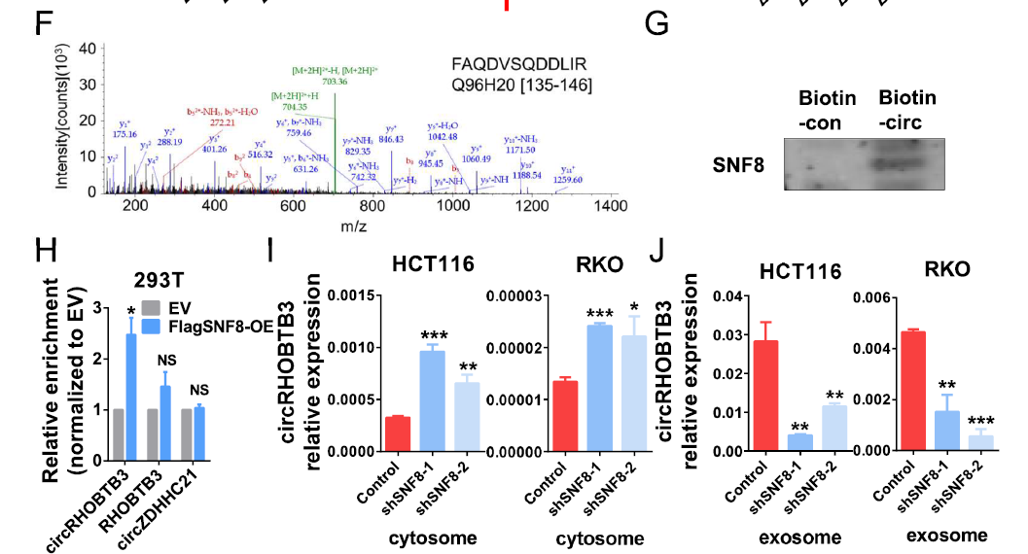
Results
circRHOBTB3 was sorted into exosomes according to its specific motif sequence
Notes:
endosomal sorting complexes required for transport (ESCRT)

Slide 19
Results
circRHOBTB3 was sorted into exosomes according to its specific motif sequence

Slide 20
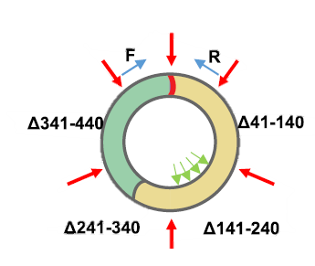
Summary
nucleus
SNF8
circRHOBTB3
MVB
CRC cell
exosome
(Multivesicular Body)

Slide 21
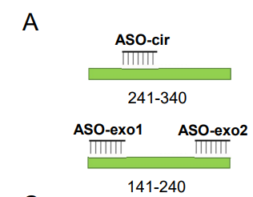
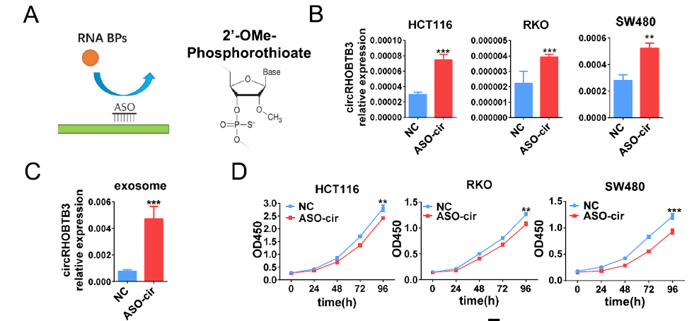
Results
ASO inhibited CRC cell proliferation, migration and invasion in vitro by controlling circRHOBTB3 circularization and secretion
Notes:
ASO-cir 促進環化
ASO-exo 減少exosome的分泌

Slide 22
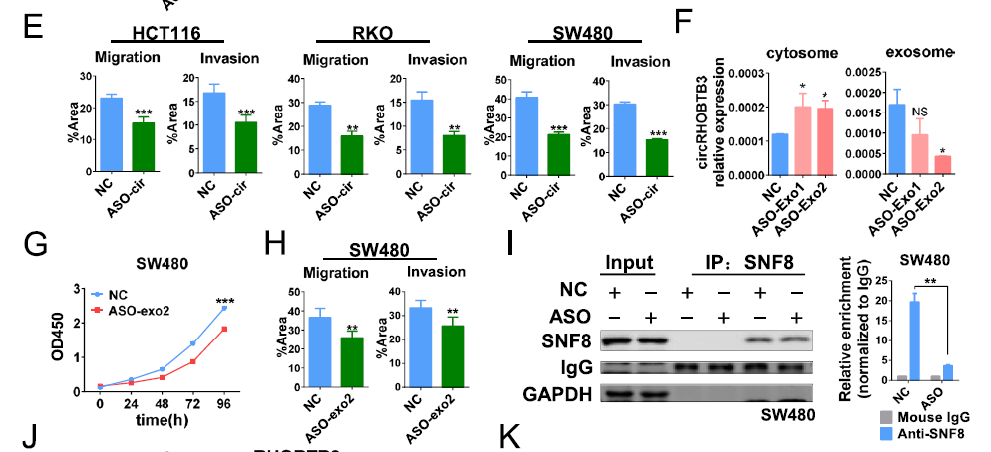
Results
ASO inhibited CRC cell proliferation, migration and invasion in vitro by controlling circRHOBTB3 circularization and secretion

Slide 23
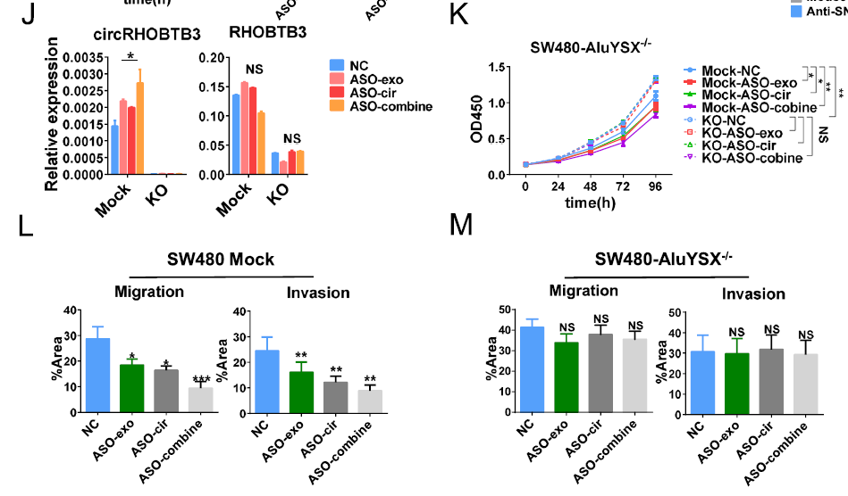
Results
ASO inhibited CRC cell proliferation, migration and invasion in vitro by controlling circRHOBTB3 circularization and secretion

Slide 24
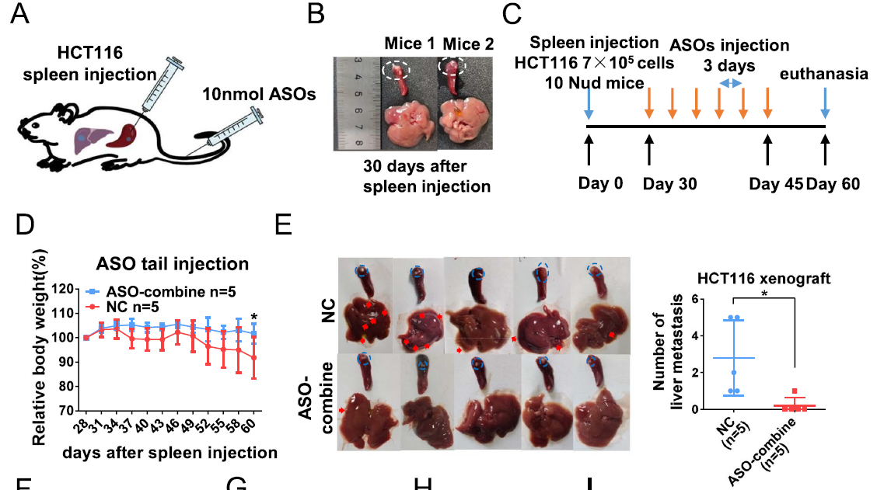
Results
ASO inhibited CRC cell growth and metastasis in vivo

Slide 25
Results
ASO inhibited CRC cell growth and metastasis in vivo

Slide 26
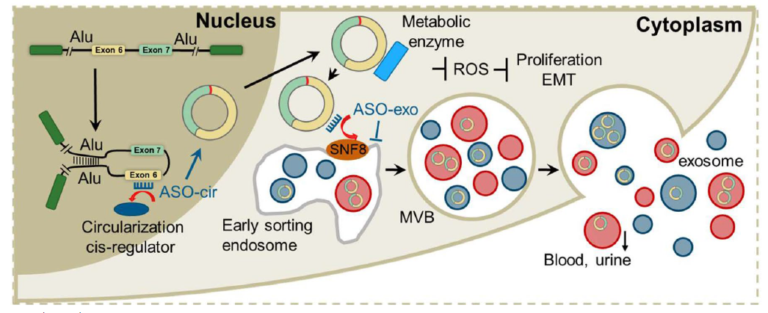
Conclusion
(multivesicular body)

Slide 27
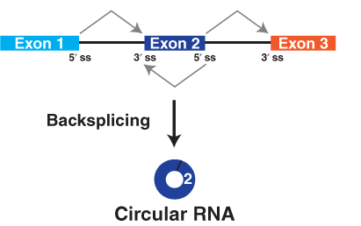
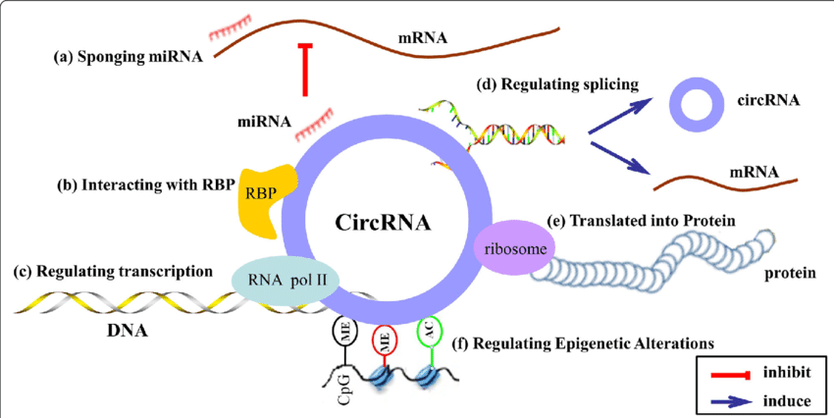
Introduction
Circular RNA (CircRNA)
(Su, Min & Xiao, et al. Molecular Cancer. (2019))

Slide 28
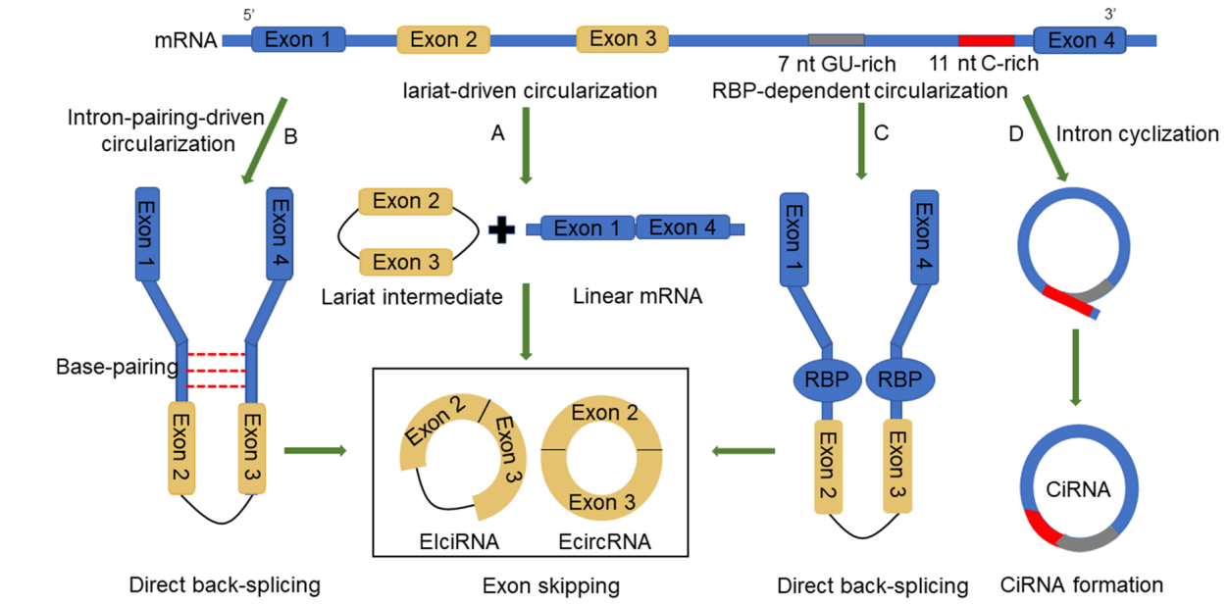
Introduction
CircRNA circularization
(Yang et al. Cancer Cell Int (2020) 20:265.)

Slide 29
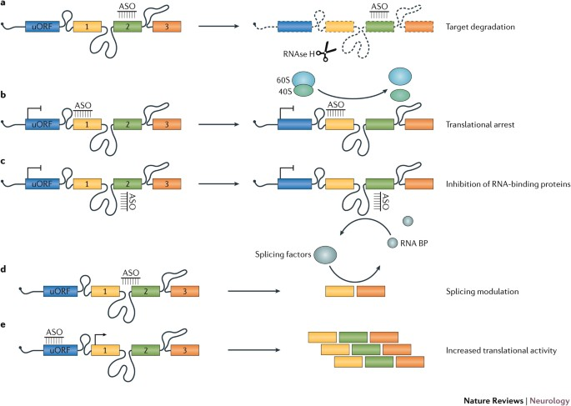
Introduction
Antisense oligonucleotides (ASOs)
(Rinaldi, C., Wood, M. Nat Rev Neurol 14, 9–21 (2018))

Slide 30
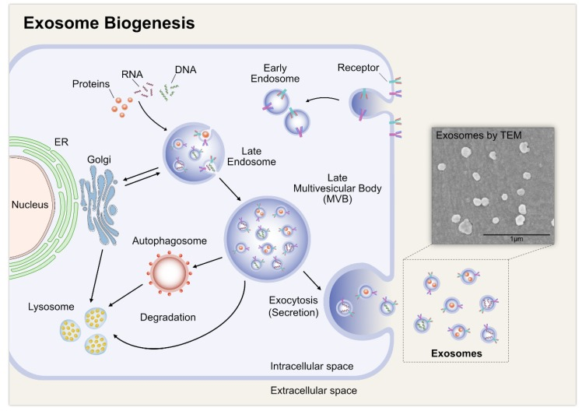
Introduction
Exosome
(Rinaldi, C., Wood, M. Nat Rev Neurol 14, 9–21 (2018))

