Slide 1
2022
Extracurricular
Speaker: Ming-Hsuan Hsu

Slide 2
Contents
01. Self-Exploration
03. Database
CSCD 2.0
ExoRBase 2.0
GEPIA 2, UALCAN, DISSECT
Adopt a vision
LncRNAfunc
LncACTdb3.0
CircNet
02. Research Tool
Knowledge Graph
Connected Papers
Read This Paper
04. Data visualization
Hiplot

Slide 3
01
Self-Exploration

Slide 4
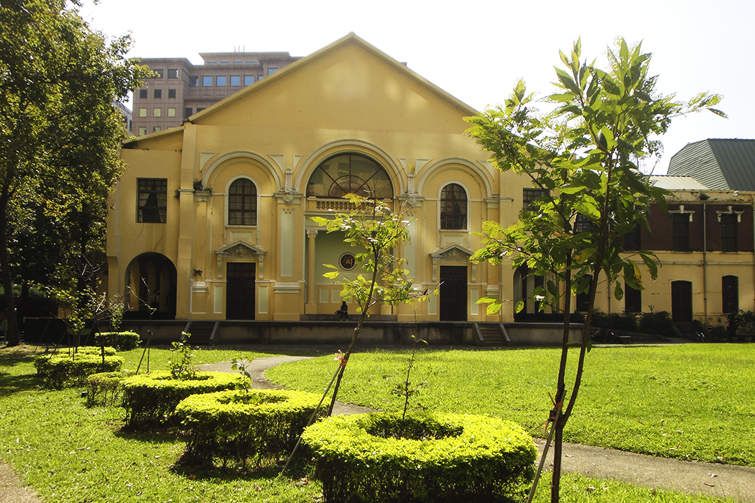
LOGO
Self-Exploration
在台灣傳統的教育體制下，我們常被灌輸應該要上甚麼學校未來才會怎樣，但是事實真的是如此嗎?
貼標籤的文化一直都存在在這病態的社會，所以我們常被迫走向自己不喜歡的道路就為了成就長輩的理想及期待，從小我們為了贏在起跑點就接受各種先修班補習班的訓練，
我們的幼稚園為了長輩期待的小學而努力，我們的小學為了長輩期待的國中而努力，我們的國中為了長輩期待的高中而努力，我們的高中為了長輩期待的大學而努力，我們的大學為了長輩期待的研究所努力，那我們的研究所為了甚麼努力?
恭喜你們考上台大，這應該是最老掉牙的開場，但下一句應該接的是，從你們錄取的那一刻起，可以享受這短暫的光環，但希望你們入學後可以放下它。為什麼呢?
從這一刻起，我們是為了自己而努力，所以請你放下台大，你才能重新認識自己，不再為了別人而活。
1-1
Notes:
恭喜你們考上台大，這應該是最老掉牙的開場，但下一句應該接的是，從你們錄取的那一刻起，可以享受這短暫的光環，但希望你們入學後可以放下它。
為什麼呢?
在台灣傳統的教育體制下，我們常被灌輸應該要上甚麼學校未來才會怎樣，但是事實真的是如此嗎?
貼標籤的文化一直都存在在這病態的社會，所以我們常被迫走向自己不喜歡的道路就為了成就長輩的理想及期待，從小我們為了贏在起跑點就接受各種先修班補習班的訓練，
我們的幼稚園為了長輩期待的小學而努力，我們的小學為了長輩期待的國中而努力，我們的國中為了長輩期待的高中而努力，我們的高中為了長輩期待的大學而努力，我們的大學為了長輩期待的研究所努力，那我們的研究所為了甚麼努力?
從這一刻起，我們是為了自己而努力，所以請你放下台大，你才能重新認識自己，不再為了別人而活。

Slide 5
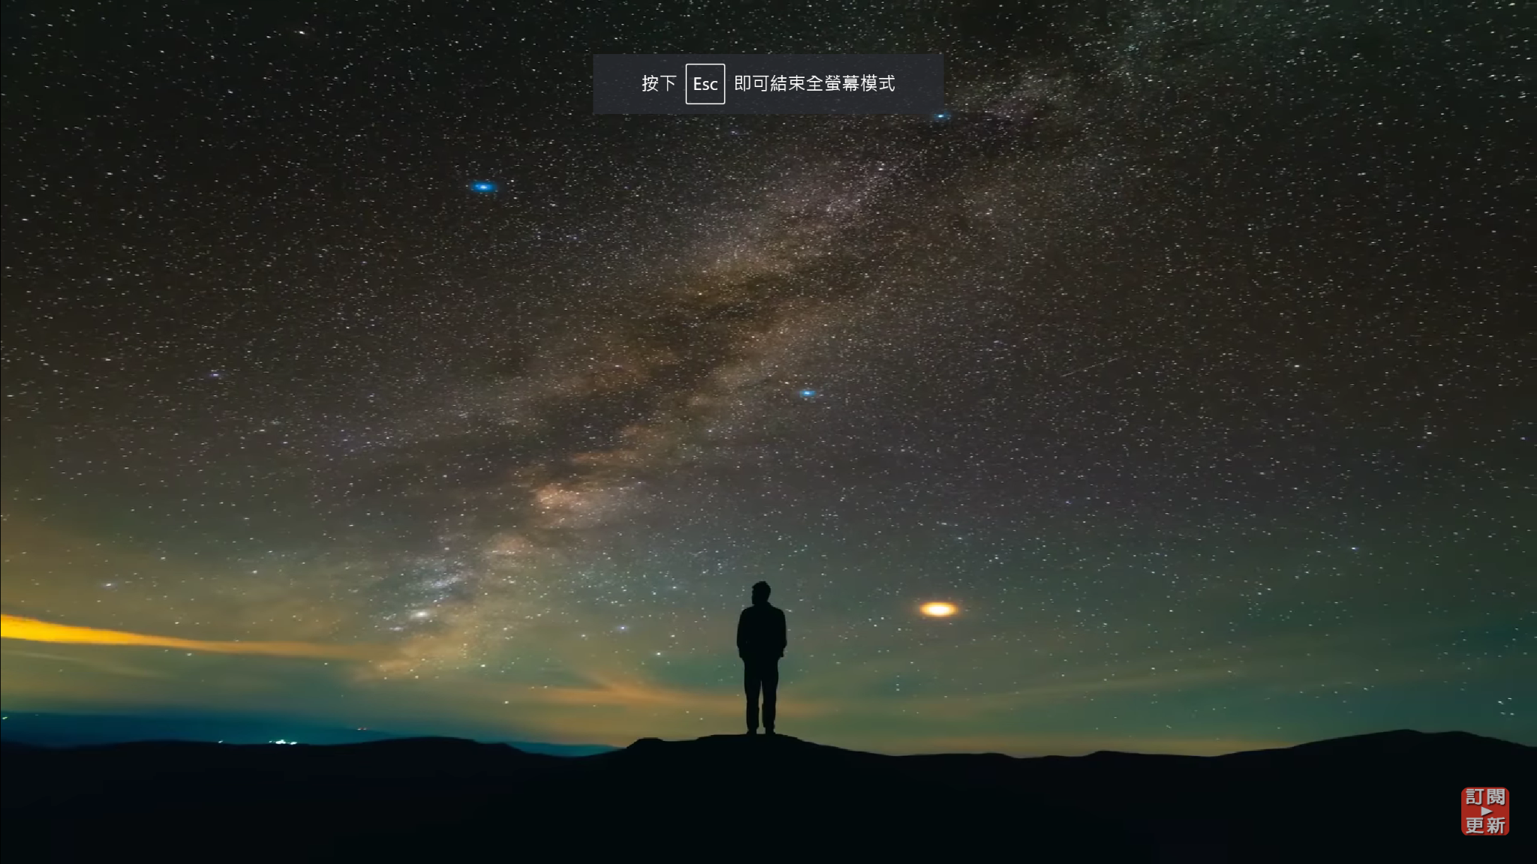
LOGO
Self-Exploration
然而，那些曾經看似順遂的事情都會在你走出象徵人生勝利組的象牙塔後一切破滅，即:畢業即失業，待業的待業，轉行的轉行，或是學習新的技能去適應新的職位。當然也有人自嘲去當一個社畜，領個基本底薪做自己不喜歡的事，做了幾個月就炒掉了自己的老闆。
後來我也聽了很多出過社會的學長姐回來分享自己的心得，每個人最常提到的就是解決問題的能力，但我不認為這是一個適合就學中的學生能得到的答案，然而自己出來教學後慢慢的才了解研究所的意義是甚麼，研究所最重要三點我希望你們要記住:
經過過去幾年的觀察，我發現台灣在就學的期間好像只要遵從一套公式生活，就能獲得社會的掌聲及同儕的擁護，例如:念好書"並"成為聽話的孩子。於是我們漸漸有目的性的去做某件事(考試會考的我才看，考古會考的我才看)(老師喜歡甚麼我就做甚麼)，深怕多做了一些額外的事我就在這場競賽當中失去資格。有多久我們忘記自己曾是那個對於這個社會充滿好期的個體?
過去我們都遵從一套範式生活，從今天起你要學習習慣未知的世界，培養如何受挫之後還能樂觀的面對明天的能力。(失敗是常態)
提早知道自己適合做甚麼，可以多方嘗試(實習也好，查資料也好)，事先從你想做的職位當中學到你應該要會的工作技能。(提早準備)
了解解決問題的能力是甚麼，應該要先了解你們的問題是甚麼。遇到問題請先拆解問題，從本質出發。(因果關係)
1-2
Notes:
經過過去幾年的觀察，我發現台灣在就學的期間好像只要遵從一套公式生活，就能獲得社會的掌聲及同儕的擁護，例如:念好書"並"成為聽話的孩子。於是我們漸漸有目的性的去做某件事(考試會考的我才看，考古會考的我才看)(老師喜歡甚麼我就做甚麼)，深怕多做了一些額外的事我就在這場競賽當中失去資格。有多久我們忘記自己曾是那個對於這個社會充滿好期的個體?
然而，那些曾經看似順遂的事情都會在你走出象徵人生勝利組的象牙塔後一切破滅，即:畢業即失業，待業的待業，轉行的轉行，或是學習新的技能去適應新的職位。當然也有人自嘲去當一個社畜，領個基本底薪做自己不喜歡的事，做了幾個月就炒掉了自己的老闆。
後來我也聽了很多出過社會的學長姐回來分享自己的心得，每個人最常提到的就是解決問題的能力，但我不認為這是一個適合就學中的學生能得到的答案，然而自己出來教學後慢慢的才了解研究所的意義是甚麼，研究所最重要三點我希望你們要記住:
過去我們都遵從一套範式生活，從今天起你要學習習慣未知的世界，培養如何受挫之後還能樂觀的面對明天的能力。(失敗是常態)
提早知道自己適合做甚麼，可以多方嘗試(實習也好，查資料也好)，事先從你想做的職位當中學到你應該要會的工作技能。(提早準備)
了解解決問題的能力是甚麼，應該要先了解你們的問題是甚麼。遇到問題請先拆解問題，從本質出發。(因果關係)

Slide 6
LOGO
Self-Exploration
不必期許自己甚麼都要會，但是要期許自己學什麼東西都快
1-3

Slide 7
02
Research Tool

Slide 8
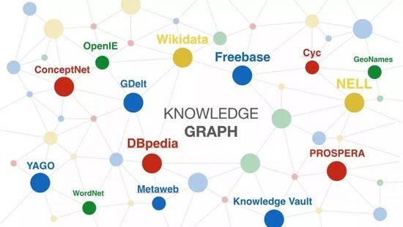
LOGO
Research Tool
Knowledge Graph
knowledge base that uses a graph-structured data model or topology to integrate data
（1）Information Extraction
（2）Knowledge Fusion
（3）Knowledge Processing
Recurrent Event Network: Global Structure Inference over Temporal Knowledge Graph
2-1

Slide 9
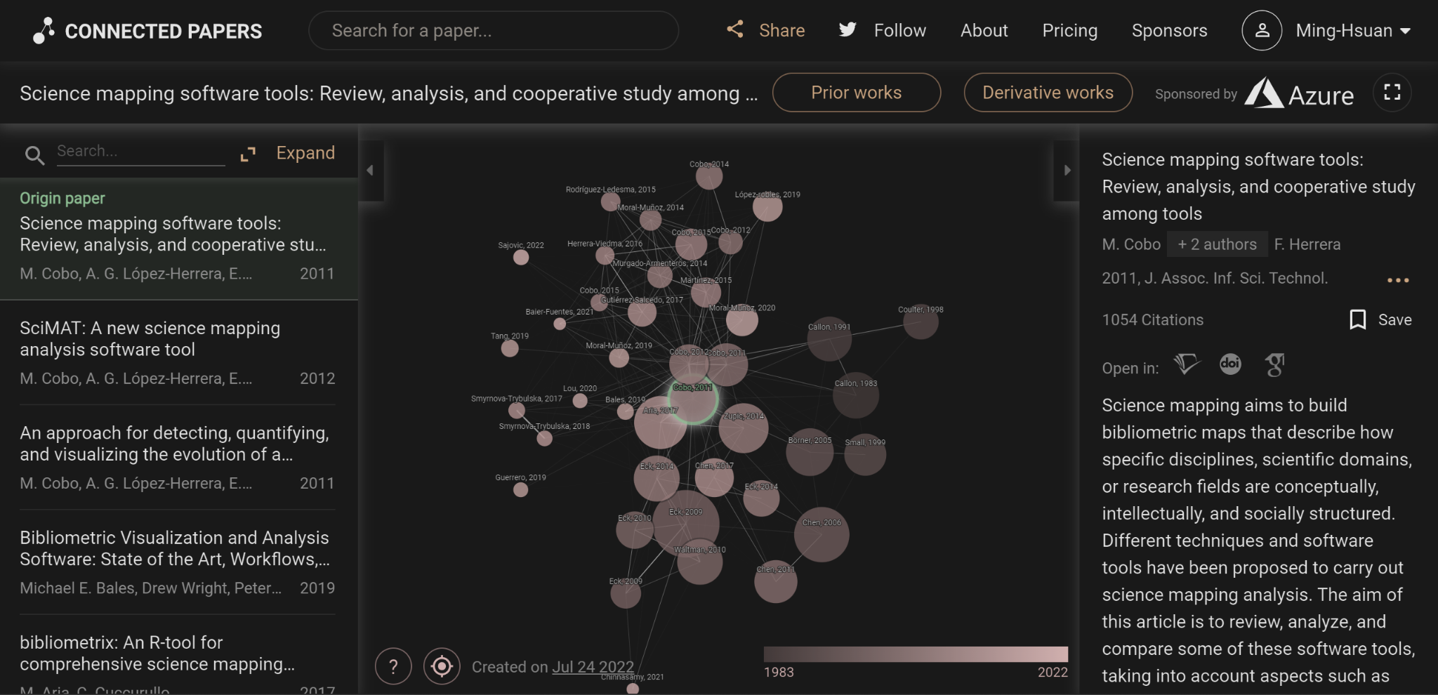
LOGO
Research Tool
獲得一個新學術領域的視覺概覽
對感興趣的領域趨勢、最具代表性的作品有真實且直觀的理解
A visual tool to help researchers and practitioners find and explore academic papers
確保你沒有錯過重要論文
使文獻跟蹤及深度調研變得容易
為你的論文創建參考書目
從參考文獻中填補其餘空白的部分
2-2

Slide 10
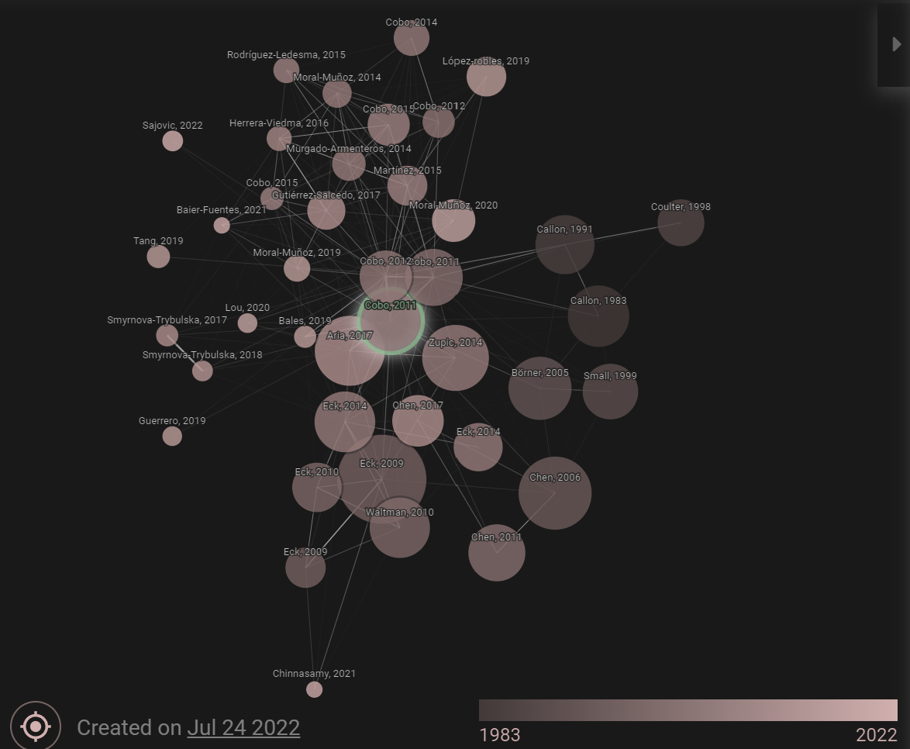
LOGO
Research Tool
每個小球代表一篇文獻，最中間的小球代表本文
右下方年份分布圖標，小球的顏色越深代表時間越近
球的大小與引用的次數有關，小球越大表示引用越多
小球連線表示引用關係，相似的文章會距離較近
光標移到小球上，右側會出現該篇文獻對應的訊息
2-3

Slide 11
LOGO
Research Tool
球的大小與________有關，小球越大表示_________
小球連線表示________，相似的文章會距離較__
https://www.connectedpapers.com/

Slide 12
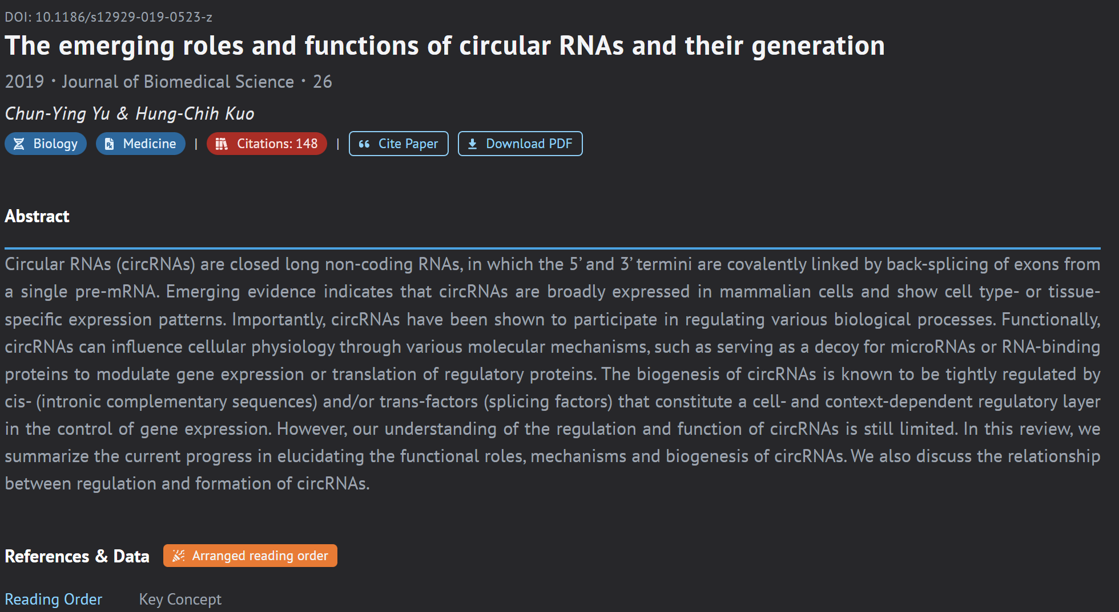
LOGO
Research Tool
完整的論文資料庫
收錄了2億5百萬篇論文，並持續更新
Fast, smart and powerful research system. Find the best research pathway for you.
一鍵安排閱讀順序
不會迷失在論文海里，提升相關領域的知識儲備量
發掘關鍵概念與技術
探索可改良及使用的技術
https://readthispaper.com/tw/
2-4

Slide 13
03
Database

Slide 14
LOGO
Database
lncRNA
The long non-coding RNAs associating with other molecules can coordinate several physiological processes and their dysfunction can impact diverse human diseases.
lncRNAfunc
Systematic and intensive annotations on diverse interaction regulations of lncRNAs in human cancer were not available. lncRNAfunc, a knowledgebase of lncRNA function in human cancer at https://ccsm.uth.edu/lncRNAfunc, aiming to provide a resource and reference for providing therapeutically targetable lncRNAs and intensive interaction regulations.
Studying upstream regulators and downstream target genes related to lncRNAs is essential to fully understand the cancer progression and identify the therapy targets
3-1

Slide 15
LOGO
Database
LncRRIsearch
NPInter
Pro: The interaction annotation of lncRNAs
Con: lack detailed and intensive downstream analyses for individual interaction relationships, which is not enough to fully understand the lncRNAs’ mechanisms of action in cancer.
LncRNA2Target
LncTarD
LncReg
LncExpDB
Con: provide limited analyses of the lncRNA regulation
3-2

Slide 16
LOGO
Database
Analyzed the interactions between lncRNAs and different types of biomolecules
The Cancer Genome Atlas (TCGA)
33 cancer types
15900 lncRNAs
Interactions with enhancers/promoters of the correlated genes in DNA-level
Interactions with 3′-UTRs of the correlated genes
Skipped exon regions of correlated alternative splicing events in RNA-level
Interactions winteractions with the potential regulators in protein-level such as transcription factors (TFs), splicing factors (SFs) and epigenetic factors (Epis).
Multiple functional annotations to identify cancer stage-associated lncRNA genes, potential miRNA binding sites in lncRNAs, RNA editing associated lncRNAs in cancer, expression quantitative locus (eQTLs) of lncRNAs, and single-nucleotide variant (SNV)-associated lncRNAs
Identified the tumor-specific lncRNAs/
coding genes/exon skipping (ES)
Normal and Tumor
Gene expression |log2FC| >1, P-value <0.05
Percent spliced in (PSI) values
|ΔPSI| > 10%, P-value < 0.05
Understand the key regulatory of lncRNAs
lncRNAs, coding genes, alternative splicing, and miRNAs
Multiple correlation analyses
|R| > 0.3 and adjusted P-value < 0.05
3-3

Slide 17
LOGO
Database
3-4

Slide 18
LOGO
Database
3-5

Slide 19
LOGO
Database
Architecture
Client, server, and database
Perl's DBI module
MySQL 3.23 with the My-ISAM storage engine
3-6

Slide 20
LOGO
Database
lncRNA
The long non-coding RNAs associating with other molecules can coordinate several physiological processes and their dysfunction can impact diverse human diseases.
LncACTdb 3.0
LncACTdb 3.0 is a comprehensive database of experimentally supported interactions among competing endogenous RNA (ceRNA) and the corresponding personalized networks contributing to precision medicine. LncACTdb 3.0 is freely available at http://bio-bigdata.hrbmu.edu.cn/LncACTdb or http://www.bio-bigdata.net/LncACTdb.
A panel of improved tools has been developed to explore the effects of ceRNA on individuals with specific pathological backgrounds
3-7

Slide 21
LOGO
Database
lnCeDB
DIANA-LncBase v3
Pro: Valuable resources for studying lncRNA functions
LncTarD
starBase v2.0
Con: a very limited collection of experimentally supported ceRNAs
miRSponge
PceRBase
3-8

Slide 22
LOGO
Database
3-9

Slide 23
LOGO
Database
3-10

Slide 24
LOGO
Database
3-12

Slide 25
LOGO
Database
3-13

Slide 26
LOGO
Database
3-14

Slide 27
LOGO
Database
3-15

Slide 28
LOGO
Database
3-16

Slide 29
LOGO
Database
3-17

Slide 30
LOGO
Database
3-18

Slide 31
LOGO
Database
Architecture
Client, server, and database
Java server pages and deployed on the Tomcat web server (v6)
Java script plugins such as jQuery (v1.11.3), Datatable (1.10.10), and ECharts (V4.0)
R framework (v3.6.3)
MySQL software (v 5.5)
3-19

Slide 32
LOGO
Database
CircRNA
Circular RNAs (circRNAs), which are single-stranded RNA molecules that have individually formed into a covalently closed continuous loop, act as sponges of microRNAs to regulate transcription and translation.
CircNet 2.0 (https://awi.cuhk.edu.cn/~CircNet/php/index.php)
CircNet (version 2.0), which circRNAs from circAtlas and MiOncoCirc, and novel circRNAs from the Cancer Genome Atlas database have been integrated.In total, 2732 samples from 37 types of cancers were integrated into CircNet 2.0 and analyzed using several of the most reliable circRNA detection algorithms.Target miRNAs were predicted from the full-length circRNA sequence using three reliable tools (PITA, miRanda and TargetScan).Additionally, 384,897 experimentally verified miRNA–target interactions from miRTarBase were integrated into our database to facilitate the construction of high-quality circRNA–miRNA–gene regulatory networks.
3-20

Slide 33
LOGO
Database
circAtlas 2.0
CircNet 1.0
Pro: Valuable resources for studying circRNA functions
Con: a very limited collection of experimentally supported circRNA
MiOncoCirc
CSCD2.0
3-21

Slide 34
LOGO
Database
3-22

Slide 35
LOGO
Database
3-23

Slide 36
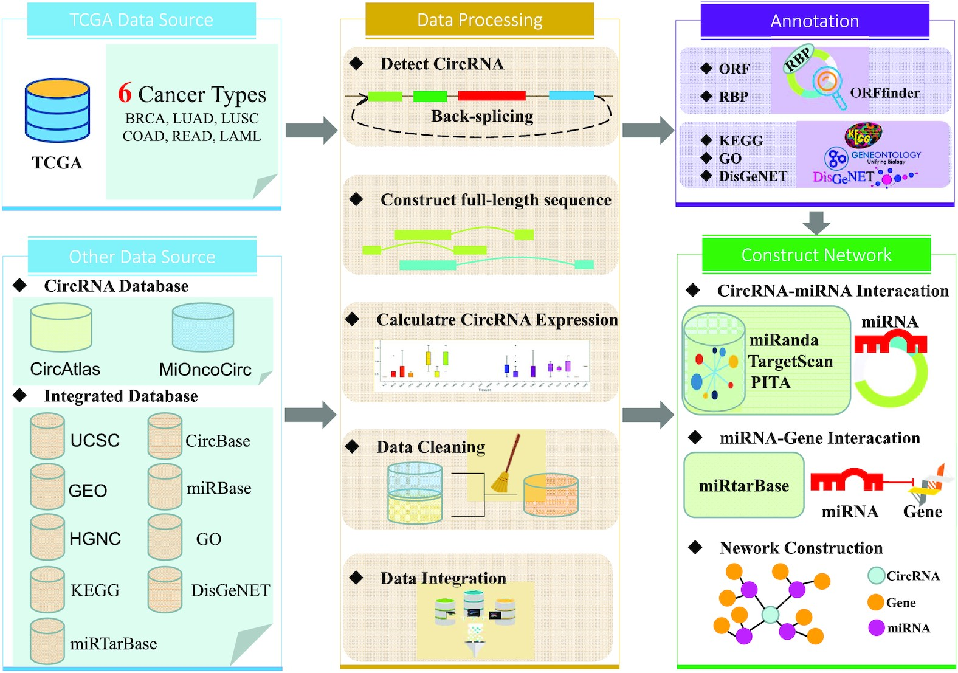
LOGO
Database
3-24

Slide 37
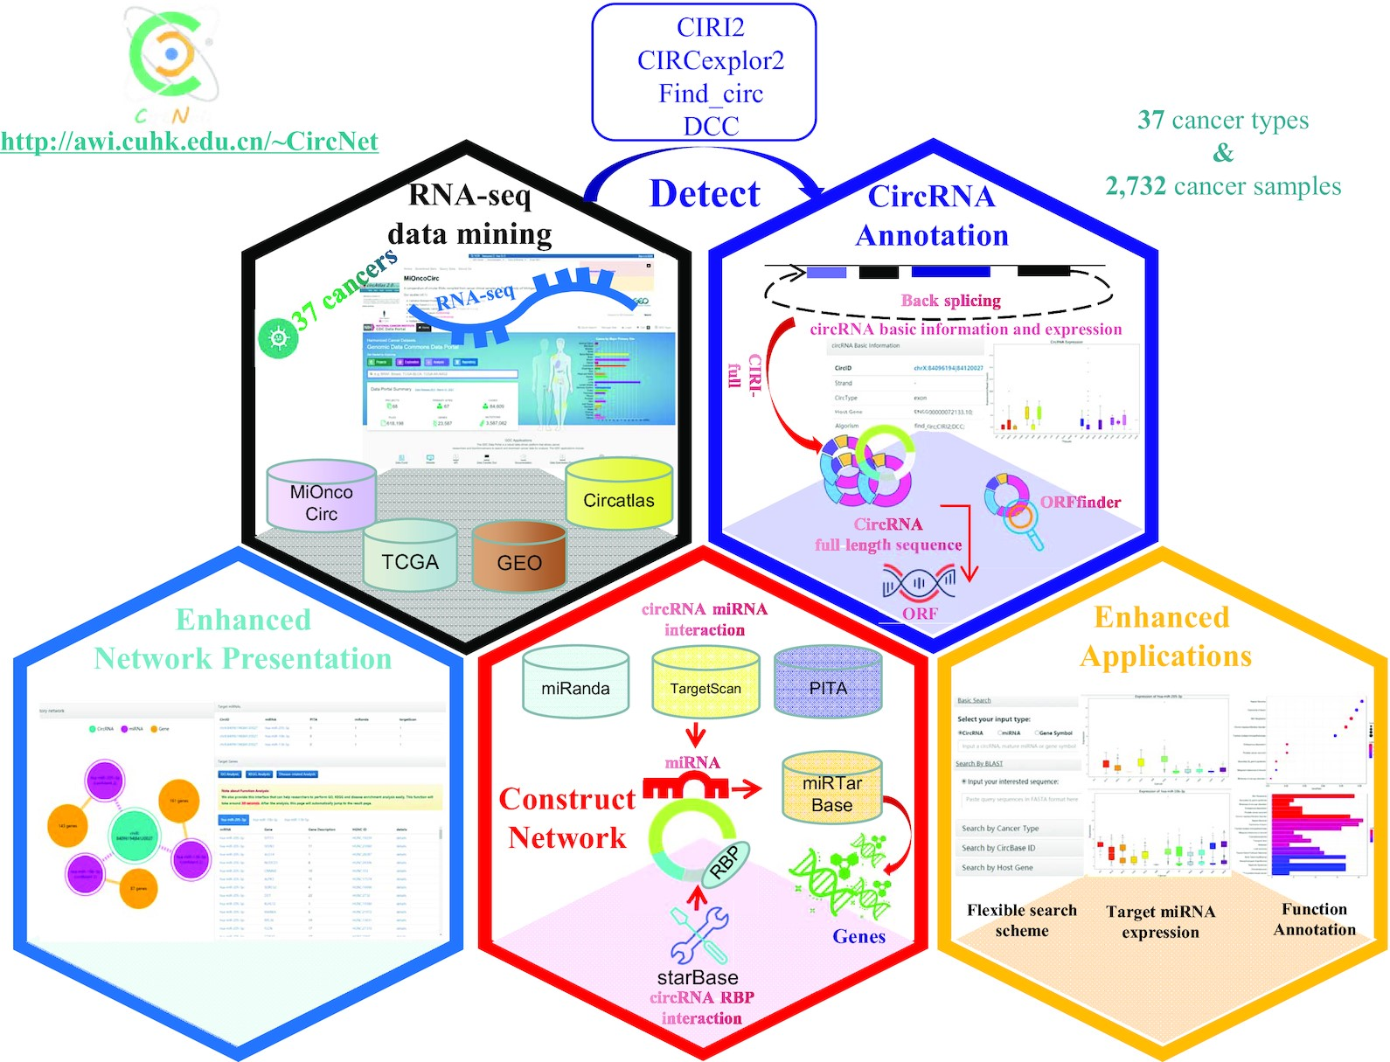
LOGO
Database
3-25

Slide 38
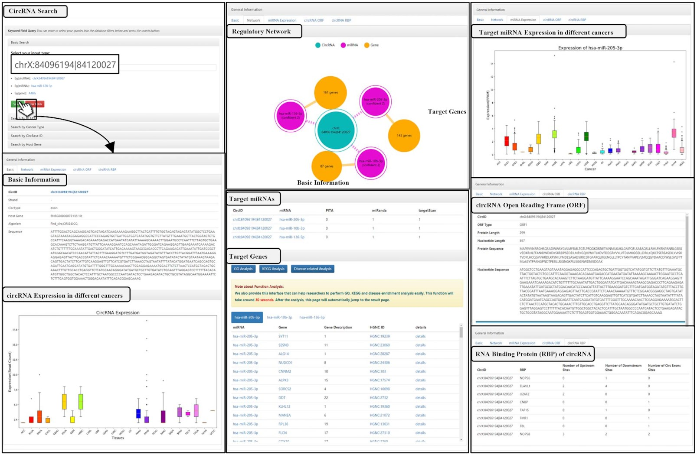
LOGO
Database
3-26

Slide 39
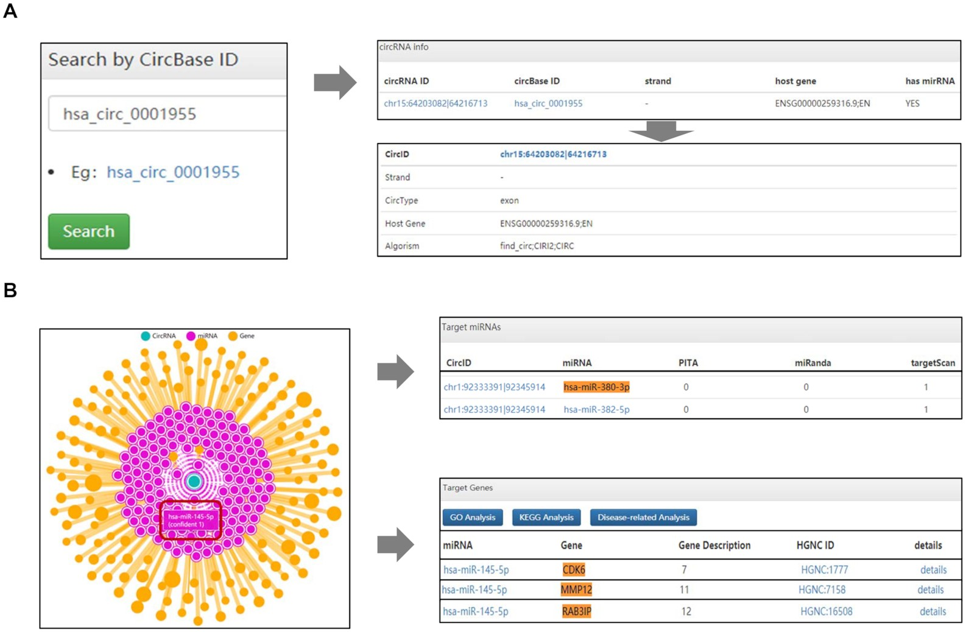
LOGO
Database
3-27

Slide 40
LOGO
Database
Architecture
Client, server, and database
PHP
JavaScript library
MySQL software
3-28

Slide 41
LOGO
Database
CircRNA
The significant function of circRNAs in cancer was recognized in recent work, so a well-organized resource is required for characterizing the interactions between circRNAs and other functional molecules (such as microRNA and RNA-binding protein) in cancer.
CSCD 2.0 (http://geneyun.net/CSCD2 or http://gb.whu.edu.cn/CSCD2)
CSCD2, which includes significantly more cancer-specific circRNAs identified from a large number of human cancer and normal tissues/cell lines. CSCD2 contains >1000 samples (825 tissues and 288 cell lines) and identifies a large number of circRNAs: 1,013,461 cancer-specific circRNAs, 1,533,704 circRNAs In addition, CSCD2 predicts potential miRNA–circRNA and RBP–circRNA interactions using binding motifs from >200 RBPs and 2000 microRNAs. Furthermore, the potential full-length and open reading frame sequence of these circRNAs were also predicted.from only normal samples and 354,422 circRNAs from both cancer and normal samples.
3-29

Slide 42
LOGO
Database
circAtlas
Pro: Valuable resources for studying circRNA functions
Con: a very limited collection of experimentally supported circRNAs
circRic
circBase
3-30

Slide 43
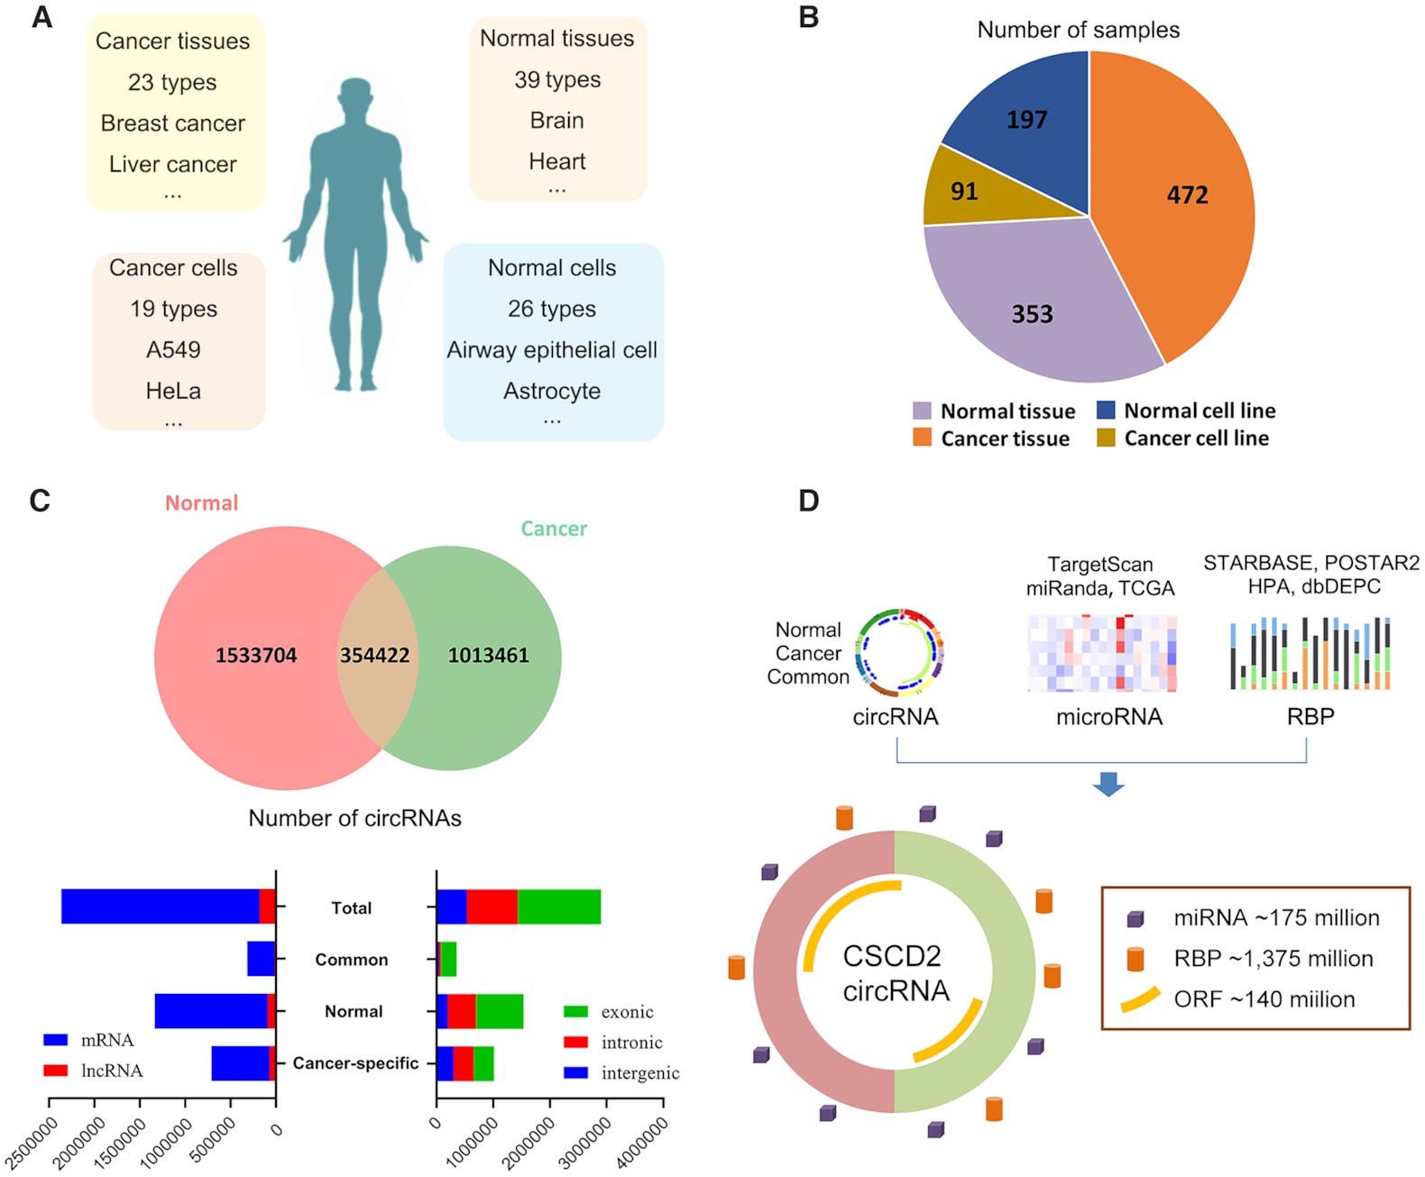
LOGO
Database
3-31

Slide 44
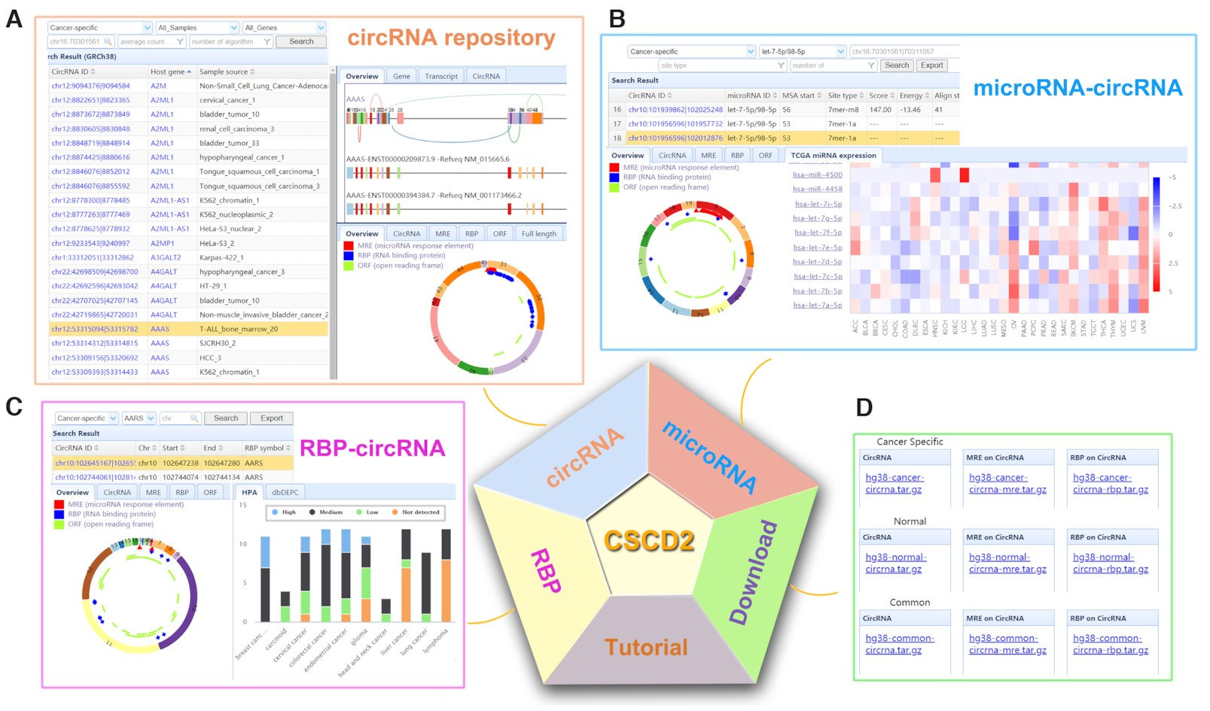
LOGO
Database
3-32

Slide 45
LOGO
Database
Architecture
Client, server, and database
ThinkPHP, an open-source web framework based on a PHP (https://github.com/top-think)
JavaScript library
MySQL software
3-33

Slide 46
LOGO
Database
Extracellular vesicles(EVs)
Extracellular vesicles (EVs) are small membranous vesicles that contain an abundant cargo of different RNA species with specialized functions and clinical implications
exoRBase 2.0 (http://www.exoRBase.org)
exoRBase 2.0, which is a repository of EV long RNAs (termed exLRs) derived from RNA-seq data analyses of diverse human body fluids. In exoRBase 2.0, the number of exLRs has increased to 19 643 messenger RNAs (mRNAs), 15 645 long non-coding RNAs (lncRNAs) and 79 084 circular RNAs (circRNAs) obtained from ∼1000 human blood, urine, cerebrospinal fluid (CSF) and bile samples.Our database provides an attractive platform for the identification of novel exLR signatures from human biofluids that will aid in the discovery of new circulating biomarkers to improve disease diagnosis and therapy.
3-34

Slide 47
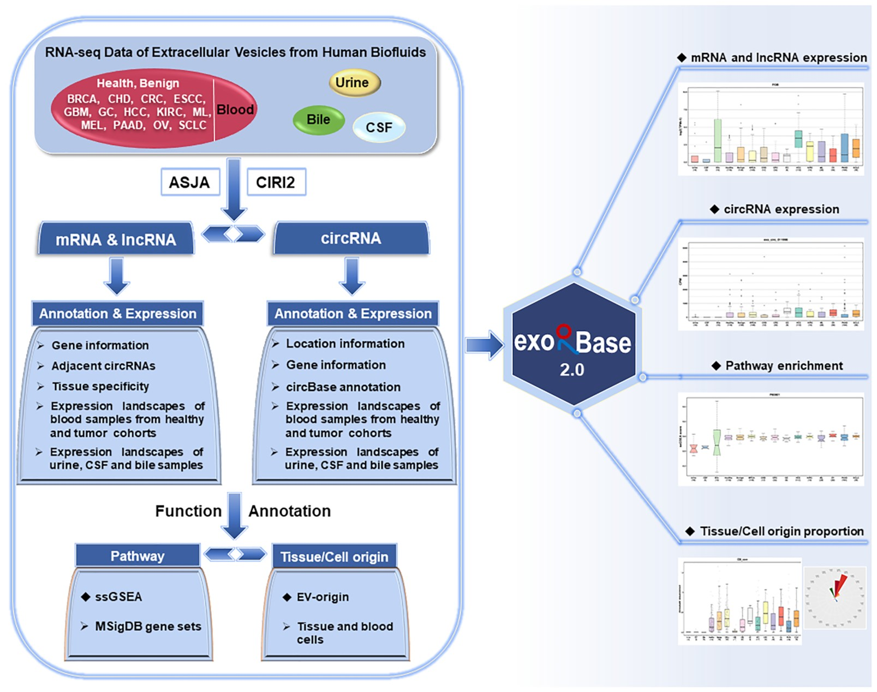
LOGO
Database
exLRs
FASTA
The reads mapped to regions of protein coding or long non-coding (mRNAs or lncRNAs) genes
FastQC (version 0.11.8)
Filtering out low-quality reads
Read count of each gene was normalized to the TPM
Trimmomatic (version 0.36)
Removing adapter sequences
STAR
(version 2.7.1a)
Aligned to the human reference genome (GRCh38 from GENCODE) in 2-pass mapping mode
featureCounts (version 1.6.3)
3-35

Slide 48
LOGO
Database
FASTA
The reads mapped to regions of protein coding or long non-coding (mRNAs or lncRNAs) genes
FastQC (version 0.11.8)
Filtering out low-quality reads
Read count of each gene was normalized to the TPM
Trimmomatic (version 0.36)
Removing adapter sequences
STAR
(version 2.7.1a)
Aligned to the human reference genome (GRCh38 from GENCODE) in 2-pass mapping mode
featureCounts (version 1.6.3)
3-36

Slide 49
LOGO
Database
3-37

Slide 50
LOGO
Database
3-38

Slide 51
LOGO
Database
3-39

Slide 52
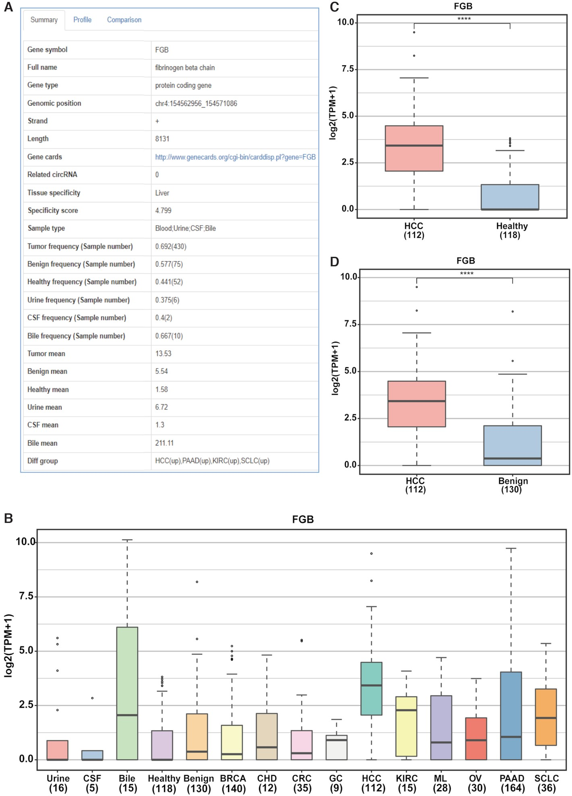
LOGO
Database
3-40

Slide 53
LOGO
Database
3-41

Slide 54
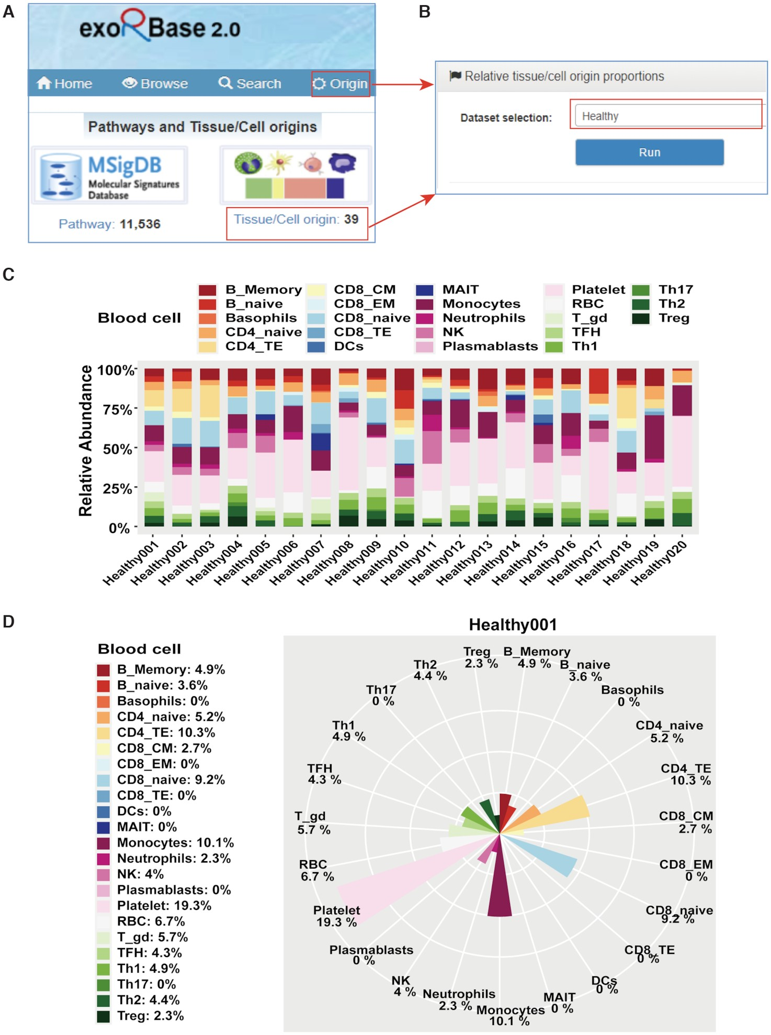
LOGO
Database
3-42

Slide 55
LOGO
Database
3-43

Slide 56
LOGO
Database
Architecture
Client, server, and database
The interface of the website was designed and implemented using the Twirl template engine (version 1.5.0).
The query system of this database was configured and handled by Play Slick (version 4.0.2)
Akka 2.6.5 (web server) and MySQL (database server), MySQL (version 5.7.31)
3-44

Slide 57
LOGO
Database
Systems-level studies
A critical component in the interpretation of systems-level studies is the inference of enriched biological pathways and protein complexes contained within OMICs datasets. Successful analysis requires the integration of a broad set of current biological databases and the application of a robust analytical pipeline to produce readily interpretable results.
Metascape (https://metascape.org/gp/index.html#/main/step1)
Metascape is a web-based portal designed to provide a comprehensive gene list annotation and analysis resource for experimental biologists. In terms of design features, Metascape combines functional enrichment, interactome analysis, gene annotation, and membership search to leverage over 40 independent knowledgebases within one integrated portal.
3-45

Slide 58
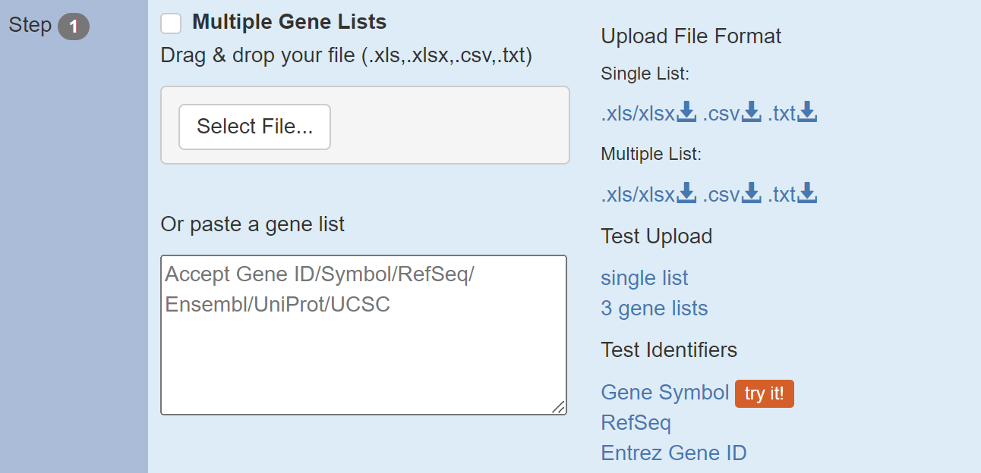
LOGO
Database
Leave it unchecked
Download examples
Click here to try upload an example
Click here to try paste an examples
3-46

Slide 59
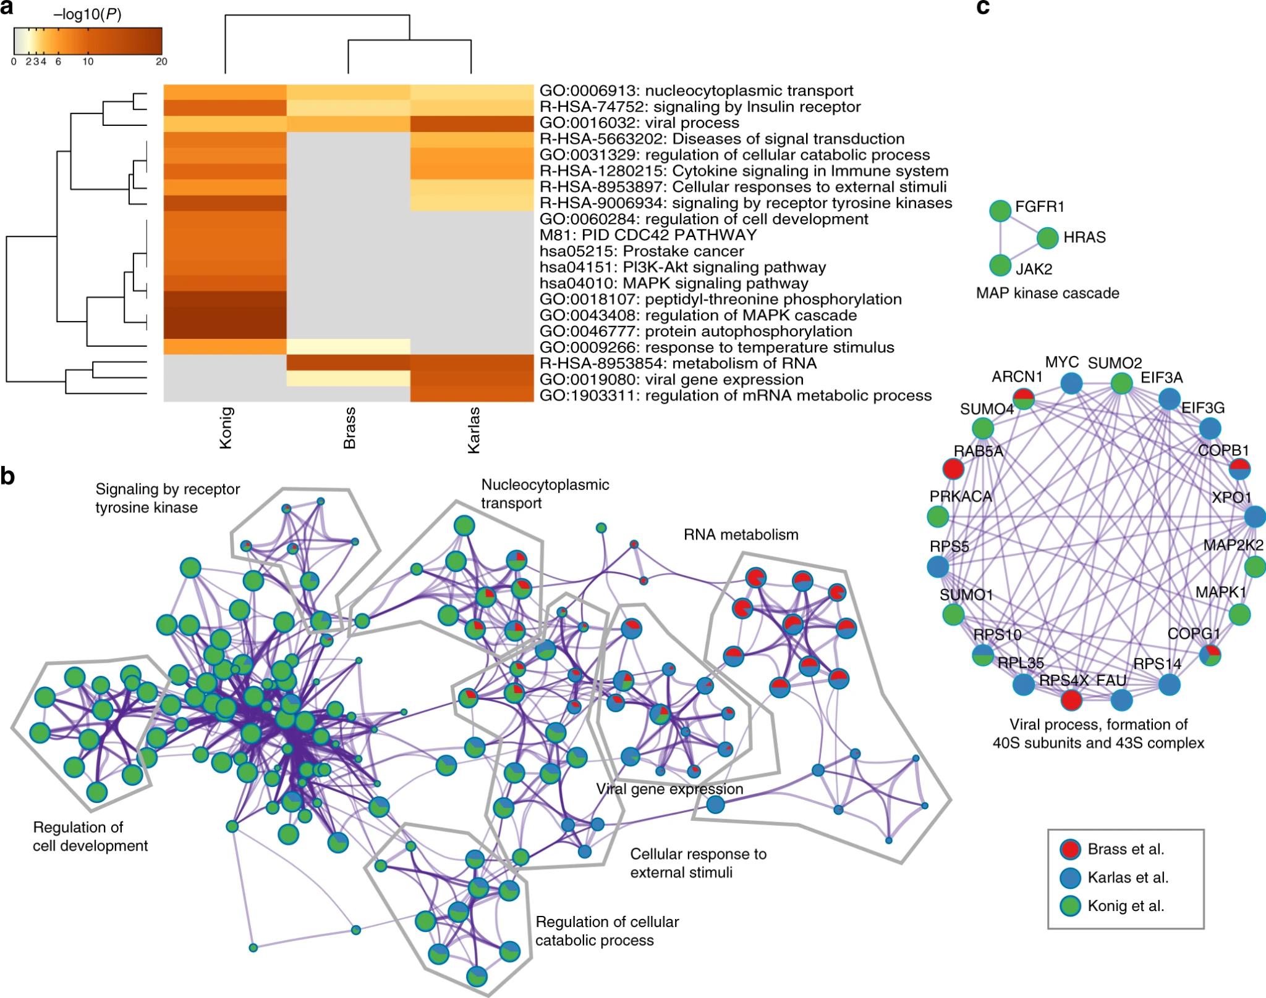
LOGO
Database
MCODE算法尋找網路中密集連結的蛋白質群
3-47
GO processes, KEGG pathways, Reactome gene sets, canonical pathways, and CORUM complexes

Slide 60
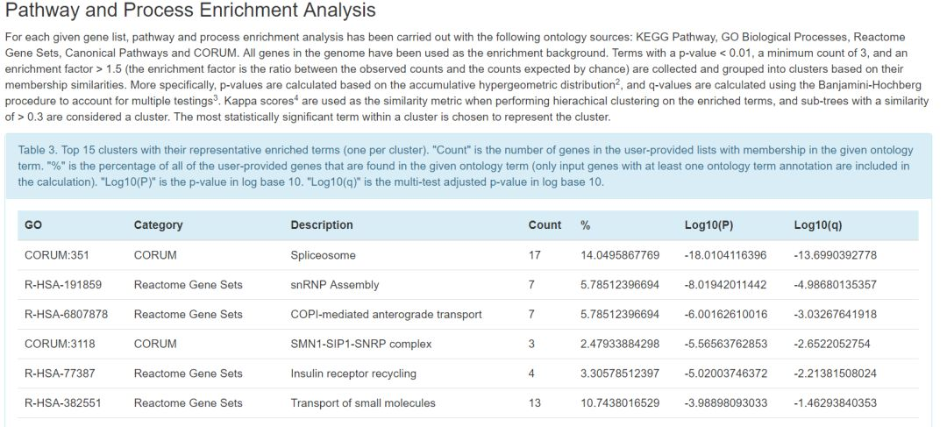
LOGO
Database
多重假設驗證校正的p-value
3-48

Slide 61
LOGO
Database
後記
First (10%)
Second (90%)
批次效應
樣品在不同的批次處理和測量時引入與生物狀態不相關的系統性技術偏差，例如:不同實驗條件、不同操作者、不同試劑、實驗時間、設備等。為一般高通量試驗中常見的變異來源。
3-49

Slide 62
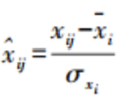
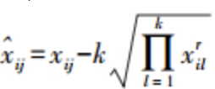
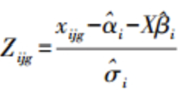
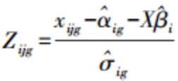
LOGO
Database
平均中心
Z-score
算數、幾何平均
距離加權判別
Combat
M-Combat
奇異值分解SVD
替代變量分析(SVA)
fSVA
RUV-2
3-50

Slide 63
04
Data visualization

Slide 64
LOGO
Data visualization
Basic scientific graphics
Omics data visualization
Biomedical Data Visualization (240+ plugins by Hiplot Consortium)
Clinical models
4-1

Slide 65
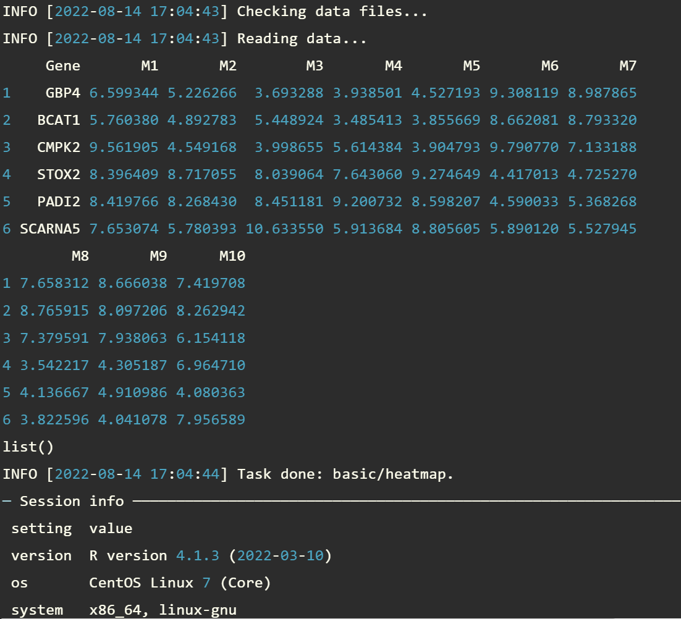
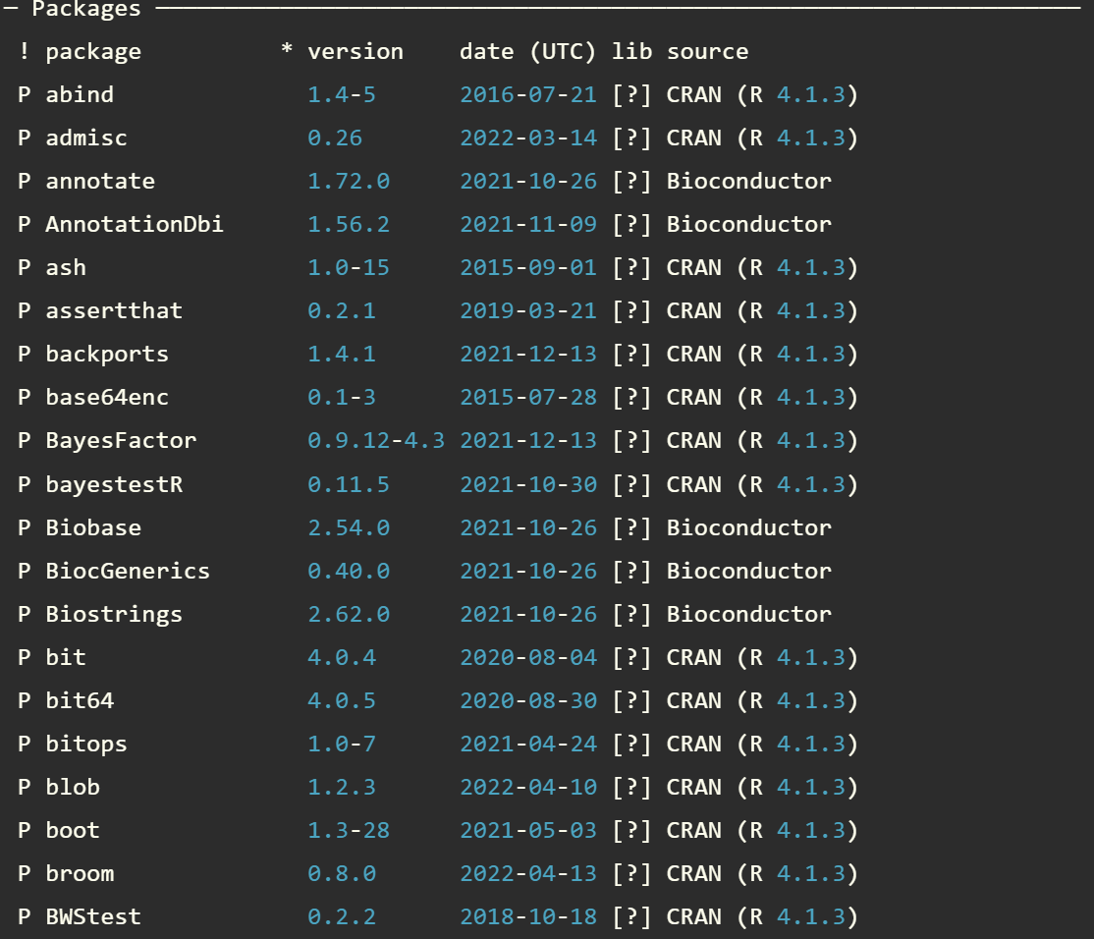
LOGO
Data visualization
4-2

Slide 66
LOGO
Data visualization
What We Have Lived For ?
大數據上游的相關數據分析已能輕鬆獲取
常規的組學數據上游分析流程趨於穩定及完善
數據上游分析流程的可自定義程度及可變程度變低
數據上游的分析流程逐漸走向自動化、規模化、專業化
數據分析下游流程中的可視化和個性化深度解讀成為當前最大的挑戰...
4-3

Slide 67
LOGO
Data visualization
What We Have Lived For ?
數據可視化工具
SPSS
Origin
SigmaPlot
Graphpad
數據分析及建模
MATLAB
R
Python
雲端計算平台、IT軟硬件設施
Galaxy
DNAnexus
Distributed computing
Container
Software management
Pipeline Framework
4-4

Slide 68
LOGO
Data visualization
基礎可視化
進階可視化
其他任務
文件管理
覆蓋大多數基礎科研可視化功能、參照SPSS、GraphPad等工具
包括Shiny在內的複雜可視化圖形及應用，文獻圖表的重現和再分析;新的可視化圖形展示插件:如基於Circos、circlize的二次開發
低計算量的其他任務(文獻數據資源下載、簡單的文本挖掘、微生物組學分析等)
支持上傳、下載、複製、移動、刪除、在線預覽及編輯
4-5

Slide 69
LOGO
Data visualization
4-6

Slide 70
LOGO
Data visualization
4-7

Slide 71
LOGO
Data visualization
4-8

Slide 72
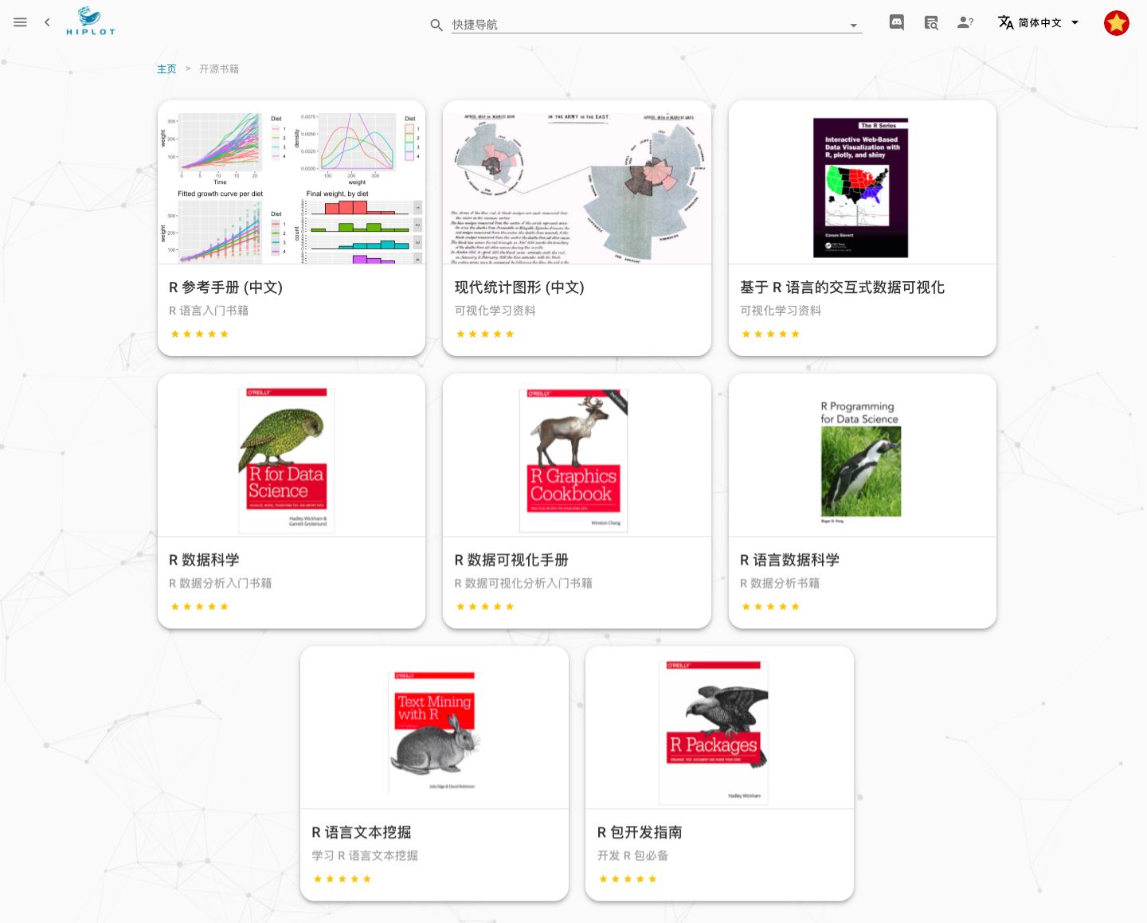
LOGO
Data visualization
4-9

Slide 73
LOGO
Data visualization
基因組學、微生物組學、生物資訊學
4-10

Slide 74
2022
THANKS

