Slide 1
The role of circular RNAs
N⁶-methyladenosine modification in cancer
Speaker: Chia-Ming Liu
Advisor: Liang-Chuan Lai, Ph.D.
Date: Sep. 6th, 2022
Notes:
Good morning everyone. I am today’s speaker Chia-Ming Liu. My adviser is Liang Chuan Lai. Today I will introduce the role of circular RNAs N6 methyladenosine modification in cancer.

Slide 2
The role of circular RNAs
N⁶-methyladenosine modification in cancer
circular RNAs
N⁶-methyladenosine modification
Notes:
Before we start our topic, there are two keywords in my title that I should talk about first(click), circular RNA and N6-methyladenosine modification. Maybe this is the first time you have heard these words. (click)

Slide 3
circular RNAs
N⁶-methyladenosine modification
Notes:
So, let me introduce these words for a few minutes (click). First is circular RNA, also called circRNAs. (click)

Slide 4
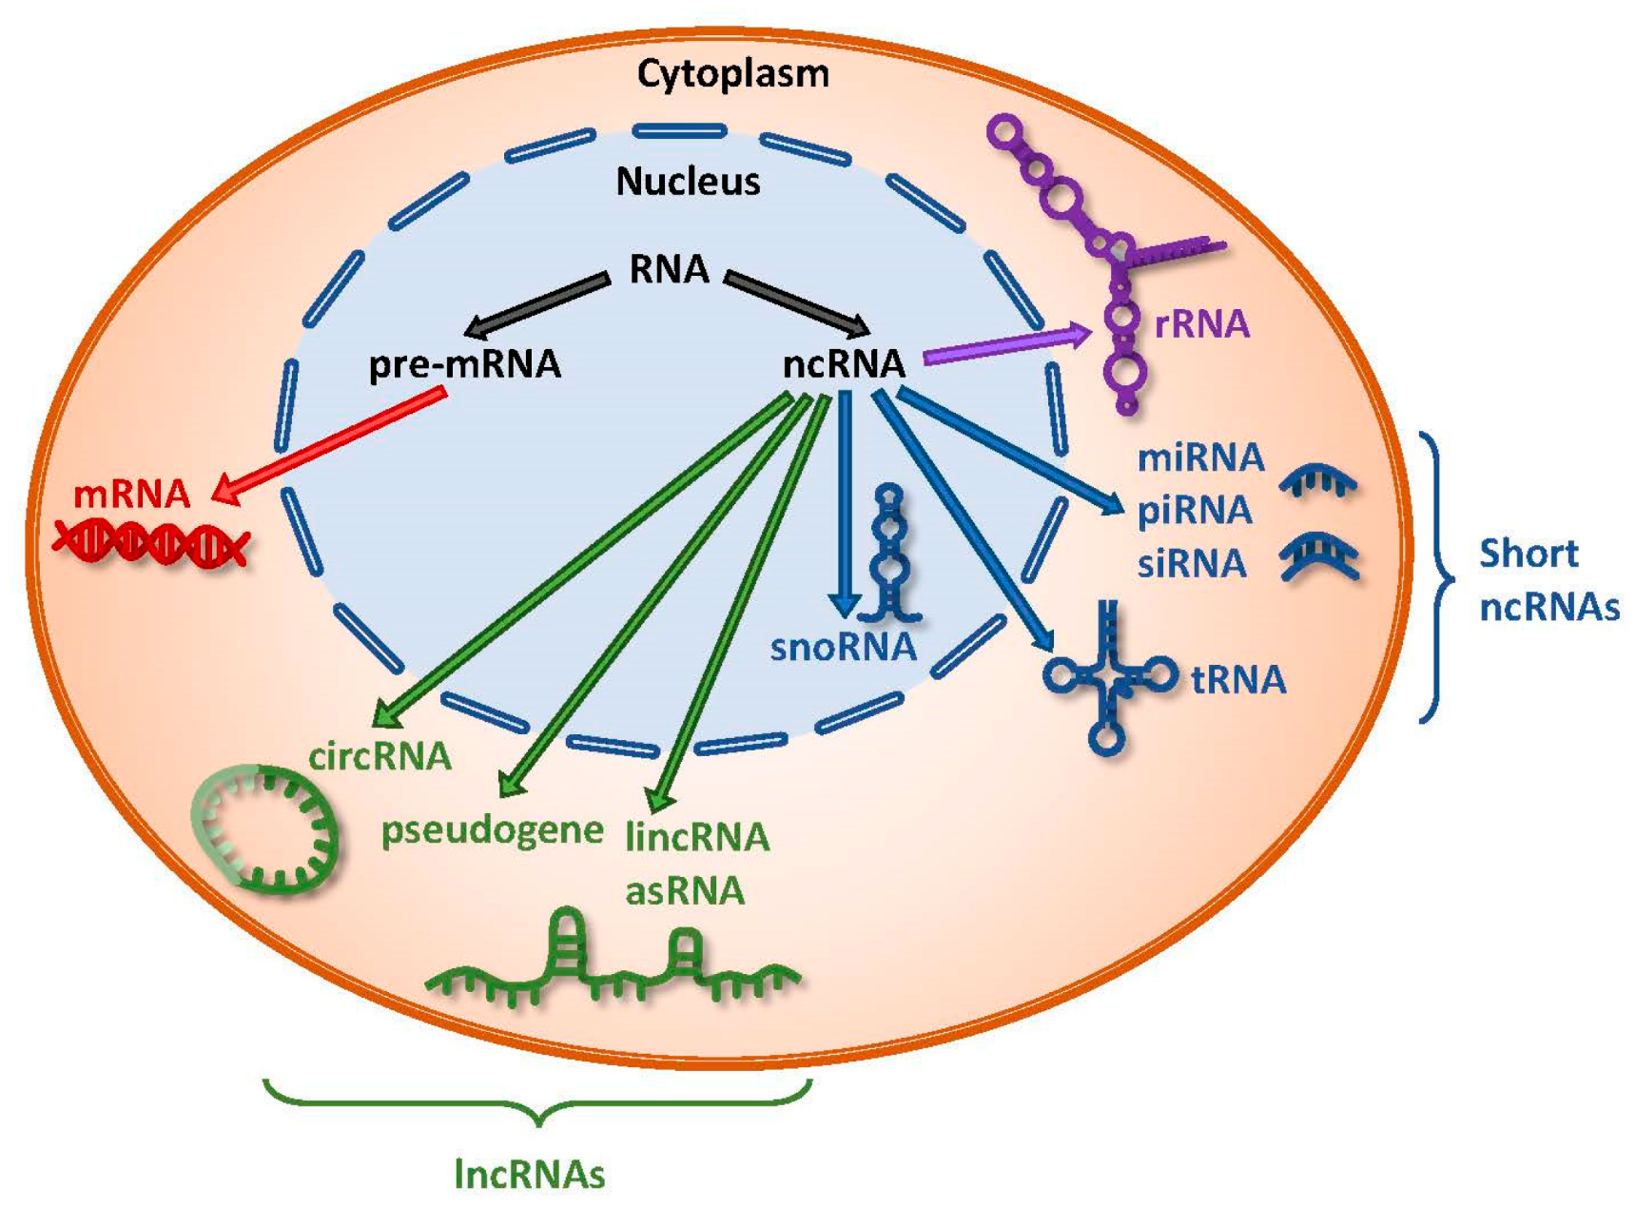
circular RNAs
RNA categories
Chan JJ, et al. Int J Mol Sci, 2018
Notes:
RNA can be classified into two major categories, coding RNA and non-coding RNA. Coding RNA means the RNA which can translate protein or peptide, such as mRNA. Non-coding RNAs contain rRNA, short non-coding RNA, and long non-coding RNA. circRNAs were one of the members of lncRNAs.

Slide 5
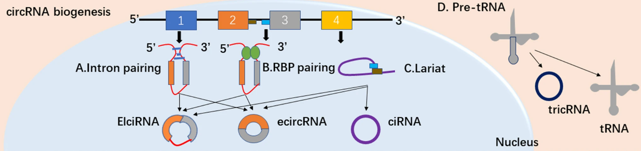
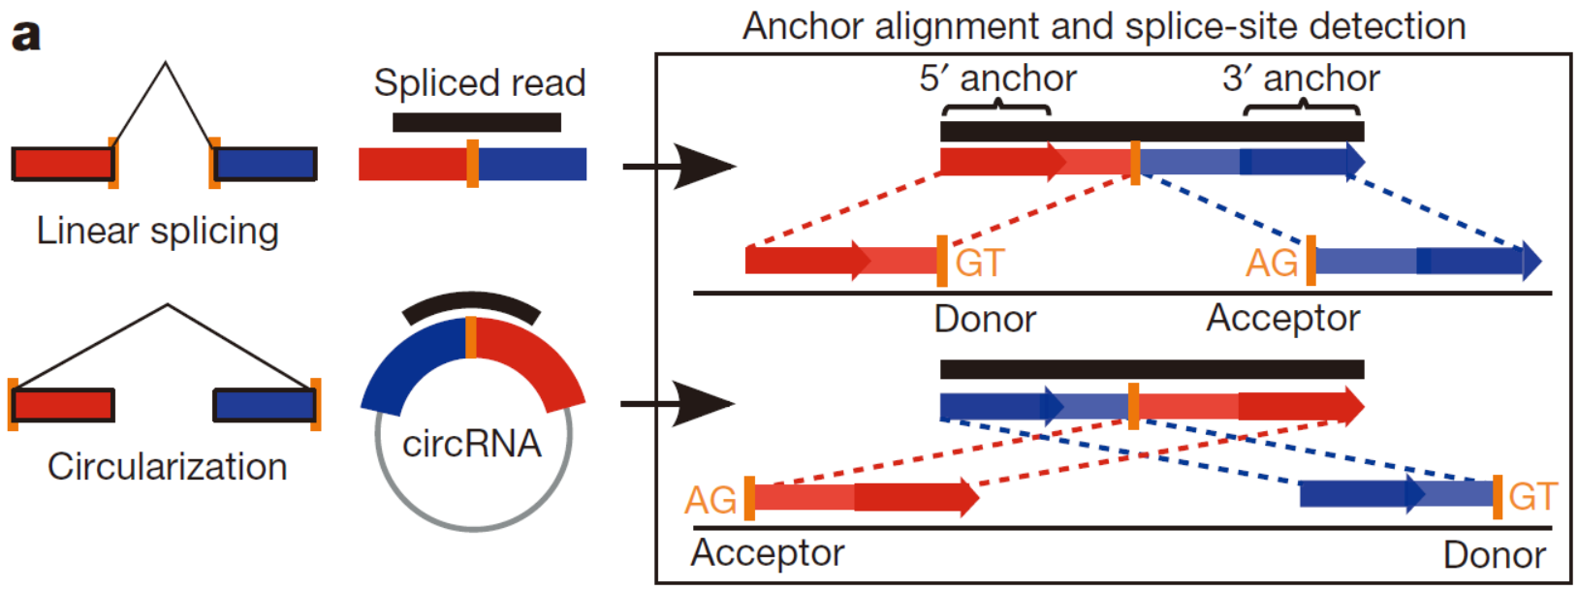
circular RNAs
CircRNAs Biogenesis
Memczak S, et al. Nature, 2013; Guo X, et al. Clin Transl Oncol, 2021
Notes:
Circular RNAs originate from pre-mRNA. Unlike mRNA spliced into a linear form from pre-mRNA, circular RNAs usually become circular because of the intron pairing or RNA binding protein pairing and then undergo a back splicing and become a circular RNAs.

Slide 6
circular RNAs
Identification of CircRNAs
Liu CX, et al.Cell, 2022

Slide 7
circular RNAs
Functions of CircRNA
Liu CX, et al.Cell, 2022
Notes:
A decade ago, circRNAs were considered splicing garbage in our bodies. However, recent studies show that circRNAs are involved in many molecular mechanisms. We can distinguish the function of circRNAs base on their location in the cell (click).

Slide 8
circular RNAs
Functions of CircRNA
Liu CX, et al.Cell, 2022
Notes:
If circRNAs are mainly located in the nucleus, they may involve DNA transcription or pre-mRNA splicing. Some studies also show that circRNAs can affect immune responses (click).

Slide 9
circular RNAs
Functions of CircRNA
Liu CX, et al.Cell, 2022
Notes:
However, if circRNAs are mainly located in the cytoplasm, they may sponge with microRNA or RNA binding protein. Also, they may affect the translation ability of other mRNAs (click).

Slide 10
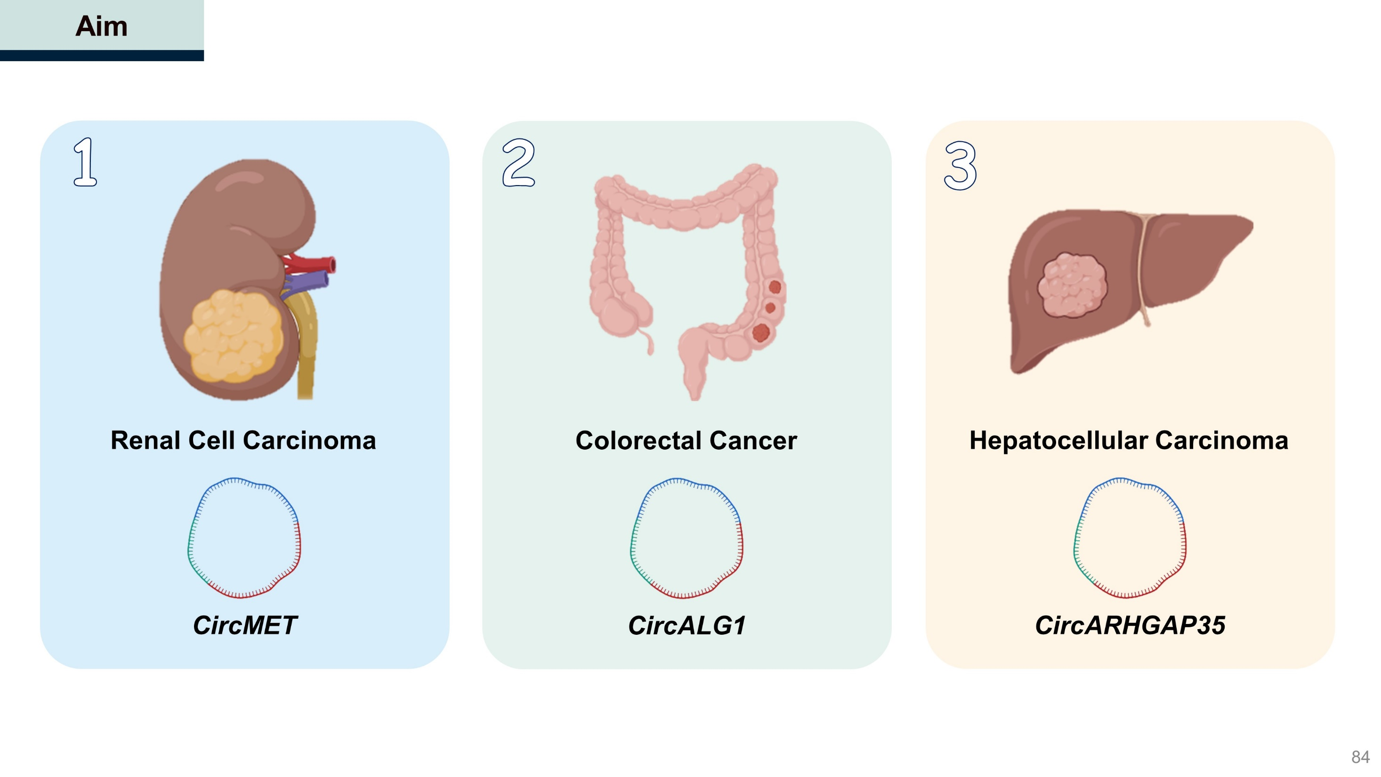
circular RNAs
Notes:
Here I will give some examples to explain the association between cancer and circRNA. There are three circRNA driven from different cancers: circMET is highly expressed in Renal cell carcinoma, circALG1 is highly expressed in colorectal cancer, and circARHGAP35 is highly expressed in hepatocellular carcinoma.

Slide 11
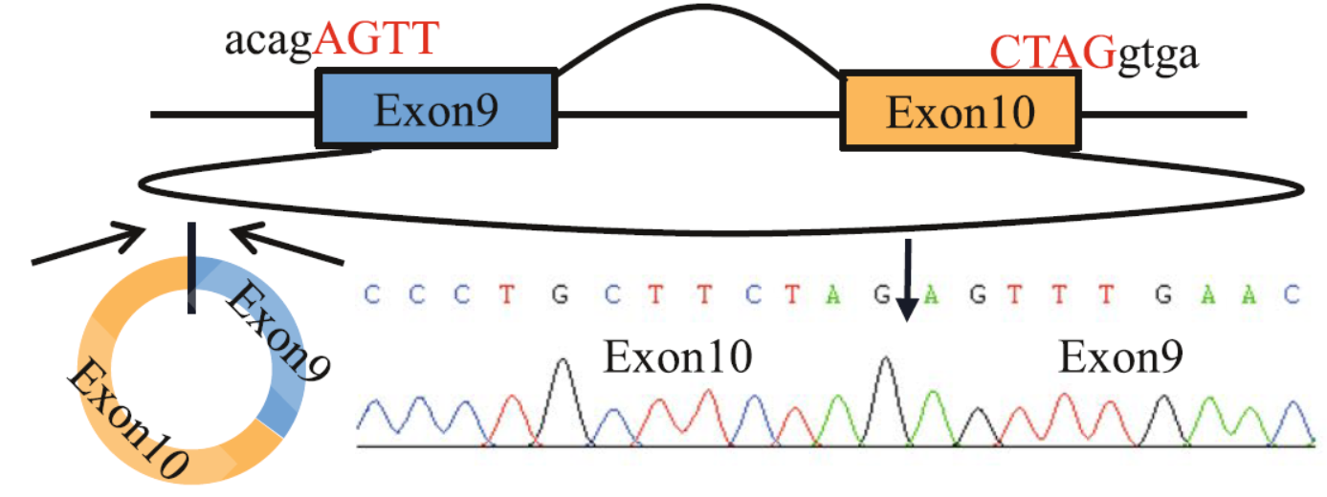
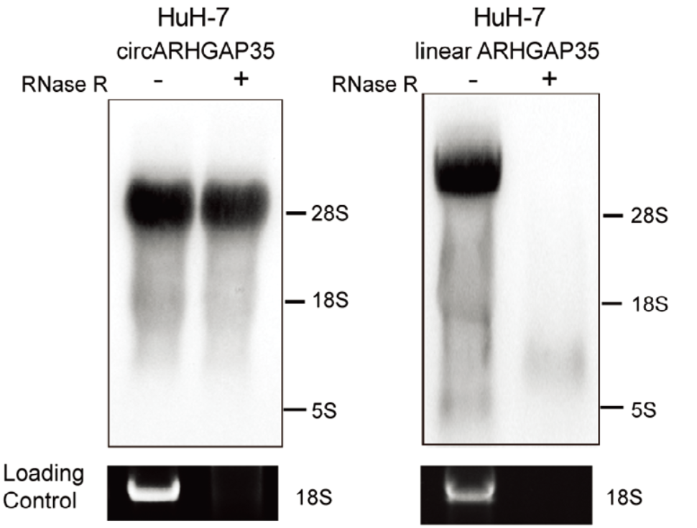
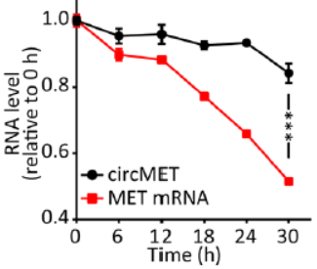
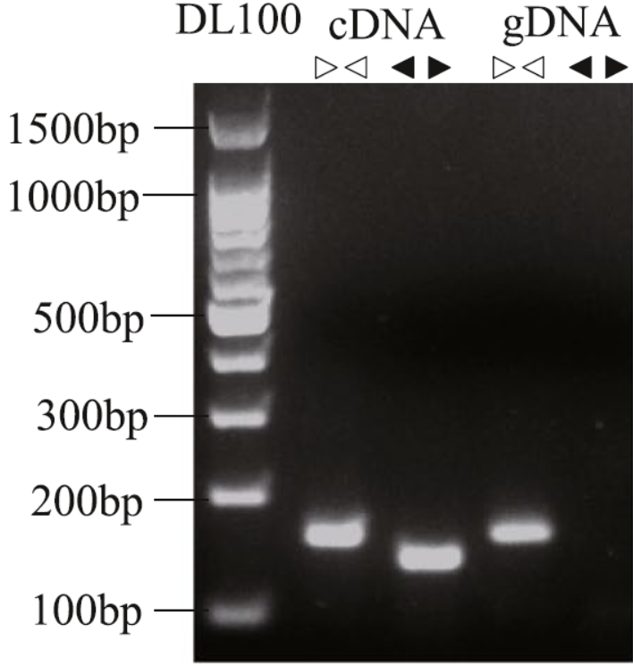
circular RNAs
Characteristic of Circular RNA
CircALG1
CircARHGAP35
CircMET
Exon9
Exon10
Notes:
But there has a big question, how did we know these RNAs are circular RNA? Here I provide some methods to identify circular RNA. Let's take circALG1, for example. Circular RNA has a back-splicing junction, so if we use sanger sequencing to determine the sequence of circRNA, we can find the junction sequence here. Besides, we can also use conversion and diversion primer to identify the circular RNA. Because circRNA is circular form, so divergent primer can amplify circular RNA. However, circular RNA did not exist in genomic DNA, so there has no amplified product in genomic DNA with divergent primer.
Moreover, because circular RNA is circular form, RNA Exonuclease cannot decay circular RNA, this time, we use circARHGAP35, for example. RNase R is an RNA exonuclease, and we can see that after treating with RNase R, the level of circARHGAP35 did not decrease, while linear ARHGAP35 disappeared. Based on the same theory, most circular RNAs are more stable than mRNA. Take circMET, for example. After treatment with a DNA transcription inhibitor, the stability of circMET is greater than MET mRNA. By using these experiments, we can confirm that these circular RNA are circular RNA. Next, let's see how circRNA affects cancer cells.

Slide 12
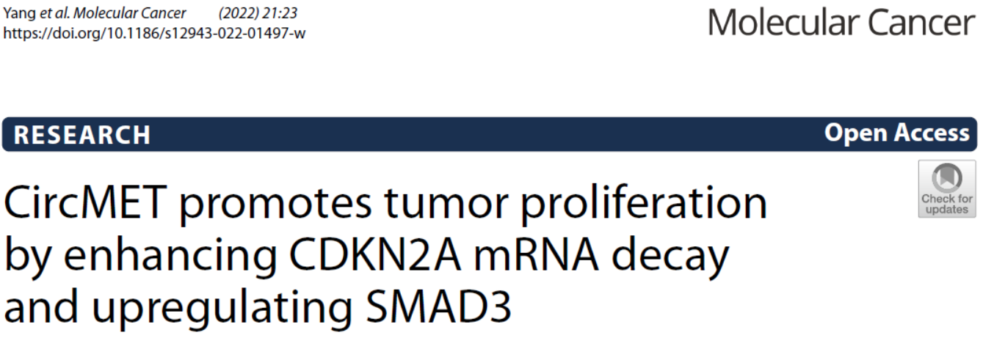
Notes:
The first paper was on the association between circMET and Renal cell carcinoma.

Slide 13

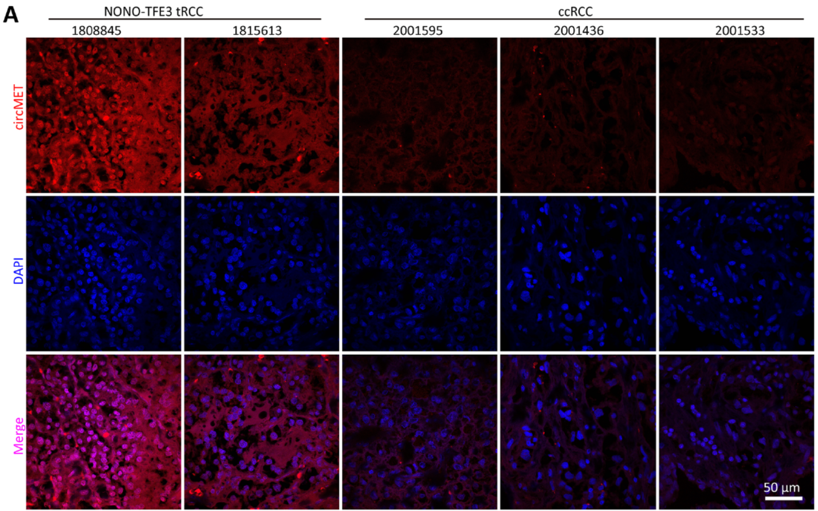
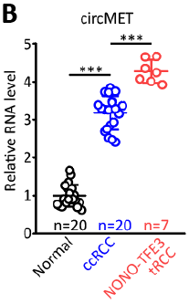
CircMET Significantly Increased in NONO‑TFE3 tRCC
tRCC: Translocation Renal Cell Carcinoma
ccRCC: Clear Cell Renal Cell Carcinoma
Notes:
In this paper, the authors found that circMET was highly expressed in patients with NONO-TEF3 tRCC. NONO-TEF3 tRCC is translocation RCC, it usually cause the tumor growth faster, become more invasive, and poor prognosis.

Slide 14
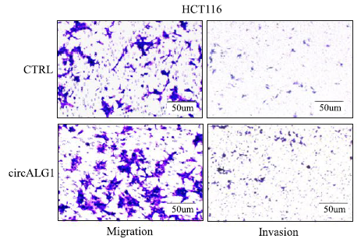
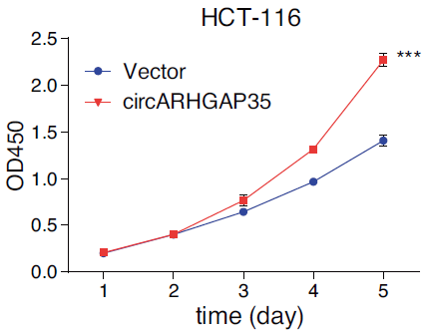
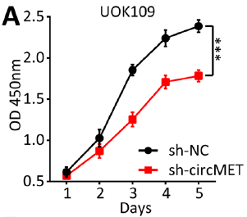
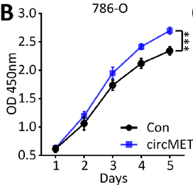
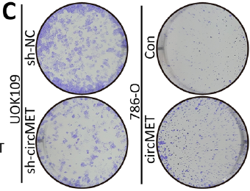
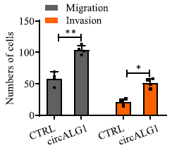
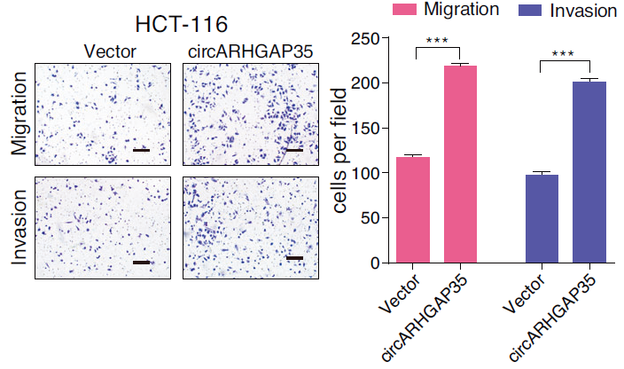
circular RNAs
Circular RNAs in Cancers
CircMET
CircALG1
CircARHGAP35
Notes:
Usually, we look at the cancer progression in two parts: cell proliferation and cell metastasis. Sometimes genes affect only one of these conditions, and sometimes they affect both. For example, when we knock down the expression of circMET, we can find that the ability of cell proliferation is inhibited in the CCK8 assay and colony formation assay. And overexpressed circMET can promote cell proliferation. On the other hand, overexpression of circALG1 can promote cell migration and invasion in a transwell assay. Moreover, circARHGAP35 can promote cell proliferation, migration, and invasion at the same time.

Slide 15
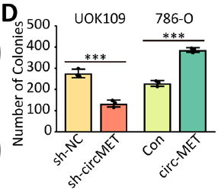
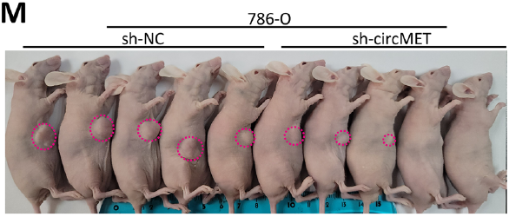
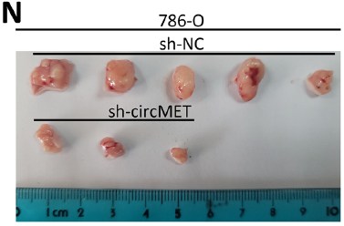
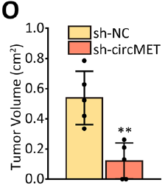
CircMET Accelerates Cell Proliferation
Notes:
To determine the functional role of circMET in NONO-TFE3 tRCC, the author overexpressed or knockdown circMET in two cell lines. We can see that circMET can promote the cell proliferation in CCK8 assay and colony formation in vitro. Additionally, the tumor size was dramatically reduced in the mice injected with circMET knockdown cells as compared to the control group.

Slide 16
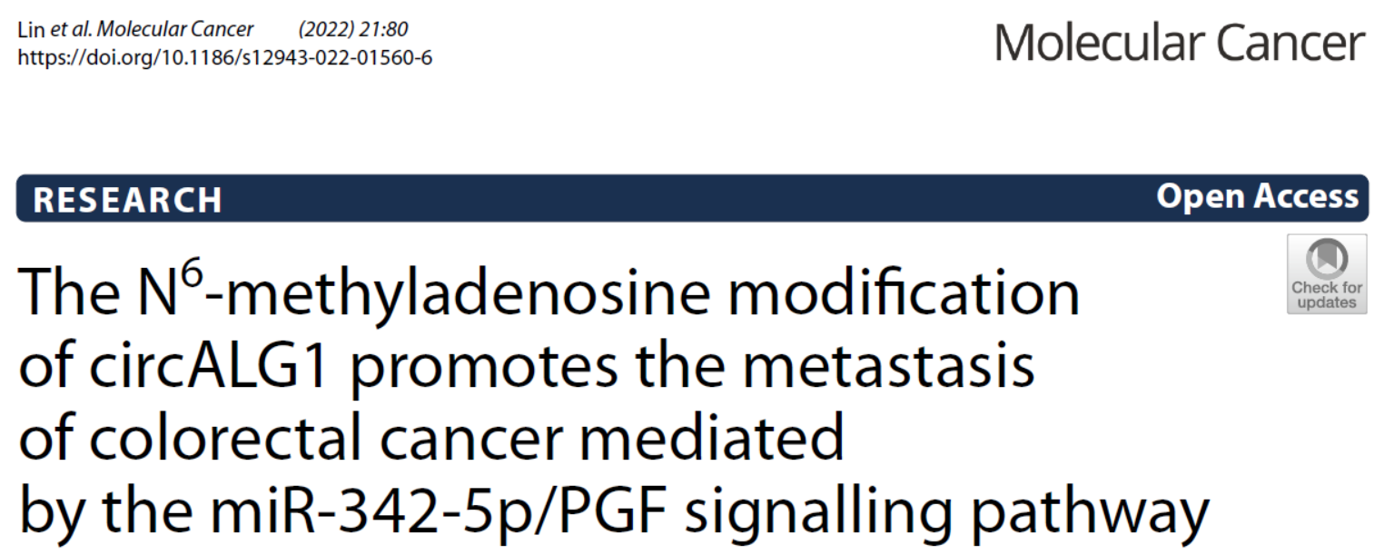
Notes:
The second paper was on the association between circALG1 and colorectal cancer.

Slide 17
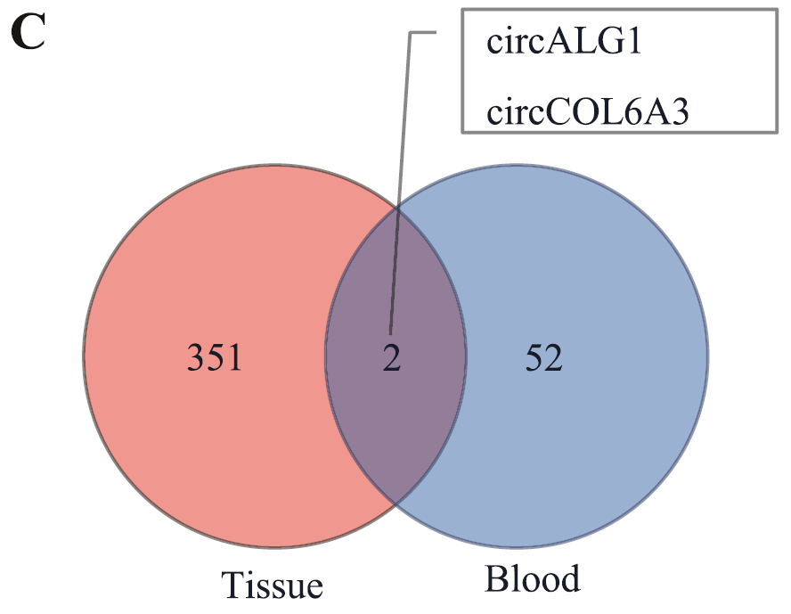
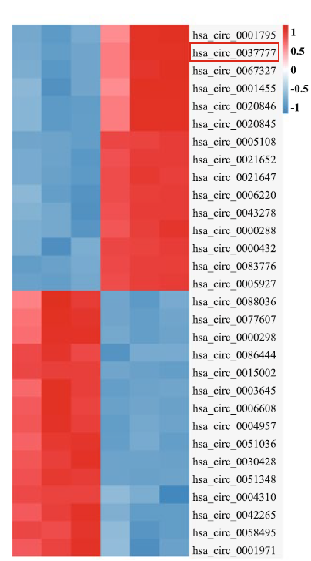
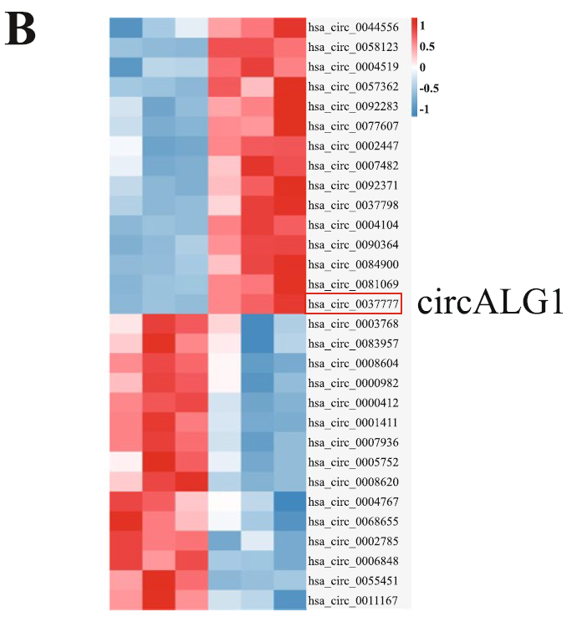
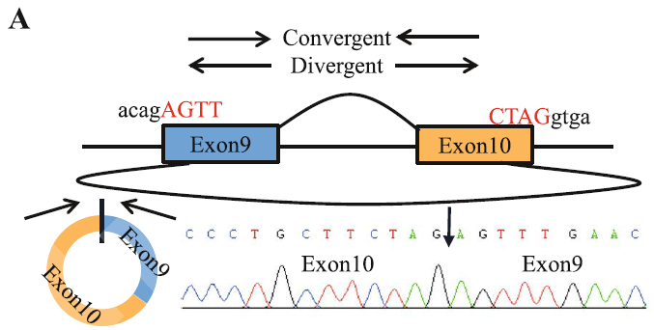
CircALG1 is Highly Expressed in Colorectal Cancer
Tissue
Blood
circALG1
Notes:
In this paper, the authors found that in patients with colorectal cancer, the expression of circALG1 was higher in both tumors and blood.

Slide 18
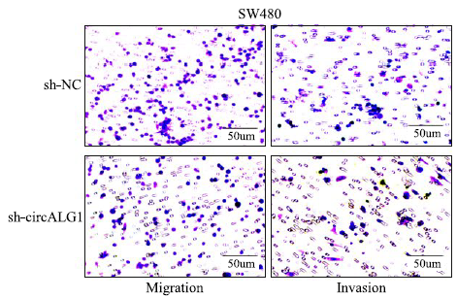
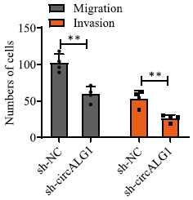
CircALG1 Promoted Migration and Invasion in CRC Cell line
Notes:
To determine the functional role of circALG1 in CRC, the author overexpressed or knockdown circALG1 in two cell lines. We can see that overexpression of circALG1 can promote the cell migration and invasion in transwell assay, and knockdown of circALG1 can inhibit the cell migration and invasion.

Slide 19
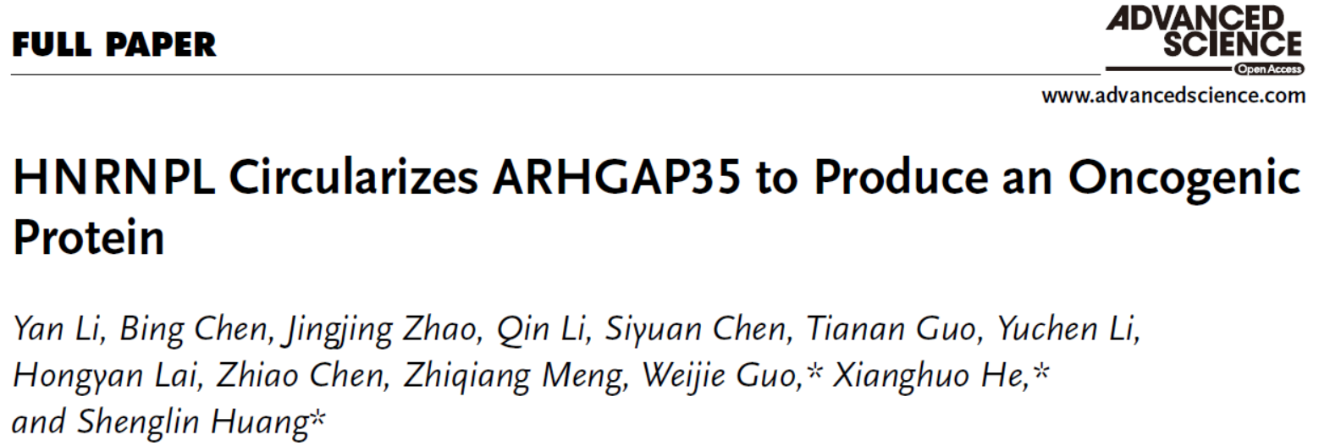
Notes:
The third paper was talk about the association between circARHGAP35 and Heptocellular carcinoma.

Slide 20

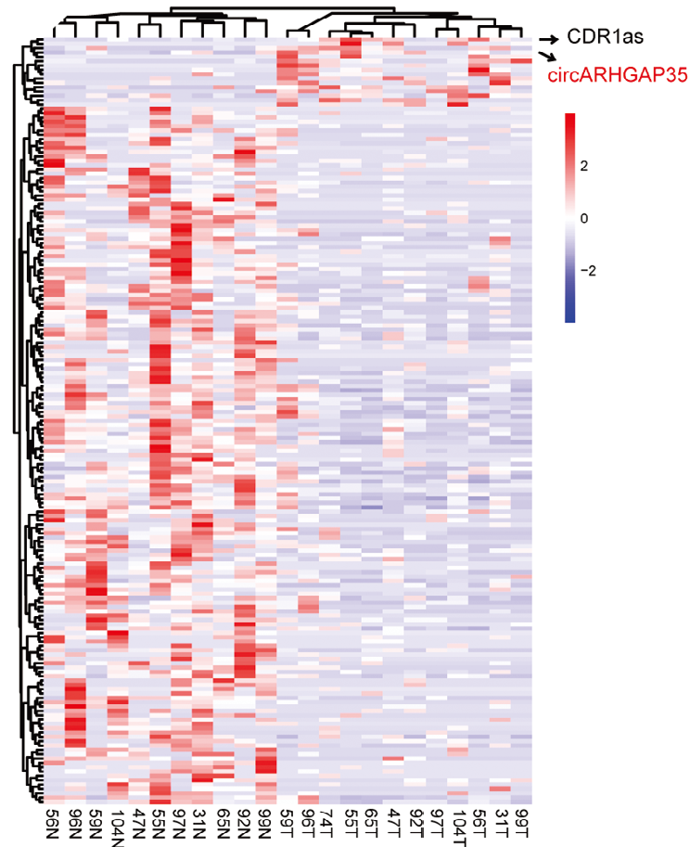
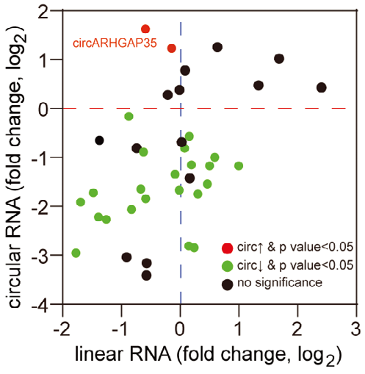
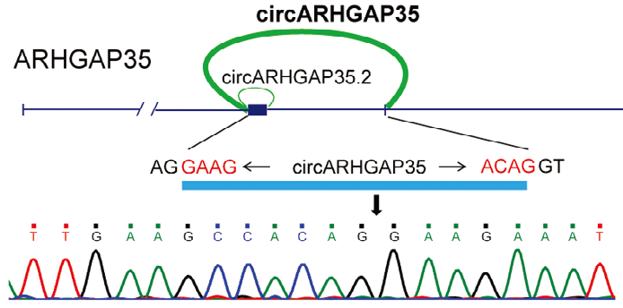
Identification of a circRNA derived from ARHGAP35 gene in HCC
Notes:
In this paper, the authors found that circARHGAP35 was highly expressed in hepatocellular tissue than normal tissue.

Slide 21
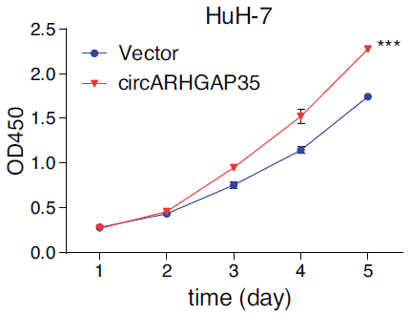
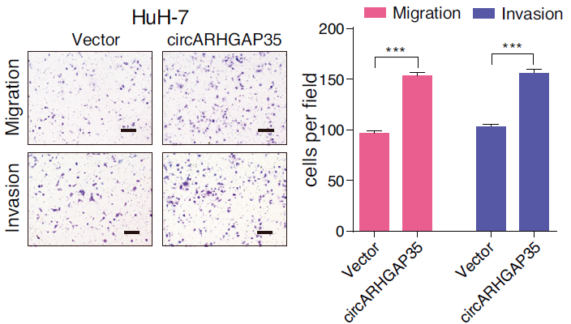
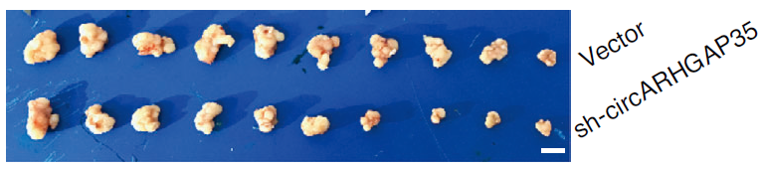
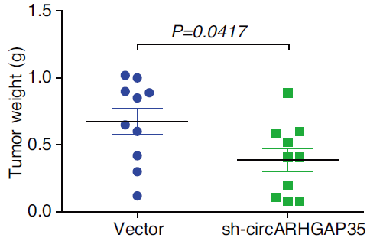
CircARHGAP35 Promoted Tumor Progression
Notes:
Same as the previous study, the author overexpressed circARHGAP35 in two CRC cell lines. We can see circARHGAP35 promoted the cell proliferation, migration, invasion, and tumor genesis.

Slide 22
circular RNAs
Proliferation
Metastasis
Proliferation
Metastasis
Notes:
In conclusion, these three circRNAs are highly expressed in cancer and play oncogenic roles. Next, we will explore the unique features of these three circRNAs and how did the author find that.

Slide 23
circular RNAs
N⁶-methyladenosine modification
RNA m⁶A
Notes:
After we talked about circRNAs (click), the next thing we should know is N6 methyladenosine modification (click), also called RNA m6A modification.

Slide 24

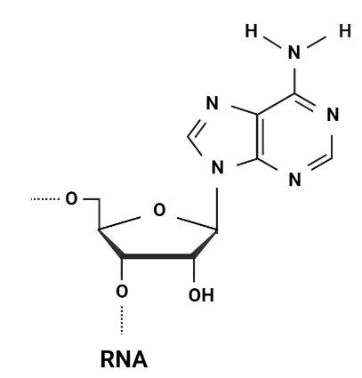

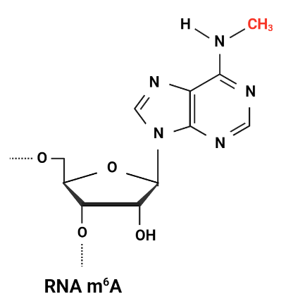


RNA m⁶A
RNA N⁶-Methyladenosine Modification
Methylation
Demethylation
Notes:
RNA m6A modification is an epigenetic modification. When methylation occurs at the sixth N position of adenosine, it is what we call m6A. The proteins can methylate RNA called Writer. On the other hand, the proteins can demethylate RNA called Eraser.
In addition, the proteins can recognize m6A and affect a downstream mechanism called Reader.

Slide 25
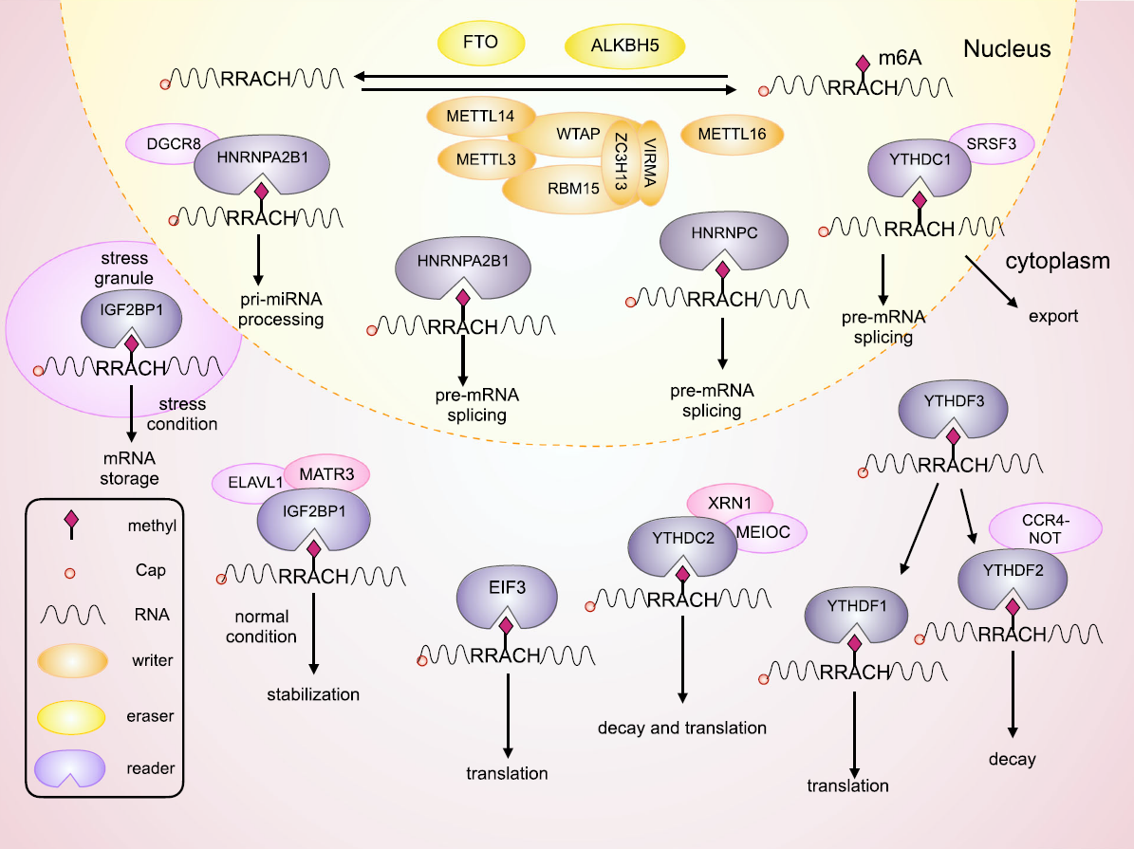
RNA m⁶A
Writer, Eraser, and Reader
m⁶A motif
RRACH
He L, et al. Mol Cancer, 2019
Notes:
The writer and eraser are mainly involved in methylation modification in the nucleus. They can recognize the m6A motif RRACH and methylate or demethylate the adenosine. However, the Reader has a more diverse function. The Reader can affect RNA splicing and export RNA to the cytoplasm and affect RNA stability and translation ability.

Slide 26

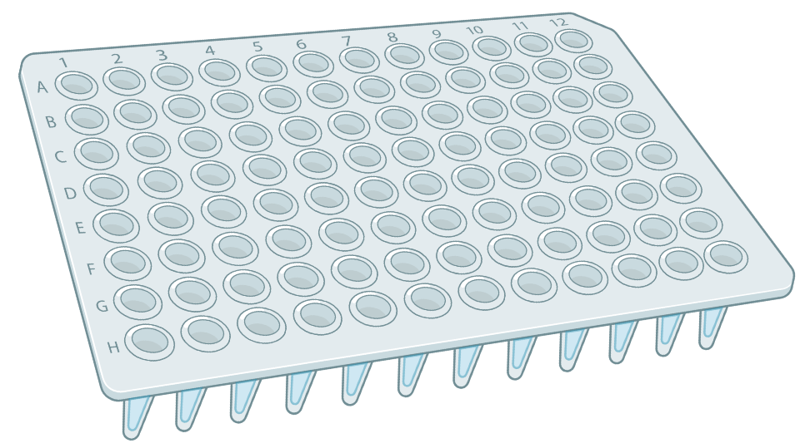
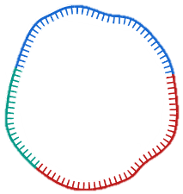
Methylated RNA immunoprecipitation
m⁶A RIP(meRIP)
Magnet Antibody
Me
Real-Time PCR
Notes:
Before we talk about how the author finds the m6A modification on circular RNA, let me introduce a method to detect m6A on circRNA called meRIP. The principle of meRIP is to use a magnet antibody to recognize the m6A on RNA, then use a magnet to pull down the complex, then extract the RNA on antibody followed by real-time PCR to detect the RNA level. By using this method, we can detect the m6A on RNA.

Slide 27
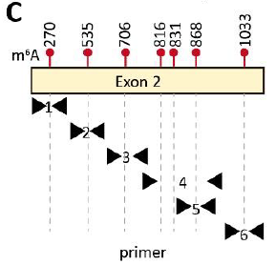
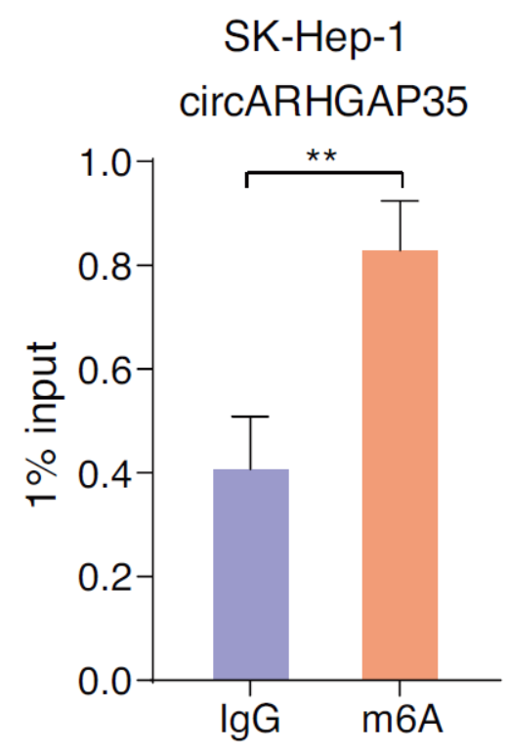
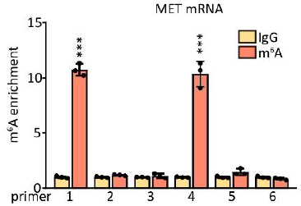
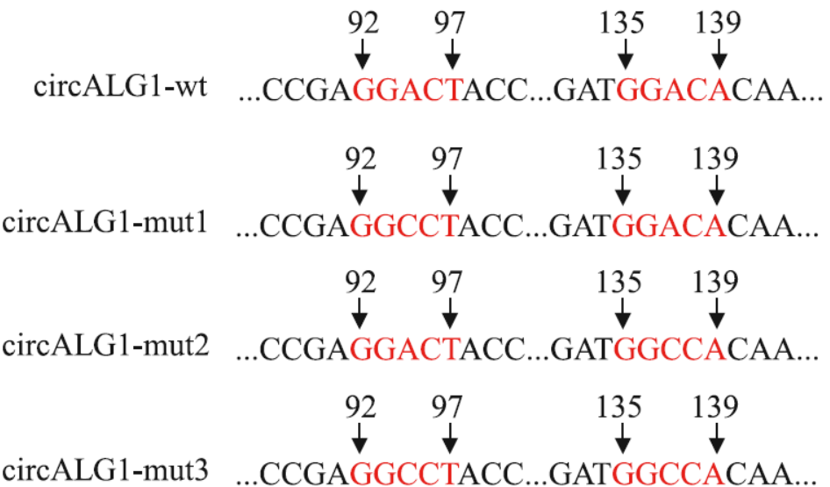
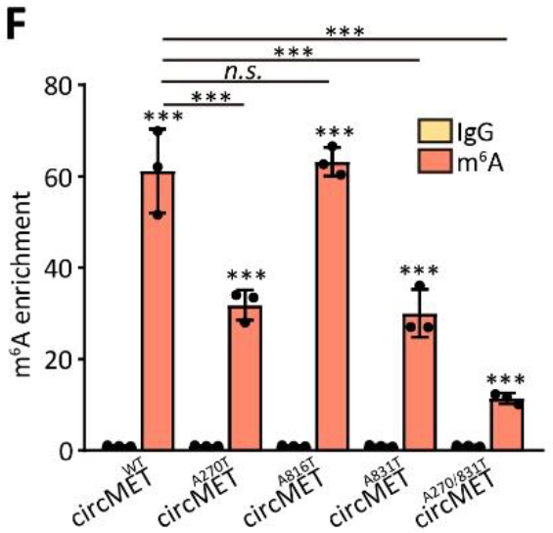
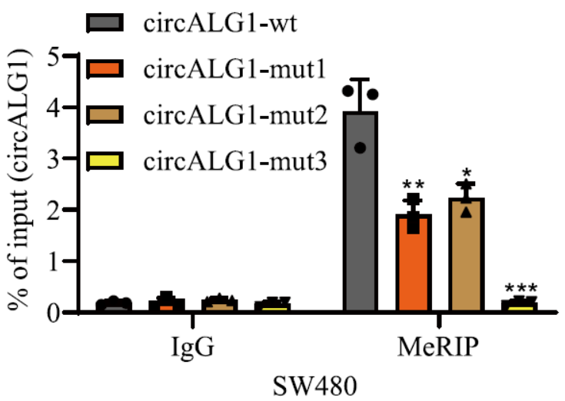
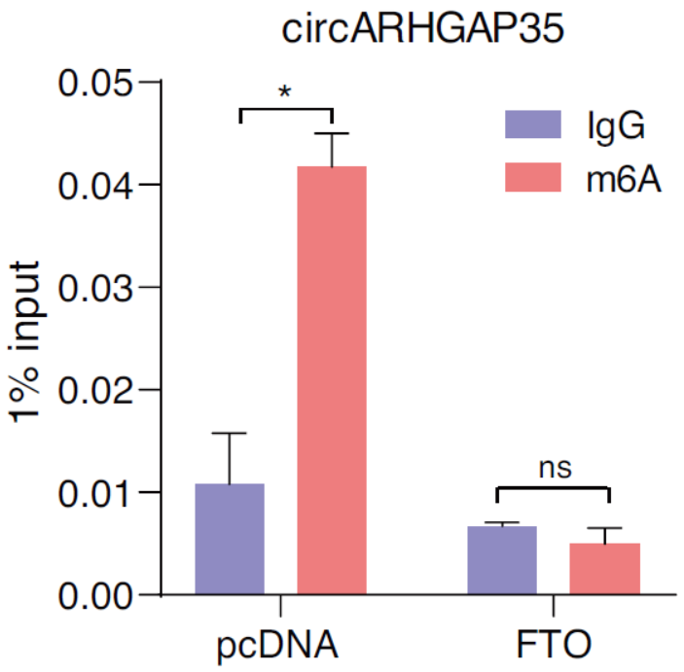
Detected the m⁶A Modification on CircRNA
CircMET
CircALG1
CircARHGAP35
Notes:
Now, Let’s take a look at circMET. CircMET has been predicted for seven potential m6A site, and the author used the meRIP assay and different primer set to validate which predicted site have m6A modification. We can see that circMET has m6A modification on site one and site four. Also, the author mutant different m6A sites, then the m6A enrichment was reduced on circMET. We can see the same protocol used to check the m6A site on circALG1. The author mutant two m6A sites followed by meRIP assay, and the m6A modification on circALG1 significantly reduced. For the third paper, the author used the meRIP assay to check that circARHGAP35 has m6A modification. However, different from the previous two reports, the author overexpressed an m6A ERASER, FTO, in cells and found that the m6A on circARHGAP35 was reduced. These data demonstrate that three circRNAs have m6A modification on them. But what will happen after m6A modification on circRNAs? This is the most important issue I would like to introduce today.

Slide 28
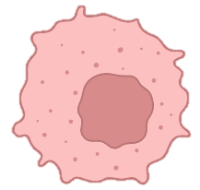
Aim
Cancer Cells
Me
CircRNA
Me
Notes:
In the following time, I will give you some information about the association between circRNAs and m6A modification in cancer and explore their impact on cancer development.

Slide 29
Notes:
In conclusion, all three circRNAs are highly expressed in cancer and all play oncogenic roles. Next, we will explore what are the special features of these three circRNAs and how did author find that.

Slide 30







Results
The m⁶A Modification Influenced CircARHGAP35 Biogenesis
CircARHGAP35
HNRNPL
Me
Pre-mRNA splicing
Notes:
In previous studies, HNRNPL has demonstrated that it is an m6A reader and can affect pre-mRNA splicing. In addition, the author finds two upstream and two downstream m6A site on circARHGAP35 pre-mRNA, then use RIP assay to demonstrate that HNRNPL can target the UP1 and DOWN2 area. Next, the author constructs two circGFP plasmids, which have an HNRNPL target site or not. qPCR results show that circGFP was highly expressed in the construct with the HNRNPL target site, and knockdown of HNRNPL can reduce the expression of circGFP.

Slide 31


Summary
circARHGAP35
m6A
HNRNPL
Notes:
So, the first mechanism of m6A modification on circRNAs is that it can affect the biogenesis of circRNAs. Here we go on the following results.

Slide 32





Results
YTHDC1 Binds to m⁶A Site and Exported CircMET to Cytoplasm
CircMET
RNA Pulldown
RIP
YTHDC1
Me
RNA Export
Notes:
CircMET is mainly located in the cytoplasm. However, when the author mutant the m6A site on circMET, they found that the location of circMET become different. YTHDC1 has reported that it is an m6A reader, which can affect the RNA export. In addition, the author uses RNA pulldown assay and RIP assay to demonstrate that circMET can bind to YTHDC1.

Slide 33




RNA Pulldown
RNA Immunoprecipitation
(RIP)
Magnet Antibody
Magnet Probe
Western Blotting
Real-Time PCR
Notes:
Some people may confuse about what are RNA pulldown assay and RIP assay. Let me briefly talk about it. RNA pulldown assay uses a magnet probe to capture the circular RNA. If there has a protein that binds to circular RNA, we can use the magnet to pull down the complex, then use western blotting to verify the protein. RIP assay uses a magnet antibody to capture the RNA binding protein. If there has a RNA that binds to this protein, we can use the magnet to pull down the complex, then use real time PCR to verify the RNA.

Slide 34




Results
CircMET is Exported to Cytoplasm by YTHDC1
CircMET
ALKBH5: m⁶A Demethylase
Notes:
After demonstrating that circMET binds with YTHDC1, the author knocked down YTHDC1 and found that circMET is mainly located in the nucleus. On the other hand, removing the m6A on circMET also causes circMET to be mainly located in the nucleus.

Slide 35

Summary
YTHDC1
circARHGAP35
m6A
m6A
circMET
HNRNPL
Notes:
These data show that the m6A modification on circMET can enhance its export to the cytoplasm. However, what will happen after circMET export to the cytoplasm?

Slide 36




Results
CircMET Downregulates CDKN2A mRNA by Direct Binding
CircMET
Luciferase assay
circMET
mRNA
CDKN2A
RNA pulldown
Proliferation
CDKN2A : cyclin-dependent kinase inhibitor 2A, inhibit cell proliferation.
Notes:
As we mentioned earlier, circMET can promote cell proliferation. So, the author wants to figure out which cell cycle-associated mRNA will be affected by circMET. They screened 16 mRNA with luciferase assay and found that CDKN2A significantly upregulated after the knockdown of circMET. Also, mutants of the binding site of CDKN2A and circMET removed this pattern. The author also shows that knockdown circMET can enhance the expression of CDKN2A, and overexpressed circMET can inhibit the expression of CDKN2A. In addition, RNA pulldown assay shows that circMET can directly bind with CDKN2A.

Slide 37




Results
CircMET Decreased CDKN2A mRNA Stability
CircMET
circMET
CDKN2A
Proliferation
Notes:
To further investigate how circMET decreased the expression of CDKN2A, the author used an RNA transcription inhibitor to see whether circMET would affect the stability of CDKN2A or not. We can see that after the knockdown of the circMET, the CDKN2A becomes more stable. Moreover, removing the m6A on circMET also enhances the stability of CDKN2A. On the other hand, overexpressed circMET reduced the stability of CDKN2A. And the CDKN2A protein also has the same trend.

Slide 38




Results
CircMET Recruited YTHDF2 to Accelerate the Decay of CDKN2A
CircMET
RIP
circMET
Luciferase
CDKN2A 3’UTR
YTHDF2
YTHDF2
Me
CDKN2A
RNA Decay
Proliferation
Notes:
YTHDF2 has been reported that it is an m6A reader and it can affect mRNA stability. In addition, RIP assay shows that circMET can recruit YTHDF2 to bind with CDKN2A, and luciferase assay also shows that overexpressed circMET can reduce the level of CDKN2A but knockdown the YTHDF2 at the same time will reverse this phenomenon.

Slide 39

Summary
Proliferation
YTHDF2
m6A
circMET
CDNK2A
YTHDC1
circARHGAP35
m6A
m6A
circMET
HNRNPL
Notes:
These data show that the m6A modification on circMET will recruit the m6A reader, YTHDF2, and accelerate the decay of CDKN2A, then enhance cell proliferation. Now we move on to the next circRNA.

Slide 40
HNRNPL
YTHDC1
YTHDF2
YTHDF1
Me
Me
Me
Me
Pre-mRNA splicing
RNA Export
RNA Decay
RNA Stability
METTL3
FTO
Me
Me
RNA Methylation
RNA Demethylation

Slide 41





Results
The m6A Modification of CircALG1 Enhanced its Stability
CircALG1
METTL3
Me
RNA Methylation
RNA Pulldown
RIP
YTHDF1
Me
RNA Stability
Notes:
METTL3 is an m6A writer. After the knockdown of METTL3, the level of m6A on circALG1 significantly decreased. Without the m6A modification, the stability of circALG1 decreased. So the author found another reader associated with RNA stability, YTHDF1. With the RNA Pulldown and RIP assay, circALG1 can directly interact with YTHDF1. Besides, the knockdown of the YTHDF1 can also inhibit the stability of circALG1.

Slide 42





Results
CircALG1 Sponge with miR-342-5p
CircALG1
RNA Pulldown
circALG1
miR-342-5p
Luciferase Assay
PGF
Migration
Invasion
PGF
Notes:
After that, the author uses bioinformatic tools to predict that circALG1 can interact with miR-342-5p, and RNA pulldown shows that circALG1 can sponge with miR-342-5p. Then, the author extracted the RNA after the knockdown of circALG1 for RNA sequencing and used a bioinformatic tool to predict the target gene of miR-342-5p. They found seven gene overlap in two data set, and PGF was chosen for further study because it is highly associated with CRC progression. The luciferase assay shows that mir-342-5p can inhibit the activity of PGF.

Slide 43



Results
PGF was a Downstream Target of the CircALG1/miR-342-5p Axis
CircALG1
circALG1
miR-342-5p
PGF
Migration
Invasion
Notes:
Next, the author overexpressed PGF after knockdown circALG1 or overexpressed miR-342-5p to see whether the migration would be rescued. We can see that PGF rescued cell migration and invasion after knockdown circALG1 or overexpressed miR-342-5p in CRC cells.

Slide 44

Summary
YTHDF1
Proliferation
m6A
YTHDF2
circALG1
Migration
Invasion
m6A
circMET
miR-342-5p
PGF
CDNK2A
YTHDC1
circARHGAP35
m6A
m6A
circMET
HNRNPL
Notes:
In conclusion, the m6A modification of circALG1 can enhance its stability and sponge more miR-342-5p and upregulated the level of PGF, then improve the cell migration and invasion.

Slide 45





Results
CircARHGAP35 Encode a Protein with m⁶A Modification
CircARHGAP35
FTO
Me
RNA Demethylation
Notes:
Here we go to on next circRNA, circARHGAP35. circARHGAP35 has an open reading frame, so the author assumes that circARHGAP35 can translate protein. In addition, the author constructs three plasmids; the first can produce circARHGAP35, and the second adds the flag sequence before the stop codon. The third one removes the Alu sequence on the plasmid. The Alu sequence can help circRNA formation. The western blot shows that circARHGAP35 can translate proteins, and mass spectrometry analysis also identifies the specific sequence of circARHGAP35 protein. Besides, after overexpressing the m6A eraser, FTO, the level of circARHGAP35 protein significantly decreased. This suggests that the m6A on circARHGAP35 can promote translation ability.

Slide 46




Results
The circARHGAP35 Protein Interacts with TFII-I in the Nucleus
CircARHGAP35
Notes:
The authors investigated the structure of circARHGAP35 protein and found four FF domains on it. Previous evidence suggested an interaction between the transcriptional regulator TFII-I and the FF domains. In addition, the author hypothesized that circARHGAP35 protein might form a complex with TFII-I. Indeed, the nuclear localization of both TFII-I and circARHGAP35 protein. Then the author performed co-immunoprecipitation assays using anti-Flag or anti-TFII-I antibodies and confirmed the interaction between TFII-I and circARHGAP35 protein.

Slide 47




Results
CircARHGAP35 Protein Interacts with TFII-I in the Nucleus
CircARHGAP35
circARHGAP35
circARHGAP35
Protein
TFII-I
Proliferation
Migration
Notes:
After confirming the interaction between TFII-I and CircARHGAP35 protein, the author wants to know how circARHGAP35 protein affects TFII-I in the cancer cell. After overexpressing circARHGAP35 protein, we can see that the cell proliferation was upregulated, and knockdown TFII-I will inhibit the proliferation. In addition, the cell migration and invasion also increased after overexpressing circARHGAP35 protein and decreased after the knockdown of TFII-I.

Slide 48




Summary
YTHDF1
Proliferation
m6A
circARHGAP35
YTHDF2
circALG1
Migration
Invasion
m6A
m6A
circMET
miR-342-5p
PGF
circARHGAP35 protein
CDNK2A
circARHGAP35
Proliferation
Migration
Invasion
YTHDC1
m6A
m6A
circMET
HNRNPL
Notes:
In summary, after m6A modification on circARHGAP35, it can translate protein. This protein will go into the nucleus and target the transcription factor TFII-I, then promote cell proliferation, migration, and invasion. Taken together, the m6A modification on each circRNA causes a different mechanism. This new epigenetic approach to RNA opens up new research areas and allows us to gain a deeper understanding of the biological mechanisms of the cell.

Slide 49
Thank you for listening!
Notes:
Thank you for listening.

Slide 50



Aim
1
2
3
Renal Cell Carcinoma
Colorectal Cancer
Hepatocellular Carcinoma
CircMET
CircALG1
CircARHGAP35

Slide 51
Results

Slide 52



Results
Characterization of CircMET in NONO‑TFE3 tRCC
Convergent Primer
Exon 2 of MET
Divergent Primer
α-amanitin: an inhibitor of transcription

Slide 53


Results
CircMET is Predominantly Located in the Cytosol

Slide 54


Results
CircMET Accelerates Proliferation of NONO‑TFE3 tRCC
CCK8
Colony Formation
Tumor Sphere Formation

Slide 55






Results
CircMET Accelerates Proliferation of NONO‑TFE3 tRCC
EdU assay

Slide 56

Results
CircMET Accelerates Proliferation of NONO‑TFE3 tRCC

Slide 57

Results
NONO-TFE3 Directly Interacted with the Promoter of MET

Slide 58

Results
NONO-TFE3 Promotes Tumor Progression by Upregulating CircMET

Slide 59


Results
CircMET Interacted with YTHDC1
MS2-RIP
RIP: RNA immunoprecipitation

Slide 60



Results
CircMET is Exported to Cytoplasm by YTHDC1

Slide 61

Results
CircMET is Exported to Cytoplasm by YTHDC1
dCas13-NLS
information
ALKBH5: m⁶A Demethylase

Slide 62

Results
CircMET Downregulates CDKN2A mRNA by Direct Binding

Slide 63


Results
CircMET Accelerates the Decay of CDKN2A by Recruitment of YTHDF2
MS2-RIP

Slide 64

Results
CircMET Downregulates CDKN2A mRNA by Direct Binding
CDNK2A : cyclin-dependent kinase inhibitor 2A, inhibit cell proliferation.

Slide 65

Results
CircMET Accelerates the Decay of CDKN2A by Recruitment of YTHDF2

Slide 66

Results
CircMET functions as a ceRNA to sponge miR-1197

Slide 67


Results
CircMET Interacted with YTHDC1
RNA Pulldown
RIP
Pulldowon RIP 示意圖
RIP: RNA immunoprecipitation

Slide 68

Results
CircMET functions as a ceRNA to sponge miR-1197

Slide 69

Results
CircMET functions as a ceRNA to sponge miR-1197

Slide 70

Results
miR-1197 binds to 3’-UTR of SMAD3 mRNA

Slide 71

Results
CircMET promotes SMAD3 expression

Slide 72

Results
miR-1197 inhibits cell proliferation by downregulated SMAD3

Slide 73
Results

Slide 74

Conclusion

Slide 75

Results
CircALG1 is Highly Expressed in Colorectal Cancer

Slide 76

Results
CircALG1 is Highly Expressed in Colorectal Cancer

Slide 77



Results
Characterization of CircALG1 in CRC Cells

Slide 78


Results
Characterization of CircALG1 in CRC Cells

Slide 79

Results
CircALG1 Promoted CRC Metastasis In Vivo

Slide 80

Results
CircALG1 Promoted CRC Metastasis In Vivo

Slide 81




Results
The m6A Modification of CircALG1 Enhanced its Stability

Slide 82

Results
CircALG1 Promotes Migration and Invasion through miR-342-5p

Slide 83

Results
PGF was a Downstream Target of the CircALG1/miR-342-5p Axis

Slide 84

Results
PGF was a Downstream Target of the CircALG1/miR-342-5p Axis

Slide 85

Results

Slide 86
Results
Notes:
為了找出跟缺氧相關的circRNA，過去實驗室將MCF-7乳癌細胞進行normoxia hypoxia reoxygenation三種處理，這樣的處理方式可以區分出變化的RNA是和氧氣相關還是和壓力相關，將sample進行RNA-seq定序後，我們利用CIRI這個circRNA的分析軟體來找出各組間有變化的circRNA，而表格中列舉的三個candidate是在乳癌中表現量較高且在缺氧情況下有上升的circRNA，最後我選定circSFMBT2作為研究的對象。

Slide 87




Results
CircARHGAP35 and ARHGAP35 have Antithetical Functions

Slide 88



Results
CircARHGAP35 Promoted Tumor Progression

Slide 89



Results
Expression and Location of circARHGAP35 in HCC Tissues

Slide 90



Results
Identification CircARHGAP35 in HCC Cell Lines

Slide 91




Results
CircARHGAP35 Encoded a Protein
CircARHGAP35

Slide 92




Results
HNRNPL Regulates CircARHGAP35 Formation
CLIP

Slide 93




Results
ARHGAP35 and circARHGAP35 have the Antithetical Roles in Cancer

Slide 94





Results
HNRNPL Regulates CircARHGAP35 Formation

Slide 95

Results
CircARHGAP35 is Associated with Poor Survival in Cancer

Slide 96

Results
CircARHGAP35 is Associated with Poor Survival in Cancer

Slide 97

Results
CircARHGAP35 is Associated with Poor Survival in Cancer

Slide 98

Results
CircARHGAP35 is Associated with Poor Survival in Cancer

Slide 99

Conclusion

