Slide 1
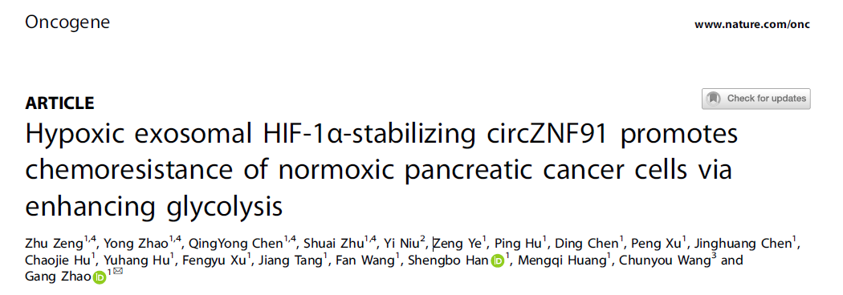
Speaker : Yi-Chun Ke
Advisor : Liang-Chuan Lai Ph.D.
Date : 2022.09.06
Notes:
Good morning everyone Im today’s first speaker, Yi-Chun Ke, and my advisor is professor Liang-Chuan Lai.
The paper I want to share today is to explore the effect of hypoxic exosomal circRNA on the chemoresistance of pancreatic cancer

Slide 2
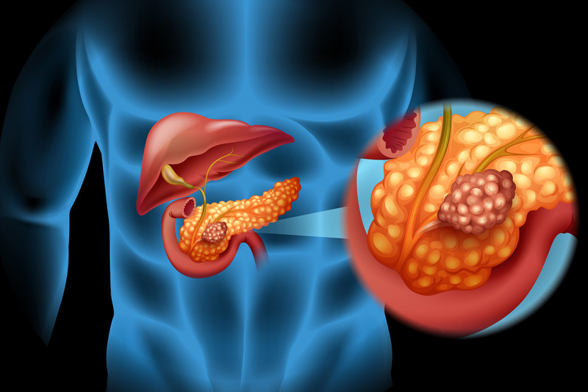
Introduction
Pancreatic cancer (PC)
early symptom concealment
delayed diagnosis
insensitivity to chemoradiotherapy
Notes:
Pancreatic cancer (PC) is a malignant disease with a 5-year survival rate of only 9% due to the early symptom concealment, delayed diagnosis, and insensitivity to chemoradiotherapy.

Slide 3
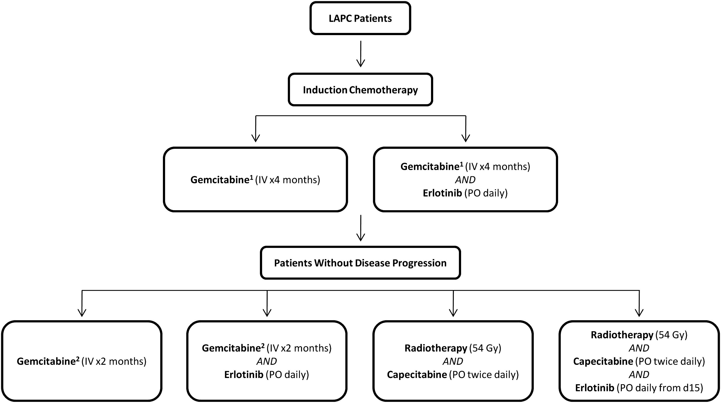
Introduction
Chemotherapy regimen for PC
Gemcitabine (GEM)
Int. J. Radiation Oncology Biol. PhysOncol, 2012
Notes:
At present, the chemotherapy regimen for pancreatic cancer is mainly Gemcitabine (GEM) or a combination regimen based on it.
However, pancreatic cancer had obvious innate and acquired resistance to GEM with clinical application.
Therefore, its urgent to explore the chemoresistance mechanism of PC cells and find the more efficient drug formulations.

Slide 4
Introduction
Hypoxia
Hypoxia
High metabolic rate
Poor vascularization
Hypoxia
Normoxia
O₂ gradient
World J Gastrointest Oncol, 2021
Notes:
According to previous studies, drug resistance is tightly associated with hypoxia.
Hypoxia is a state in which oxygen is not available in sufficient amounts at the tissue or cells.
This condition has become the most common microenvironmental characteristic in rapidly growing solid tumors since they perform high level of metabolic rates, and poor vascularization.

Slide 5
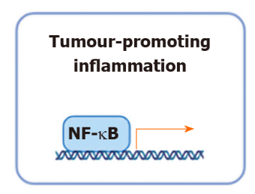
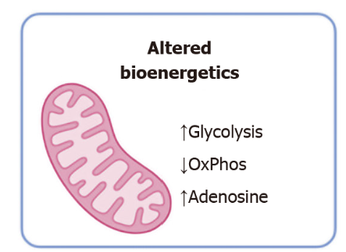
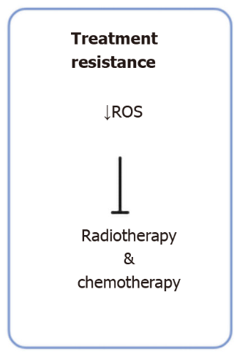
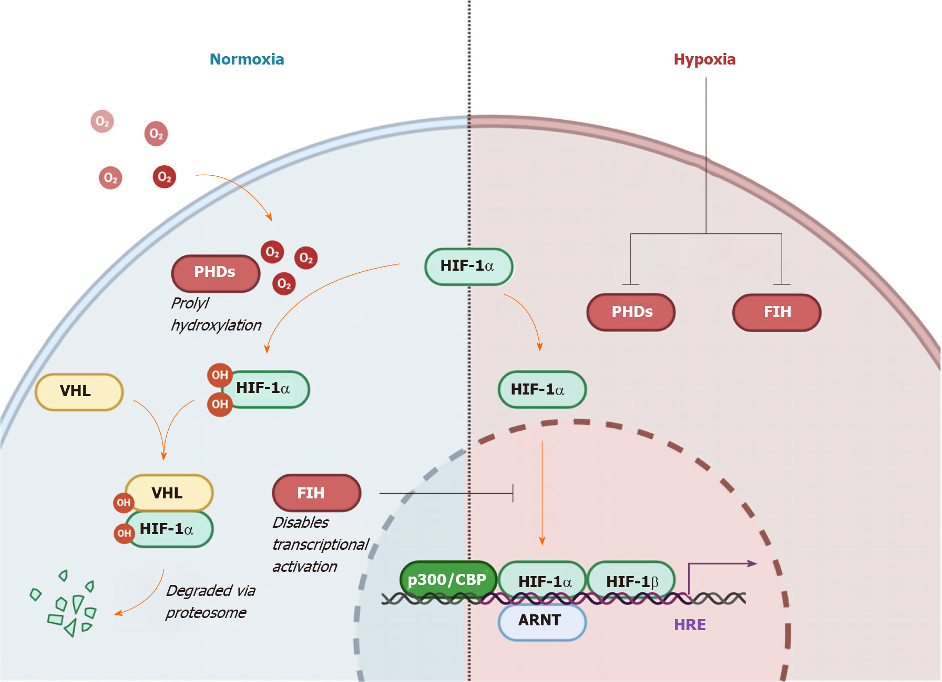
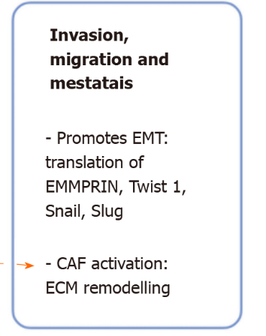
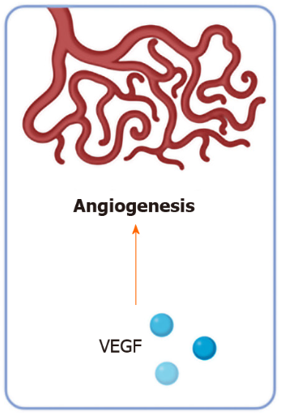
Introduction
Hypoxia-inducible factor 1-α (HIF-1a)
World J Gastrointest Oncol, 2021
Notes:
Tumor cells, while adapting to hypoxia, lead to more aggressive and metastatic phenotypes.
In this process, the increased expression of hypoxia-inducible factor 1α (HIF-1α) is a pivotal hallmark.
It can transcriptionally activates a set of genes to promote tumor cell survival, treatment resistant, or angiogenesis.
Among them, the increase of glycolysis and chemoresistance under hypoxia are the focus of this paper.

Slide 6
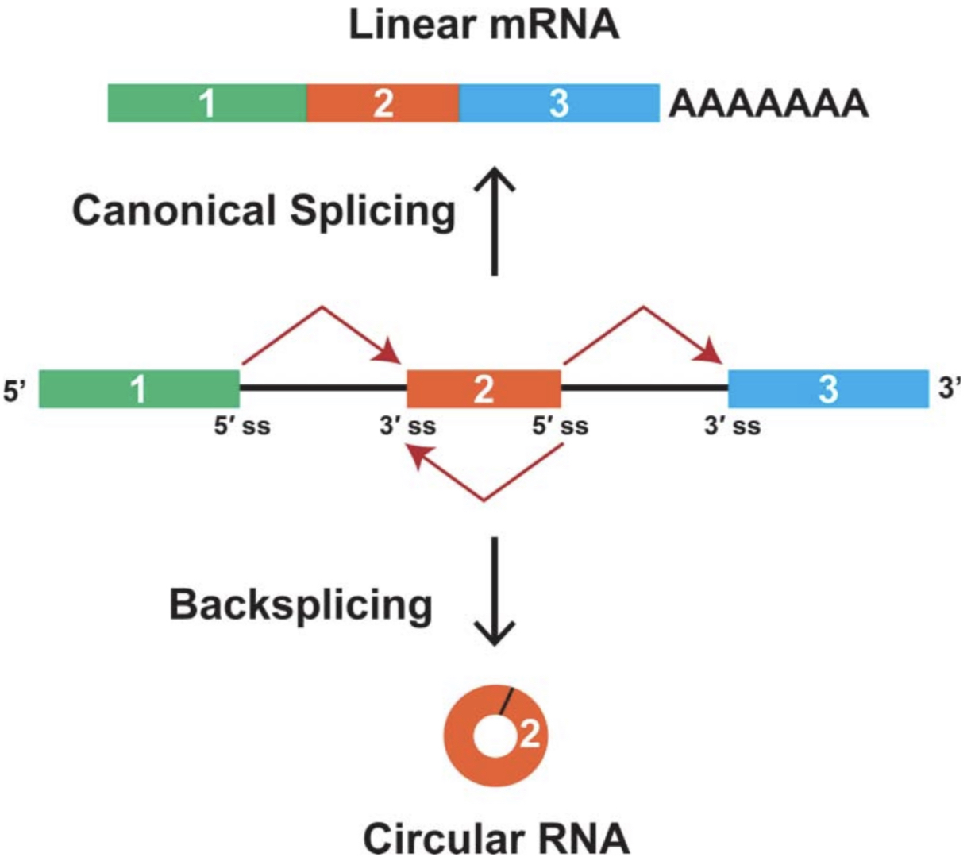
Introduction
Circular RNA (circRNA)
Resistant to Rnase R
High stability
Notes:
Next, I will introduce two non-coding RNA.
First, Circular RNAs, we will call it circRNA for short, are produced by back splicing of pre-mRNA.
Unlike linear RNAs, circRNAs form a covalently closed continuous loop without a 5′ cap and 3′ poly A tail, therefore, they are resistant to Rnase R and have high stability.

Slide 7
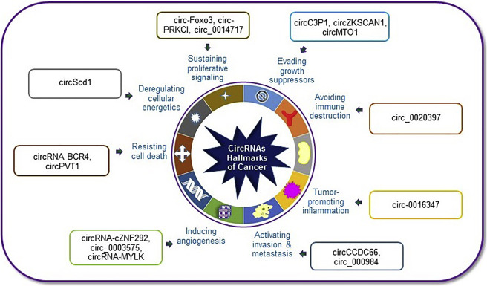
Introduction
Circular RNA (CircRNA)
Molecular Therapy - Nucleic Acids. (2019)
Notes:
Although circRNAs are defined as a class of rubbish during the splicing process since they were firstly discovered.
Nowadays, an increasing number of researches have revealed that circRNAs play a critical role in the progression of cancers via modulating various cellular mechanisms that are essential for tumorigenesis.

Slide 8
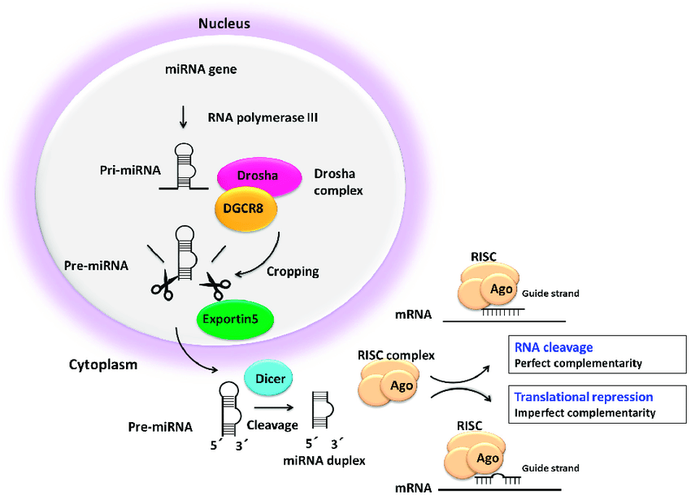
Introduction
MicroRNA (miRNA)
Non-Coding RNA. (2019)
Notes:
The second non-coding RNA I want to introduce is called microRNA.
In most cases, miRNAs interact with the 3′ untranslated region (3′ UTR) of target mRNAs to regulate gene expression through RNA cleavage or translational repression.

Slide 9
Introduction
Interplay between circRNA and miRNA
miRNA sponge
miRNA
ceRNA
(competitive endogenous RNA )
Notes:
However, miRNA can also bind with circRNA, which is called miRNA sponge.
The sponge of miRNA can reverse the repressive effect of miRNA on mRNA.
Since circRNA and mRNA compete the same miRNA response element, they are also called competitive endogenous RNA

Slide 10
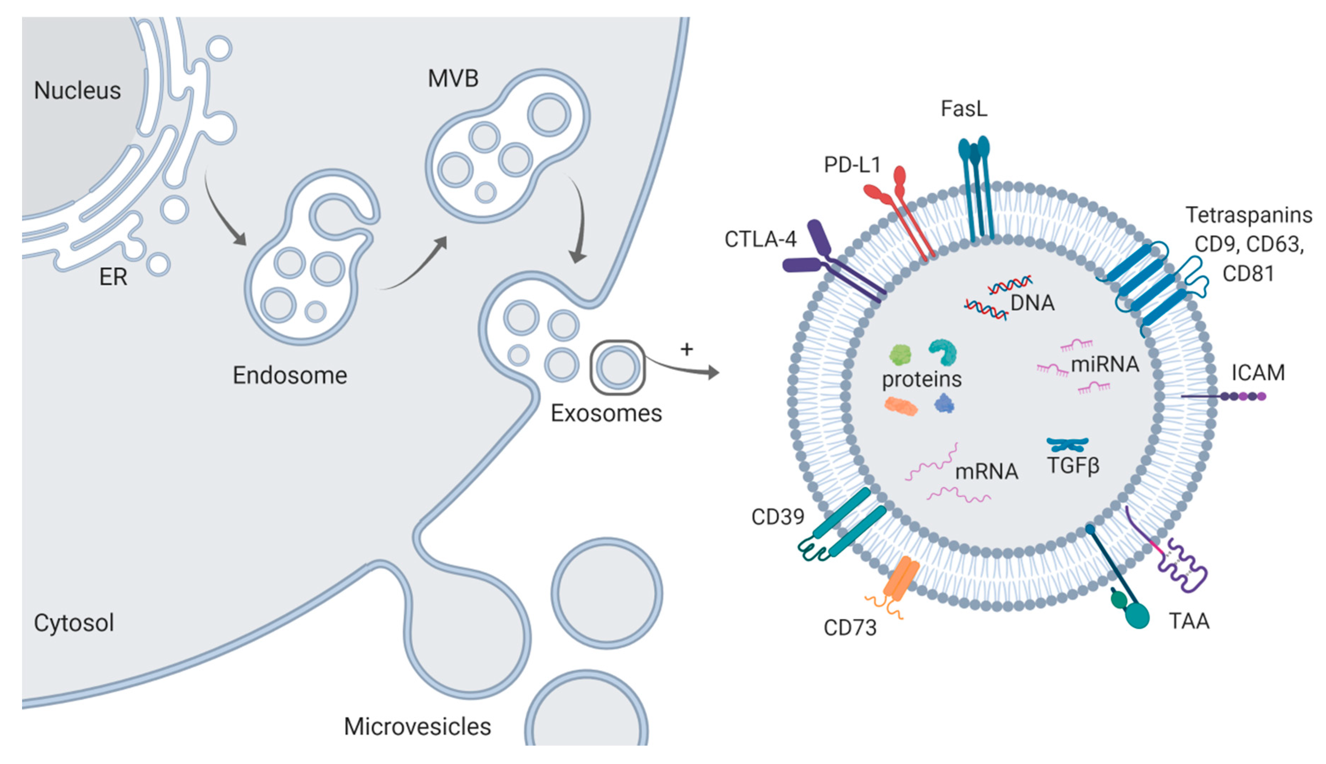
Introduction
Exosome
30-150nm
Int. J. Mol. Sci. 2020
Notes:
At last, I want to introduce exosome.
Exosomes are a specific subtype of extracellular vesicles with a diameter of 30–150 nm.
Since they contain many non-coding RNAs, DNA, lipids, and proteins, they may affect the biological functions of adjacent or distant cells which had ingested these particles.

Slide 11
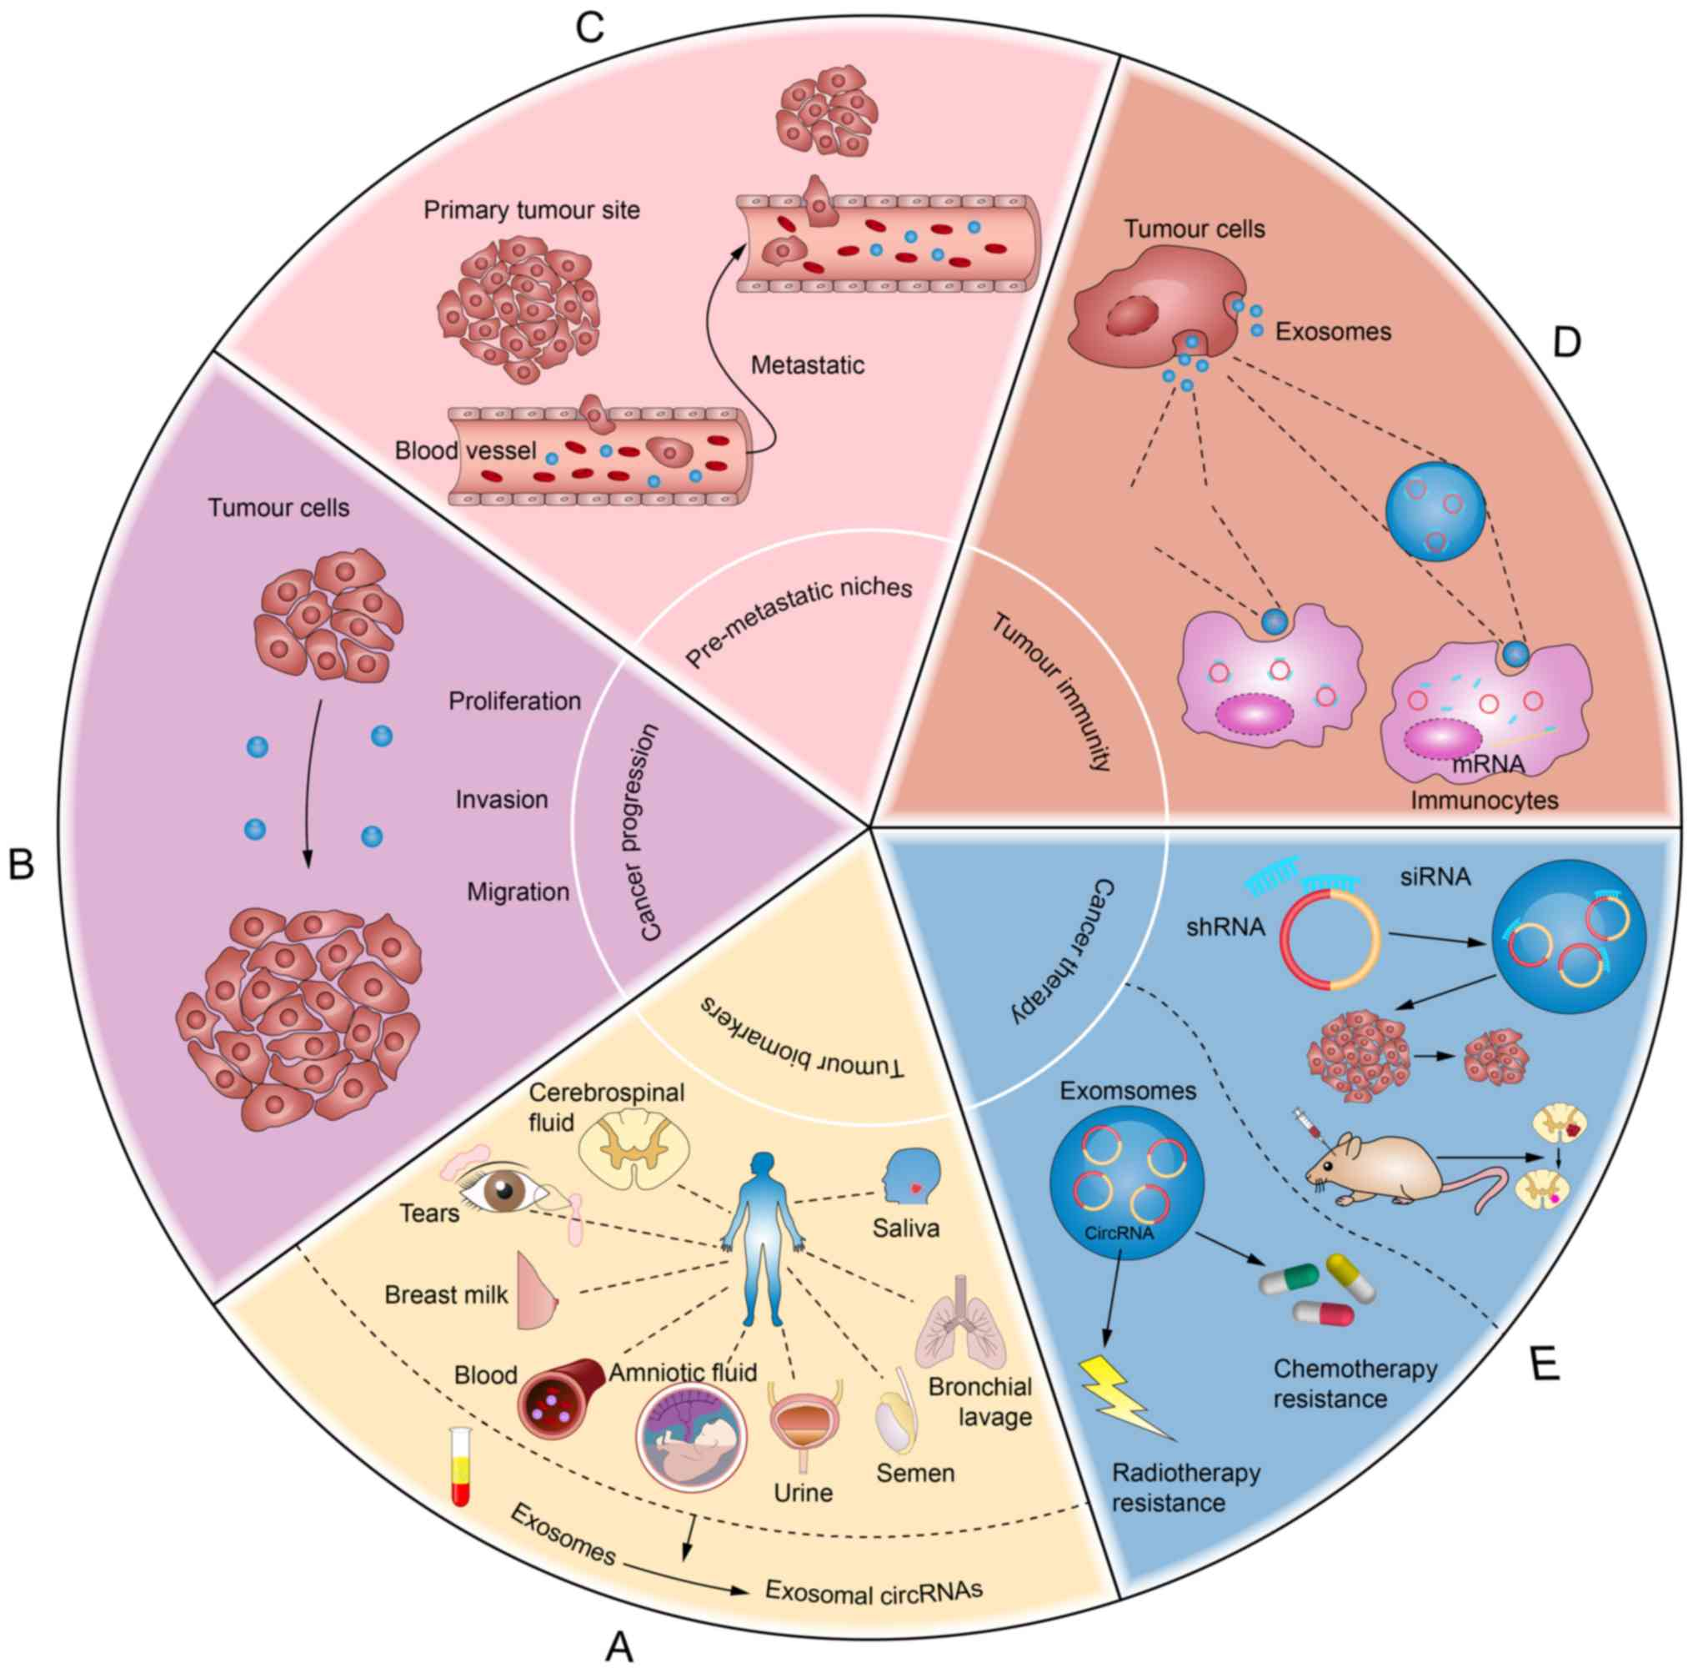
Introduction
Exosomal circRNA
Cancer progression
Oncol Lett. 2020
Notes:
Numerous studies have demonstrated that circRNAs are highly enriched and stable in exosomes.
Also, these exosomal circRNAs have found to be act as a tumor promoter or tumor surppressor.

Slide 12
Introduction
Exosomal circRNA
Tumor biomarker
Oncol Lett. 2020
Notes:
And Because Exosomes can be detected in nearly all types of human bodily fluids, exosomal circRNAs are regarded as good tumor biomarker.

Slide 13
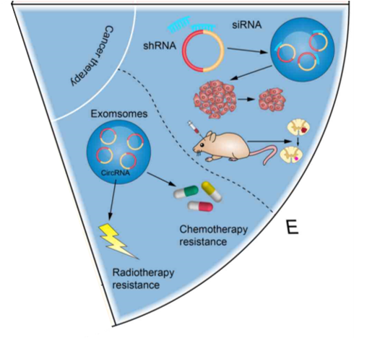
Introduction
Exosomal circRNA
Cancer therapy
Oncol Lett. 2020
Notes:
Moreover, they may used as a tool for cancer therapy or considered as a promoting factor to cause the chemotherapy resistance of cancer.

Slide 14
Results
Exosomes derived from hypoxic PC cells promote GEM resistance of normoxic PC cells
Fig.S1
IC50 : indicates how much drug is needed to inhibit a biological process by half
Notes:
In this paper, the authors initially found that the cells cultured under hypoxic CM had an increased IC50 upon GEM, so they predicted that hypoxic CM might contain promoting factor resulting in chemoresistance of normoxic PC cells.
And considering the vital roles of exosomes in the interaction between cancer cells, the authors then hypothesized that exosomes were involved in the chemoresistance transmission.

Slide 15
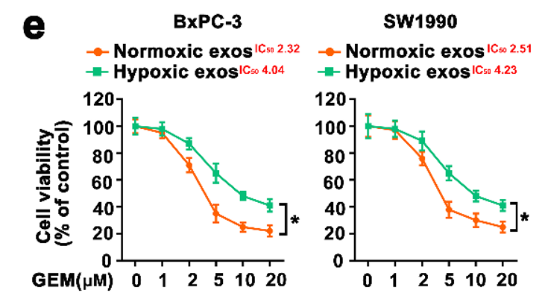
Results
Exosomes derived from hypoxic PC cells promote GEM resistance of normoxic PC cells
NTA
Fig.S1
NTA : Nanoparticle tracking analysis
CD63 : exosome marker
GM130 : Golgi compartment-specific marker
Notes:
So, the authors then extracted the exosomes from medium.
First, The exosome marker CD63 and the absence of Golgi compartment-specific marker confirmed the identity of exosomes
And according to the results of NTA, we could see that hypoxic cancer cells secreted more exosomes than normoxic cancer cells.
In addition, the authors used fluorescent dye PKH26 to label exosomes, and verified that hypoxic exosomes could exactly be fused to recipient normoxic cells.
Also, they found that when the cells were fed with hypoxic exosomes, they really would increased IC50 with GEM treatment.

Slide 16
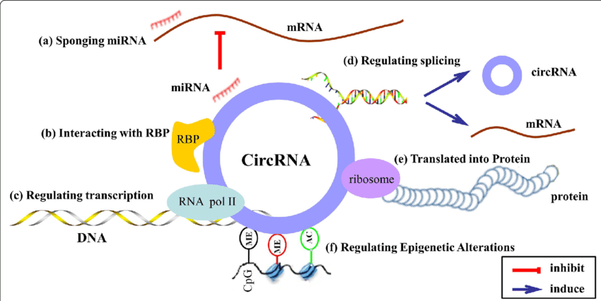
Aim
Which exosomal circRNA?
What’s the molecular mechanism?
?
?
Hypoxic PC cell
Molecular mechanism
exosome
IC50
Normoxic PC cell
Notes:
Since the important roles of exosomal circRNA in cacer we had mentioned before.
The authors aimed to see which exosomal circRNA is involved in the chemoresistance of pancreatic cancer, and what the molecular mechanism is.

Slide 17
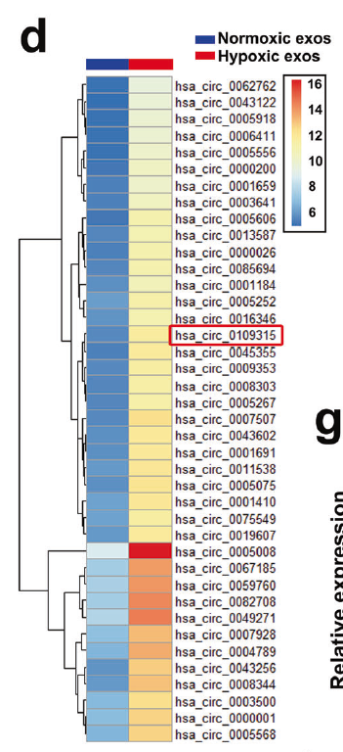
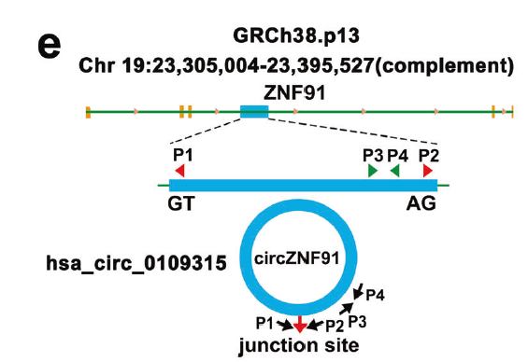
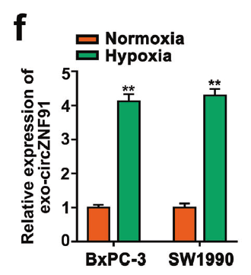
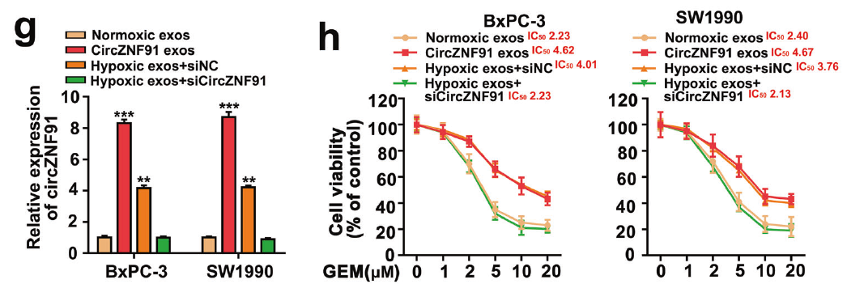
Results
CircZNF91 is critical for the hypoxic exosome- promoted GEM resistance in normoxic cancer cells
Notes:
They first applied microarray assay to analyze differentiated circRNAs between normoxic and hypoxic exosomes
Ultimately, they focused on circZNF91 for further research.
From the result of qPCR, we could found that it was consistent with the result of microarray that circZNF91 was upregulated in hypoxic exosomes of PC cells.
Exosomes secreted from circZNF91-overexpressed or hypoxic PC cells could obviously enhance circZNF91 expression and GEM resistance in recipient PC cells, however, knockdown of circZNF91 could reverse this effect.

Slide 18
Results
CircZNF91 is critical for the hypoxic exosome- promoted GEM resistance in normoxic cancer cells
RAB27A/B : exosome production
GW4859 : NSMase inhibitor
Notes:
In order to validate the critical role of exosomes, the authors then reduced the production of exosomes by depletion of RAB27A/B or NSMase inhibitor.
From the results, we could see that inhibition the release of exosomes by these two things obviously suppressed hypoxic CM-mediated transmission of GEM resistance in PC cells
Together, these results indicated a vital role of exosomal circZNF91 in GEM resistance transmission between hypoxic PC cells and normoxic PC cells.

Slide 19
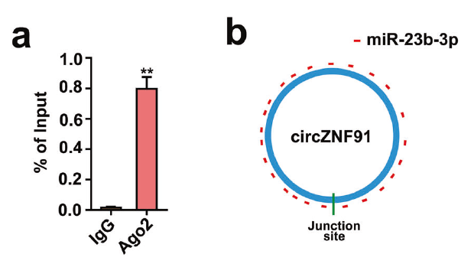
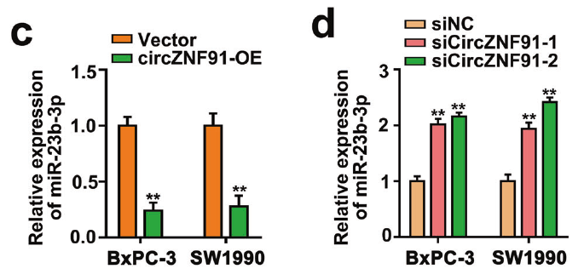
Results
Exosomal circZNF91 functions as a sponge of miR-23b-3p
RIP
Notes:
Next, the authors sought to clarify the underlying mechanism.
Since miR-23b-3p had 24 target sites on circZNF91 and the binding between circZNF91 and Ago protein was validated by RIP assay, they presumed whether
circZNF91 exerted its function by sponging miR-23b-3p.
From the results of qPCR, we could see that overexpression circZNF91 could remarkably downregulate miR-23b-3p expression however, knockdown circZNF91 could upregulate miR-23b-3p expression.

Slide 20
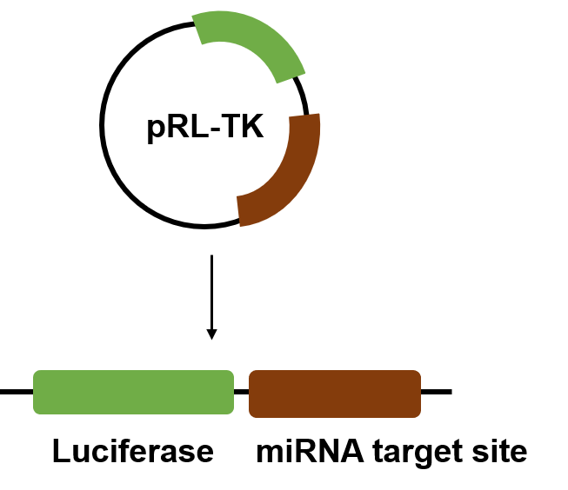
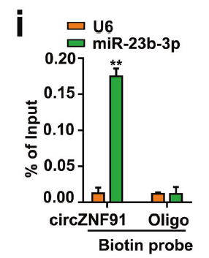
Results
Exosomal circZNF91 functions as a sponge of miR-23b-3p
Notes:
In addition, the results of luciferase assay showed that when the cells were transfected with WT plasmid, the luciferase activity was decreased upon miR-23b-3p overexpression and increased upon miR-23b-3p inhibition, but there were no changes when transfected with MUT plasmid, this indicated the binding between circZNF91 and miR-23b-3p.
Further, the authors also used FISH assay and RNA pulldown assay to again validate the interaction between circZNF91 and miR-23b-3p.

Slide 21
Results
Exosomal circZNF91 functions as a sponge of miR-23b-3p
circZNF91
miR-23b-3p
chemoresistance
Notes:
As for the GEM resistance of PC cells, the results show that it would be promoted by exosomes secreted from circZNF91-overexpressed PC cells or hypoxic PC cells, however,
inhibited by miR-23b-3p overexpression .
These results implied that miR-23b-3p was involved in exosomal circZNF91-transmitted chemoresistance by binding to circZNF91.

Slide 22
Results
Exosomal circZNF91 functions as a sponge of miR-23b-3p
circZNF91
miR-23b-3p
chemoresistance
Notes:
As for the GEM resistance of PC cells, the results show that it would be promoted by exosomes secreted from circZNF91-overexpressed PC cells or hypoxic PC cells, however,
inhibited by miR-23b-3p overexpression .
These results implied that miR-23b-3p was involved in exosomal circZNF91-transmitted chemoresistance between hypoxic PC cells and normoxic PC cells by binding to
circZNF91.

Slide 23
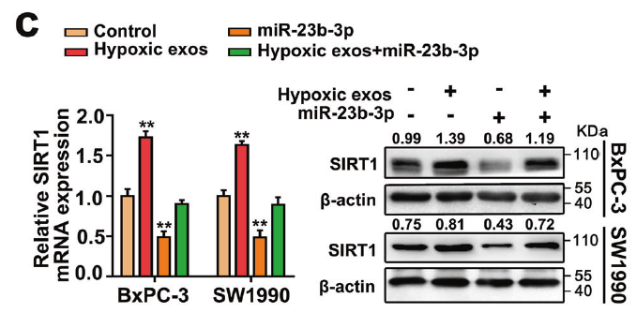
Results
CircZNF91 upregulates SIRT1 expression via competitively
binding to miR-23b-3p
Notes:
Next, by using three online software, SIRT1 was predicted as a potential target of miR-23b-3p.
We could see that circZNF91 overexpression and hypoxic exosomes significantly increased the mRNA and protein level of SIRT1, however, it could be reversed by miR-23b-3p upregulation.

Slide 24
Results
CircZNF91 upregulates SIRT1 expression via competitively
binding to miR-23b-3p
Notes:
Next, by using three online software, SIRT1 was predicted as a potential target of miR-23b-3p.
We could see that circZNF91 overexpression and hypoxic exosomes significantly increased the mRNA and protein level of SIRT1, however, it could be reversed by miR-23b-3p upregulation.

Slide 25
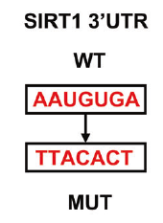
Results
CircZNF91 upregulates SIRT1 expression via competitively
binding to miR-23b-3p
ActD : RNA polymerase II inhibitor
Notes:
Furthermore, when treated the cells with ActD to block the RNA synthesis, we could see that circZNF91 overexpression could enhance SIRT1 stability, while miR-23b-3p overexpression could rescue this effect.
Also, the luciferase assay showed a similar trend, which confirmed that SIRT1 was indeed the target of miR-23b-3p.

Slide 26
Results
CircZNF91 upregulates SIRT1 expression via competitively
binding to miR-23b-3p
Notes:
Meanwhile, we could see that knockdown SIRT1 could reverse the effect of circZNF91 and hypoxic exosomes on enhancing the chemoresistance of PC cells.

Slide 27
Summary
Hypoxic PC cell
SIRT1
miR-23b-3p
IC50
SIRT1
Normoxic PC cell
Notes:
In summary, now we know that during hypoxia, hypoxic PC cells could secret more exosomes and would ingest by adjacent normoxic PC cells to enhance their intracellular circZNF91 level.
Then, circZNF91 could sponge miR-23b-3p to increase SIRT1 expression and further enhance the chemoresistance of PC cells.

Slide 28
Sirtuin 1 (SIRT1)
Hypoxia
deacetylation
stabilization
?
circZNF91/miR-23b-3p/SIRT1 pathway
HIF-1α stability
Notes:
Previous study had indicated that SIRT1 deacetylates and stabilizes HIF-1α during hypoxia.
So the authors further presumed whether circZNF91/miR-23b-3p/SIRT1 pathway could regulate HIF-1α stability

Slide 29
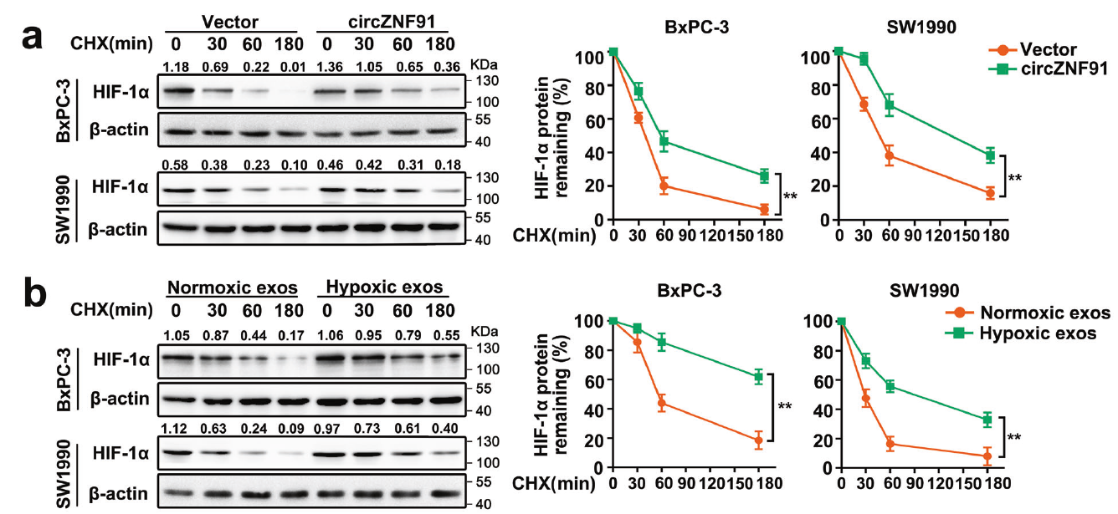
Results
Exosomal circZNF91 stabilizes HIF-1α protein by
SIRT1-dependent deacetylation
cycloheximide(CHX) : translation inhibitor
Notes:
They treated the cells with different concentration of cycloheximide to see the stability of HIF1a.
According to the results of western blot, we could see that circZNF91 overexpression and hypoxic exosomes remarkably increased HIF-1α protein stability.

Slide 30
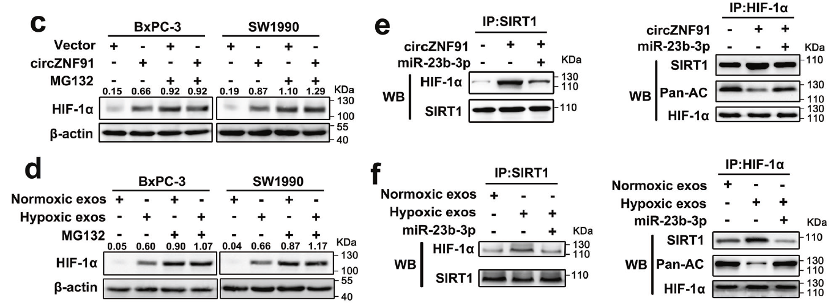
Results
Exosomal circZNF91 stabilizes HIF-1α protein by
SIRT1-dependent deacetylation
Co-IP assay
MG132 : proteosome inhibitor
Notes:
In addition, after treated the cells with proteasome inhibitor, there were no increase expression of HIF-1α induced by circZNF91 overexpression or hypoxic exosomes, which validated that the effect of SIRT1 on HIF1a was to increase their stability rather than production.
Meanwhile, the Co-IP assay indicated that both circZNF91 overexpression and hypoxic exosomes could increase the binding between HIF-1α and SIRT1 and decreased the acetylation of HIF-1α,

Slide 31
Results
Exosomal circZNF91 stabilizes HIF-1α protein by
SIRT1-dependent deacetylation
Notes:
Also, circZNF91 overexpression and hypoxic exosomes obviously increased HIF-1α protein level in PC cells.
However, there were no changes on mRNA level of HIF-1α.
This result again validated that SIRT1 would effect HIF1a on protein level rather than RNA level.

Slide 32
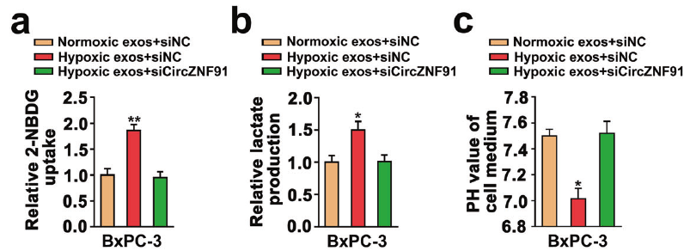
Results
Hypoxic exosomal circZNF91 promotes GEM resistance of normoxic PC cells by enhancing HIF-1α-regulated glycolysis
2-NBDG : fluorescent glucose analog
Notes:
Next, Since studies have shown that HIF-1α and HIF-1α-enhanced glycolysis are related to chemoresistance.
So, the authors wanted to know whether circZNF91 could increase drug resistance by increasing the glycolysis.
As expected, hypoxia exosomes would elevate glucose consumption, lactate production, and decrease extracellular pH value.

Slide 33
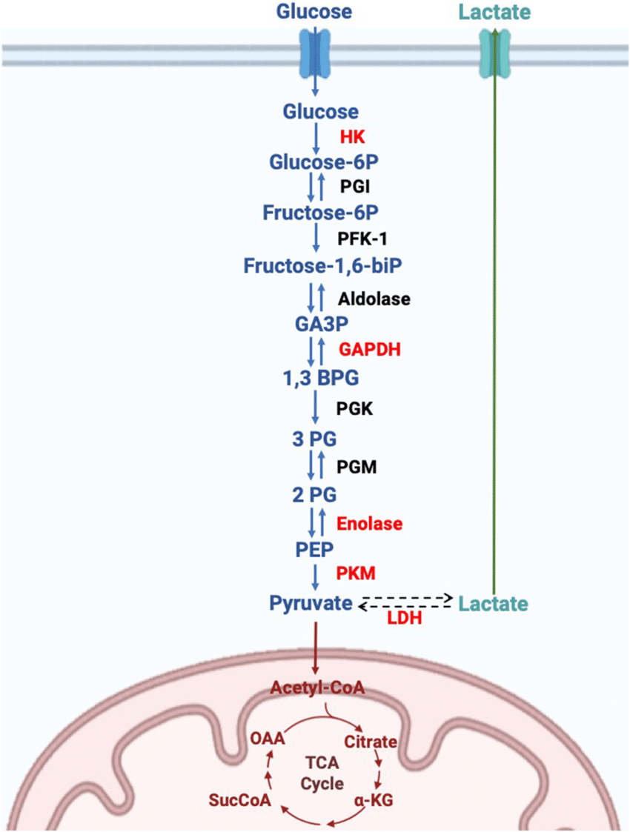
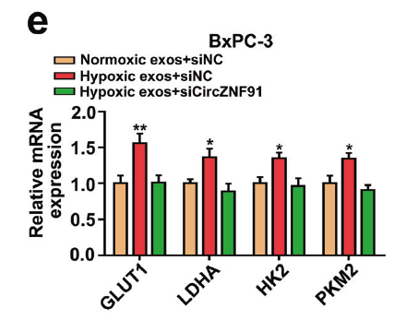
Results
Hypoxic exosomal circZNF91 promotes GEM resistance of normoxic PC cells by enhancing HIF-1α-regulated glycolysis
GLUT1
Notes:
Furthermore we could see that both mRNA and protein levels of glycolytic enzymes were remarkably increased in hypoxic exosome-treated PC cells but could be reversed by downregulating circZNF91.

Slide 34
Results
Hypoxic exosomal circZNF91 promotes GEM resistance of normoxic PC cells by enhancing HIF-1α-regulated glycolysis
Dig/YC-1 : HIF1a inhibitor
Notes:
And To further validate the role of HIF-1α- associated glycolysis in GEM resistance transmission, the authors utilized Digoxin, YC-1, or siRNA to inhibit the activity of HIF-1α.
Results showed that inhibition of HIF-1α activity significantly prohibited the hypoxic exosome-induced glycolytic genes expression and GEM resistance in normoxic PC cells.

Slide 35
Results
Hypoxic exosomal circZNF91 promotes GEM resistance of normoxic PC cells by enhancing HIF-1α-regulated glycolysis
2-DG : glycolysis inhibitor
Notes:
In addition, 2-DG, the glycolysis inhibitor, also remarkably eliminated glycolysis and GEM resistance promoted by exosomes derived from hypoxic or circZNF91-overexpressed PC cells.
Thus, these data verified that HIF-1α-promoted glycolysis was critically necessary for hypoxic exosomal circZNF91-transmitted GEM resistance in normoxic PC cells.

Slide 36
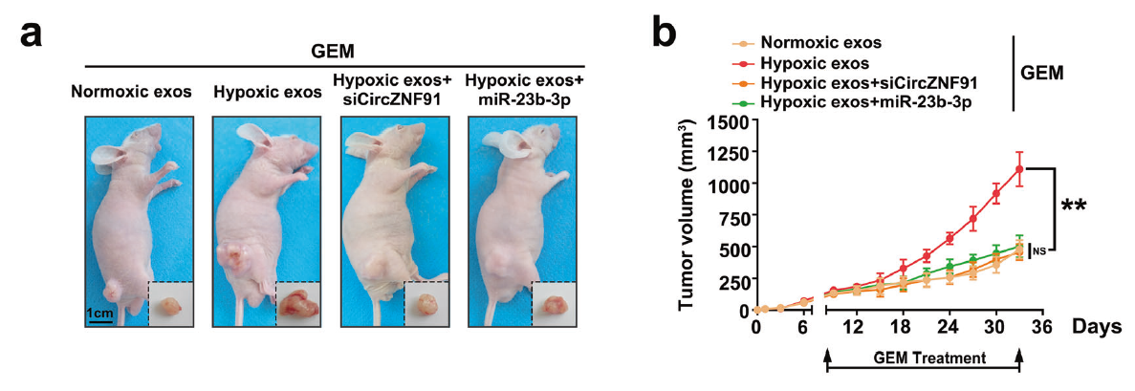
Results
Targeting circZNF91/miR-23b-3p impedes the hypoxic exosome-promoted chemoresistance of PC in vivo
Notes:
Then, To verify these reults in vivo, the cells and exosomes were subcutaneously injected into the right hip of nude mice and were treated with GEM simultaneously.
Result showed that mice injected with hypoxic exosomes exhibited a poorer GEM response than those injected with normoxic exosomes.
However, intratumor injection of hypoxic exosomes with siCircZNF91 or miR- 23b-3p overexpression restored the sensitivity of xenografts to GEM.

Slide 37
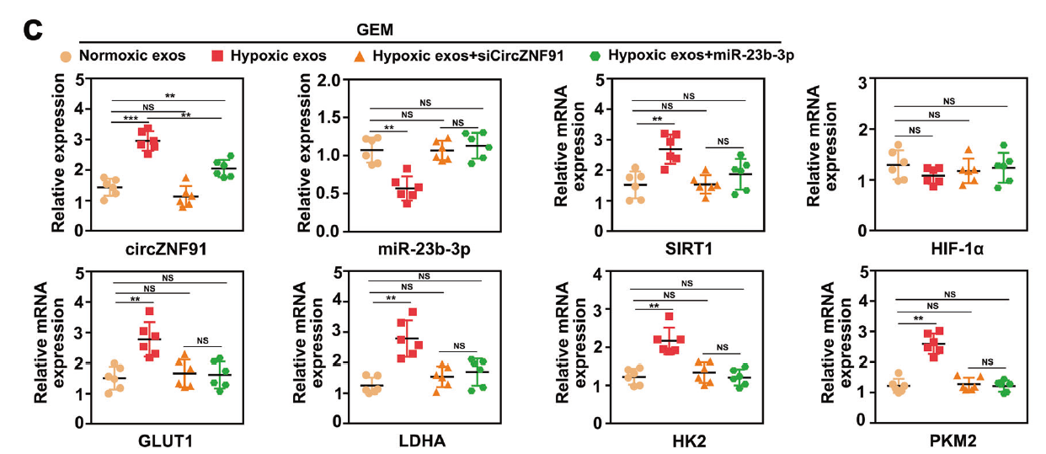
Results
Targeting circZNF91/miR-23b-3p impedes the hypoxic exosome-promoted chemoresistance of PC in vivo
Notes:
In addition, The qPCR results showed an increased expression of circZNF91, SIRT1 and glycolytic enzyme in tumors injected with hypoxic exosomes, however, the expression of miR-23b-3p showed the opposite trend.
And The RNA level of HIF1a showed no changes.
All these results were consistent with in vitro experiments.

Slide 38
Results
Exosomal circZNF91 is transcriptionally upregulated
by HIF-1α during hypoxic condition
HRE : hypoxia responsive elements
Notes:
At last, since recent studies had shown that a subset of circRNAs were transcriptionally regulated by HIF-1α during hypoxic condition.
Thereby, the authors presumed that the increased circZNF91 in hypoxic exosomes might be attributed to HIF-1α-regulated transcription.
We could see that both the cellular and exosomal circZNF91 levels were obviously increased in PC cells during hypoxia in a time-dependent manner.
Meanwhile, DNA sequence analysis indicated two potential hypoxia responsive elements (HREs) in the promoter area of ZNF91.
However, the result of ChIP assay verified that only the region of HRE2 could bind to HIF-1α and could be enhanced during hypoxia.

Slide 39
Results
Exosomal circZNF91 is transcriptionally upregulated
by HIF-1α during hypoxic condition
Notes:
In addition, the result of western blot and qPCR revealed that the expression of circZNF91 would decrease after knockdown HIF1a, which validated that HIF1a could transcriptionally regulate ZNF91 during hypoxia.

Slide 40
Results
Exosomal circZNF91 is transcriptionally upregulated
by HIF-1α during hypoxic condition
Endogenous transcribed
Hypoxia exosome transmitted
ActD : RNA polymerase II inhibitor
Notes:
Moreover, after treating the cells with ActD, we could see that the expression of circZNF91 would slightly decrease, which indicated that the increase of circZNF91 in recipient cells is not only derived from the transmission of hypoxic exosomes, but also induced by endogenous transcription.
Besides, expressions of circZNF91 and glycolytic genes would remarkably increased in recipient PC cells when treated with hypoxic exosomes, but obviously inhibited when knockdown of HIF-1a.

Slide 41
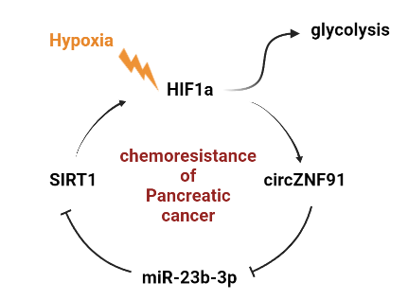
Conclusion
HIF1a
ZNF91
Hypoxic PC cell
Notes:
So, in conclusion, during hypoxia, HIF1a could transcriptionally regulate ZNF91 and increased the intracellular expression of circZNF91 in hypoxic PC cells.
Also, there were more exosomes secreted from hypoxic PC cells and would be ingested by normoxic PC cells

Slide 42
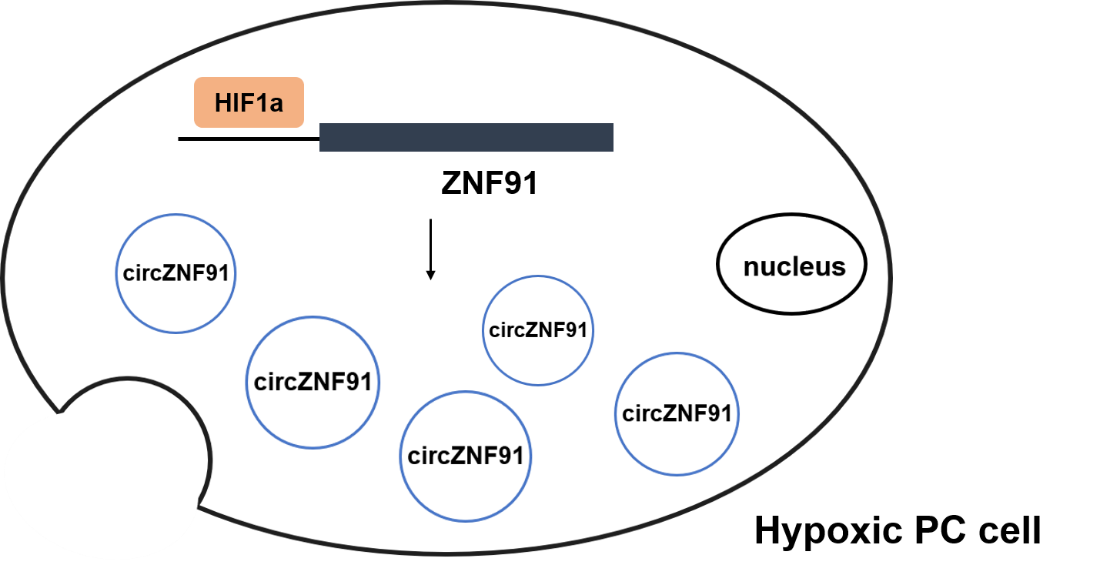
Conclusion
SIRT1
miR-23b-3p
SIRT1
AC
glycolysis
HIF1a
HIF1a
IC50
HIF1a
ZNF91
Normoxic PC cell
Notes:
Therefore, the expression of circZNF91 would also increase in normoxic PC cells.
Then, circZNF91 could sponge miR-23b-3p to elevate SIRT1 expression, which mediated HIF-1α stabilization via deacetylation.
And HIF-1α could further activate a number of glycolytic protein to enhance glycolysis and chemoresistance of normoxic PC cells to gemcitabine.
Furthermore, HIF1a would also transcriptionally upregulate circZNF91 and form a reciprocal feedback

Slide 43
Comments
Pros :
The study is comprehensive that involves both in vitro and in vivo experiments.
It reveal a molecular mechanism of chemoresistance and provide great value in treatment and prognosis of pancreatic cancer

Slide 44
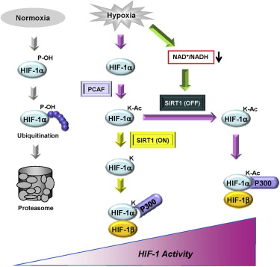
Notes:
However, In addition to the paper cited by the author themself, other papers advocate that HIF1a has relatively high activity in the state of acetylation.

Slide 45
Comments
Pros :
The study is comprehensive that involves both in vitro and in vivo experiments.
It reveal a molecular mechanism of chemoresistance and provide great value in treatment and prognosis of pancreatic cancer
Cons :
There is a gap between stability and activity of HIF1a which should need more research.
Notes:
Therefore, I think there is a gap between stability and activity of HIF1a which should need more research.

Slide 46
Thanks for listening

Slide 47
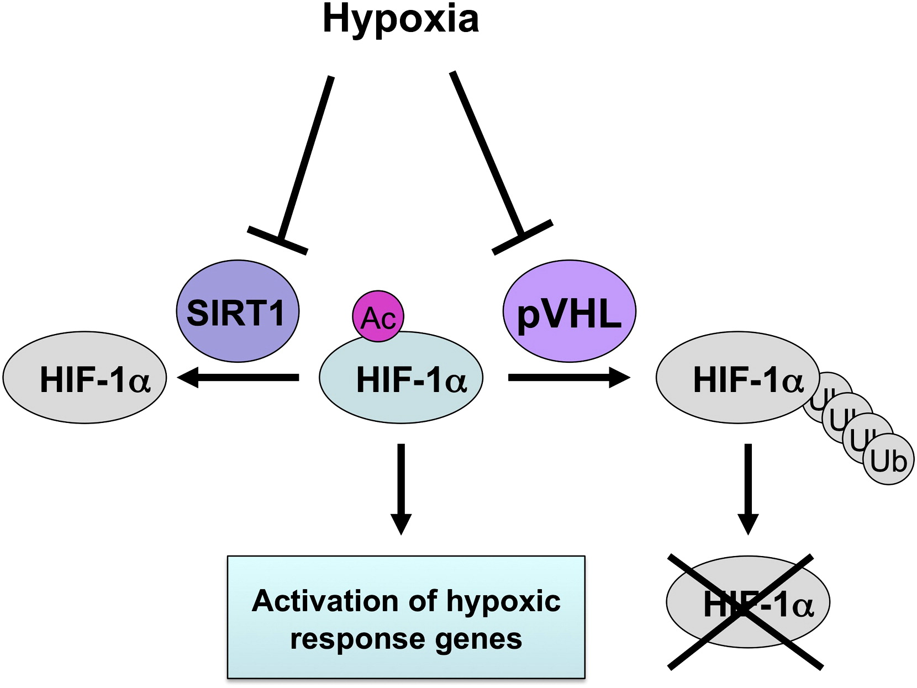

Slide 48
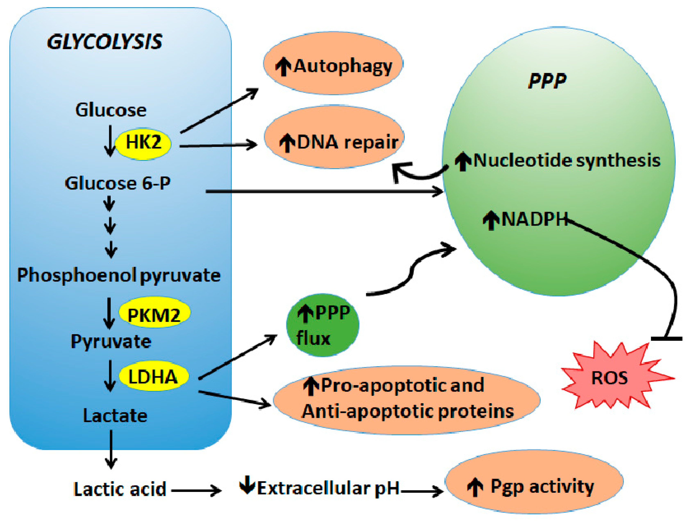

Slide 49
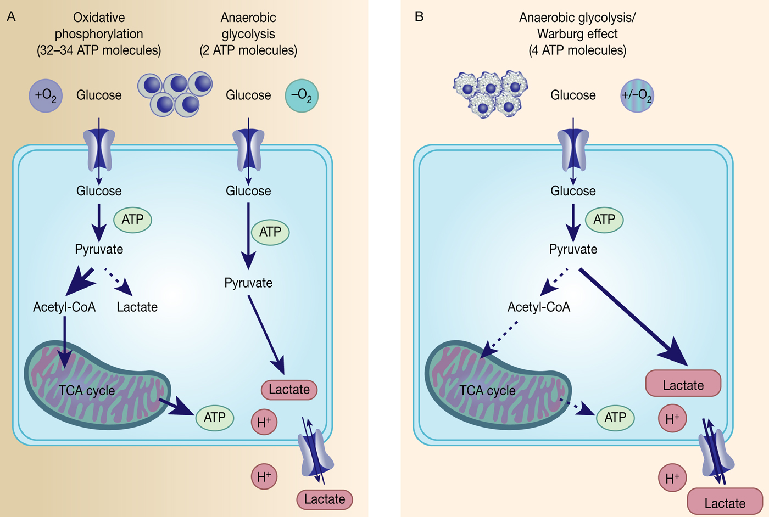

Slide 51
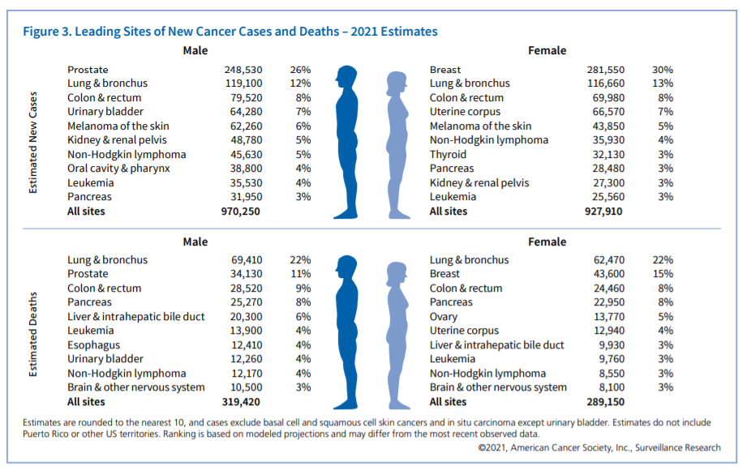
Introduction
Pancreatic cell
CA CANCER J CLIN, 2021

Slide 52
Introduction
Circular RNA (circRNA)
Molecular Cancer. (2019)
Notes:
Although circRNAs are defined as a class of rubbish during the splicing process since they were firstly discovered.
Nowadays they have been considered as important regulator to participate in diverse physiological and pathological processes.
For example, they may function as miRNA sponge , or interacting with RNA-binding proteins (RBP) , regulating transcription and splicing , and even can translate into polypeptides .

Slide 53
Summary
SIRT1
Hypoxic PC cell
miR-23b-3p
SIRT1
glycolysis
AC
HIF1a
HIF1a
IC50
Normoxic PC cell
Notes:
So now we know that hypoxic exosomes could increase normoxic PC cells expression of circZNF91 and the sponge of miR-23b-3p could further enhance the expression of SIRT1. Then, SIRT1 could deacetylate HIF1a protein and increase their stability.
Also, HIF-1a- promoted glycolysis then further enhanced chemoresistance of normoxic PC cells.

Slide 54
SIRT1
miR-23b-3p
SIRT1
AC
glycolysis
HIF1a
HIF1a
HIF1a
IC50
ZNF91
Normoxic PC cell

