Slide 1
How to use Genome Browser and find promoter binding site?
Speaker : Yi-Chun Ke
Date : 2022/09/05

Slide 3
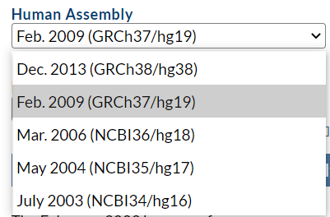
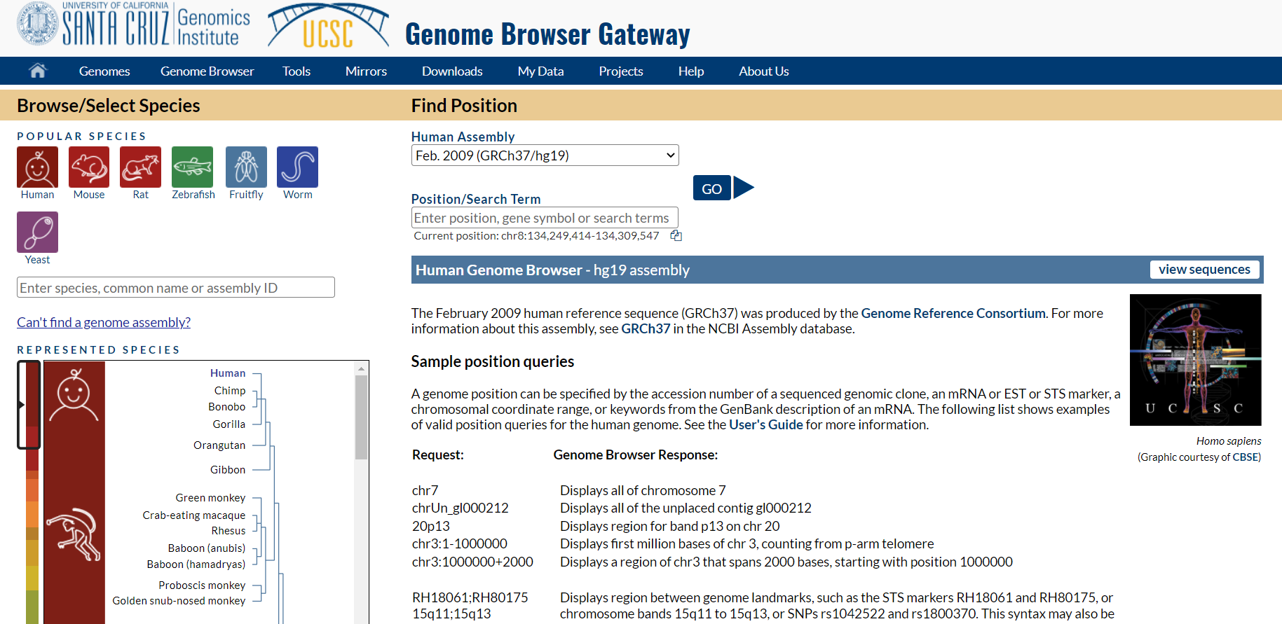

Slide 4
最常見的isoform
箭頭方向指向3’
端

Slide 5
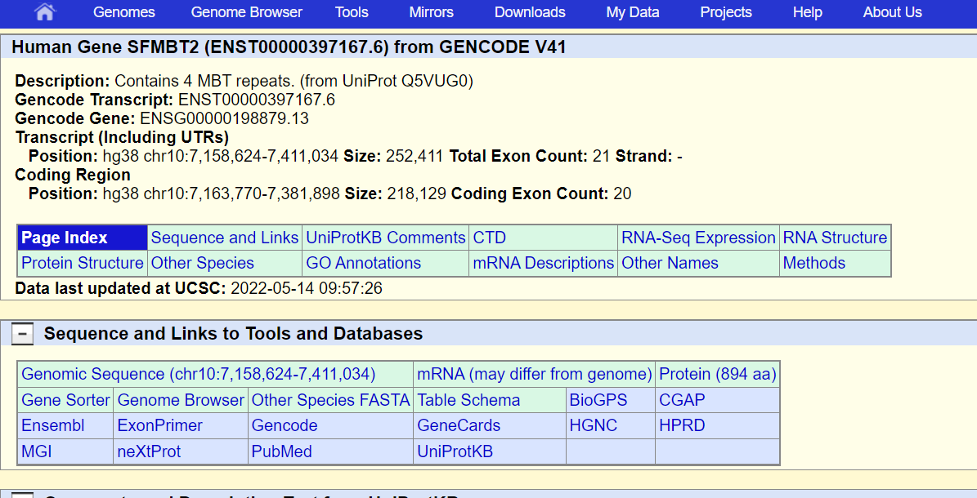
Get sequence

Slide 6
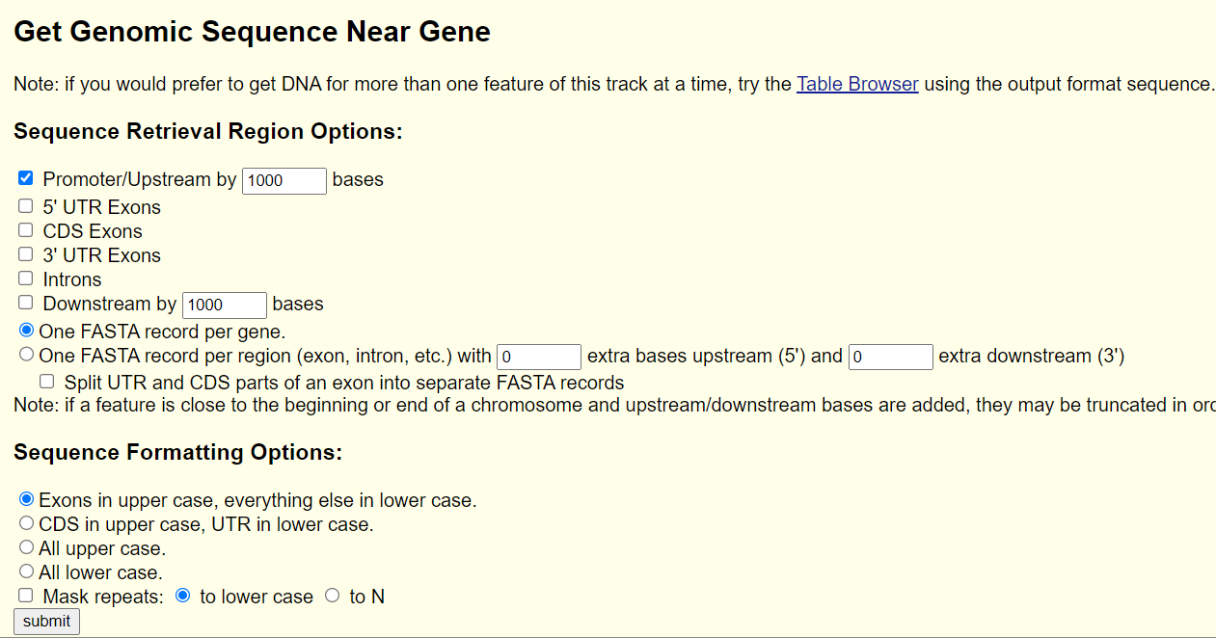
Get sequence

Slide 7
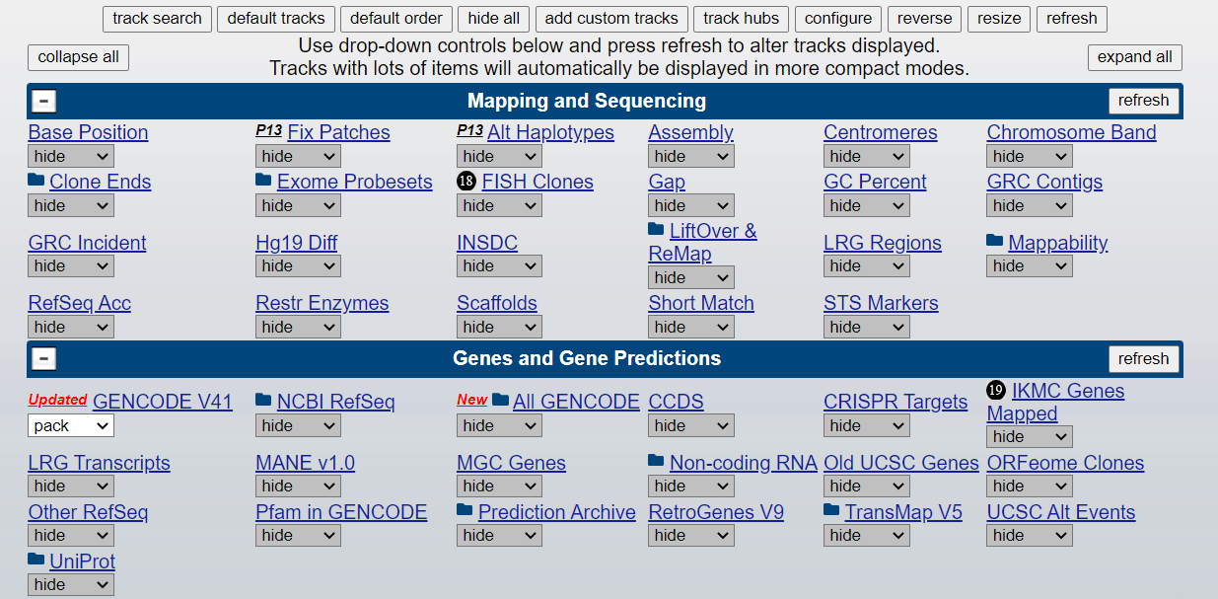
Add track from hub

Slide 8
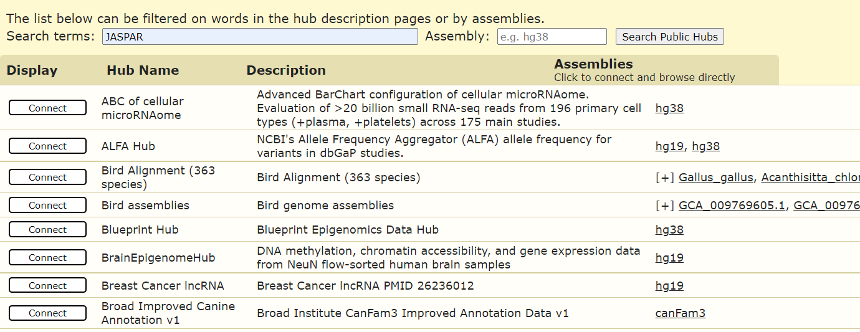
Add track from hub
輸入track名稱

Slide 9
Add track from hub

Slide 10
Add track from hub

Slide 11
How to predict transcription factors on the promoter of gene?

Slide 12
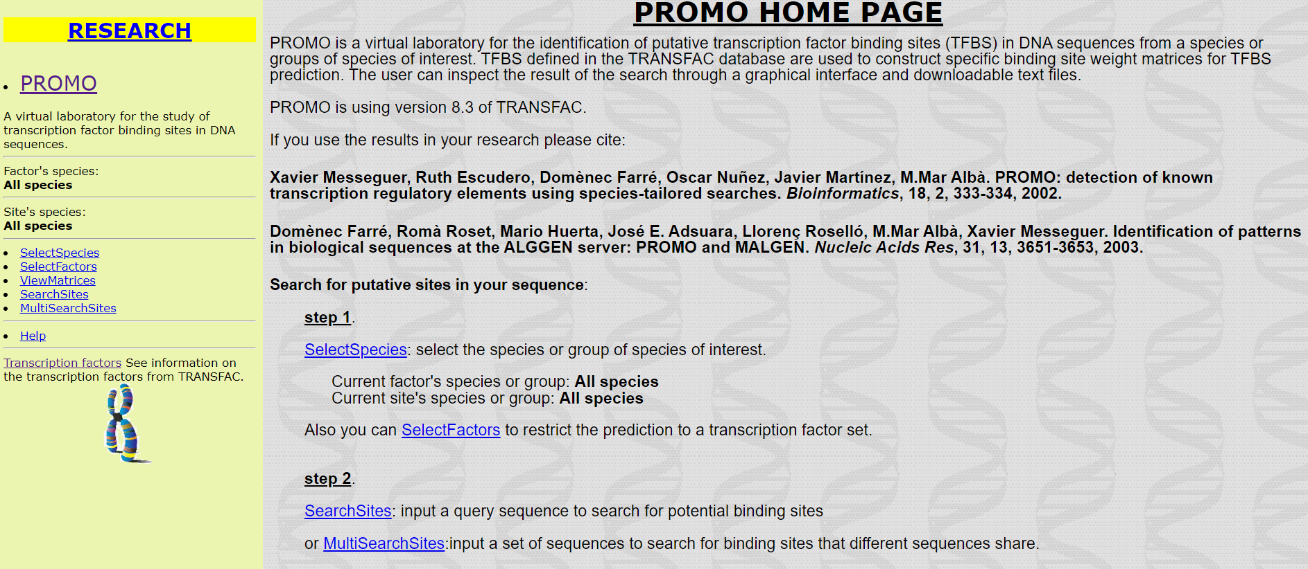

Slide 13
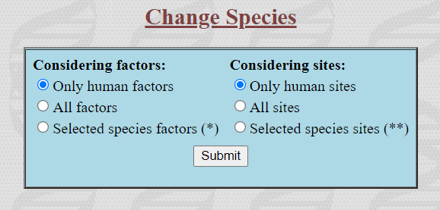
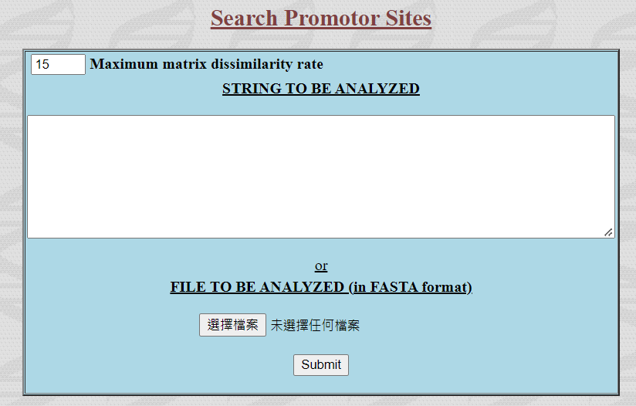
Genome browser→選籃底transcripit→genome sequence→promoter upstream by 1000 base pair

Slide 14
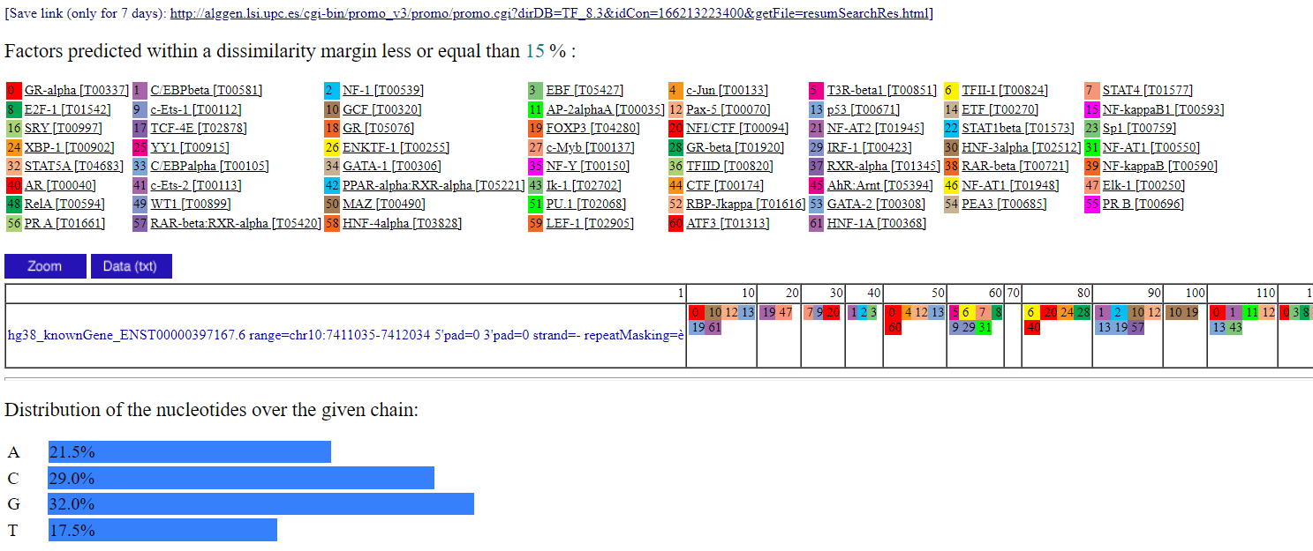
下載結果

Slide 15
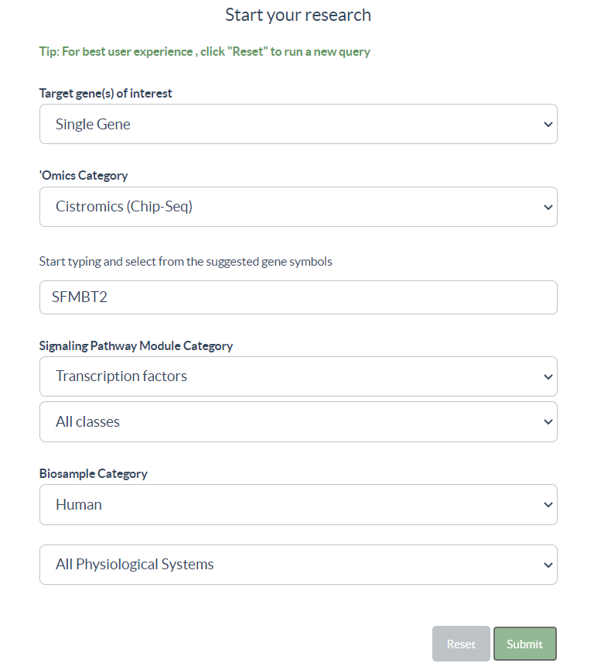

Slide 16
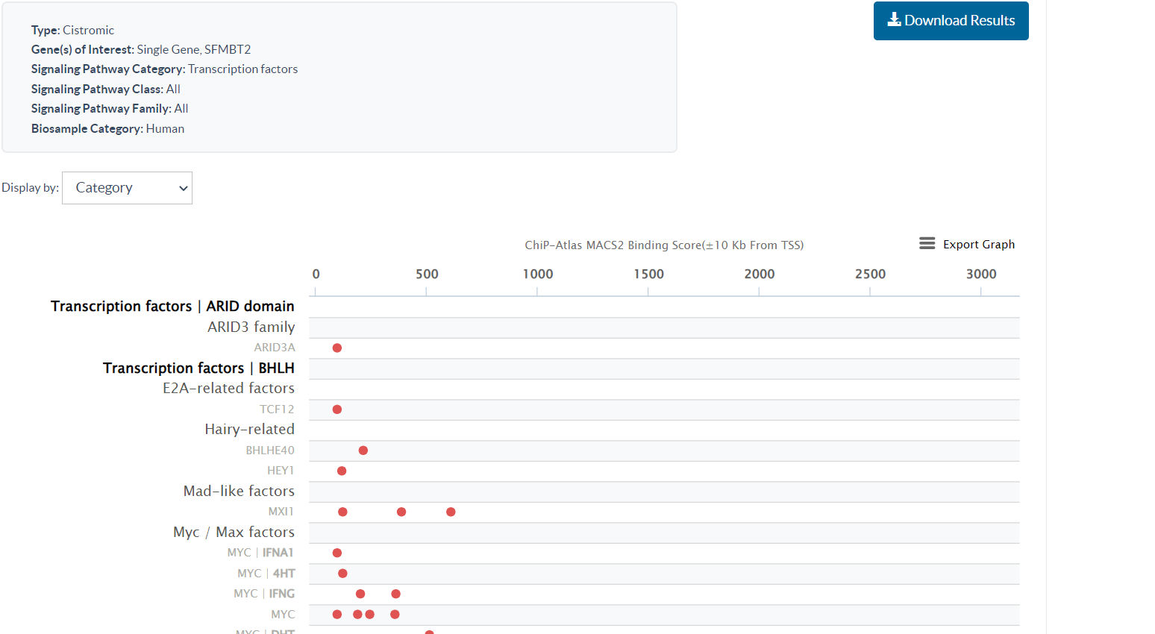
下載結果

Slide 17
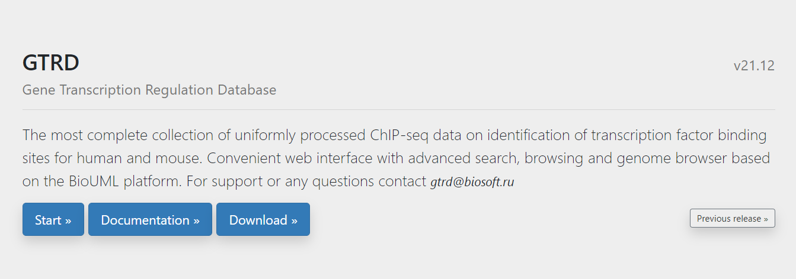
Gene Transcription Regulation Database

Slide 18
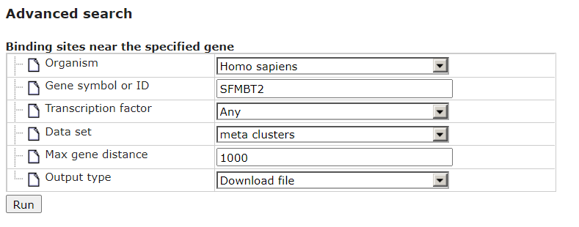
Gene Transcription Regulation Database

Slide 19
How to find promoter binding site?

Slide 20
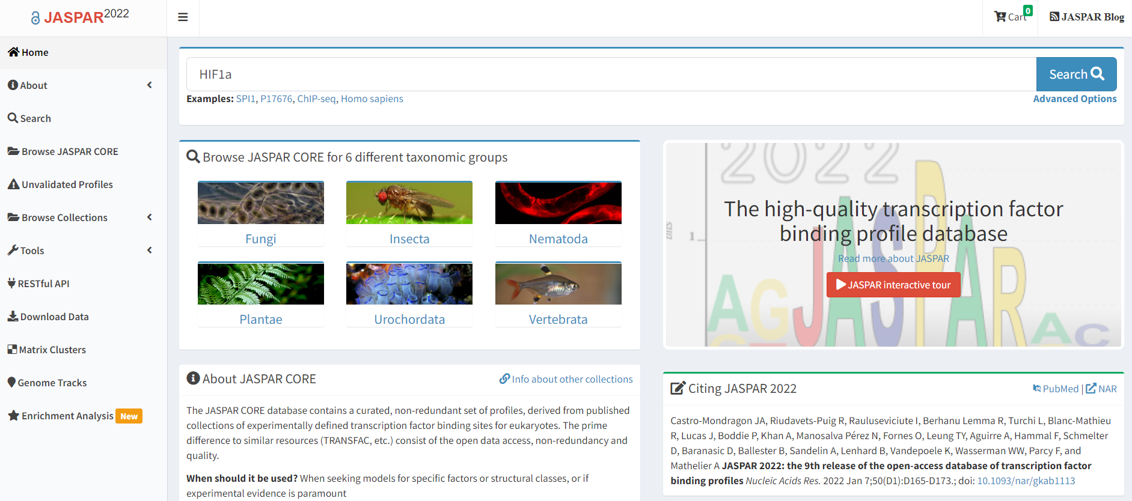
輸入transcription name

Slide 21
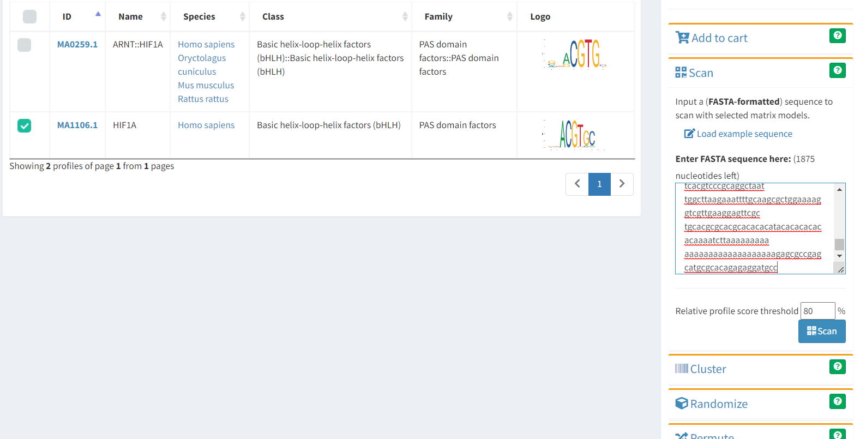
勾選人類的TF
輸入promoter序列

Slide 22
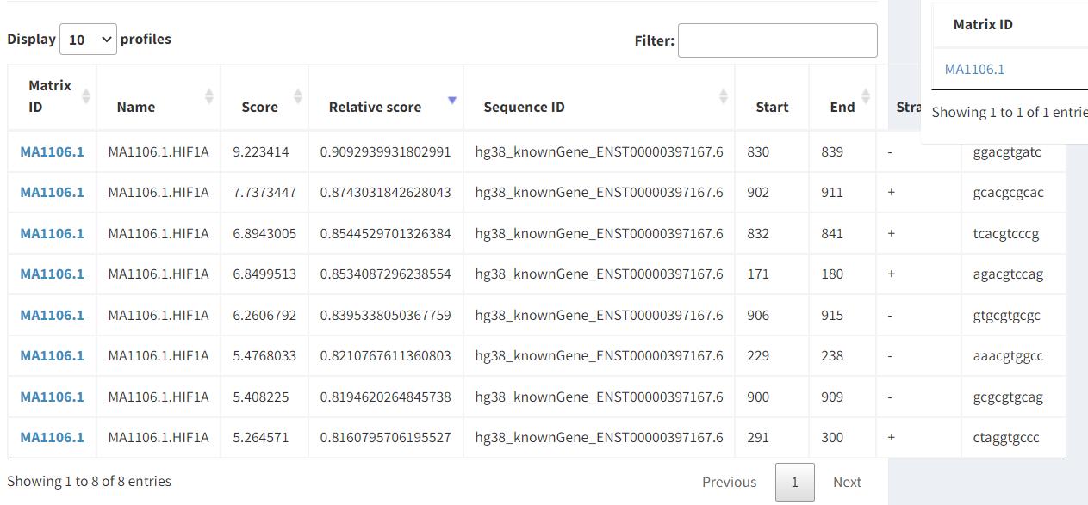

Slide 23
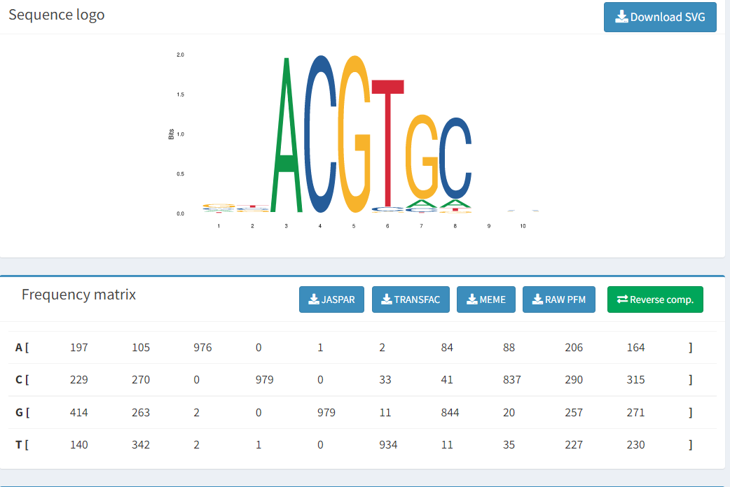

Slide 24
Q&A

Slide 25
( ).Genome Browser可以找到基因的DNA序列
( ). Genome Browser 只能找人類的序列
( ). Genome Browser可以找到基因的RNA序列
( ). Genome Browser可以找到蛋白的序列
( ). Genome Browser 只能找到coding region sequence
( ). Genome Browser 只能用使用加入已知的track
O
X
O
O
X
X

Slide 26
Thanks for listening

Slide 27
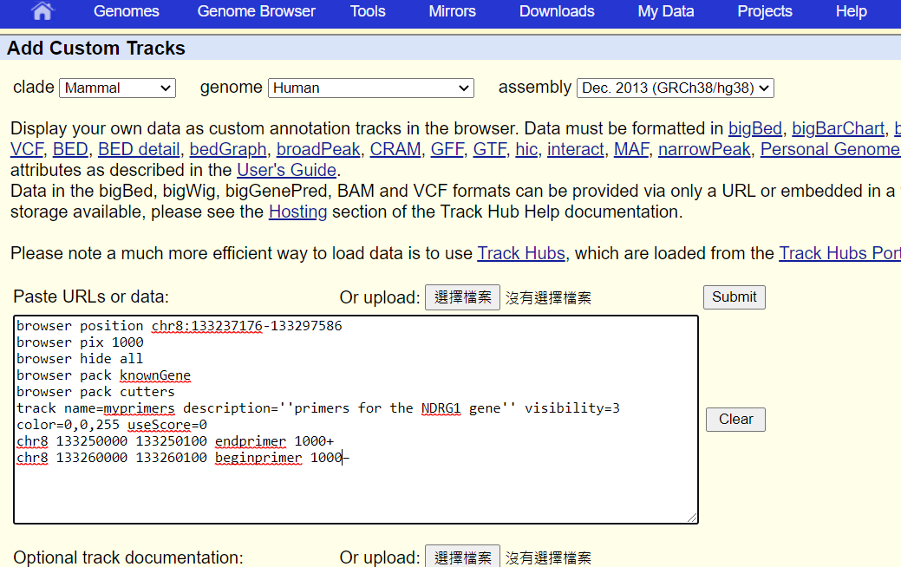
Add custom track

