Slide 1
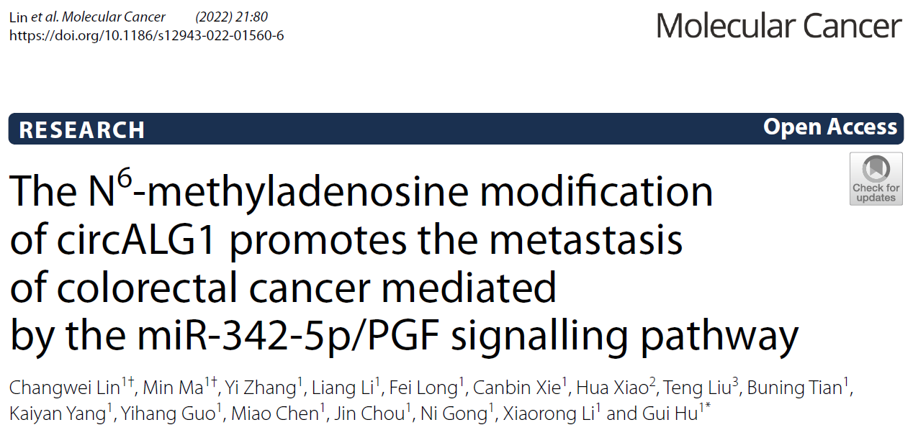
Speaker: Chia-Ming Liu
Advisor: Liang-Chuan Lai, Ph.D.
Date: Sep. 26th, 2022
Notes:
Good morning everyone. I am today’s speaker Chia-Ming Liu. My adviser is Liang Chuan Lai. Today I will introduce the role of circular RNAs N6 methyladenosine modification in cancer.

Slide 2
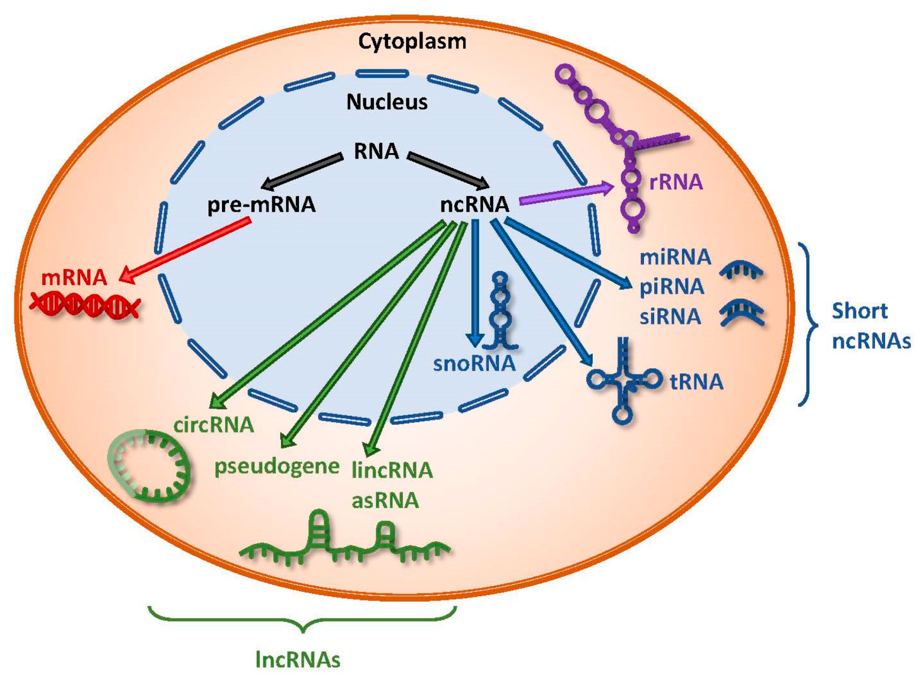
Introduction
RNA categories
Chan JJ, et al. Int J Mol Sci, 2018
Notes:
RNA can be classified into two major categories, coding RNA and non-coding RNA. Coding RNA means the RNA which can translate protein or peptide, such as mRNA. Non-coding RNAs contain rRNA, short non-coding RNA, and long non-coding RNA. circRNAs were one of the members of lncRNAs.

Slide 3
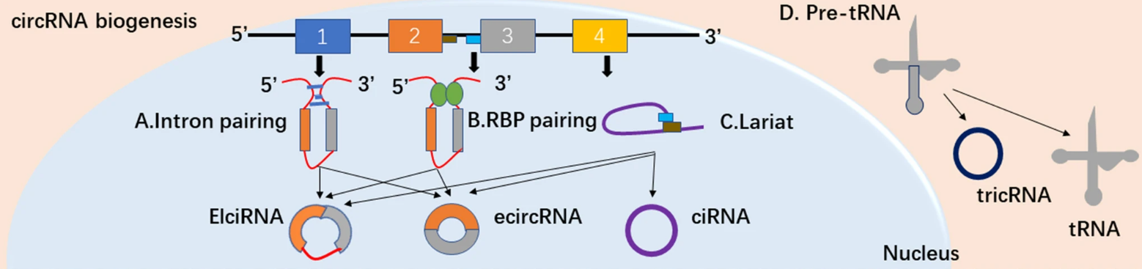
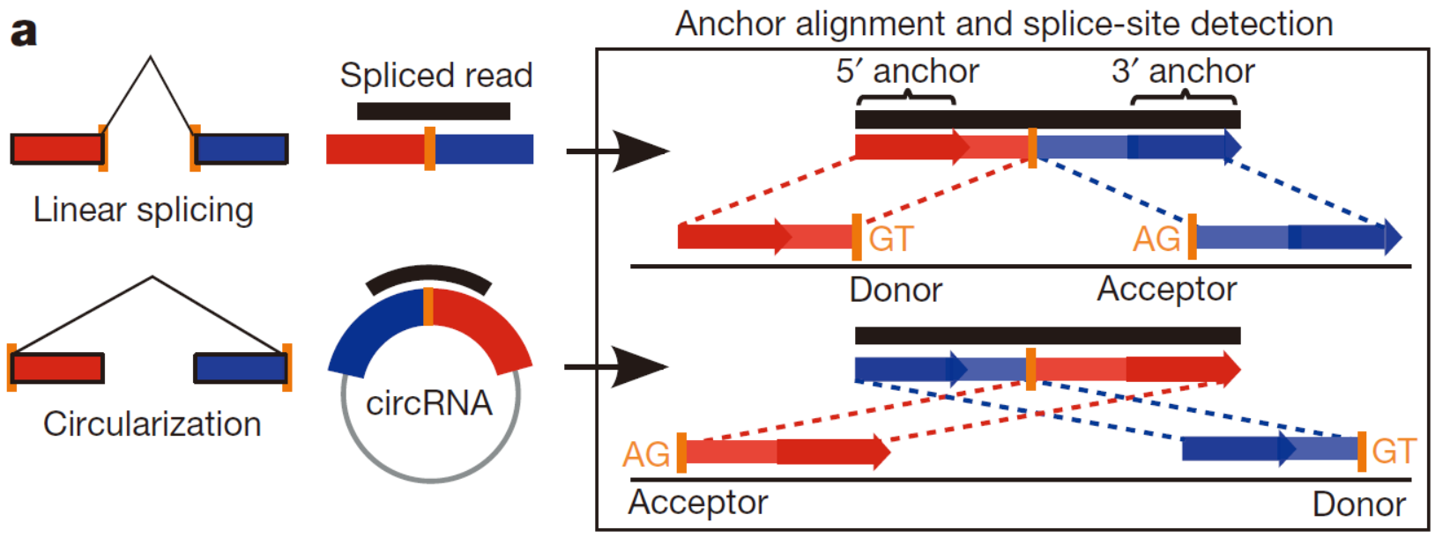
Introduction
CircRNAs Biogenesis
Memczak S, et al. Nature, 2013; Guo X, et al. Clin Transl Oncol, 2021
Notes:
Circular RNAs originate from pre-mRNA. Unlike mRNA spliced into a linear form from pre-mRNA, circular RNAs usually become circular because of the intron pairing or RNA binding protein pairing and then undergo a back splicing and become a circular RNAs.

Slide 4
Introduction
Functions of CircRNA
Cell, 2022
Notes:
在過去circRNA被認為是一種錯誤剪接所產生的垃圾，但在近10年間非常多篇研究陸續發現circRNA獨特的功能，circRNA主要的功能可以從位於細胞核還是細胞質來討論。

Slide 5
Introduction
Functions of CircRNA
Cell, 2022
Notes:
如果circRNA主要位於細胞核的話，那他可能會參與在基因的transcription和pre-mRNA 的 spilcing，也有可能和一些核內的蛋白有binding的現象並影響該蛋白的功能，也有研究指出circRNA可以在細胞核內與一些免疫相關的蛋白結合，進而維持自身造血幹細胞的存活。

Slide 6
Introduction
Functions of CircRNA
Cell, 2022
Notes:
如果circRNA主要位於細胞質的話，他可能可以和一些先天免疫相關的蛋白結核並抑制先天免疫相關疾病，而也有研究指出circRNA參與粒線體ROS的釋放，進而影響酒精性脂肪肝的纖維化。也有研究指出circRNA可以做為miRNA Sponge的功用，影響miRNA的功能，同時circRNA也能和RNA binding protein結合，去促進mRNA的穩定性跟translation的能力，而因為circRNA的序列與他的host gene相同，因此他也可以和他的host gene競爭相同的RBP，並影響host gene的表現。

Slide 7

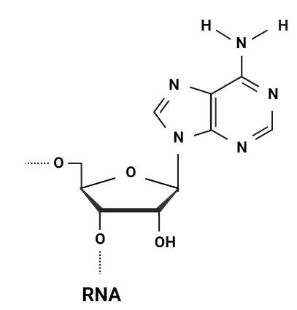
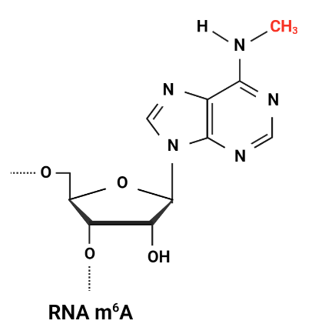



Introduction
RNA N⁶-Methyladenosine Modification
Methylation
METTL3
METTL14
HNRNPL
YTHDC1
YTHDF1
YTHDF2
FTO
ALKBH5
Demethylation
Notes:
RNA m6A modification is an epigenetic modification. When methylation occurs at the sixth N position of adenosine, it is what we call m6A. The proteins can methylate RNA called Writer, such as METTL3, METTL14. On the other hand, the proteins can demethylate RNA called Eraser, such as FTO, ALKBH5.
In addition, the proteins can recognize m6A and affect a downstream mechanism called Reader, such as HNRNPL, YTHDC1, YTHDF1, YTHDF2.

Slide 8
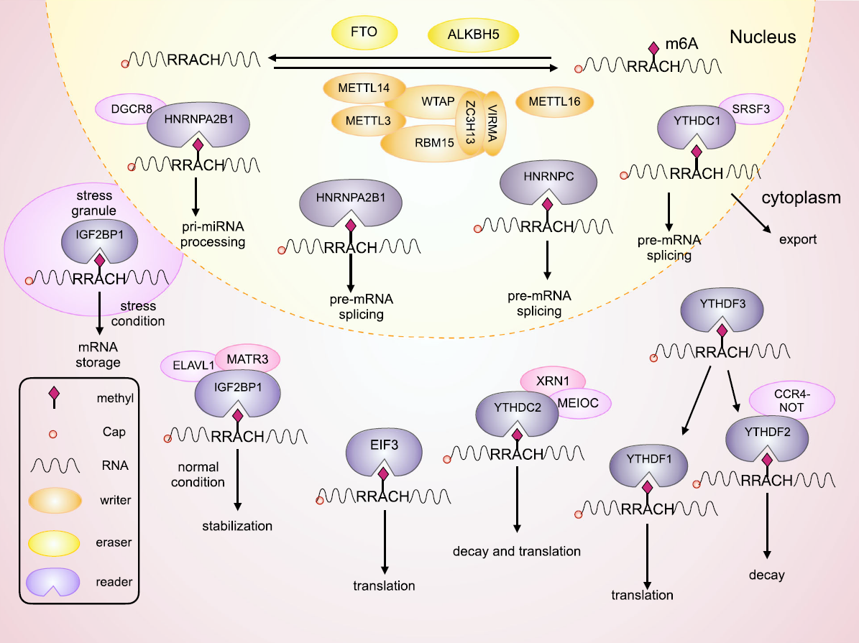
Introduction
Writer, Eraser, and Reader
m⁶A motif
RRACH
He L, et al. Mol Cancer, 2019
Notes:
The writer and eraser are mainly involved in methylation modification in the nucleus. They can recognize the m6A motif RRACH and methylate or demethylate the adenosine. However, the Reader has a more diverse function. The Reader can affect RNA splicing and export RNA to the cytoplasm and affect RNA stability and translation ability.

Slide 9
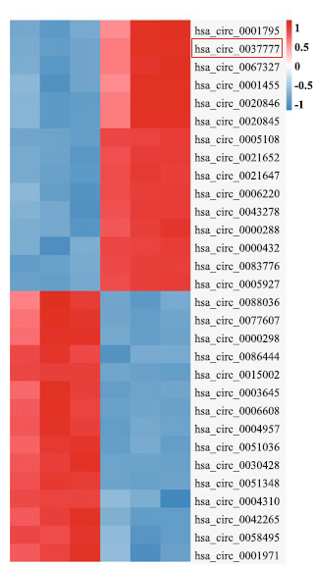
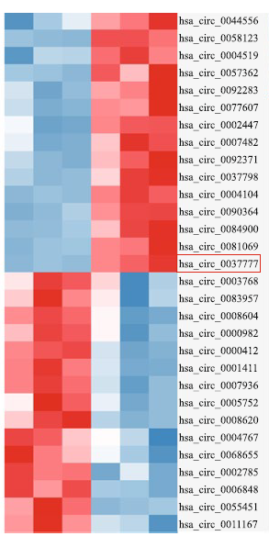
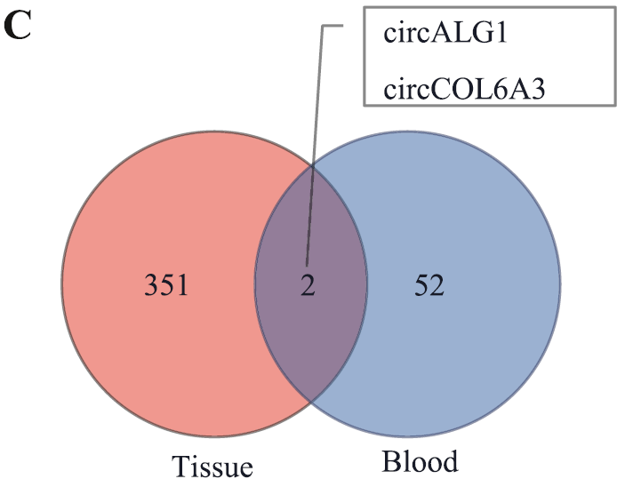
Results
CircALG1 is highly expressed in CRC
Tissue
Blood

Slide 10
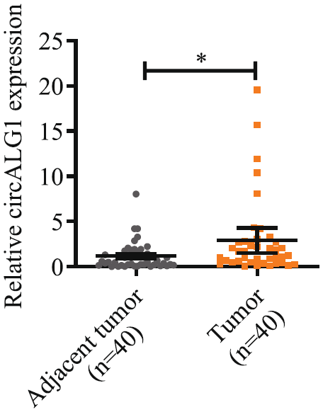
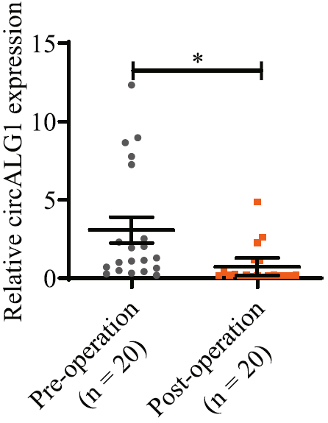
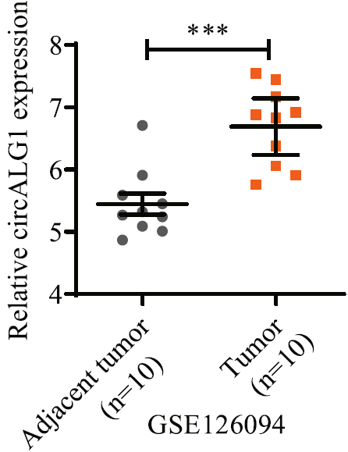
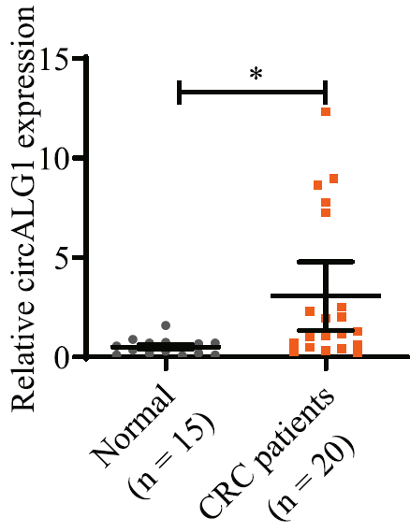
Results
CircALG1 is highly expressed in CRC

Slide 11
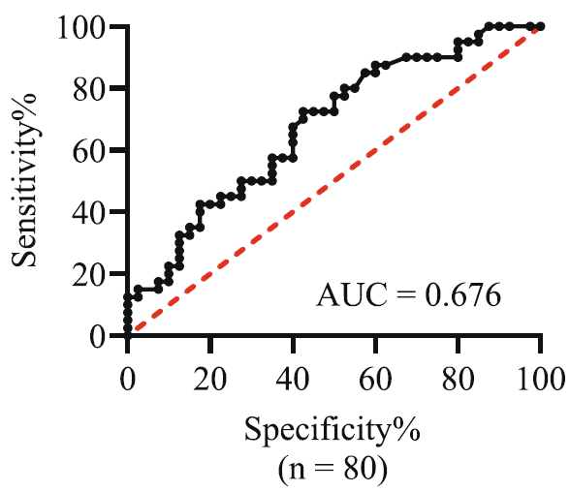
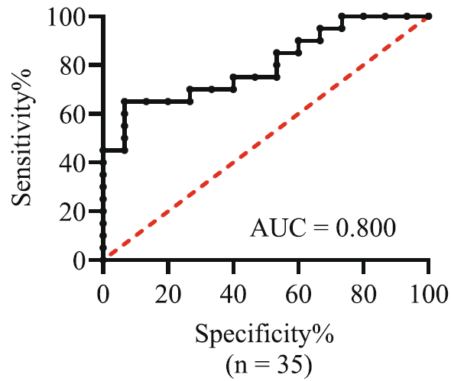
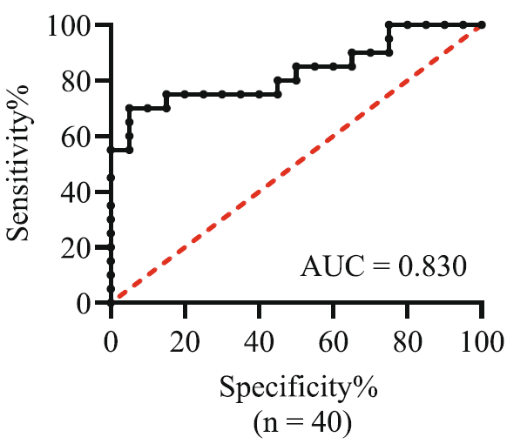
Results
CircALG1 is highly expressed in CRC
Tumors
vs
Adjacent tumor
CRC
vs
Healthy
Pre-operation
vs
Post-operation

Slide 12
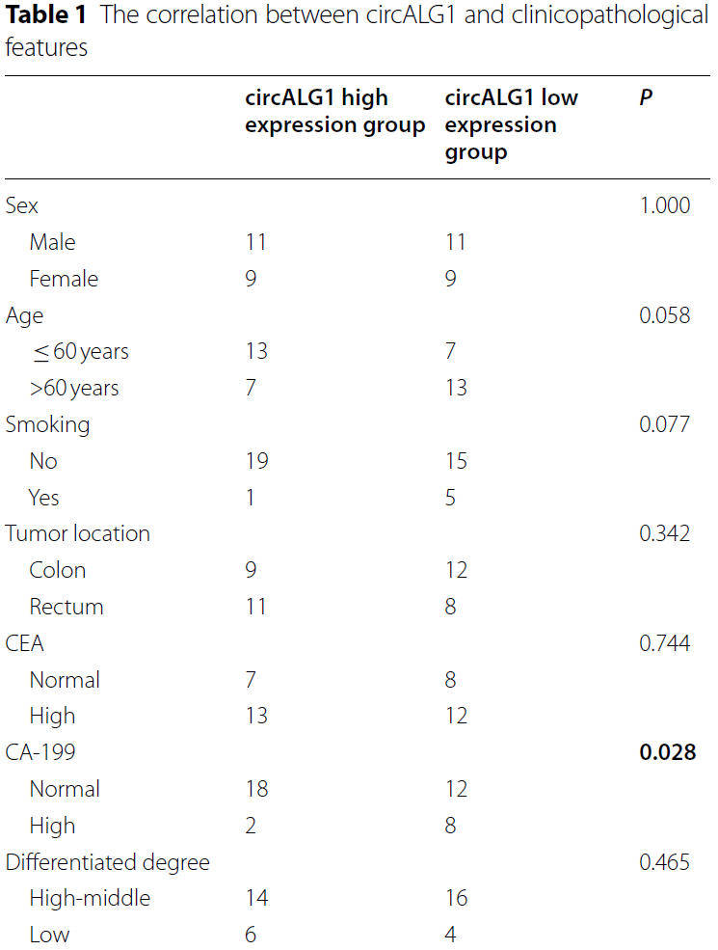
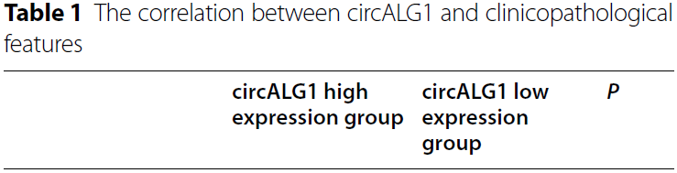
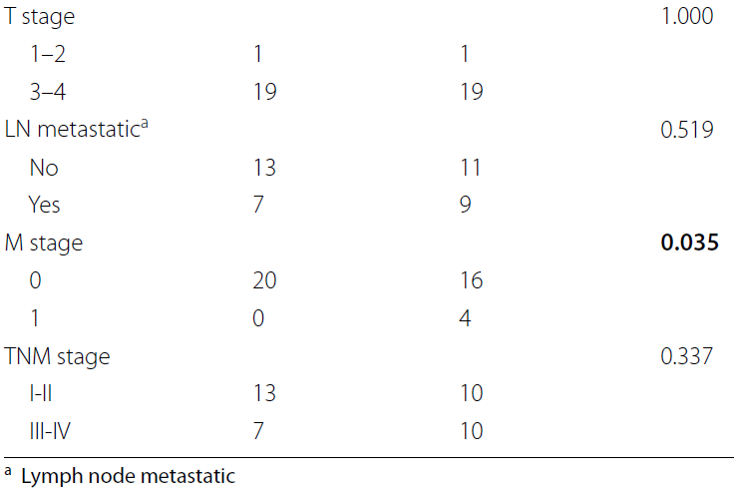
Results

Slide 13
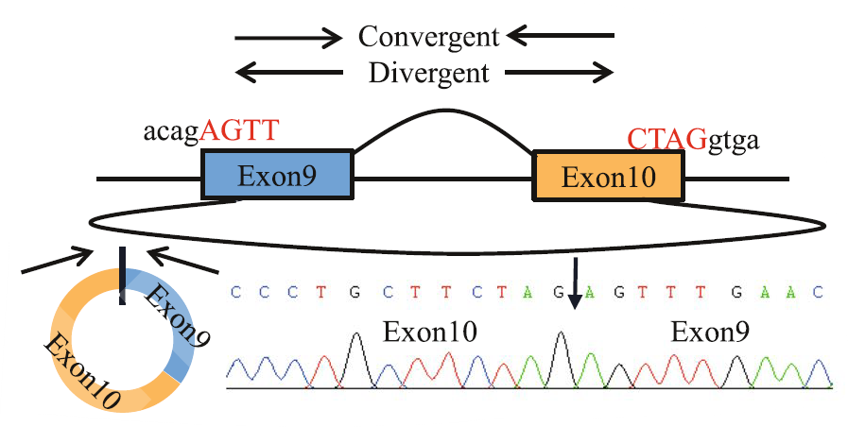
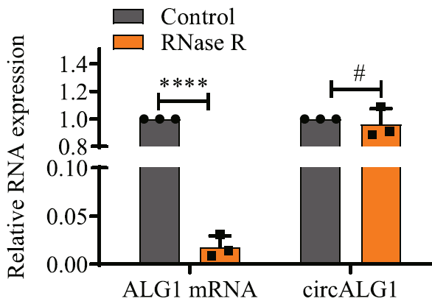
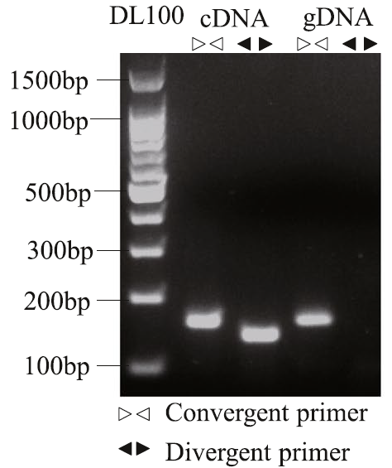
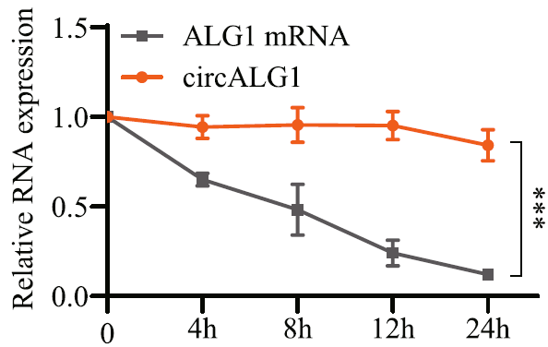
Results
Characterization of CircALG1

Slide 14
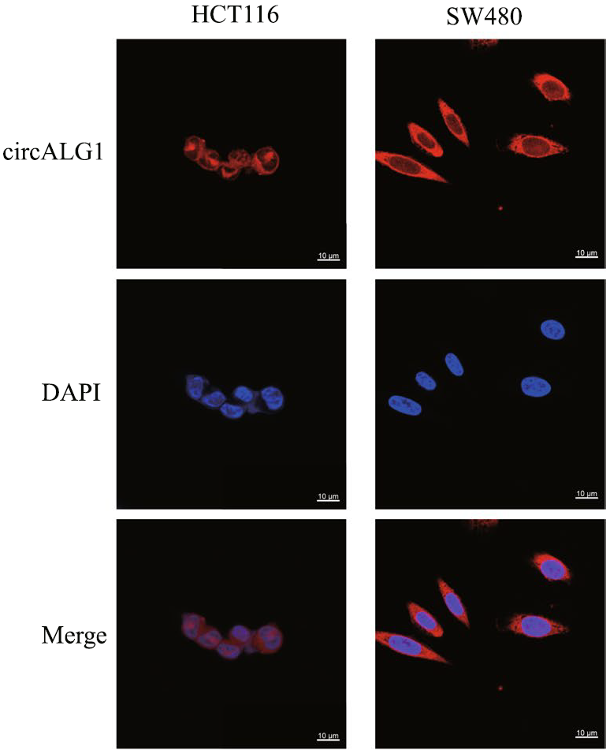
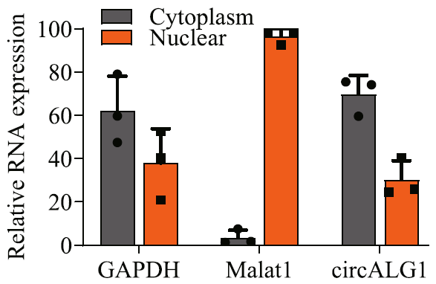
Results
Characterization of CircALG1

Slide 15
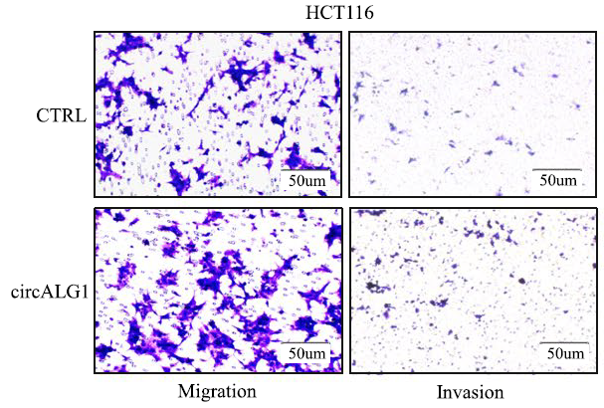
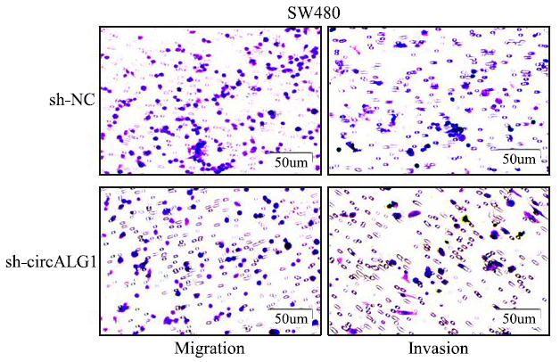
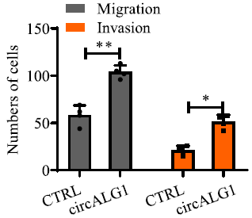
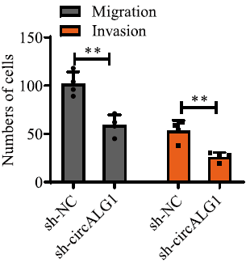
Results
CircALG1 promoted CRC metastasis in vitro

Slide 16
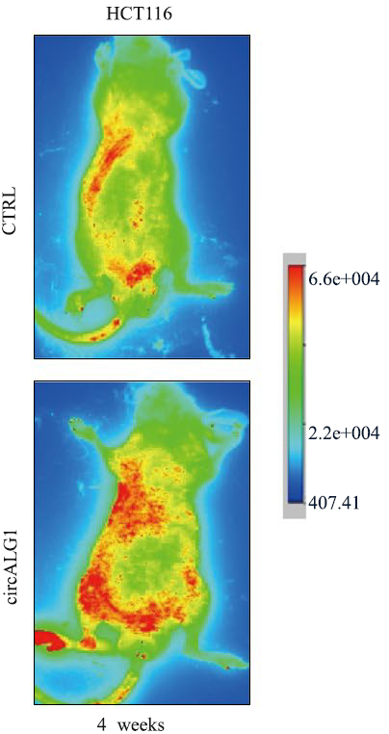
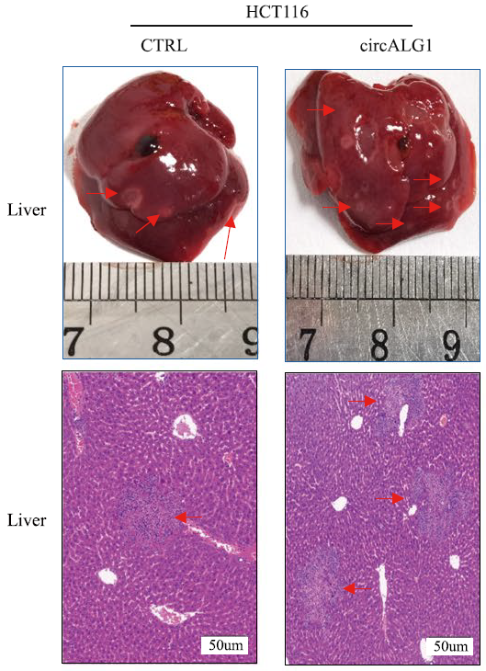
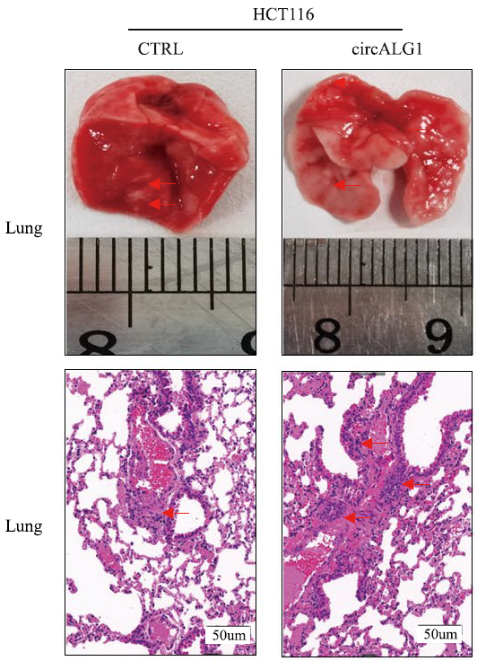
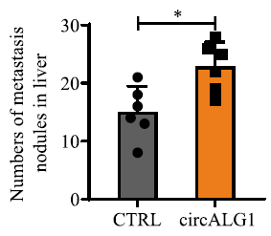
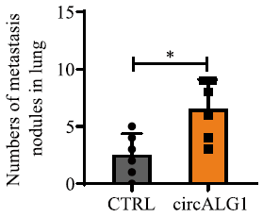
Results
CircALG1 promoted CRC metastasis in vivo

Slide 17
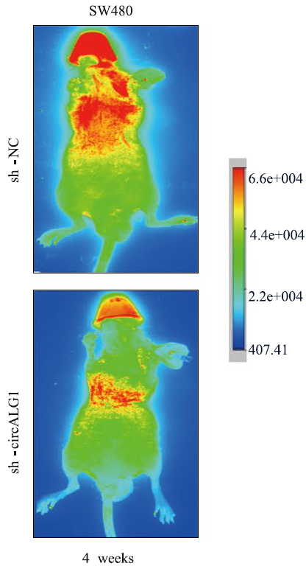
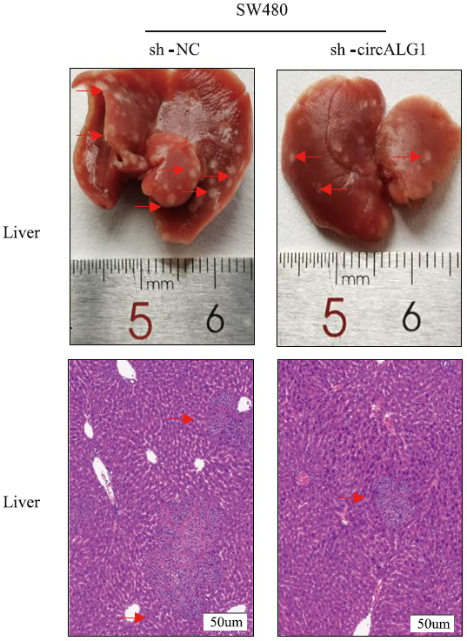
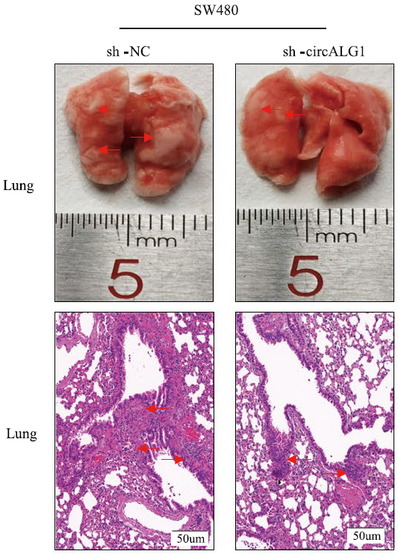
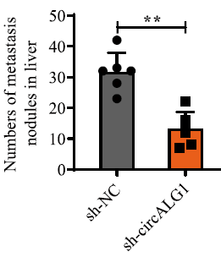
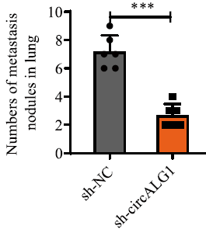
Results
CircALG1 promoted CRC metastasis in vivo

Slide 18
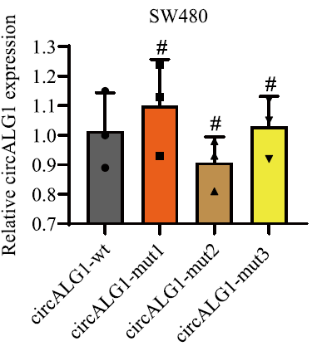
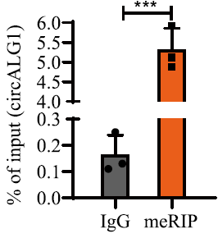
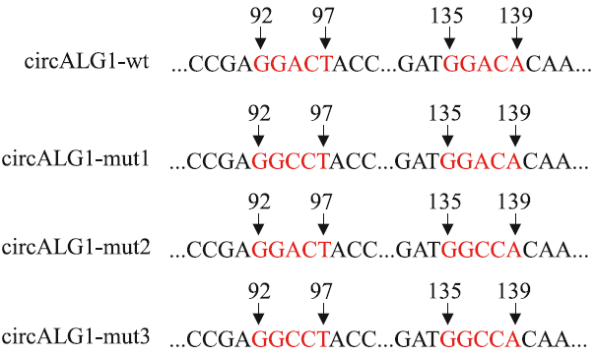
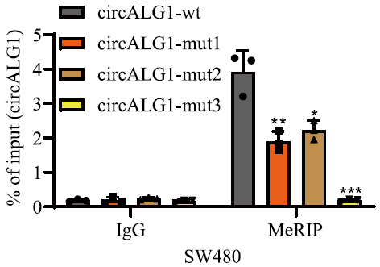
Results
The m⁶A modification of circALG1 promoted CRC metastasis

Slide 19
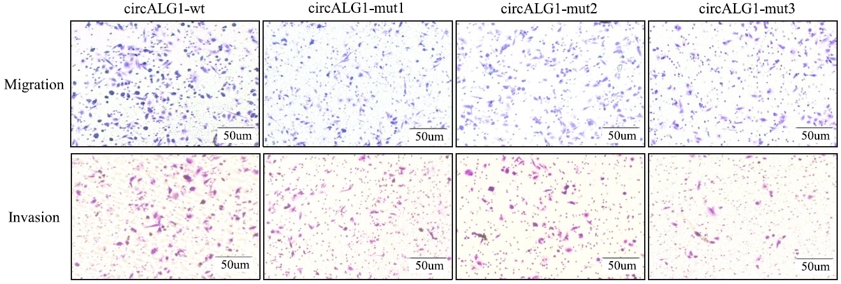
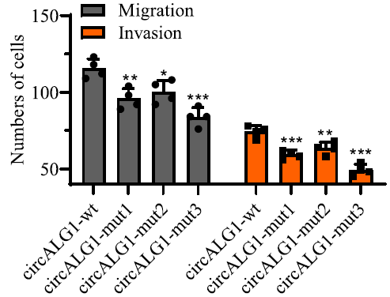
Results
The m⁶A modification of circALG1 promoted CRC metastasis

Slide 20
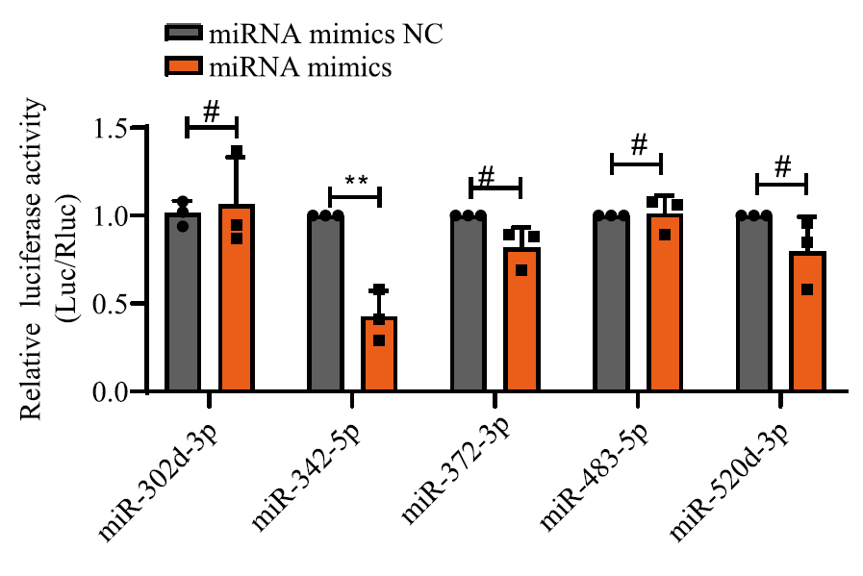
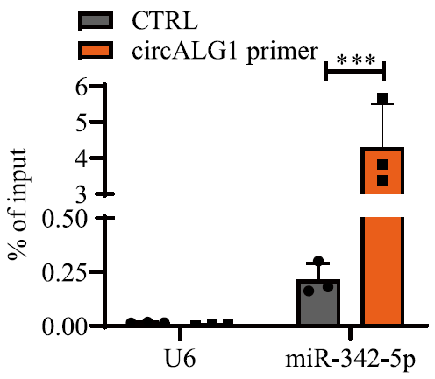
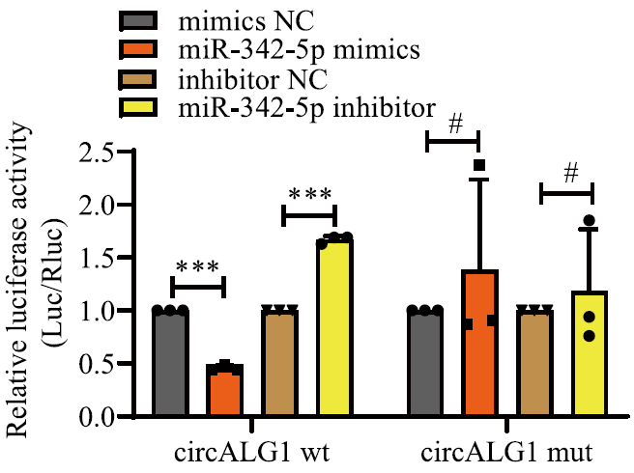
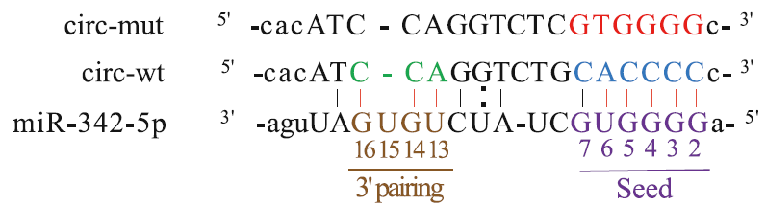
Results
CircALG1 promoted migration and invasion through miR-342-5p

Slide 21




Results
CircALG1 promoted migration and invasion through miR-342-5p

Slide 22







Results
PGF was a downstream target of the circALG1/miR-342-5p signaling axis

Slide 23






Results
PGF was a downstream target of the circALG1/miR-342-5p signaling axis

Slide 24


Results
PGF was a downstream target of the circALG1/miR-342-5p signaling axis

Slide 25





Results
The m⁶A of circALG1 enhanced its ability to bind to miR-342-5p

Slide 26






Results
The m⁶A of circALG1 enhanced its ability to bind to miR-342-5p

Slide 27

Summary

Slide 28
Thank you for listening!
Notes:
This is my speech today, thank you for listening.

