Slide 1
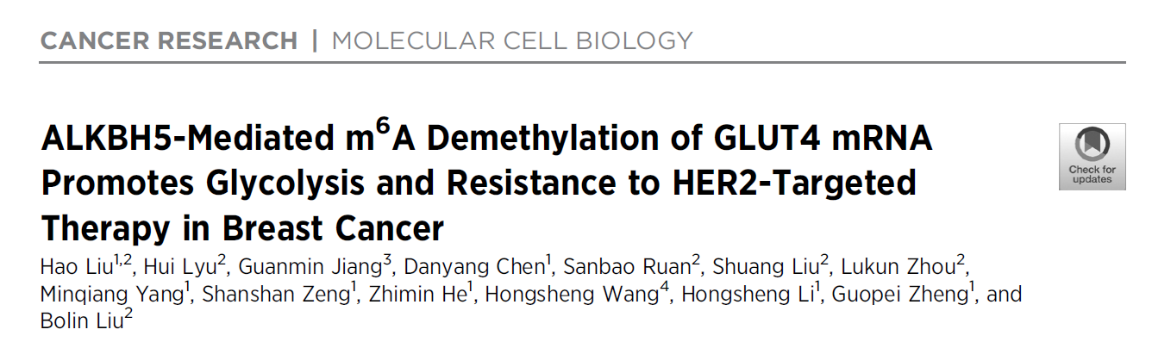
Speaker: Yi-An Chen
Advisor: Liang-Chuan Lai, Ph.D.
Date: 2022.11.14

Slide 2
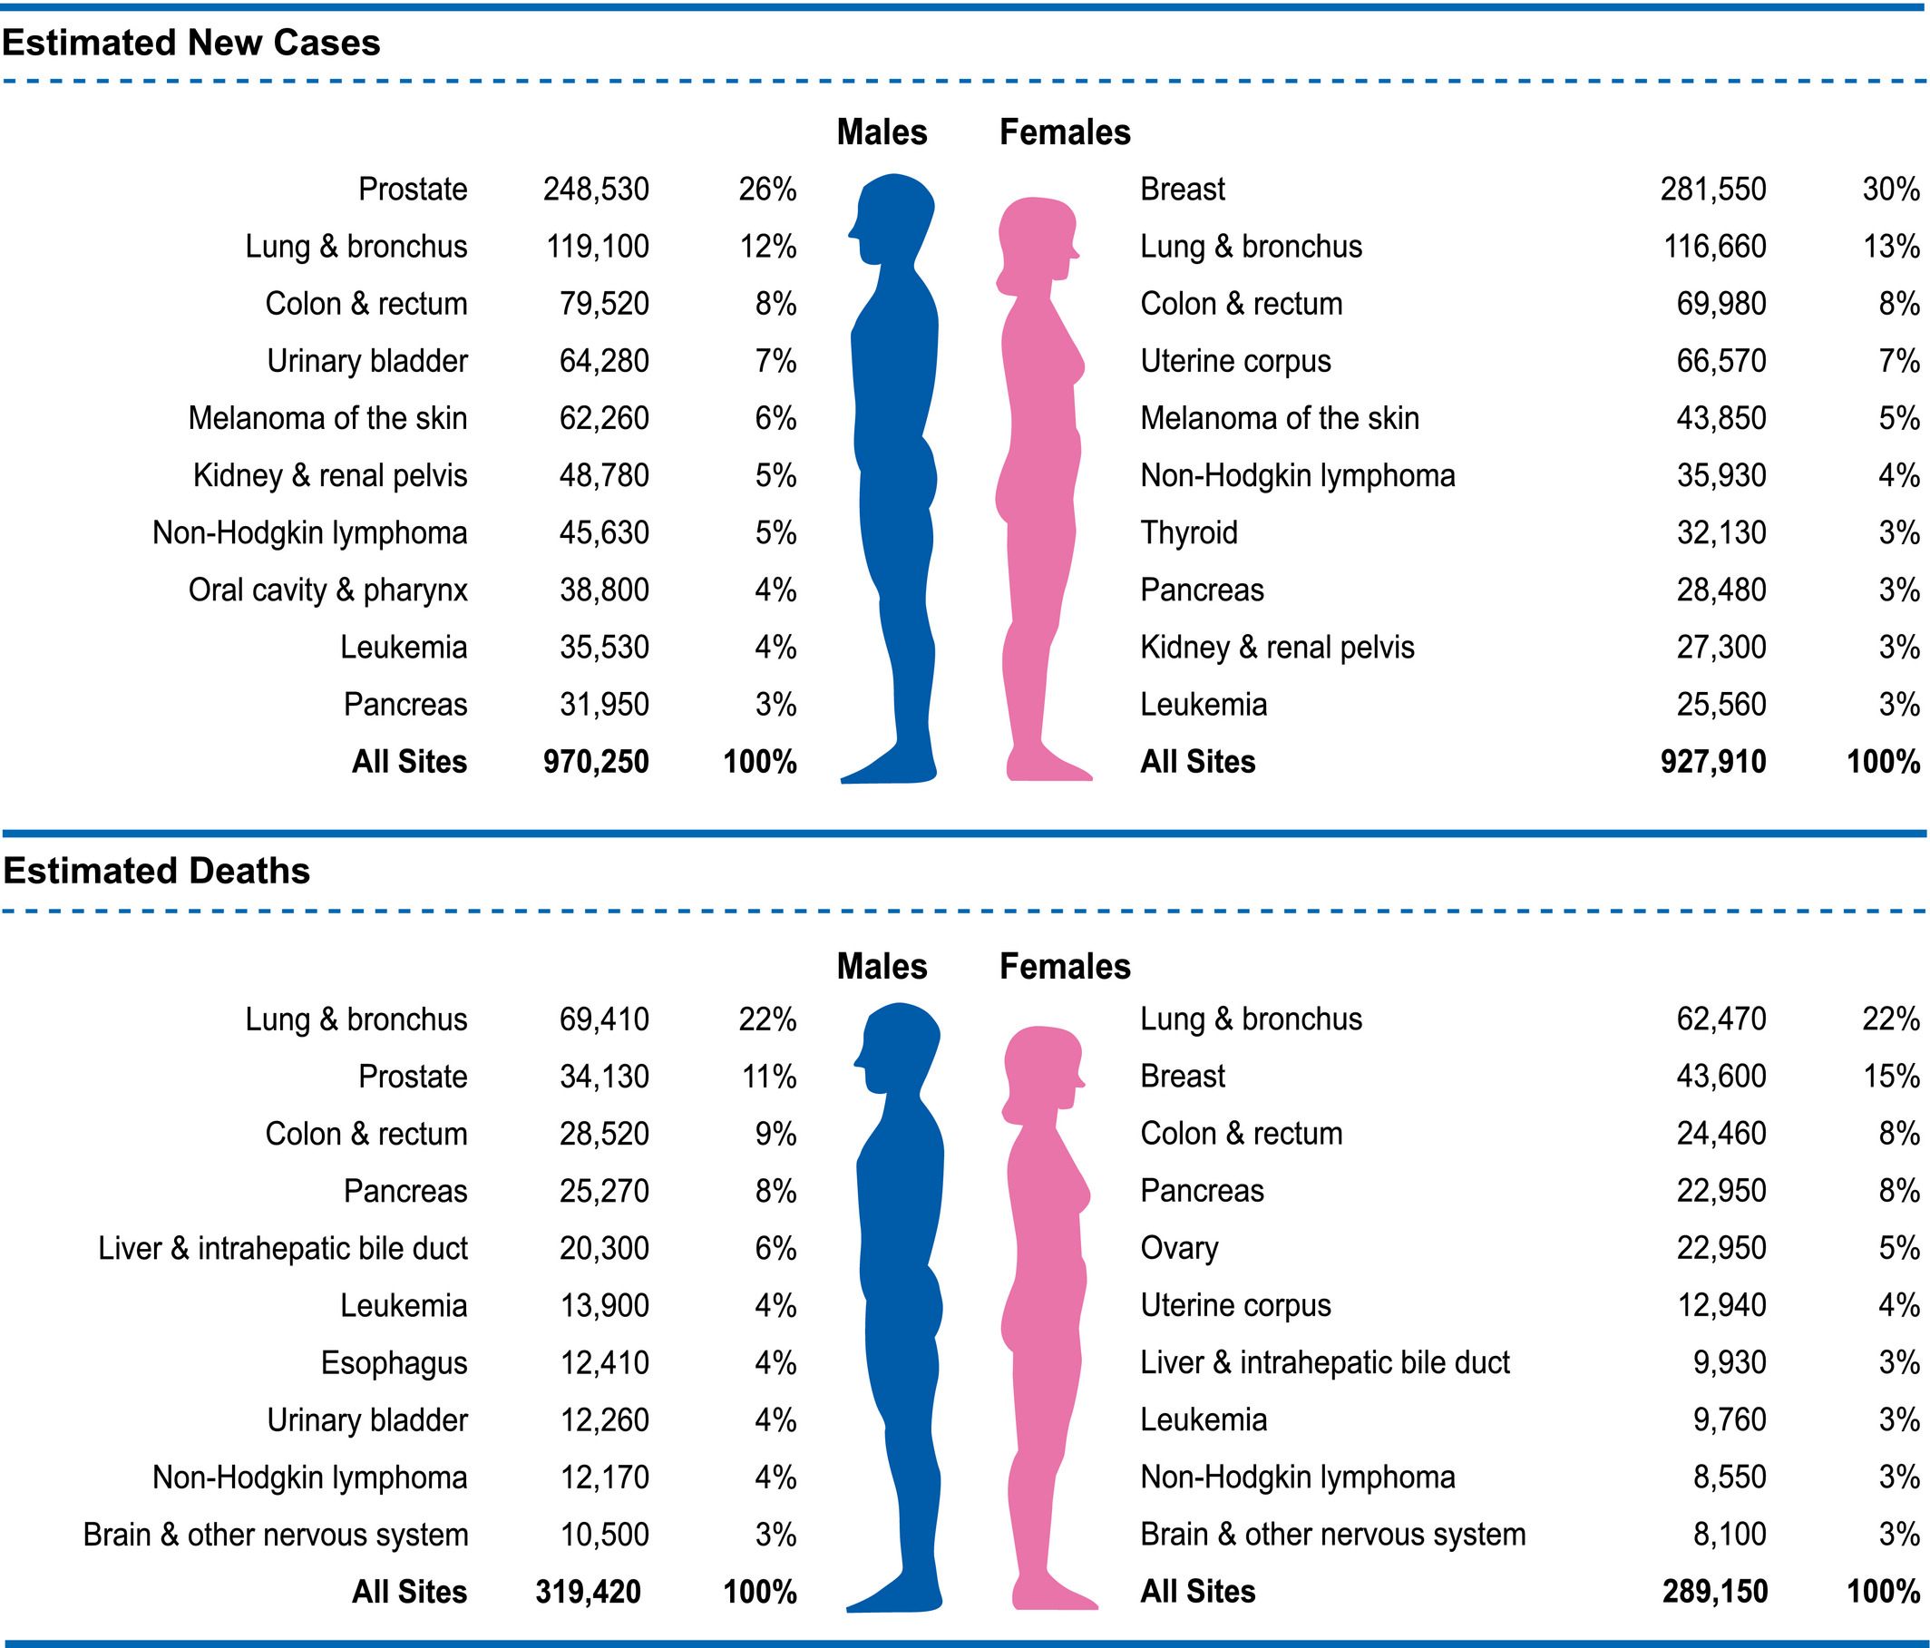

Introduction
Breast cancer (BC)
The most common invasive cancer in women worldwide
Many subtypes
Best
prognosis
Luminal A
ER(+), PR(+), HER2(-),
Luminal B
HER2(-)
ER(+), PR(+), HER2(-),
Luminal B
HER2(+)
ER(+), PR(+), HER2(+),
HER2 type
ER(-), PR(-),HER2(+)
Triple-negative
ER(-), PR(-),HER2(-)
Worst
prognosis
CA CANCER J CLIN 2021;71:7–3

Slide 3
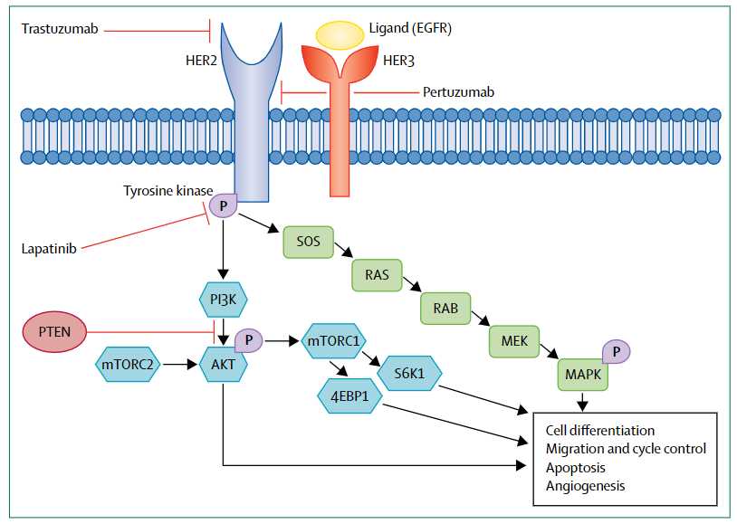
Introduction
HER2 positive breast cancer
About 15%–20% of all breast cancers
Associated with poor clinical outcomes in patients
Promote tumor cell proliferation and survival pathways
HER2-targeted therapies:
Trastuzumab
Lapatinib
Lancet 2017;389:2415–29
Notes:
HER2是細胞膜上的蛋白質，功能是調控細胞生長和分裂。HER2陽性乳癌是HER2過度表現，刺激癌細胞快速生長，是乳癌的惡中之惡，即使是早期的HER2陽性乳癌，也比其他型的早期乳癌惡性度高，更容易復發及轉移。
若是用HER2單標靶藥物治療，10年內還是約有25％的病人會復發

Slide 4
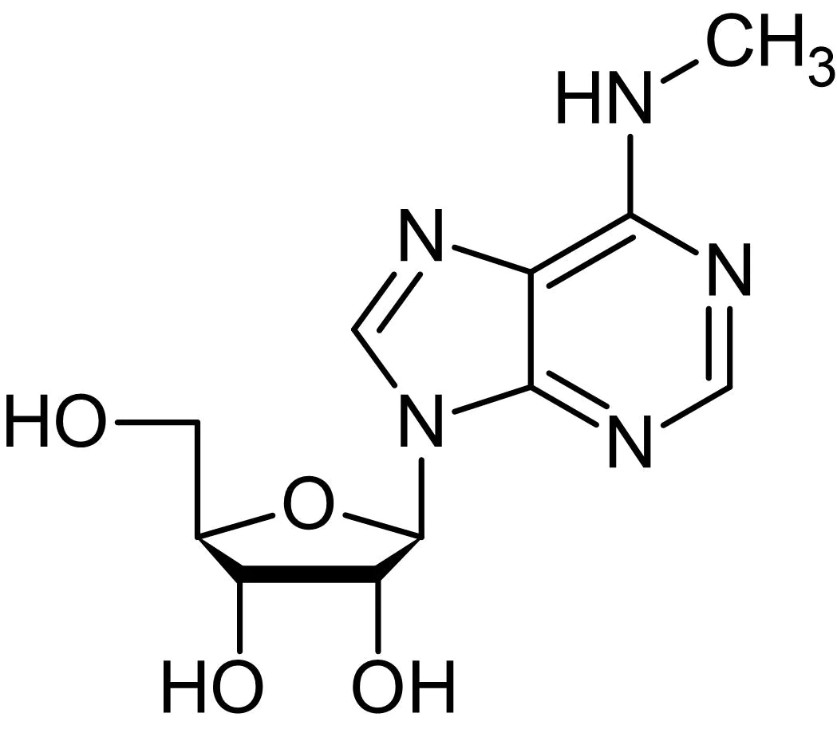
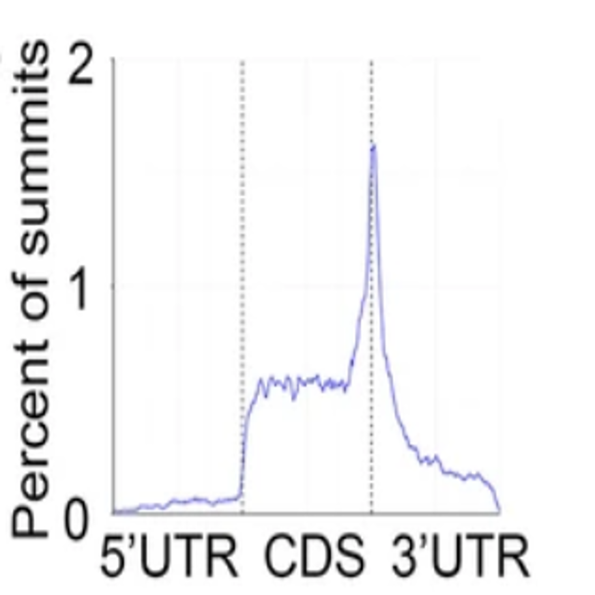

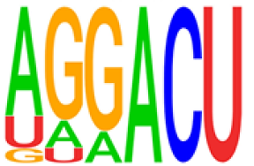
Introduction
RNA methylation
(N6-methyladenosine modification, m6A)
The average 1000 nucleotides contain 1~2 m6A residues ➜ 0.1% m6A
Enriched near CDS, stop codon, 3′ UTR and, 5′ UTR
Affecting RNA stability, splicing, translation and nuclear export
Me
Hu et al. Molecular Cancer (2022) 21:34

Slide 5
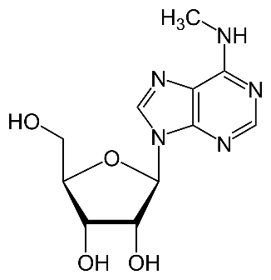
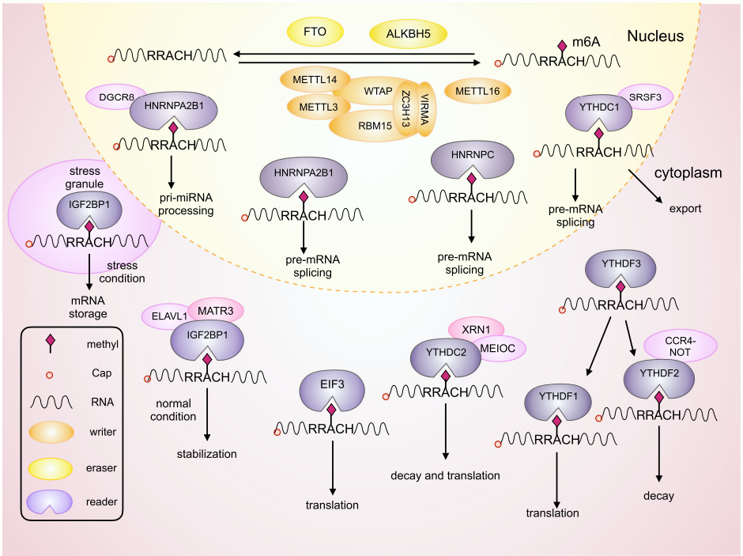
Introduction
Mechanism of RNA methylation
He et al. Molecular Cancer (2019) 18:176

Slide 6
Results
Fig. 1
iTRAQ-based proteomics analysis
iTRAQ: Isobaric Tags for Relative and Absolute Quantitation

Slide 7
Results
Fig. 1

Slide 8
Results
Fig. 2

Slide 9
Results
Fig. 2

Slide 10
Results
Fig. 3

Slide 11
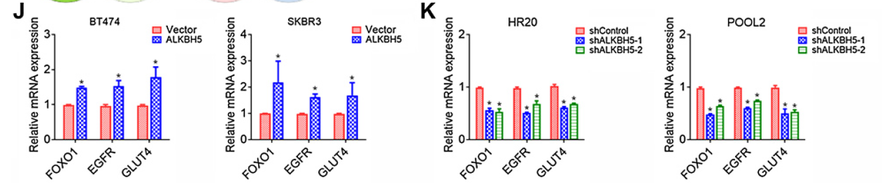
Results
Fig. 3

Slide 12
Results
Fig. 4

Slide 13
Results
Fig. 4

Slide 14
Results
Fig. 4

Slide 15
Results
Fig. 5

Slide 16
Results
Fig. 5

Slide 17
Results
Fig. 6

Slide 18
Results
Fig. 6

Slide 19
Results
Fig. 7

Slide 20
Something I learned from this paper…
Database: STRING (protein-protein interaction)
ALKBH5 is demethylated at the protein level,
so the authors only detect ALKBH5 by Western blot, not qPCR
RNA sequencing is important

