Slide 1
Speaker : Yi-Chun Ke
Advisor : Liang-Chuan Lai Ph.D.
Date : 2022.11.21

Slide 2
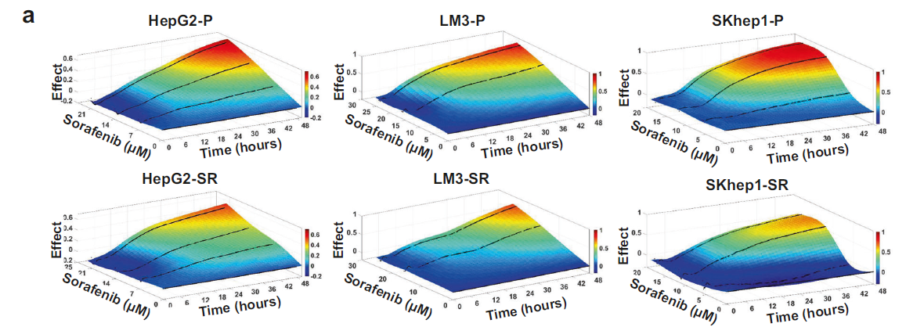
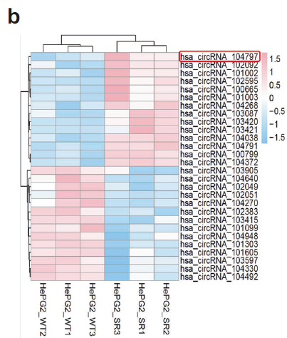
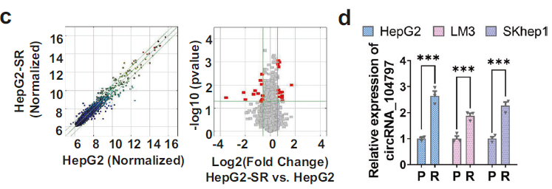
Results
CircRNA-SORE was overexpressed in sorafenib-resistant HCC cells
Notes:
首先建立了三個sorafenib耐藥的 HCC 細胞系通過用遞增劑量的sorafenib處理12 個月

Slide 3
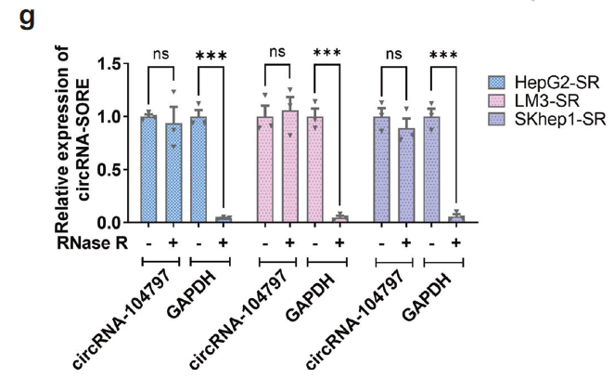
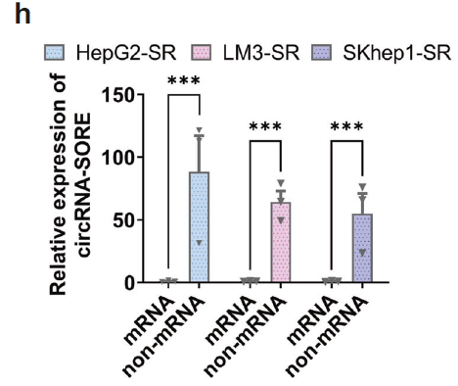
Results
CircRNA-SORE was overexpressed in sorafenib-resistant HCC cells

Slide 4
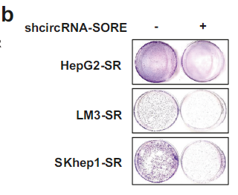
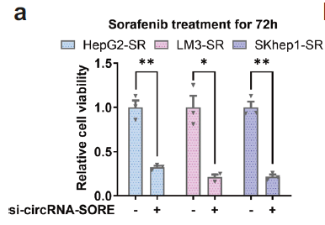
Results
CircRNA-SORE was critical for maintaining sorafenib resistance

Slide 5
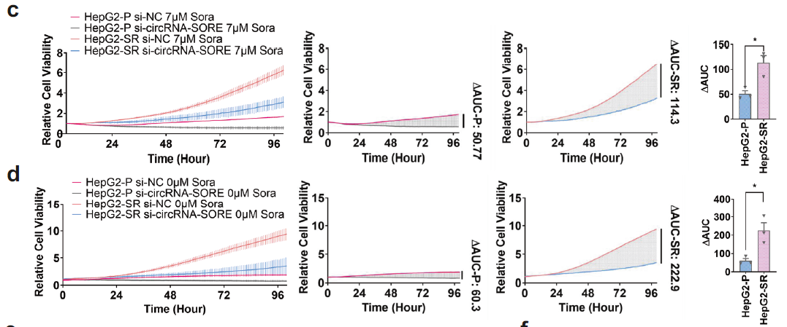
Results
CircRNA-SORE was critical for maintaining sorafenib resistance

Slide 6
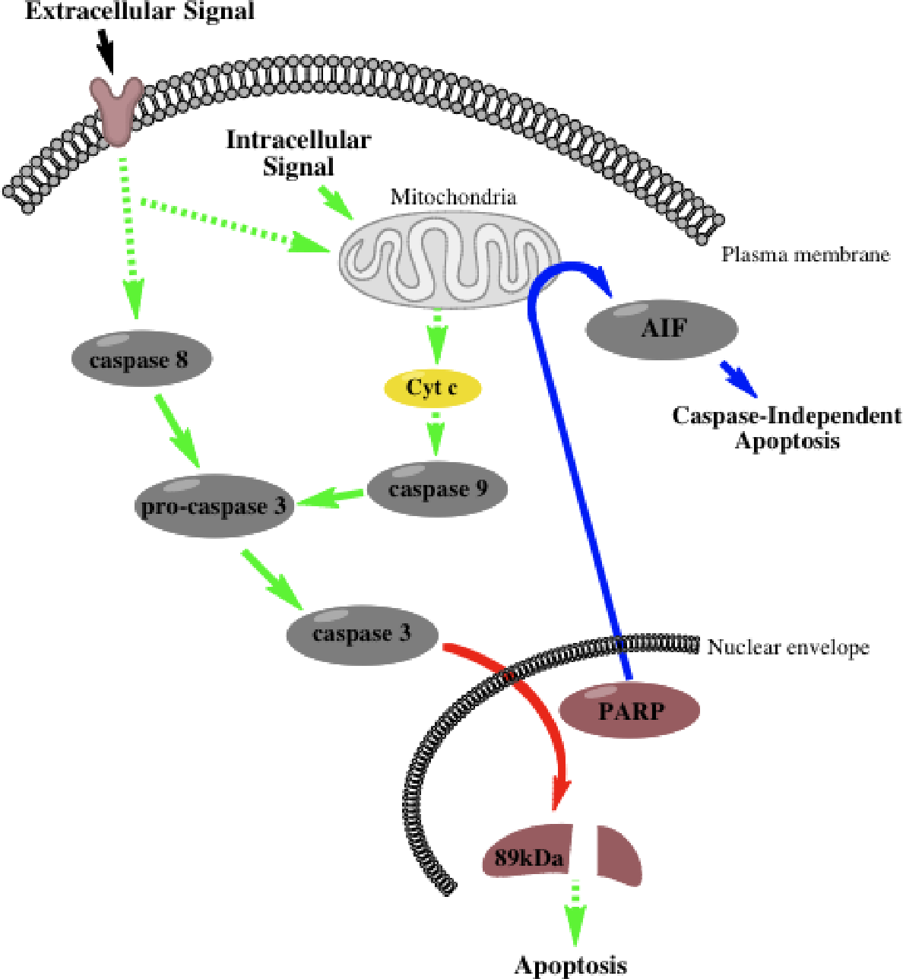
Results
CircRNA-SORE was critical for maintaining sorafenib resistance

Slide 7
Results
CircRNA-SORE was critical for maintaining sorafenib resistance
Terminal deoxynucleotidyl transferase dUTP nick end labeling (TUNEL)
LL - live LR- apoptotic
UR - late stage apoptotic UL - necrotic
Notes:
細胞凋亡晚期時，染色體 DNA 會開始斷裂，產生大量的3’-OH 末端，因此可透過特殊酵素 terminal deoxynucleotidyl transferase (TdT)，將預先標記好的 dUTP 鍵結上去。因此能夠透過觀察標記的 dUTP，反映細胞凋亡的情形

Slide 8
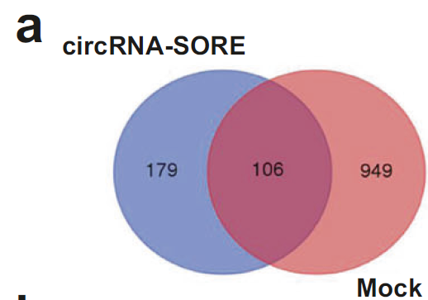
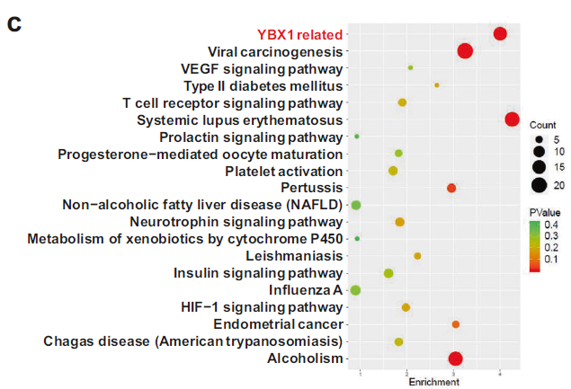
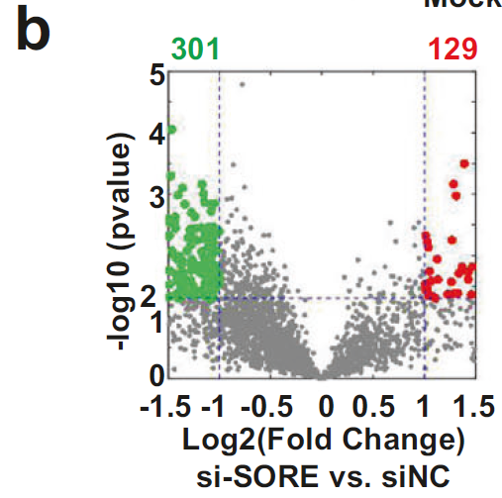
Results
CircRNA-SORE functioned by binding to YBX1 protein
Notes:
A圖: circSORE probe pulldown 打MS
B圖: total lysate 打MS看有變化的基因
c圖:KEGG pathway

Slide 9
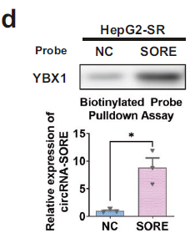
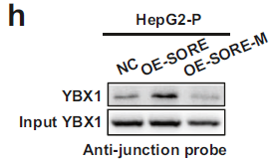
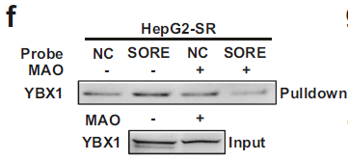
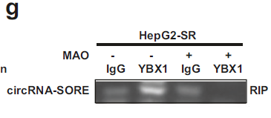
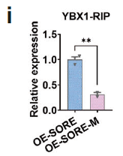
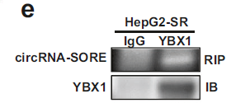
Results
CircRNA-SORE functioned by binding to YBX1 protein
morpholino antisense oligos (MAO)

Slide 10
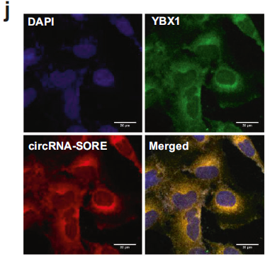
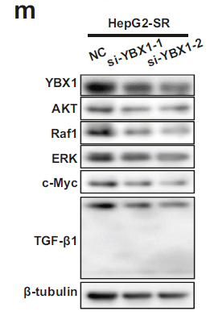
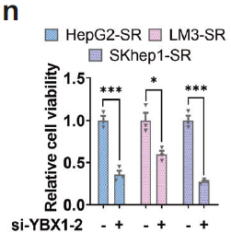
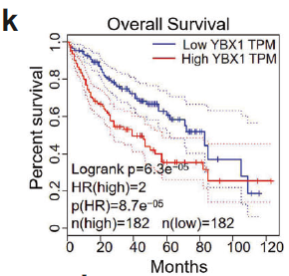
Results
CircRNA-SORE functioned by binding to YBX1 protein

Slide 11
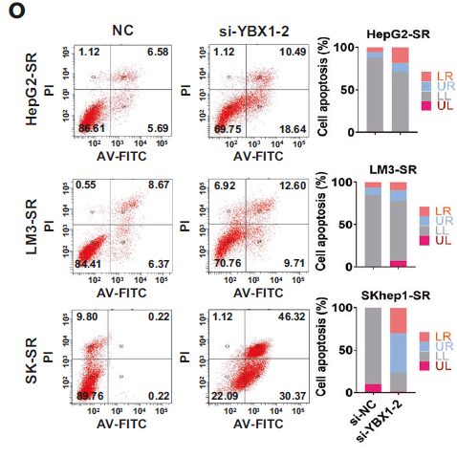
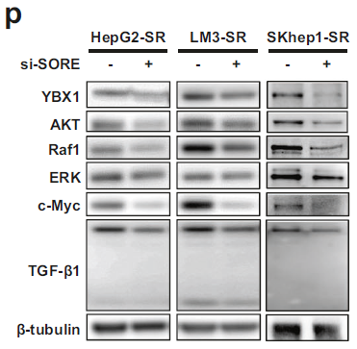
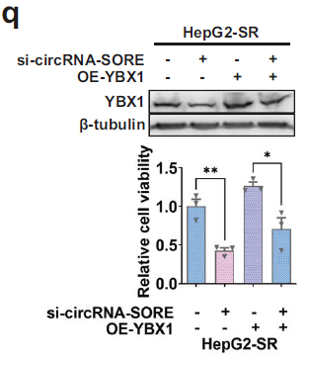
Results
CircRNA-SORE functioned by binding to YBX1 protein

Slide 12
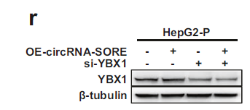
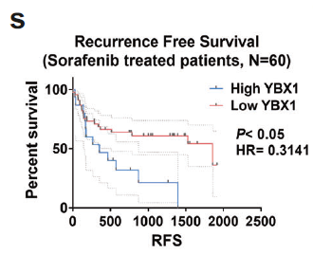
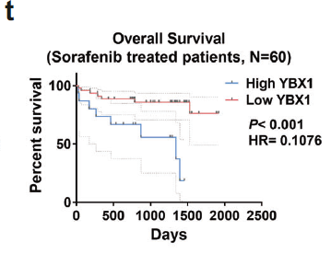
Results
CircRNA-SORE functioned by binding to YBX1 protein

Slide 13
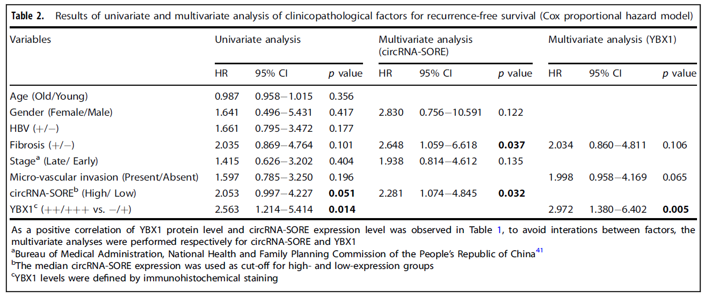
Results
Patients with lower circRNA-SORE or YBX1 expression were associated with better recurrence-free survival

Slide 14
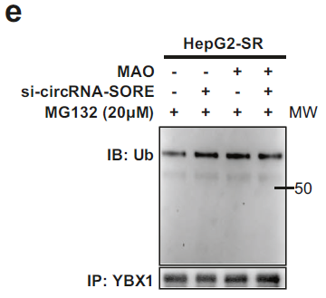
Results
CircRNA-SORE stabilized YBX1 by preventing its PRP19-mediated degradation

Slide 15
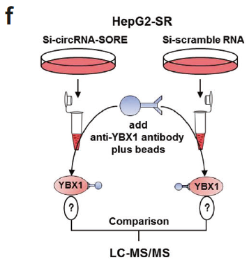
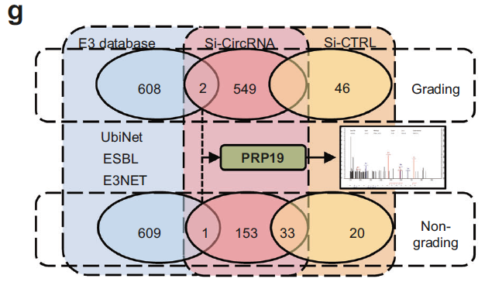
Results
CircRNA-SORE stabilized YBX1 by preventing its PRP19-mediated degradation

Slide 16
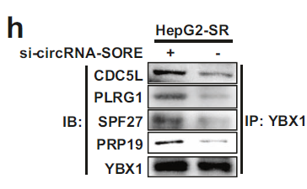
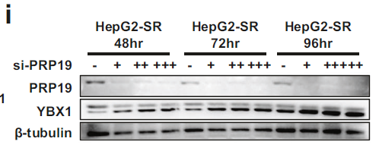
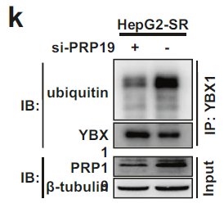
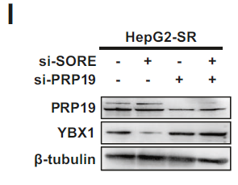
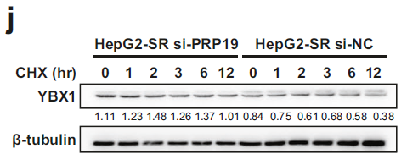
Results
CircRNA-SORE stabilized YBX1 by preventing its PRP19-mediated degradation

Slide 17
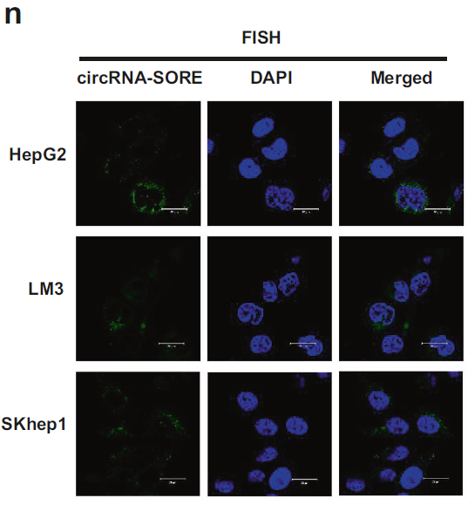
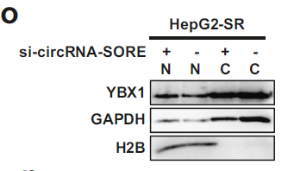
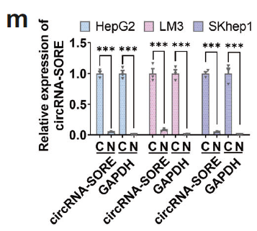
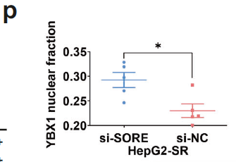
Results
CircRNA-SORE stabilized YBX1 by preventing its PRP19-mediated degradation

Slide 18
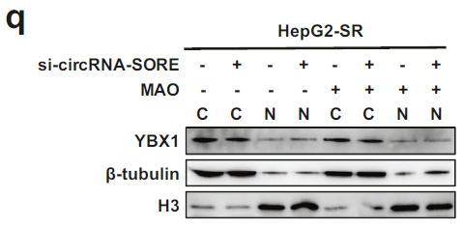
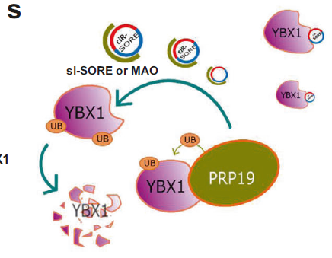
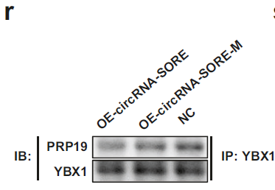
Results
CircRNA-SORE stabilized YBX1 by preventing its PRP19-mediated degradation

Slide 19
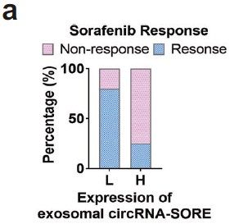
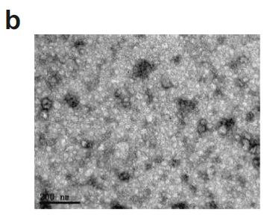
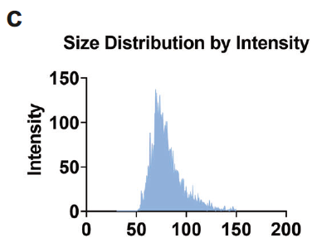
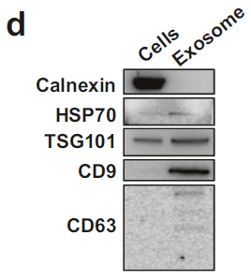
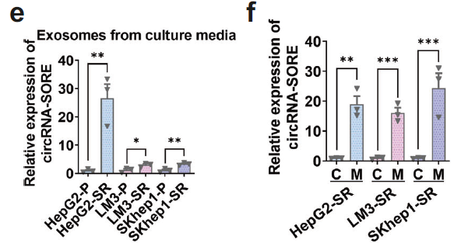
Results
CircRNA-SORE transmited sorafenib resistance by exosomes

Slide 20
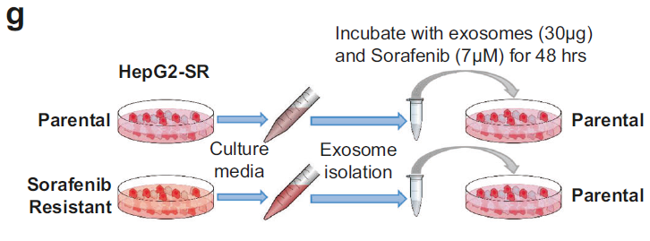
Results
CircRNA-SORE transmited sorafenib resistance by exosomes

Slide 21
Results
CircRNA-SORE transmited sorafenib resistance by exosomes

Slide 22
Results
Silencing circRNA-SORE substantially improved sorafenib efficacy in vivo

Slide 23
Results
Silencing circRNA-SORE substantially improved sorafenib efficacy in vivo

Slide 24
Results
Silencing circRNA-SORE substantially improved sorafenib efficacy in vivo

Slide 25
Results
Silencing circRNA-SORE substantially improved sorafenib efficacy in vivo

Slide 26
Conclusion

