Slide 1
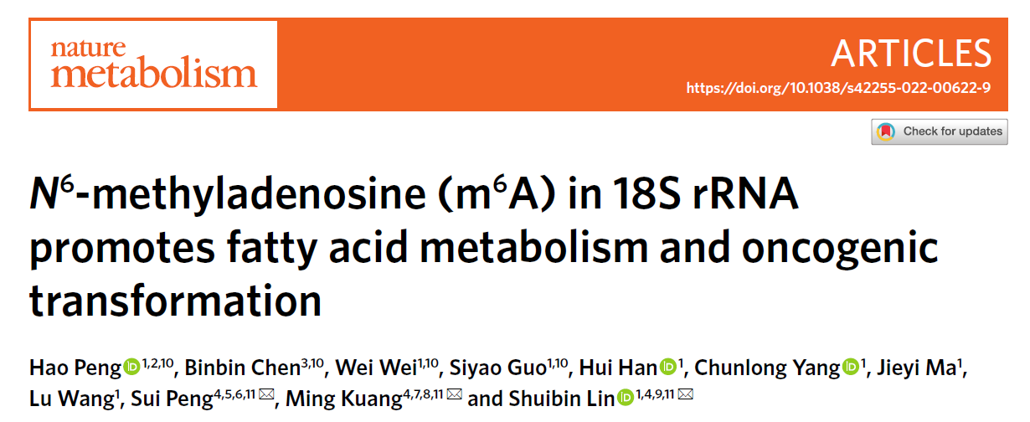
Speaker: Yi-An Chen
Advisor: Liang-Chuan Lai, Ph.D.
Date: 2022.12.12

Slide 2
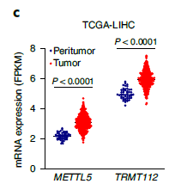
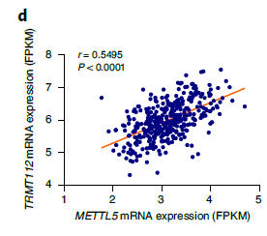
Results
Fig. 1

Slide 3
Results
Fig. 1

Slide 4
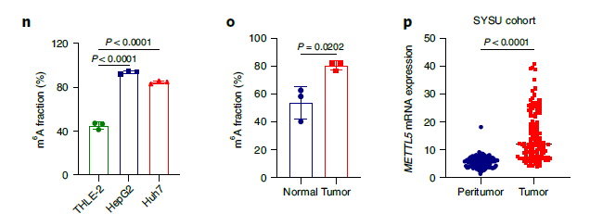
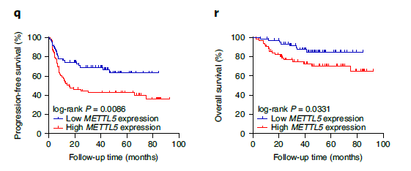
Results
Fig. 1

Slide 5
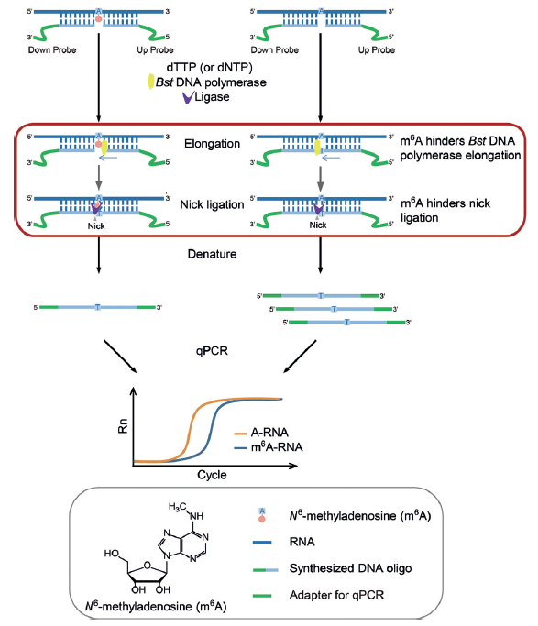
single-base elongation-and ligation-based qPCR amplification (SELECT)

Slide 6
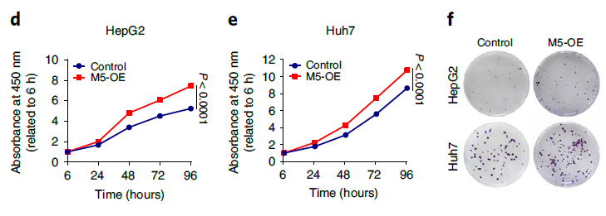
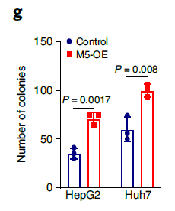
Results
Fig. 2

Slide 7
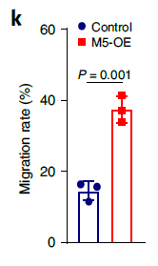
Results
Fig. 2

Slide 8
Results
Fig. 2

Slide 9
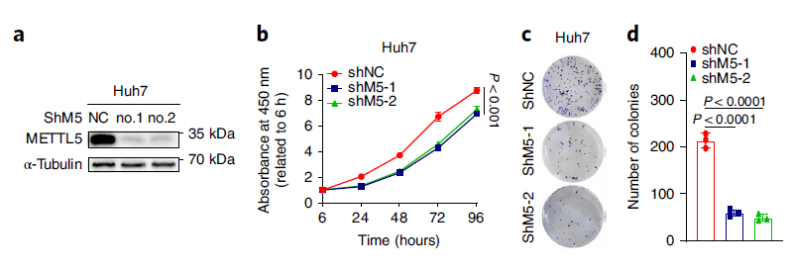
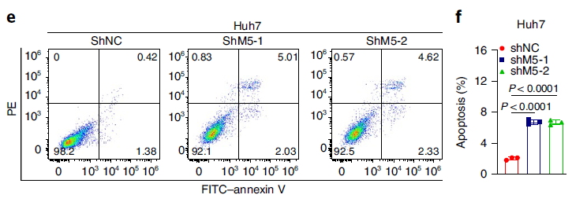
Results
Fig. 3

Slide 10
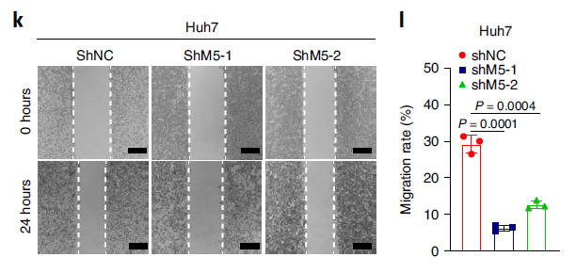
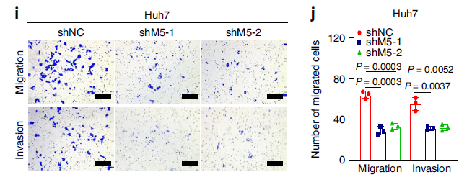
Results
Fig. 3

Slide 11
Results
Fig. 3

Slide 12
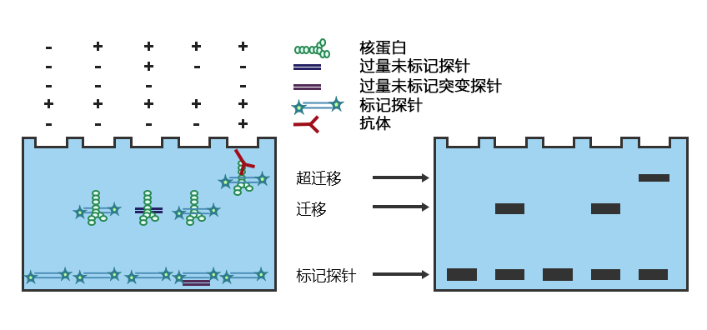
Electrophoretic Mobility Shift Assay (EMSA)

Slide 13
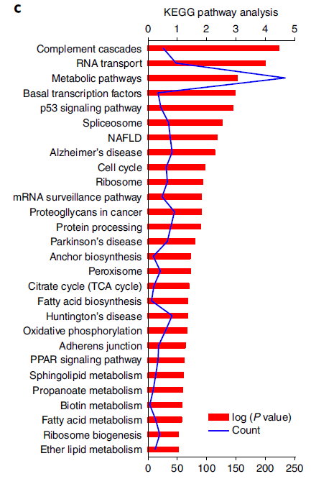
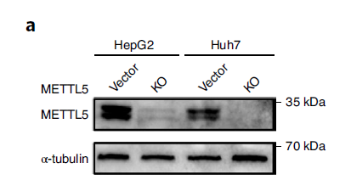
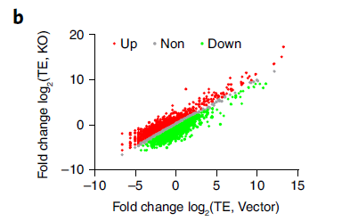
Results
Fig. 4

Slide 14
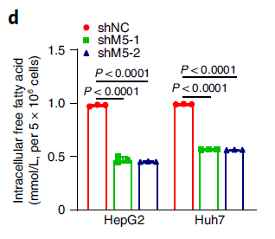
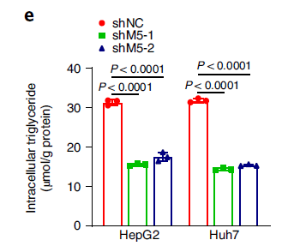
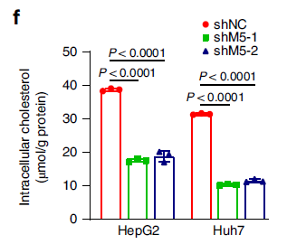
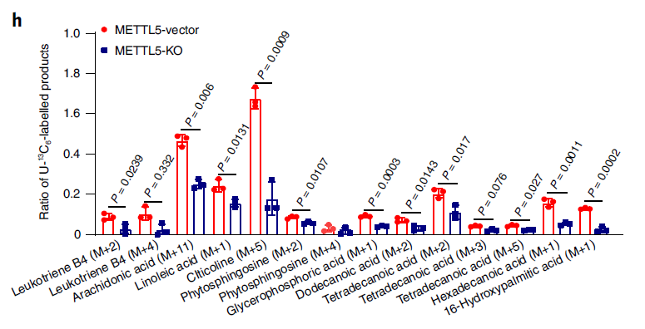
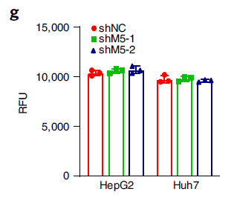
Results
Fig. 4

Slide 15
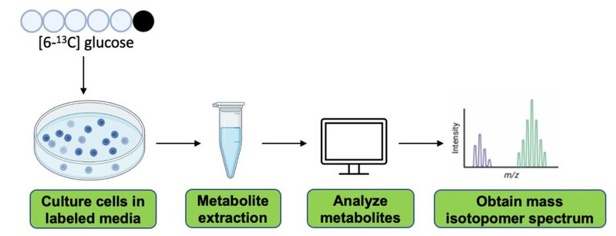
Metabolic flux analysis

Slide 16
Results
Fig. 4

Slide 17
Results
Fig. 5

Slide 18
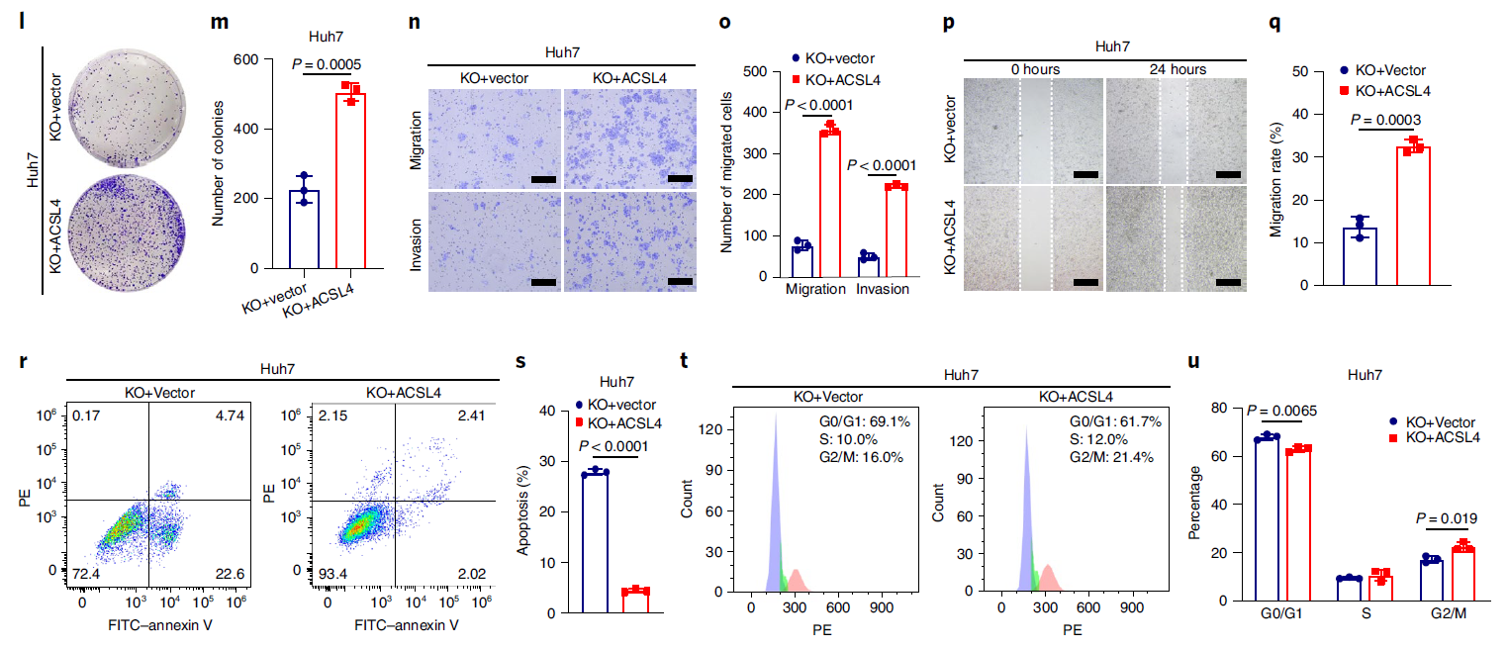
Results
Fig. 5

Slide 19
Results
Fig. 6

Slide 20
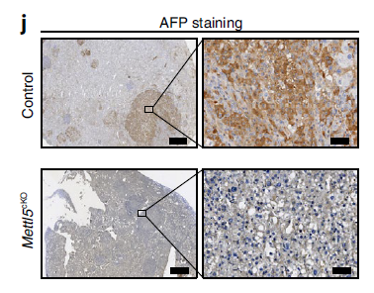
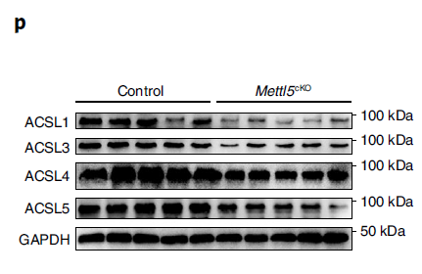
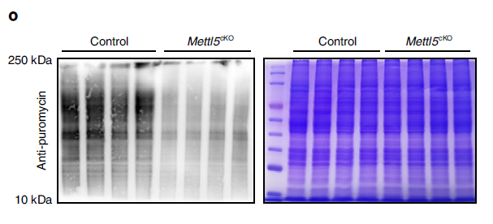
Results
Fig. 6

Slide 21
Results
Fig. 6

Slide 22
Results
Fig. 7

Slide 23
Results
Fig. 7

