Slide 1
Speaker : Yi-Chun Ke
Advisor : Liang-Chuan Lai Ph.D.
Date : 2023.01.09

Slide 2
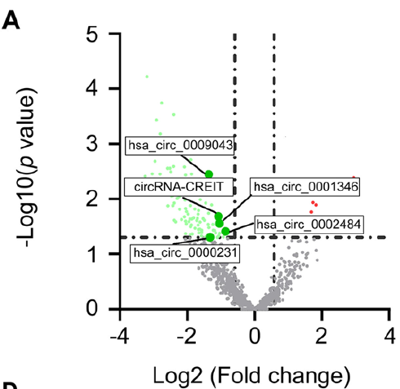
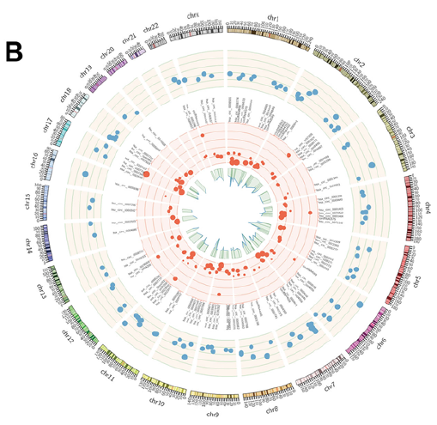
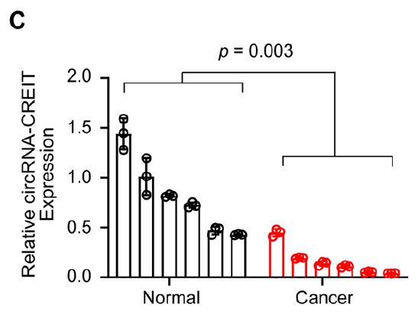
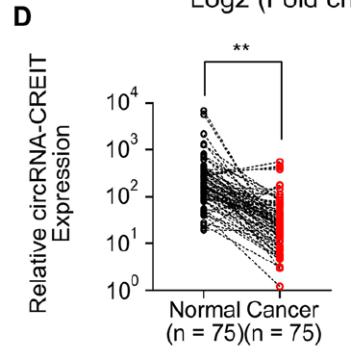
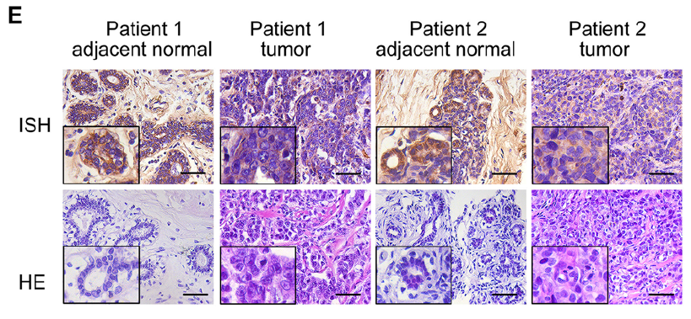
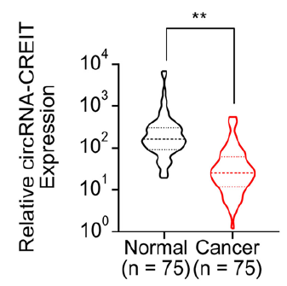
Results
CircRNA-CREIT was downregulated in TNBC

Slide 3
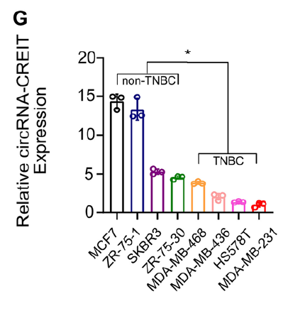
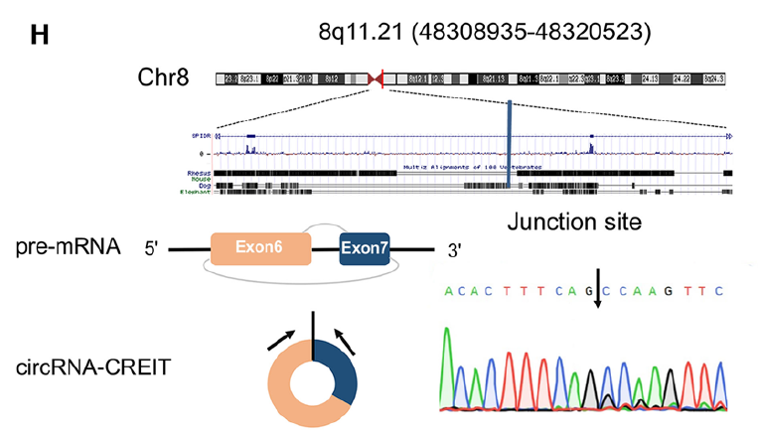
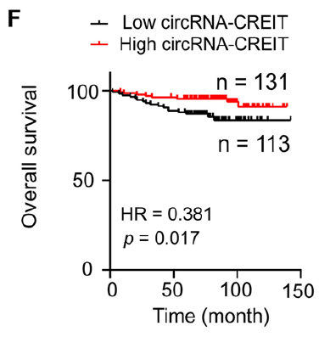
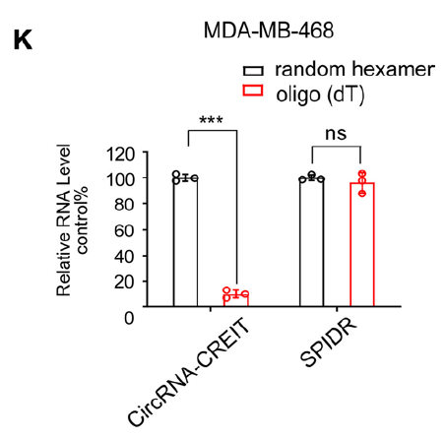
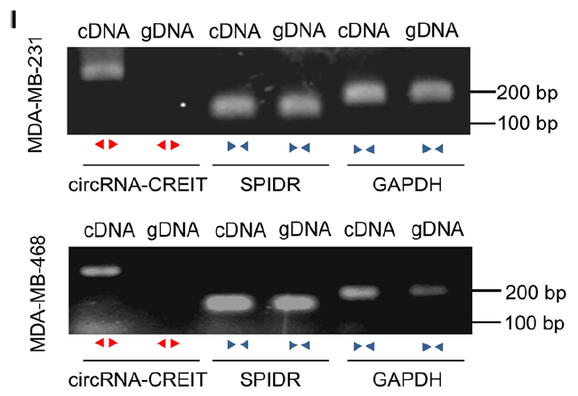
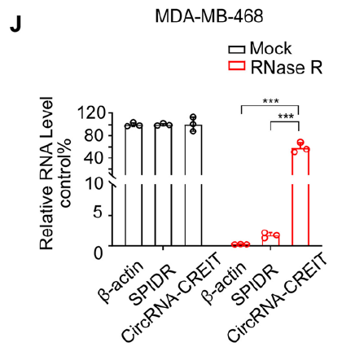
Results
CircRNA-CREIT was downregulated in TNBC

Slide 4
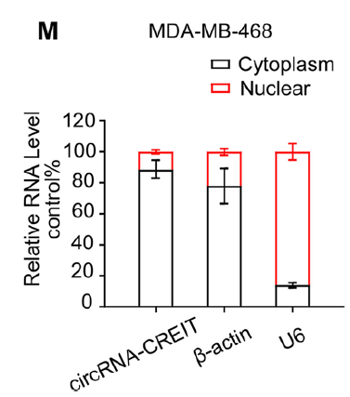
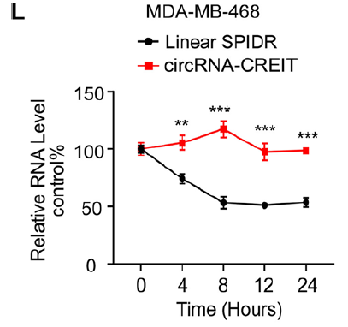
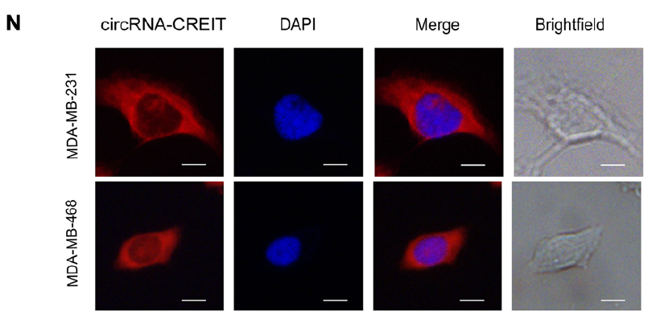
Results
CircRNA-CREIT was downregulated in TNBC

Slide 5
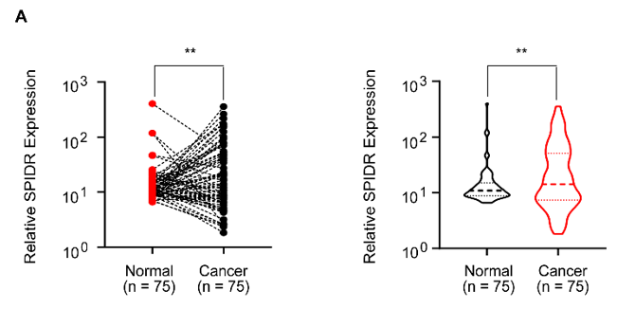
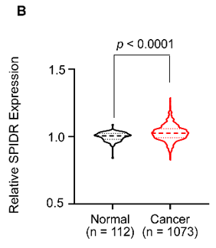
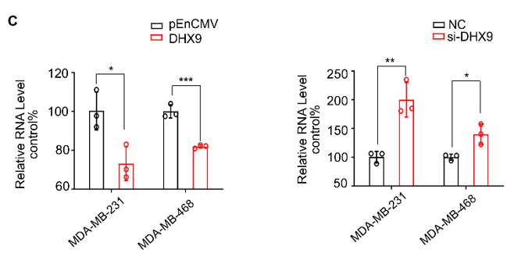
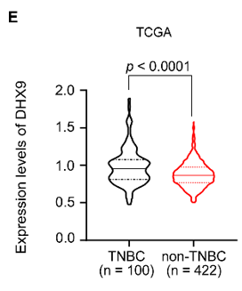
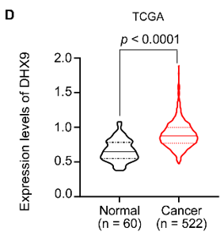
Results
The biogenesis of circRNA-CREIT was inhibited by DHX9

Slide 6
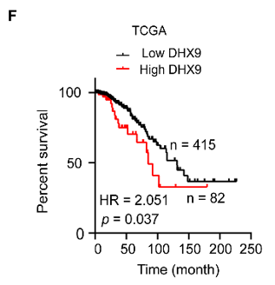
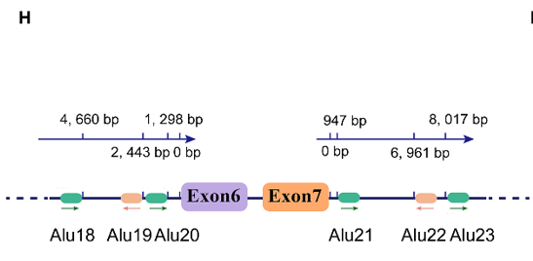
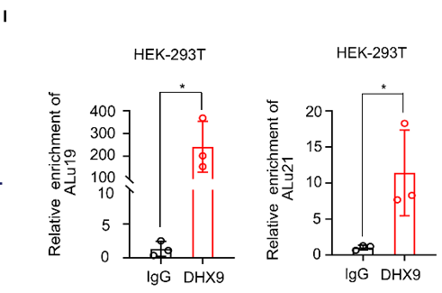
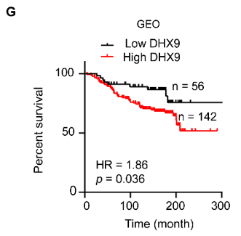
Results
The biogenesis of circRNA-CREIT was inhibited by DHX9

Slide 7
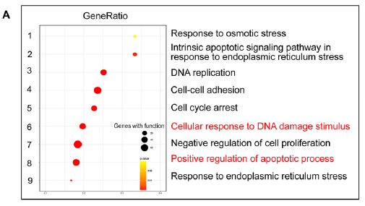
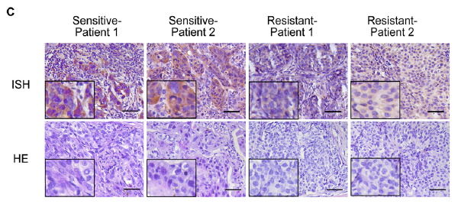
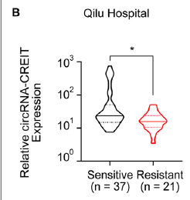
Results
CircRNA-CREIT significantly enhanced the chemosensitivity of TNBC cells in vitro and in vivo

Slide 8
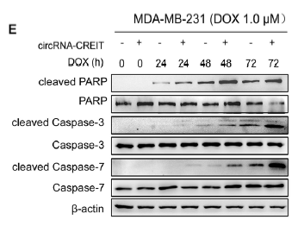
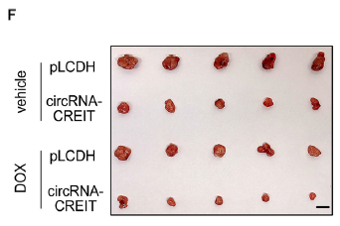
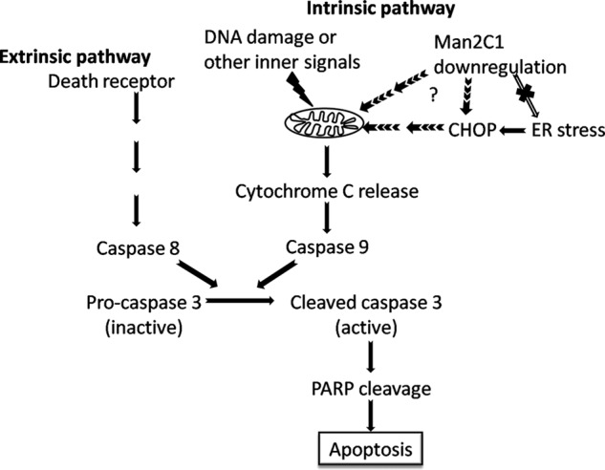
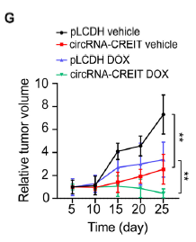
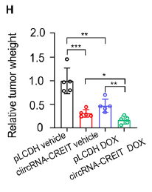
Results
CircRNA-CREIT significantly enhanced the chemosensitivity of TNBC cells in vitro and in vivo
/7

Slide 9
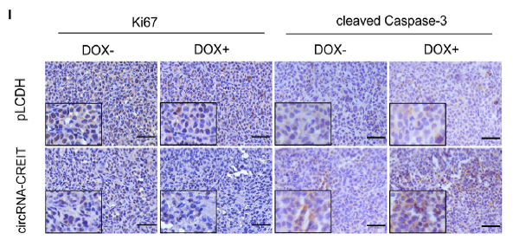
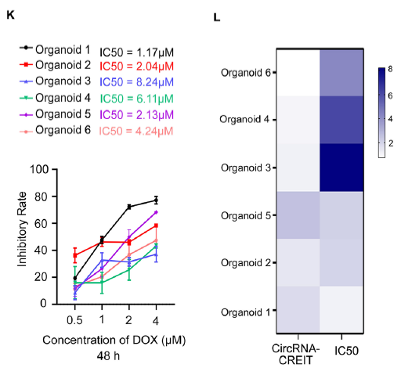
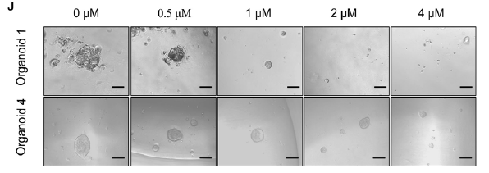
Results
CircRNA-CREIT significantly enhanced the chemosensitivity of TNBC cells in vitro and in vivo

Slide 10
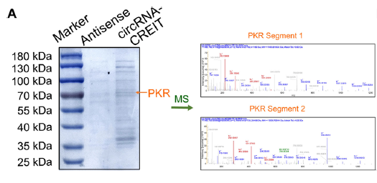
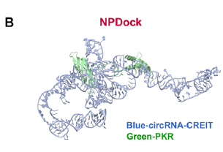
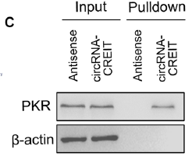
Results
CircRNA-CREIT physically interacted with PKR

Slide 11
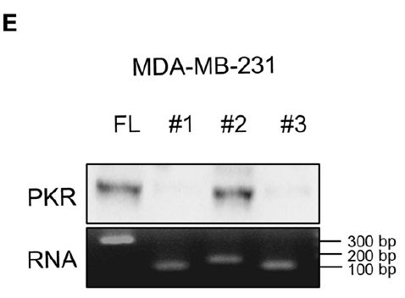
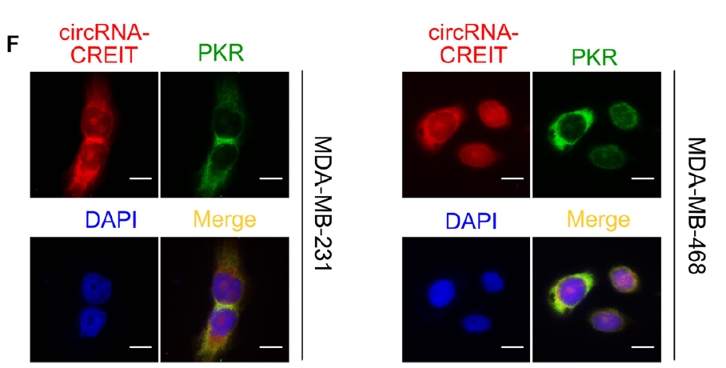
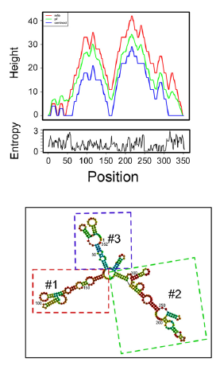
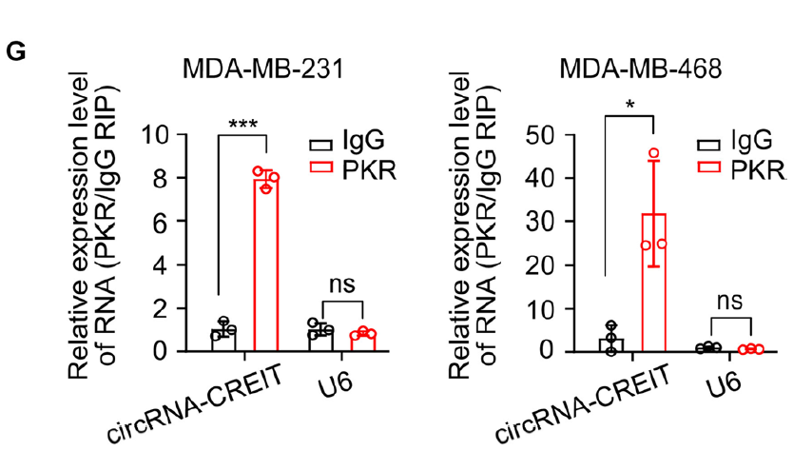
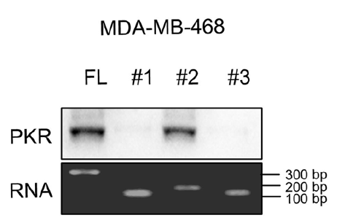
Results
CircRNA-CREIT physically interacted with PKR

Slide 12
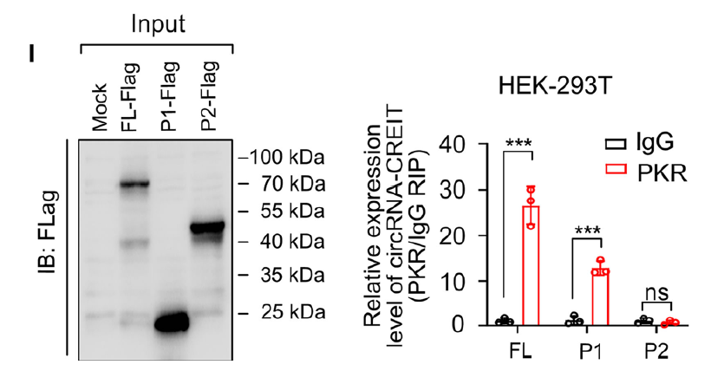
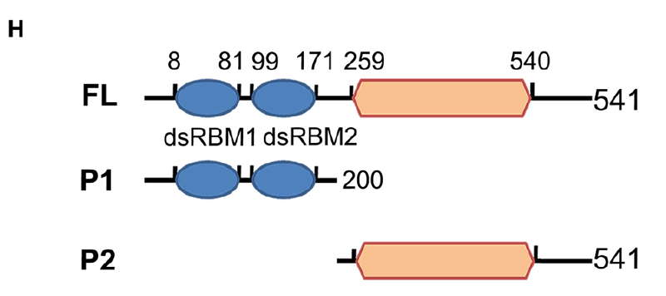
Results
CircRNA-CREIT physically interacted with PKR

Slide 13
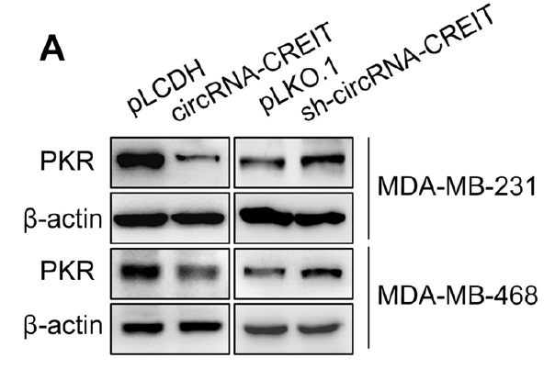
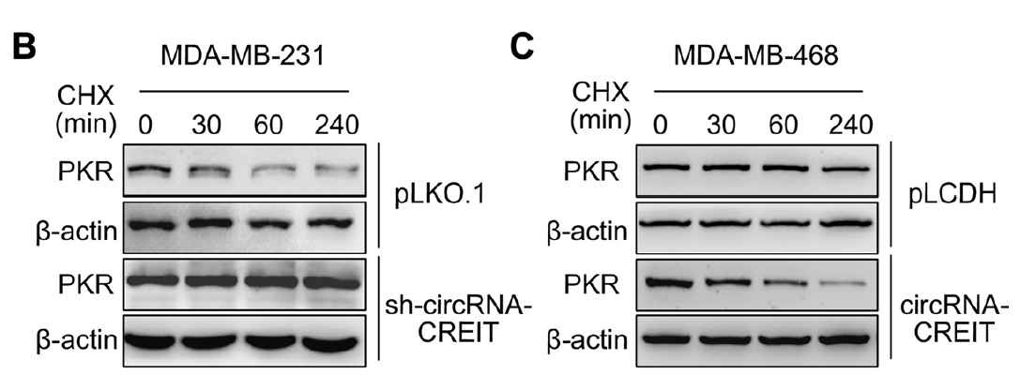
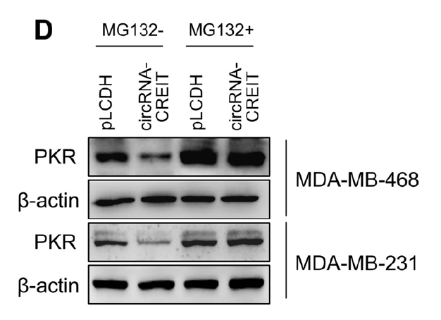
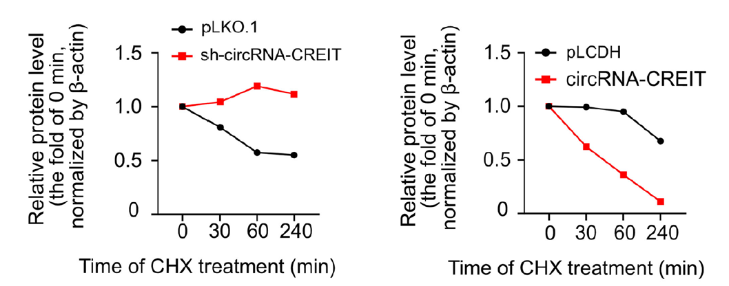
Results
CircRNA-CREIT promoted PKR degradation via the ubiquitin–proteasome system

Slide 14
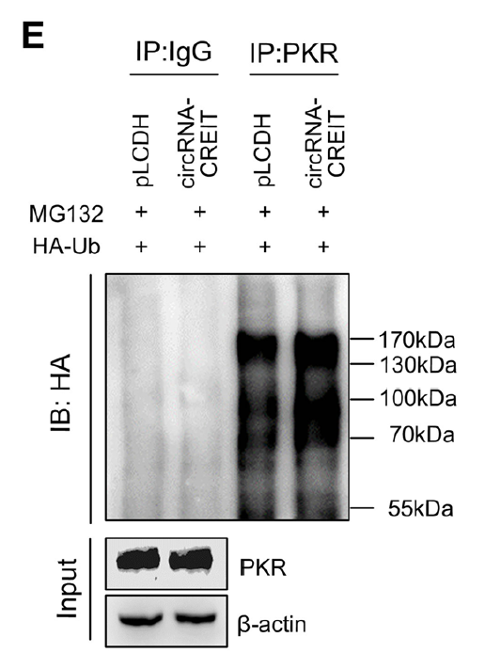
Results
CircRNA-CREIT promoted PKR degradation via the ubiquitin–proteasome system

Slide 15
Ubiquitin–proteasome system

Slide 16
Results
CircRNA-CREIT promoted PKR degradation via the ubiquitin–proteasome system

Slide 17
Results
CircRNA-CREIT promoted PKR degradation via the ubiquitin–proteasome system

Slide 18
Results
CircRNA-CREIT enhanced the binding of
HACE1 and PKR proteins

Slide 19
Results
CircRNA-CREIT enhanced the binding of
HACE1 and PKR proteins

Slide 20
Results
CircRNA-CREIT enhanced the binding of
HACE1 and PKR proteins

Slide 22
Results
CircRNA-CREIT attenuated SG formation
via the PKR/eIF2α axis

Slide 23
Results
CircRNA-CREIT attenuated SG formation
via the PKR/eIF2α axis

Slide 25
Results
CircRNA-CREIT attenuated SG formation
via the PKR/eIF2α axis

Slide 26
Results
CircRNA-CREIT attenuated SG formation
via the PKR/eIF2α axis

Slide 27
Results
ISRIB exerted synergistic roles with circRNA-CREIT in improving chemosensitivity of TNBC cells

Slide 28
Results
ISRIB exerted synergistic roles with circRNA-CREIT in improving chemosensitivity of TNBC cells

Slide 29
Results
ISRIB exerted synergistic roles with circRNA-CREIT in improving chemosensitivity of TNBC cells

Slide 30
Results
CircRNA-CREIT exerted tumor suppressive roles
by exosome transmission in TNBC

Slide 31
Results
CircRNA-CREIT exerted tumor suppressive roles
by exosome transmission in TNBC

Slide 32
Results
CircRNA-CREIT exerted tumor suppressive roles
by exosome transmission in TNBC

Slide 33
Conclusion

