Slide 1
CircPDIA4 induces gastric cancer progression
by promoting ERK1/2 activation and
enhancing biogenesis of oncogenic circRNAs
Yue Shen; Nasha Zhang; Jie Chai; Teng Wang; Chi Ma; Linyu Han; Ming Yang
Speaker : Yi-Chun Ke
Advisor : Liang-Chuan Lai Ph.D.
Date : 2023.03.07
Notes:
Good morning everyone Im today’s first speaker, Yi-Chun Ke, and my advisor is professor Liang-Chuan Lai.
The paper I want to share today is to explore the role of circPDIA4 in gastric cancer.

Slide 2
Introduction
Gastric cancer (GC)
(CA Cancer J Clin 2021;71:209-49)
(Phyathai 1 International)
Notes:
Gastric cancer is estimated to be the fifth most frequently diagnosed cancer in the world, and the fourth leading cause of cancer-related death.
The Established environmental risk factors of gastric cancer include smoking, overweight, diet high in saltly or Helicobacter pylori (H. pylori) infection.

Slide 3
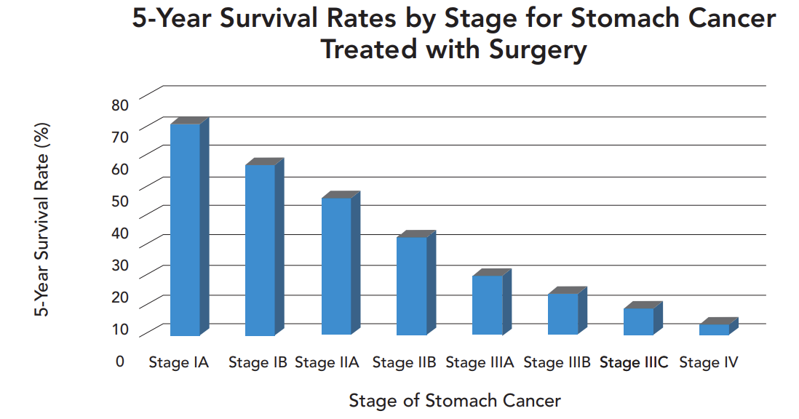
Introduction
Gastric cancer (GC)
(Michael R. Page, et al. AJMC. (2017))
Notes:
The vast majority of gastric cancers are diagnosed when patients already have late-stage disease.
However, the prognosis in late stage of gastric cancer still remains unsatisfactory.
So, its critical to identify novel curative approaches to improve prognosis and clinical outcomes of gastric cancer patients.

Slide 4
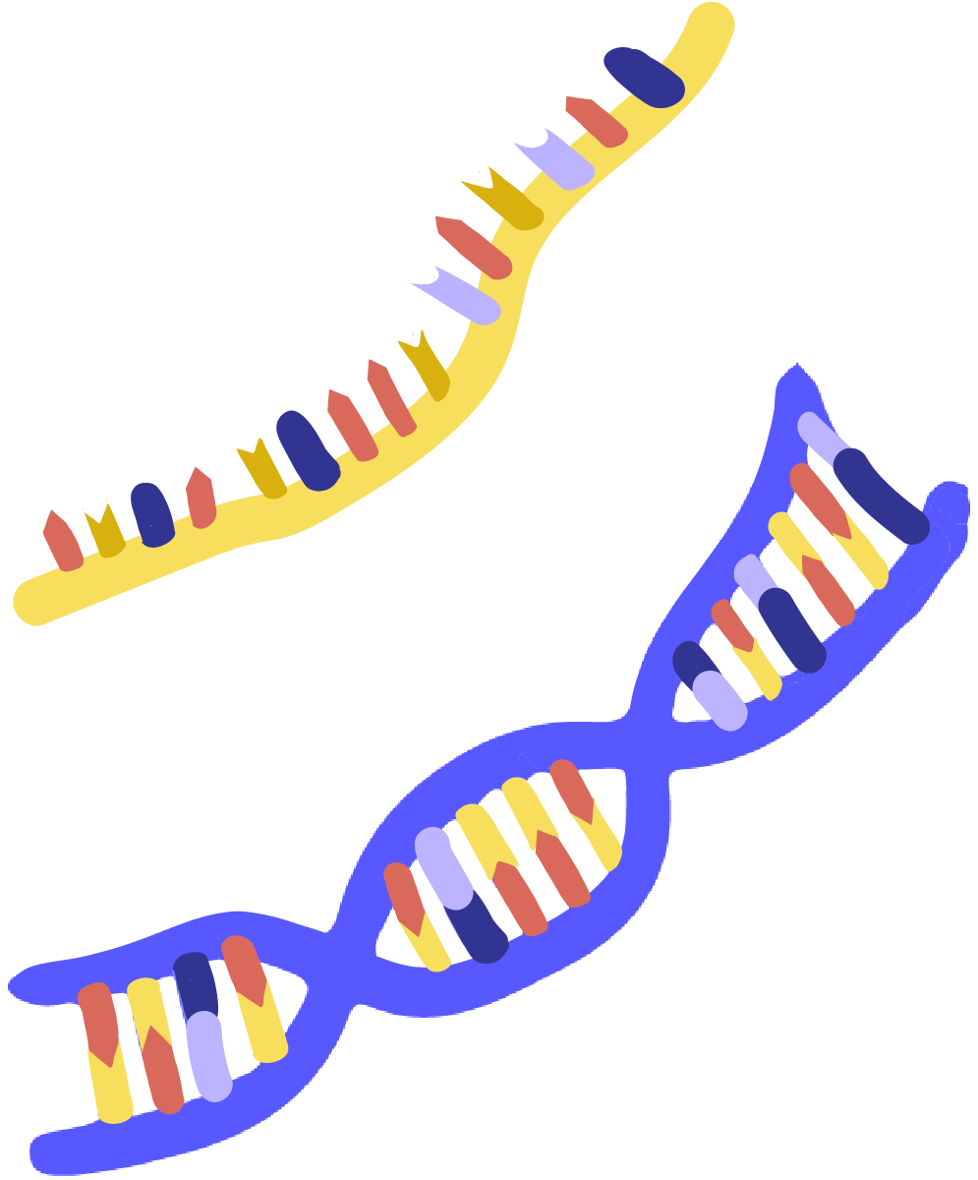
Introduction
Human Genome
the human genome contains over
3 billion base pairs of DNA
70% is transcribable into RNA
only less than 2% of these RNAs can be translated into proteins
Notes:
As we know, the human genome contains over 3 billion base pairs of DNA, of which 70% is transcribable into RNA.
However, only less than 2% of these RNAs can be used as a template to translate into proteins.
And we call them the non-coding RNA.

Slide 5
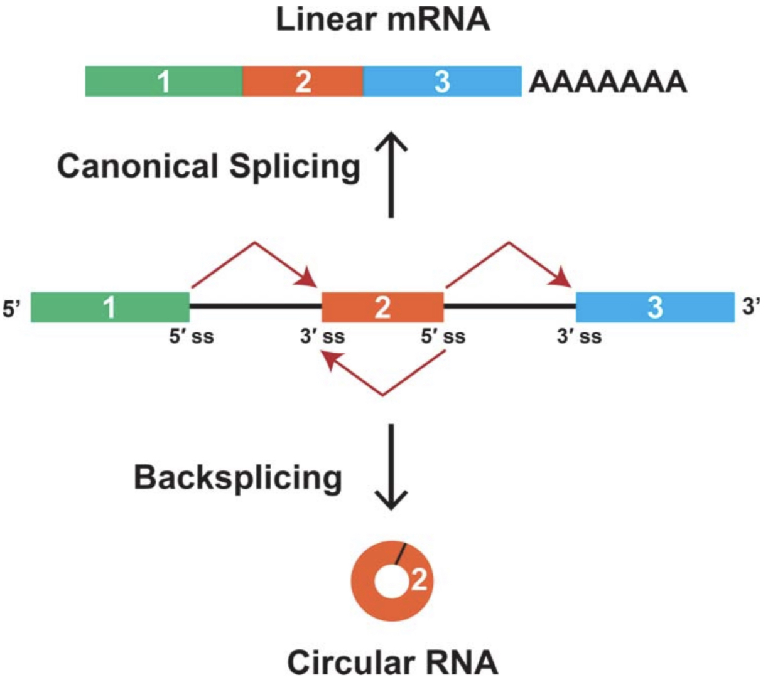
Introduction
Circular RNA (CircRNA)
Without 5’ cap and 3’ poly A tail
Resistant to Rnase R
High stability
Notes:
Today’s main character Circular RNAs, we will call it circRNA for short, is one kind of noncoding RNAs,
They are produced by back splicing of pre-mRNA.
Unlike linear RNAs, circRNAs form a covalently closed continuous loop without a 5′ cap and 3′ poly A tail, therefore, they are resistant to Rnase R and have high stability.

Slide 6
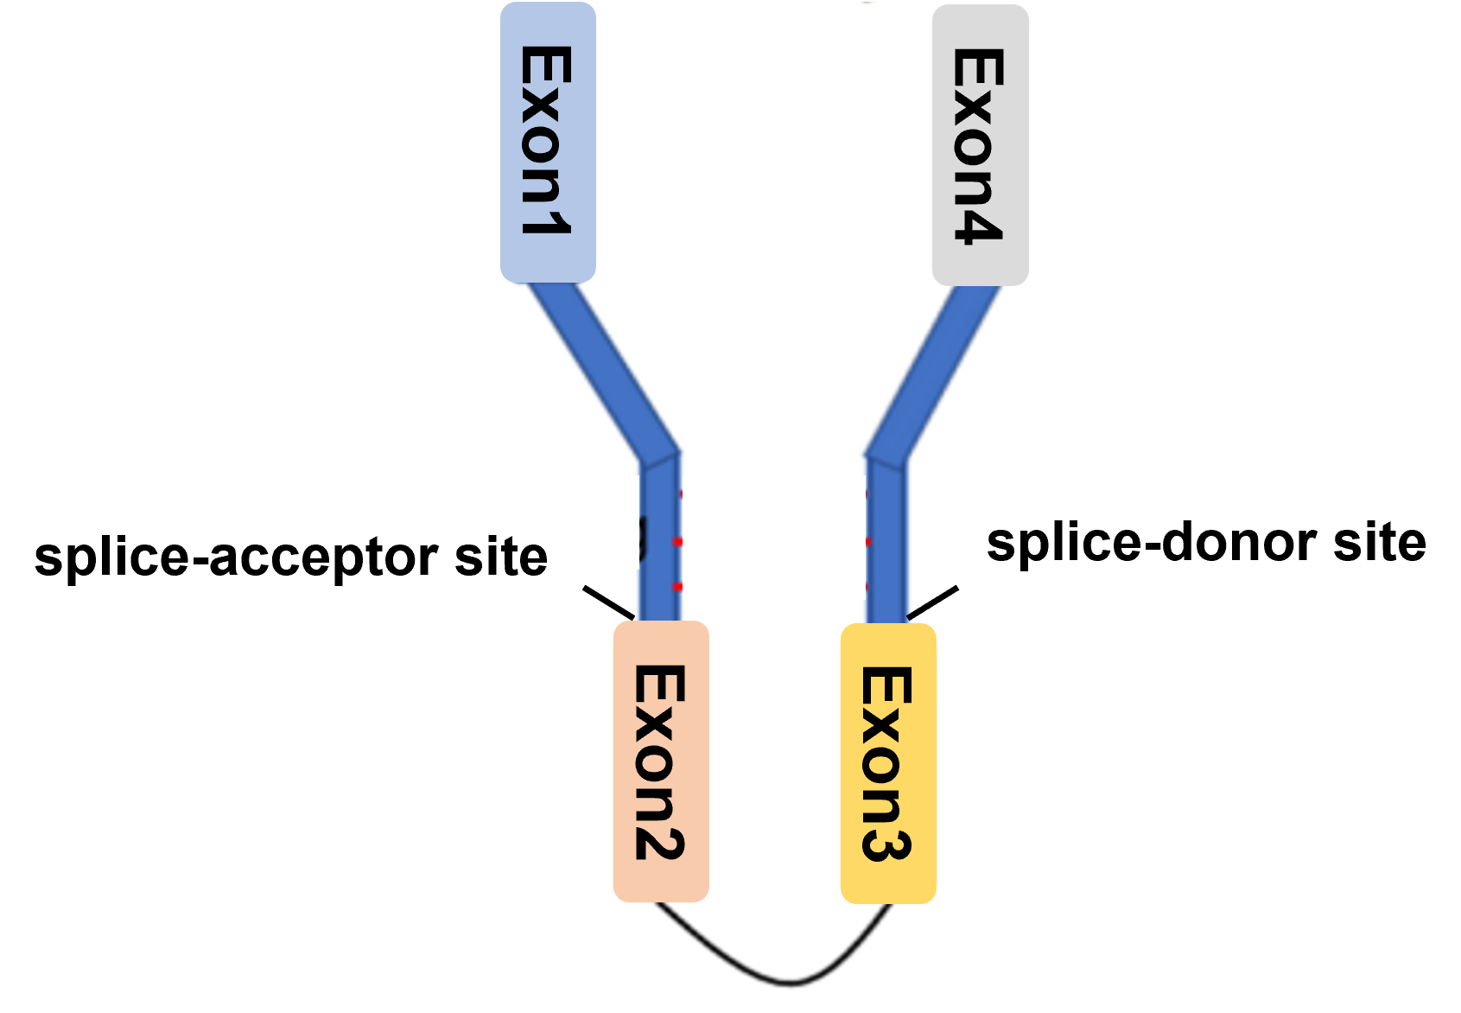
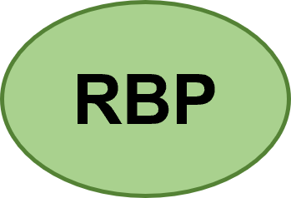
Introduction
Biogenesis of circRNA
RNA binding protein (RBP)
Base-pairing
Notes:
The main hypothesis of backsplicing is that looping of the intron sequences flanking the downstream splice-donor site and the upstream splice-acceptor site brings these sites into close proximity.
This looping can be mediated by base pairing between inverted repeat elements located in the upstream and downstream introns,
or by the dimerization of RNA-binding proteins (RBPs) in the flanking introns.

Slide 7
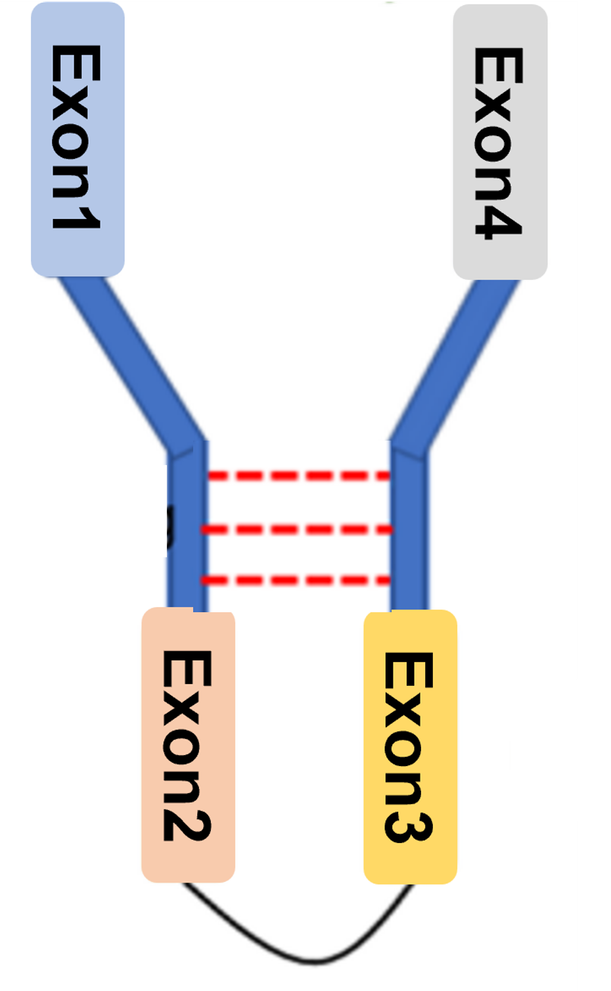
Introduction
CircRNA circularization - Alu element
Alu element :
short interspersed elements (SINEs)
primate-specific repeats, contributing almost 11%
of the human genome
typically 300 nucleotides in length
involved in alternative splicing, RNA editing and
translation regulation
Notes:
In base-pairing drive, the Alu element is the most frequently mentioned.
The Alu element are one type of short interspersed elements and they are primate-specific repeats, contributing almost 11% of the human genome.
In addition, they are typically 300 nucleotides in length and reported to be involved in alternative splicing, RNA editing and translation regulation.
In circRNA formation, the reverse complementary character of Alu element at the flanking intron have been reported to promote the circRNA circularization.

Slide 8
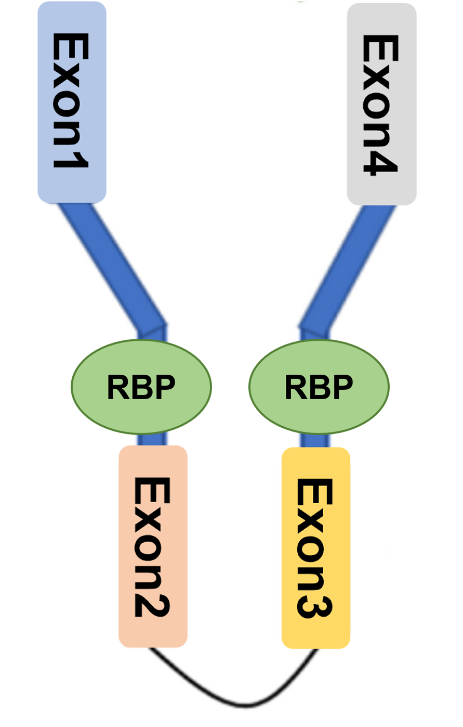
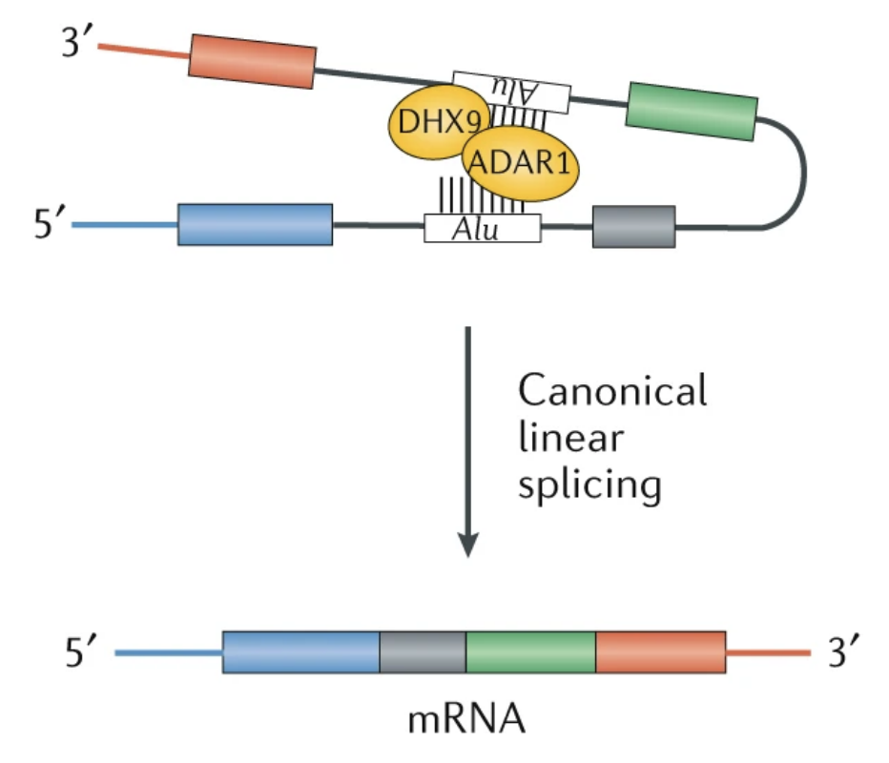
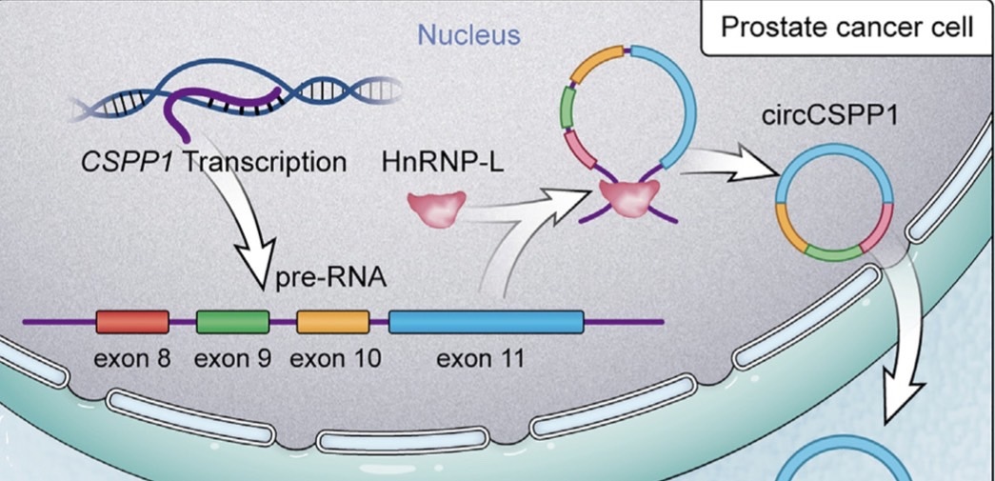
Introduction
CircRNA circularization – RNA Binding Protein (RBP)
Negative correlation :
Positive correlation :
Ex: DHX9, ADAR1
Ex : QKI, FUS, HNRNPL ....
(Jianming Lu, et al. Molecular Therapy - Nucleic Acids. (2021))
(Lasse S. Kristensen, et al. Nature Reviews Genetics. (2019))
Notes:
As for the RNA binding protein drive, there are some protein such as QKI, FUS, HNRNPL reported to promote circRNA circularization.
For example, HNRNPL could promote the formation of circCSPP1 in prostate cancer.
However, DHX9 and ADAR1 were found to unwind RNA pairs flanking in the intron and inhibit the circRNA expression.

Slide 9
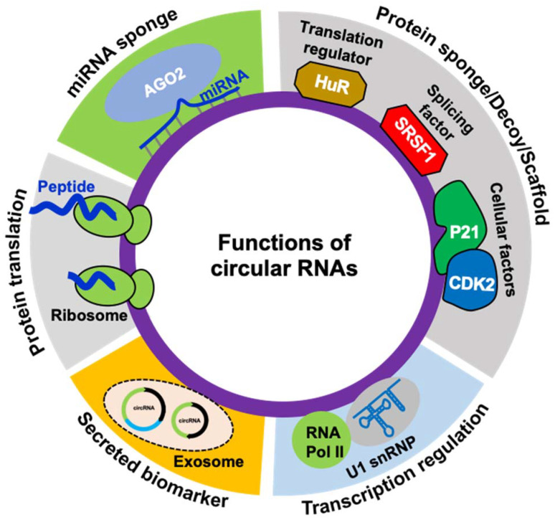
Introduction
Functions of circRNA
(Arundhati Das, et al. Noncoding RNA. (2021))
Notes:
Next lets talk about the functions of circRNA.
Overall, if they are in nucleus, they may regulate the transcription or alternative splicing
While if they are in cytoplasm, they may function as miRNA sponge or interact with RNA-binding proteins (RBP)
Also, they even can translate into polypeptides.
And due to their stable structure, they are expected to be more stable tumor markers and better therapeutic targets.
In this paper, the authors focus on the interaction between circRNA and protein.

Slide 10
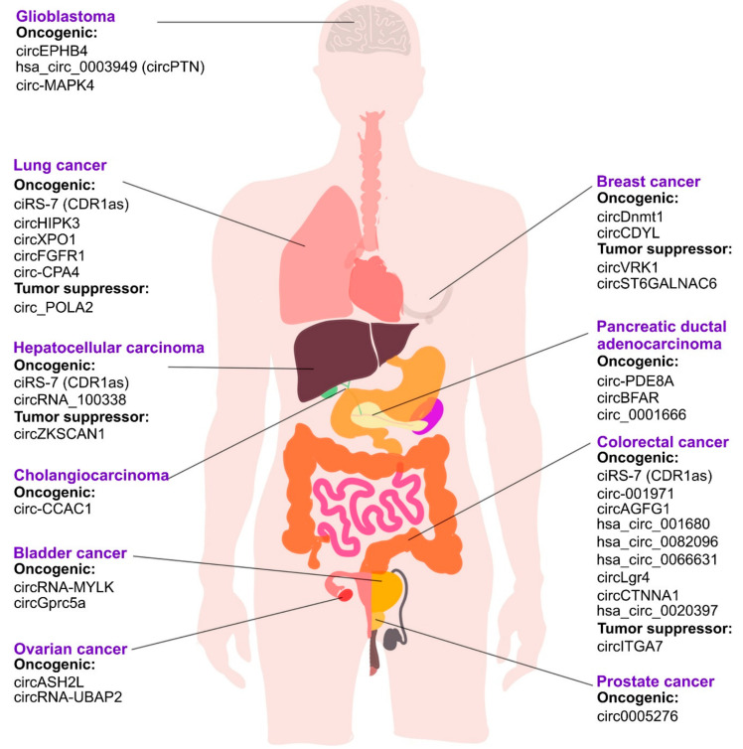
Introduction
The role of circRNAs in cancer
(Aliaksandr A Yarmishyn, et al. Cancers (Basel). (2022))
Notes:
Although circRNAs are defined as a class of rubbish during the splicing process since they were firstly discovered.
Nowadays, an increasing number of researches have revealed that circRNAs play a critical role in the progression of cancers via modulating various cellular mechanisms that are essential for tumorigenesis.

Slide 11
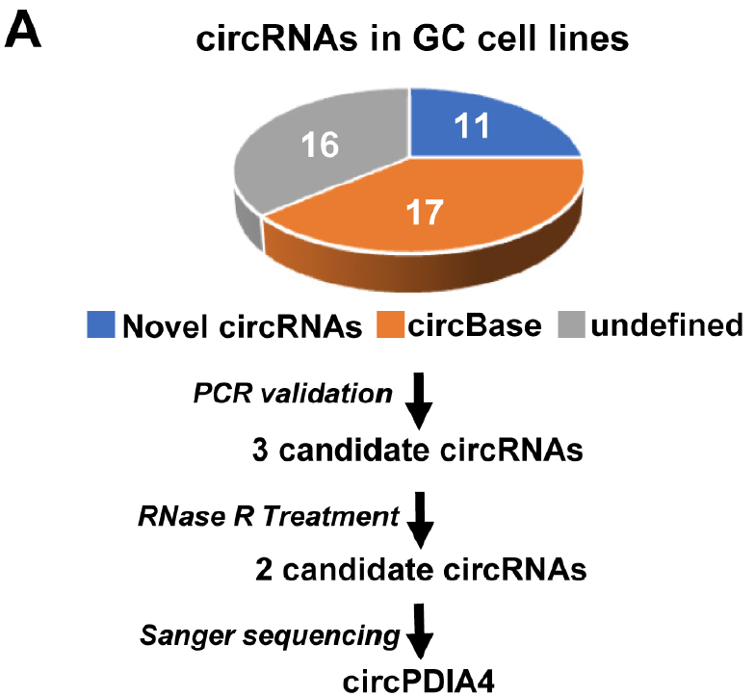
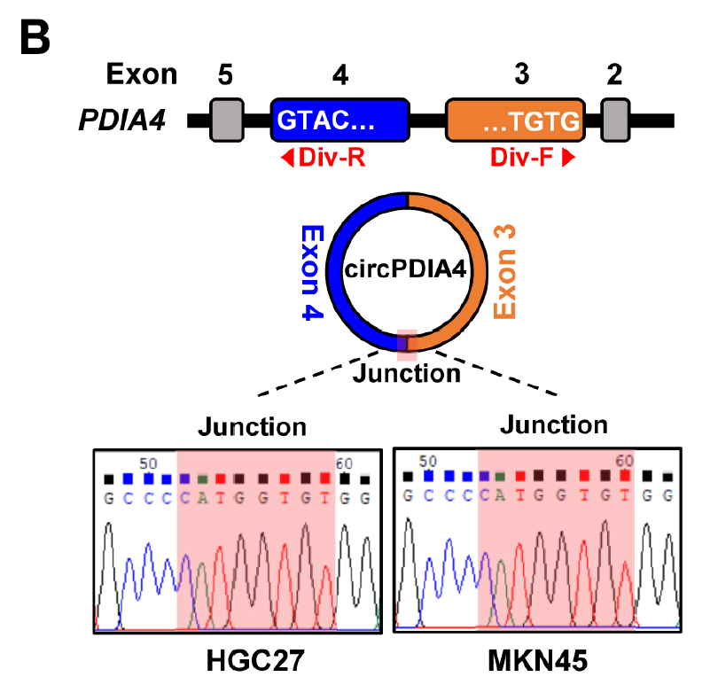
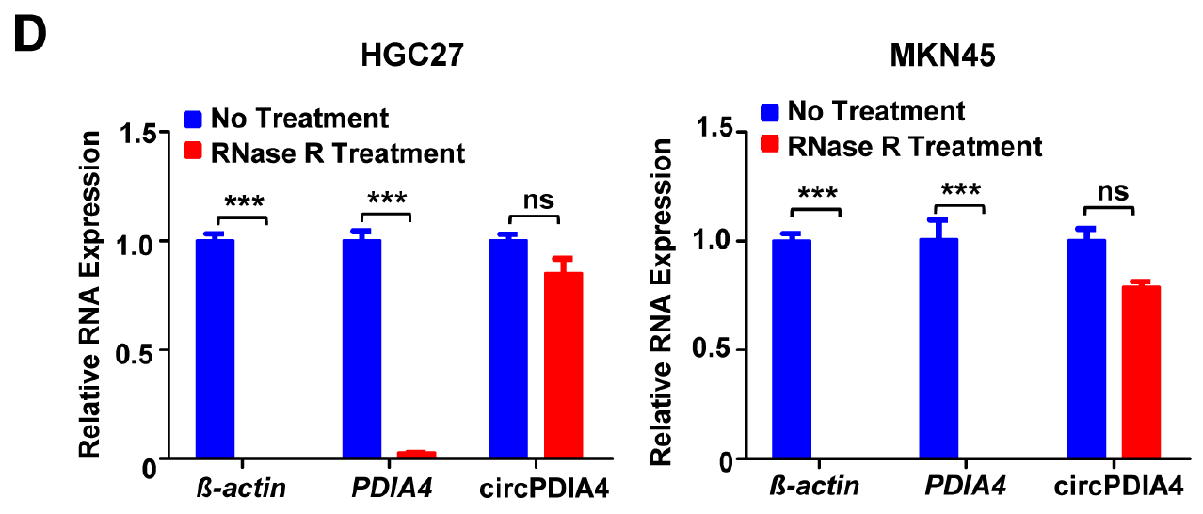
Results
Identification of a novel circRNA, circPDIA4
PCR
cancer-specific circRNA database(CSCD)
gDNA
Sanger sequencing
: divergent primer
RNase R
Notes:
In this paper, the author wanted to identify circRNAs involved in gastric cancer development.
Therefore, they systematically analyzed the cancer-specific circRNA database.
Then, they identified forty-four cancer-specific, potential circRNAs in different gastric cancer cell lines.
There are 11 novel circRNAs, 17 circRNAs in circBase and 16 undefined RNAs.
Finally, they chose circPDIA4 for further research.
Because After performing PCR, circPDIA4 could be amplified by divergent primers using cDNA, but not using genomic DNA.
Moreover, circPDIA4 was resistant to RNase R treatment
The most important, it has been found that circPDIA4 was successfully validated the junction site by Sanger sequencing.

Slide 12
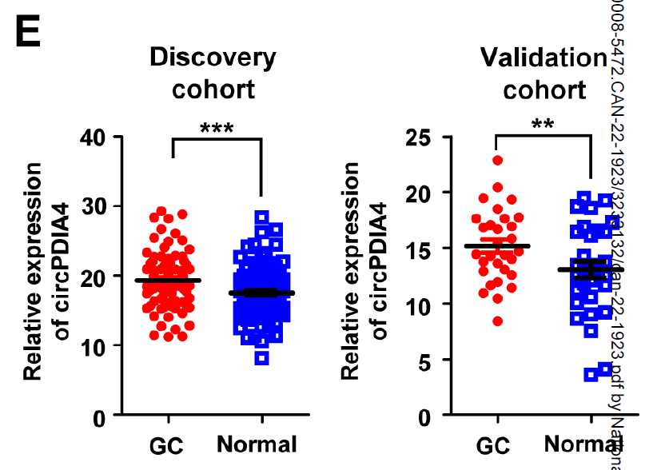
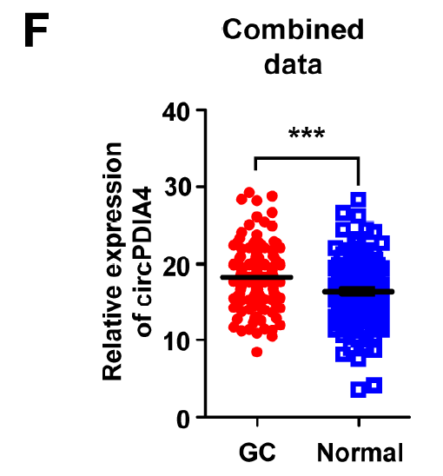
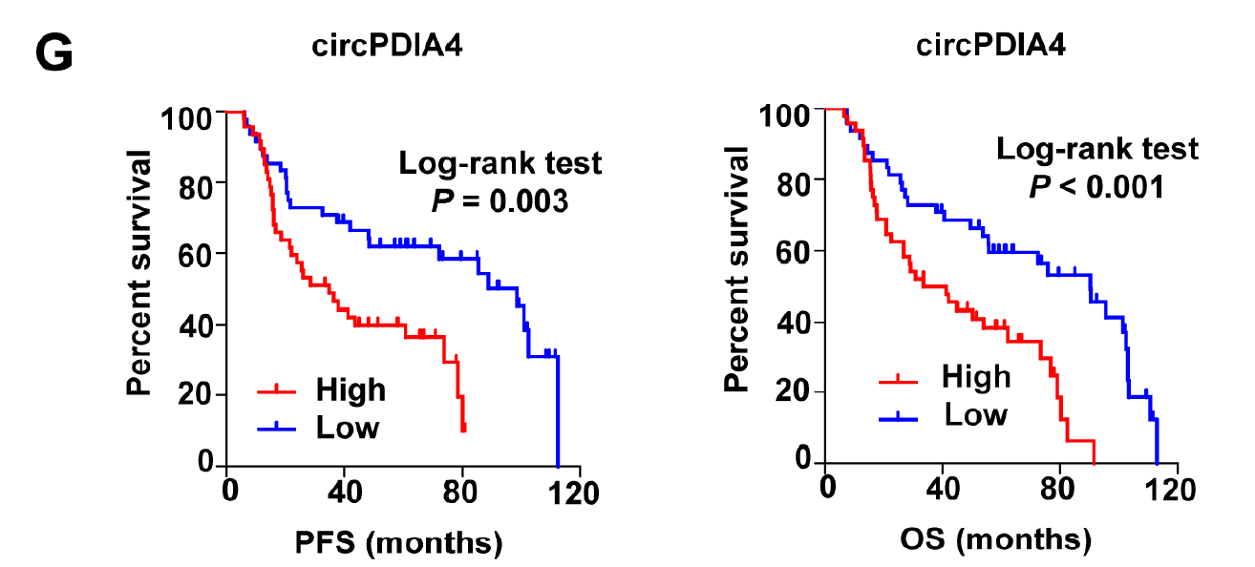
Results
Identification of a novel circRNA, circPDIA4
PFS : progression-free survival
OS : overall survival
Notes:
The circPDIA4 expression was further analyzed and compared in gastric cancer specimens and normal tissues of patients from Discovery cohort, Validation cohort and combined corhot.
According to the result, we could see that the expression of circPDIA4 was increased in gastric cancer tissues.
Importantly, the high circPDIA4 levels were significantly associated with shorten progression-free survival and overall survival in gastric cancer patients, suggesting that circPDIA4 might be involve in progression of gastric cancer as a novel oncogene.

Slide 13
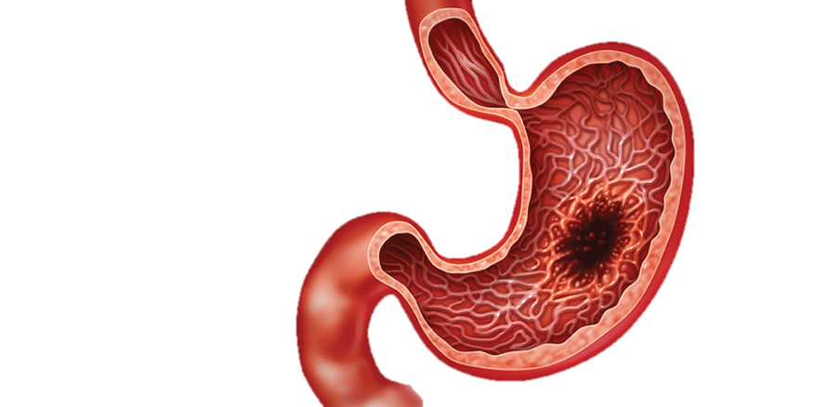
Aim
circPDIA4
Functions in gastric cancer
Circularization mechanism
Molecular mechanism
Notes:
So, the aim of this study is to explore the functions of circPDIA4 and their circularization mechanism and molecular mechanism in gastric cancer.
First, the authors wanted to explore the function of circPDIA4 in gastric cancer.

Slide 14
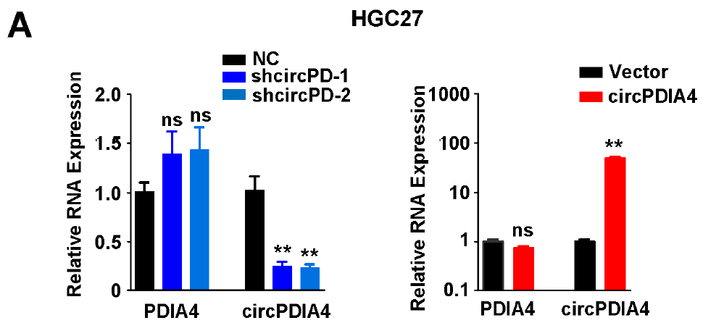
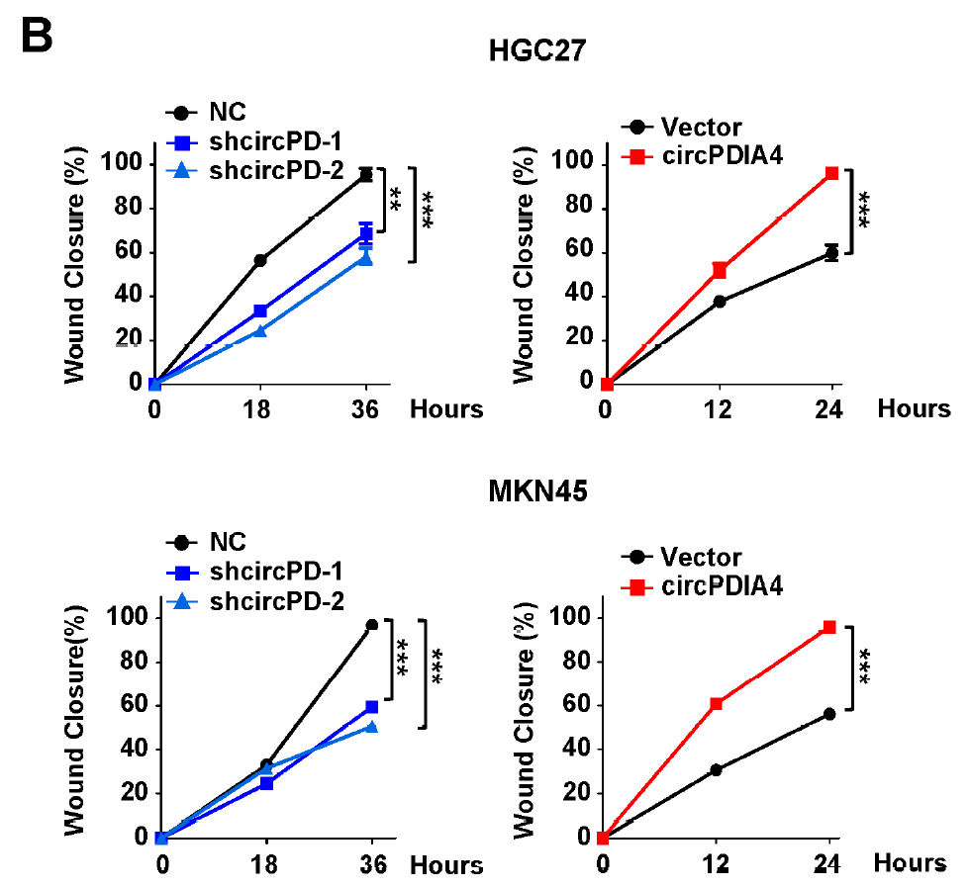
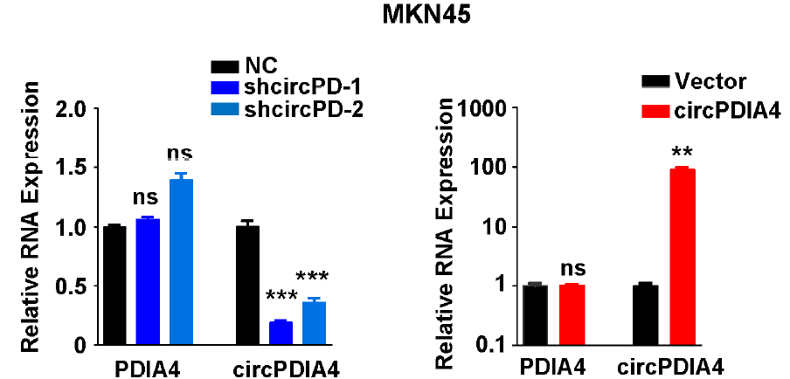
Results
CircPDIA4 promoted migration and metastasis capabilities of gastric cancer cells in vitro and in vivo
Wound healing
Notes:
To explore their function, the author knockdown and overexpressed the circPDIA4.
According to the result of wound healing assay, we could see that silencing the expression of circPDIA4 significantly inhibited the migration capabilities of gastric cancer cells, and on the other hand, overexpressing the expression of circPDIA4 promoted the migration capabilities of gastric cancer cells, suggesting that circPDIA4 could promote the migration of gastric cancer .

Slide 15
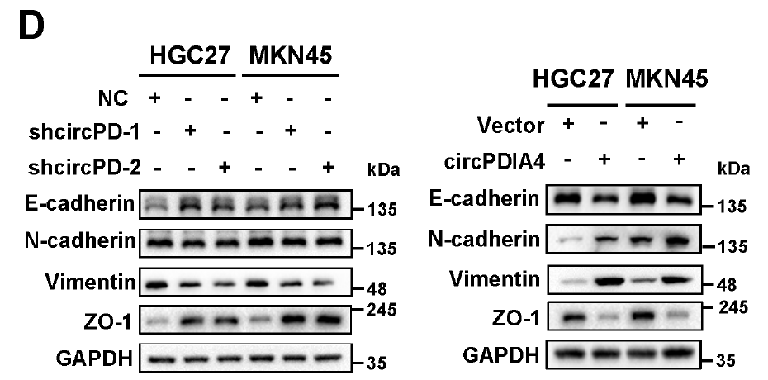
Results
CircPDIA4 promoted migration and metastasis capabilities of gastric cancer cells in vitro and in vivo
Transwell assay
Epithelial-Mesenchymal Transition(EMT)
(JASN July 2007, 18 (7) 2004-2013)
Notes:
In addition, the transwell assay showed the same trend of result.
And the authors had also looked some EMT markers, the result of western blot showed that knockdown of circPDIA4 stimulated the expression of epithelial markers E-cadherin and ZO-1 however, reduced the expression of mesenchymal markers N-cadherin and VIMENTIN
And overexpress of circPDIA4 showed the opposite results.
These data proved that circPDIA4 could promote the metastasis capability of gastric cancer cells in vitro.

Slide 16
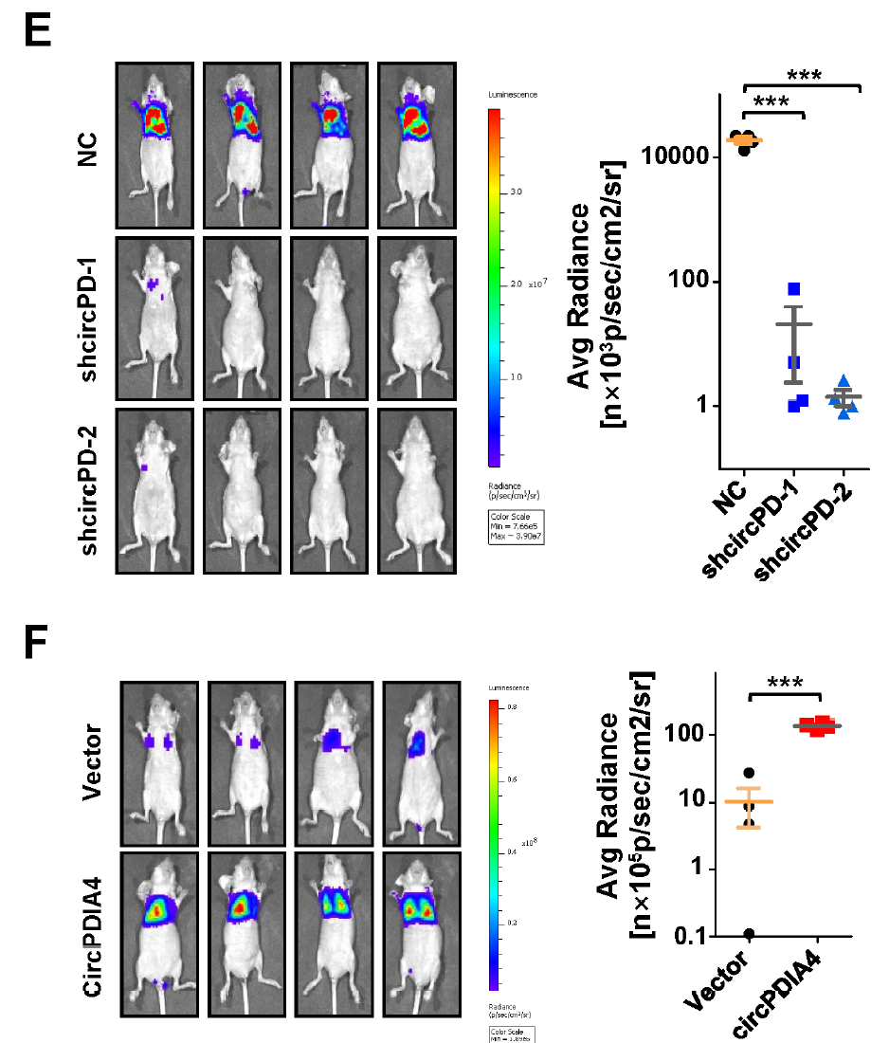
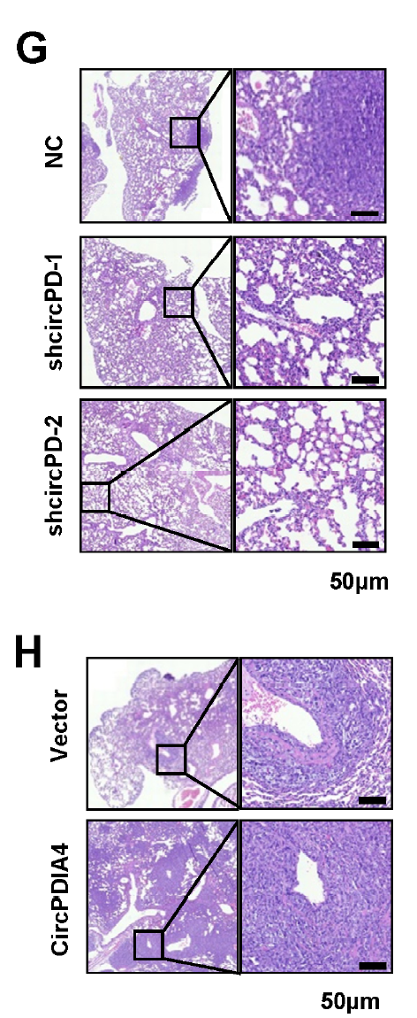
Results
CircPDIA4 promoted migration and metastasis capabilities of gastric cancer cells in vitro and in vivo
HE staining
CEA antibody
Notes:
Then, to validate the result in vivo, the authors injected the cancer cells with knockdown and overexpress circPDIA4 into the tail vein of nude mice.
From the result of IVIS and HE staining, We could see that there were less cancer cells metastasis to the lung in circPDIA4 knockdown group, however, more cancer cells metastasis to the lung in circPDIA4 overexpress group.
Moreover, the authors also injected the cancer cells into the abdomen of mice and observed the amount of tumors that had metastasis to the liver.
We could see that there were more tumors in circPDIA4 overexpress group.
And HE staining and IHC staining show the same trend of result.

Slide 17
Summary
circPDIA4
Migration
Metastasis
Notes:
Therefore, we knew that the expression of circPDIA4 elevated in gastric cancer, and the increase expression of circPDIA4 acted as a oncogene to promote the migration and metastasis capability of gastric cancer cells.

Slide 18
circPDIA4
Functions in gastric cancer
Circularization mechanism
Molecular mechanism
Notes:
Next, the authors wanted to explore how circPDIA4 biogenesis was regulated in gastric cancer cells.

Slide 19
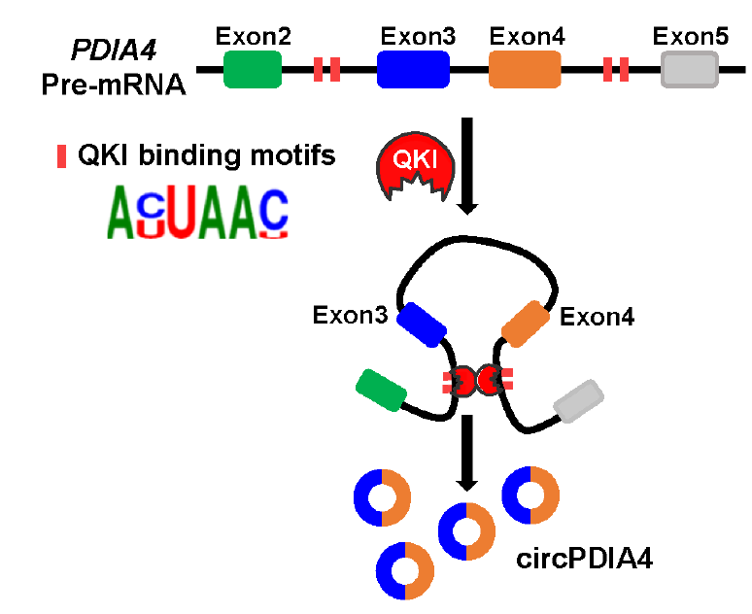
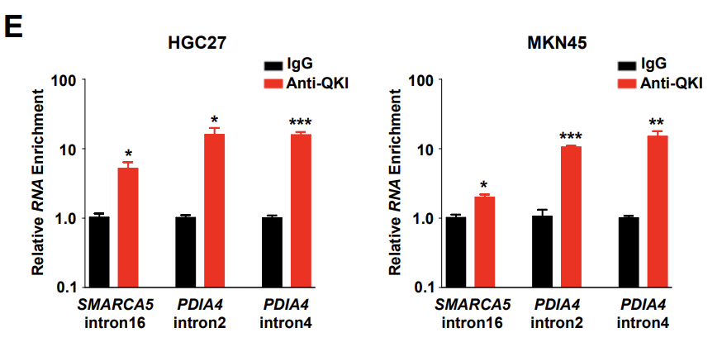
Results
The RBP QKI induced the formation of circPDIA4
in gastric cancer cells
S3A
RBPmap
intron 2
intron 4
QKI
S3
Notes:
They predicted which RNA binding protein was involved in regulation of circPDIA4 production through RBPmap database.
Prediction indicated that there were 128 RNA bind proteins might bind both PDIA4 intron 2 and intron 4 RNA.
Among these RNA bind proteins, QKI is the only one which has been reported to control circRNA biogenesis, so they chose it for further research.
According to the result of RIP, we could see that QKI exactly bound on intron 2 and intron 4 of PDIA4 pre-mRNA.

Slide 20
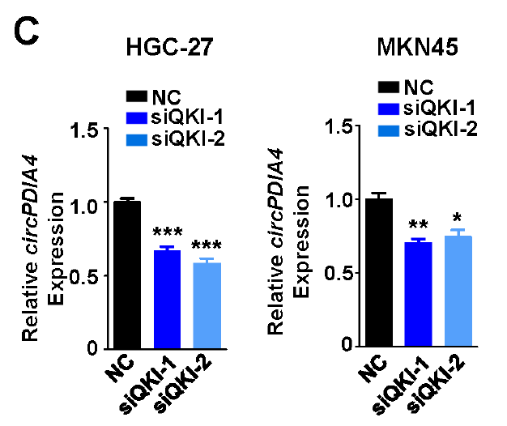
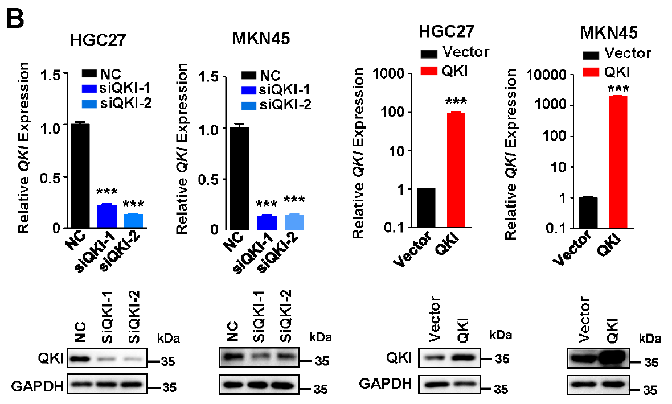
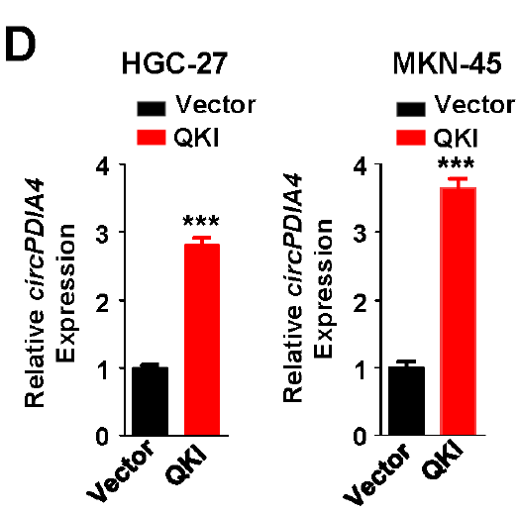
Results
The RBP QKI induced the formation of circPDIA4
in gastric cancer cells
Notes:
Moreover, when knockdowning down QKI, the expression of circPDIA4 then decreased.
However, when overexpressing QKI, the expression of circPDIA4 then increased.
These data indicated that the RNA binding protein QKI induced the formation of circPDIA4 in gastric cancer cells.

Slide 21
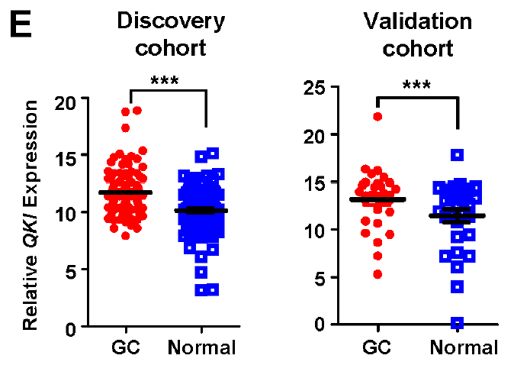
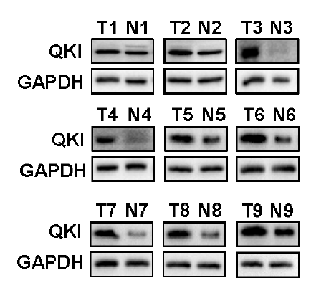
Results
The RBP QKI induced the formation of circPDIA4
in gastric cancer cells
Notes:
In addition, according to the result from the patient specimen and databases, the authors found that the expression of QKI significantly increased in gastric cancer tissues compared to normal tissues.
And QKI protein expression in gastric cancer tissues was also proved to be upregulated by western blot.

Slide 22
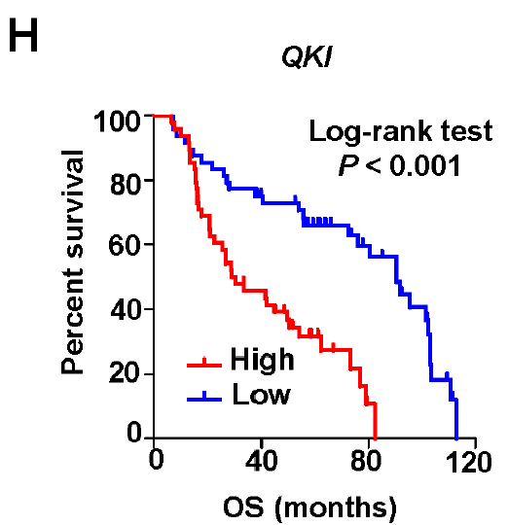
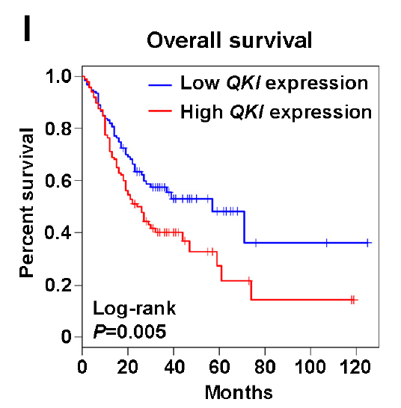
Results
The RBP QKI induced the formation of circPDIA4
in gastric cancer cells
Notes:
Further, the authors also found that the high QKI levels were significantly associated with shortened overall survival time in gastric cancer patients.
The positive expression correlations between QKI and circPDIA4 were observed in gastric cancer and normal tissues from different patient cohorts, which support the regulatory relationship between QKI and circPDIA4.

Slide 23
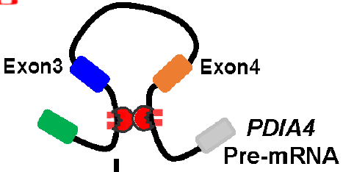
Summary
circPDIA4
Gastric cancer cells migration and metastasis
Notes:
In summary, these data elucidated that QKI bound on intron 2 and intron 4 of PDIA4 pre-mRNA, regulating the biogenesis of circPDIA4.
And the increased expression of QKI in gastric cancer cells induced the production of circPDIA4 and further promoted the progression of gastric cancer.

Slide 24
circPDIA4
Functions in gastric cancer
Circularization mechanism
Molecular mechanism
Notes:
At last, the authors wanted to explore how did circPDIA4 work in gastric cancer.

Slide 25
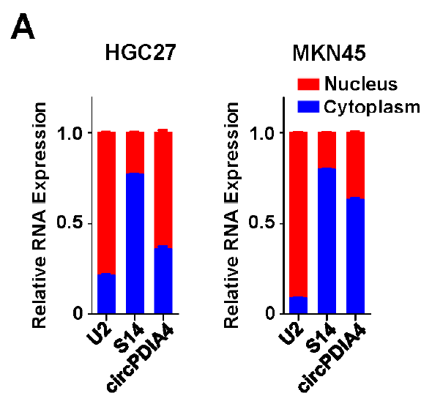
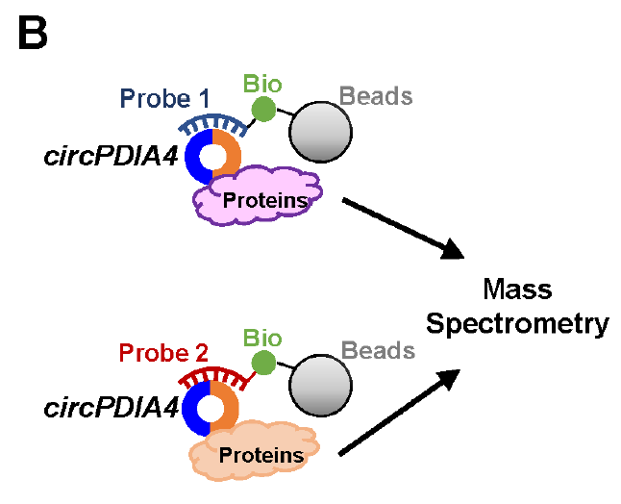
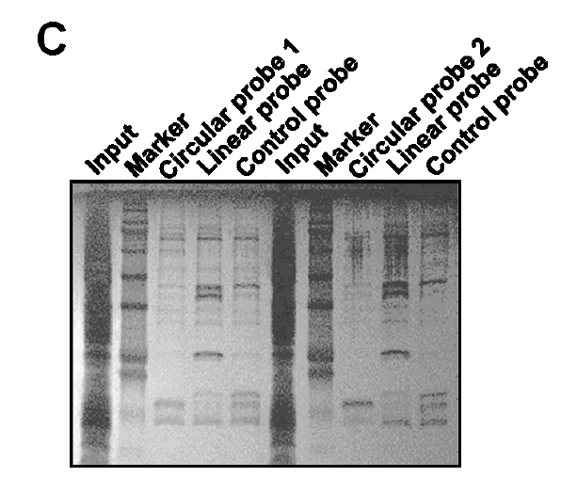
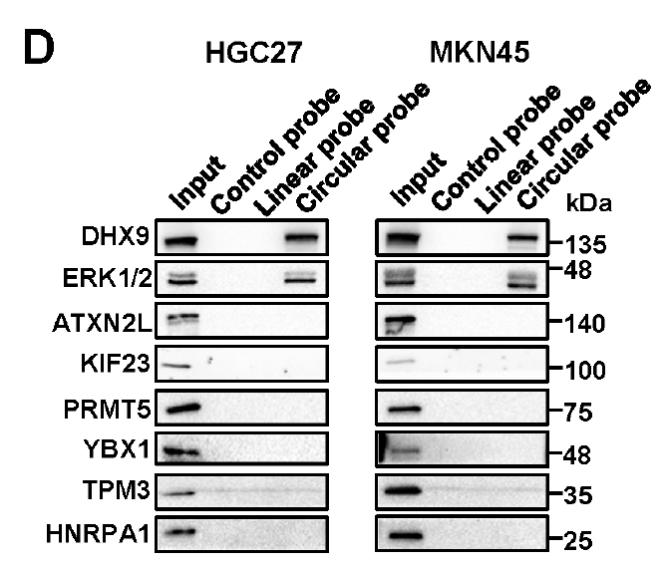
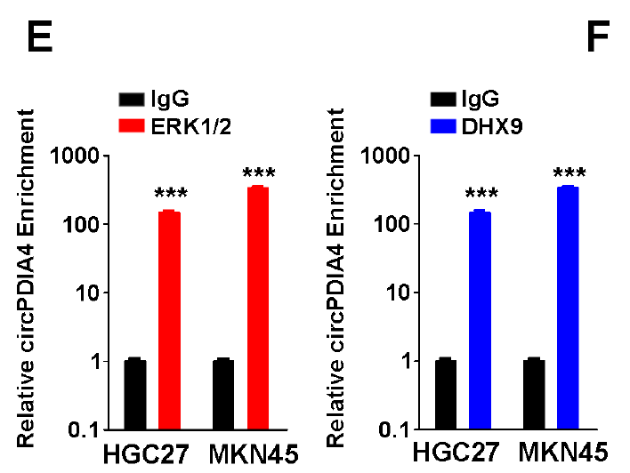
Results
CircPDIA4 bound with DHX9 and ERK1/2
RNA pulldown
RIP
Notes:
According to the result of subcellular fractionation, we could see that circPDIA4 located both in cytoplasm and nucleus.
So, the authors hypothesized that circPDIA4 might bind certain protein to promote gastric cancer development.
Then, they did the RNA pulldown assay that used the probe binding to circPDIA4 to pulldown the proteins that could bind with circPDIA4.
And the proteins were confirmed by Mass spectrometry.
After validating these candidate proteins in both cell lines through independent RNA pulldown assays, the authors successfully confirmed DHX9 and ERK1/2 bound with circPDIA4.
In turn, they also did the RIP assay that used ERK1/2 and DHX9 antibody to catch the RNA and ran the qPCR to check the enrichment of circPDIA4 on these two proteins.
The result again validated that circPDIA4 bound with DHX9 and ERK1/2 protein.

Slide 26
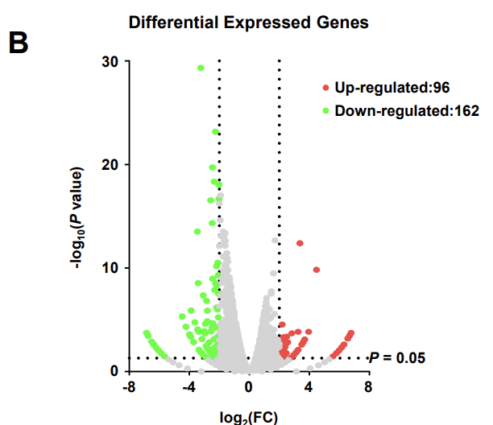
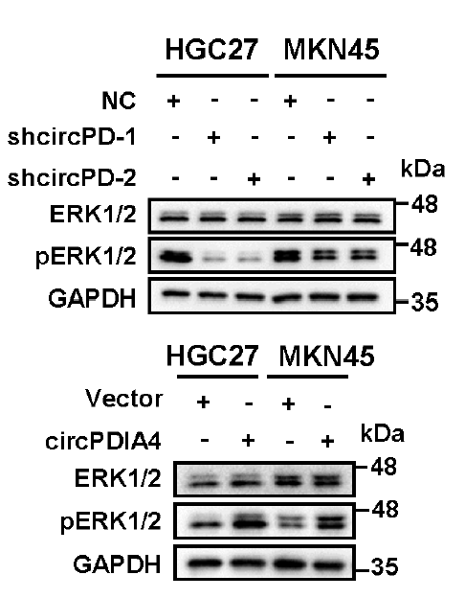
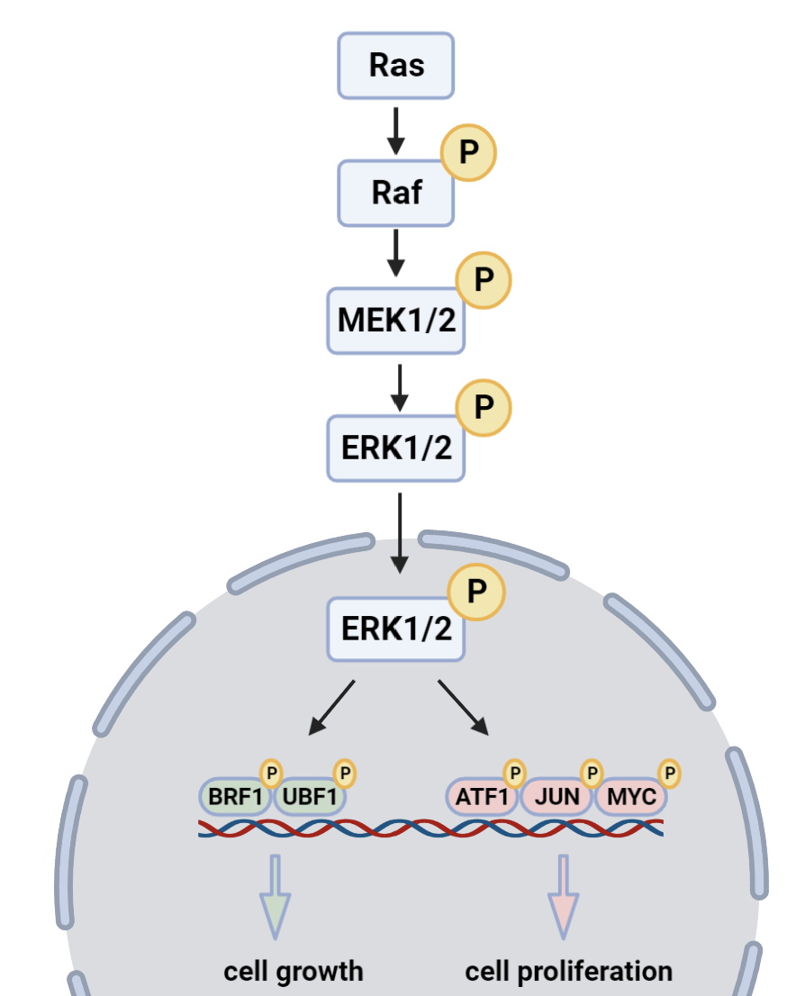
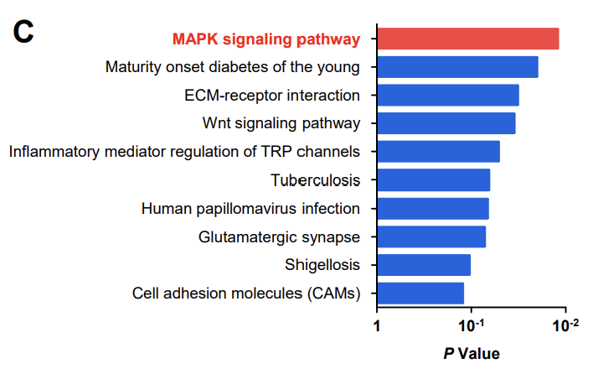
Results
CircPDIA4 sustained high phosphorylation levels of ERK1/2
Vector vs. circPDIA4
S5B
MAPK signaling pathway
S5C
(Eun Kyung Kim, et al. Archives of Toxicology. (2015))
Notes:
First, lets look the interaction between circPDIA4 and ERK1/2.
To reveal the mechanisms underlying circPDIA4-mediated downstream signaling in gastric cancer, the authors profiled genome-wide gene expression by using RNAseq.
And the KEGG pathway analyses of these differential expressed genes demonstrated that the MAPK signaling is the top changed signaling pathways.
Interestingly, ERK1/2 was the member of MAPK signaling pathway, and this pathway had already been revealed to involved in cancer progression.
The authors found that although circPDIA4 did not impact total ERK1/2 protein levels in cells, however, knockdown of circPDIA4 resulted in decreased pERK1/2 level.
On the contrary, overexpressed circPDIA4 upregulated the pERK1/2 levels.
These data showed that circPDIA4 might regulate the phosphorylation of ERK1/2.

Slide 27
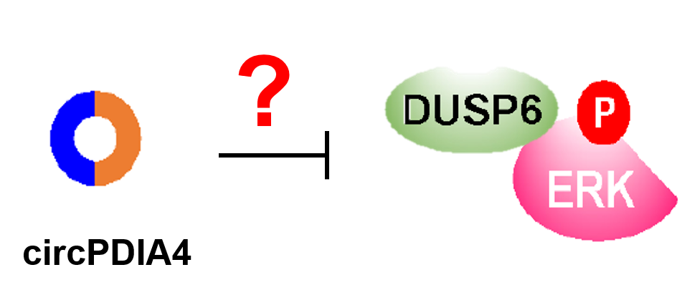
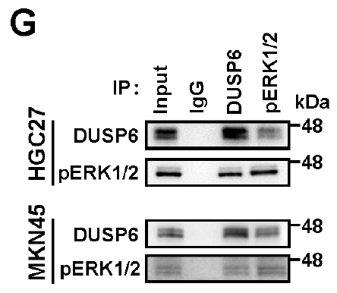
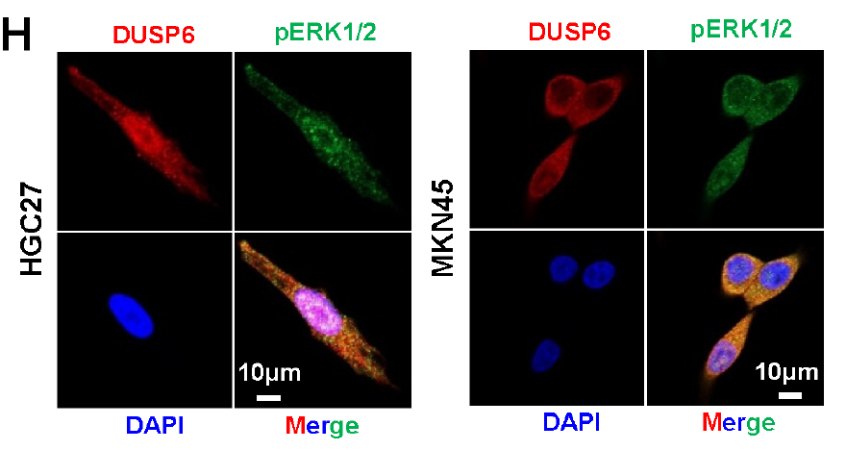
Results
CircPDIA4 sustained high phosphorylation levels of ERK1/2 through interrupting binding of DUSP6 with ERK1/2
Co-IP
Notes:
Since previous study had demonstrated that DUSP6 dephosphorylates pERK1/2, and preventing the activation of MAPK signaling.
The authors firstly investigated whether DUSP6 is also a partner protein of pERK1/2 in gastric cancer cells.
Co-IP assays showed that DUSP6 could precipitate with pERK1/2 and, in contrast, pERK1/2 also could precipitate with DUSP6 in cells.
In addition, Immunofluorescence assays also demonstrated that pERK1/2 and DUSP6 co-localized with each other in gastric cancer cells.
Therefore, the authors wanted to look whether circPDIA4 regulate the phosphorylation of ERK1/2 via interrupting the interaction between DUSP6 and pERK1/2.

Slide 28
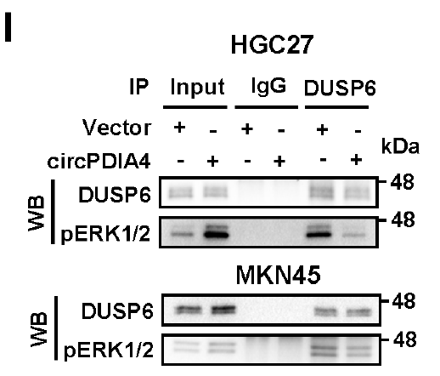
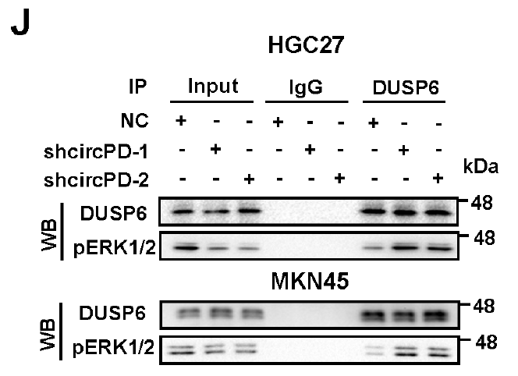
Results
CircPDIA4 sustained high phosphorylation levels of ERK1/2 through interrupting binding of DUSP6 with ERK1/2
Notes:
According to the results, the authors found that overexpression of circPDIA4 evidently attenuated the interactions between DUSP6 and ERK1/2.
And On the contrary, knockdown of circPDIA4 markedly strengthened the interactions between DUSP6 and ERK1/2, indicating circPDIA4 could compete with DUSP6 to bind with pERK1/2.

Slide 29
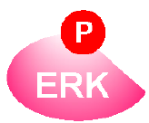
Results
CircPDIA4 sustained high phosphorylation levels of ERK1/2 and reduced the sensitivity of ERKi
ERKi resistance
MK-8353 : ERK1/2 inhibitor
Notes:
Moreover, previous study had found that hyper activation of the ERK1/2 phosphorylation was associated with chemotherapy resistance.
Therefore, the authors treat the cells with ERK1/2 inhibitor while knockdown circPDIA4.
The MTT assay showed that knockdown of circPDIA4 expression strikingly reinforced the sensitivity of ERK1/2 inhibitor, MK-8353.

Slide 30
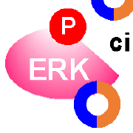
Summary
circPDIA4
ERKi resistance
Notes:
In summary, These results demonstrate that elevated circPDIA4 expression in gastric cancer could weaken interactions between DUSP6 and pERK1/2, therefore enhance ERK1/2 phosphorylation, and, thus, reduce ERK1/2 inhibitor sensitivities.

Slide 31
Results
CircPDIA4 competitively combined with DHX9 as a decoy to promote oncogenic circRNAs formation
Vector vs. circPDIA4
Notes:
Next, lets look the interaction between circPDIA4 and DHX9.
We could see that the expression levels of DHX9 protein were not disturbed when circPDIA4 was overexpressed or knockdown.
Additionally, circPDIA4 did not impact the nucleoplasm distribution ratio of DHX9.
Since It has been reported that Alu-mediated circRNA biogenesis could be repressed by DHX9.
To assess whether production of certain circRNAs is regulated by circPDIA4, the authors profiled genome-wide circRNA expression through circRNAseq.
The result showed there were 785 circRNAs upregulated after overexpressing circPDIA4, suggesting that circPDIA4 might participate in regulating the functions of DHX9.

Slide 32
Results
CircPDIA4 competitively combined with DHX9 as a decoy to promote oncogenic circRNAs formation
A
B
A
A
B
B
Notes:
So, the authors generated two HA-tagged DHX9 expression constructs without or with the two Double-stranded RNA binding motifs.
RIP assays demonstrated that wildtype DHX9 and construct B which had Double-stranded RNA binding motifs could significantly enrich with antibody against HA, while construct A which had no Double-stranded RNA binding motifs could not enrich endogenous circPDIA4.
This data suggested that circPDIA4 competitively combined with DHX9.

Slide 33
Results
CircPDIA4 competitively combined with DHX9 as a decoy to promote oncogenic circRNAs formation
Notes:
The authors then validated the increased abundance of five most significantly upregulated candidate circRNAs in gastric cancer cells with overexpression of circPDIA4, among them, circ_1610 was chosen for further research.
We could see that after knockdown DHX9, the expression of circ_1610 significantly increased, and so did after overexpression of circPDIA4.
Therefore, we could confirm that circPDIA4-mediated upregulation of circRNAs depends on DHX9 protein.

Slide 34
Results
CircPDIA4 competitively combined with DHX9 as a decoy to promote oncogenic circRNAs formation
Notes:
In order to determine whether circPDIA4-regulated circRNAs have any effects on invasive activities of gastric cancer cells.
The authors then performed rescue assays using cells with stable circPDIA4 overexpression.
We could observe a significant increase of invasive activity after circPDIA4 overexpression however, it could be rescued by knockdown of circ_0001610, indicating the oncogene nature of circ_0001610 in gastric cancer.

Slide 35
Summary
circPDIA4
Migration
Metastasis
Invasion
oncogenic circRNAs
Notes:
These results elucidate that circPDIA4 could competitively bind the RNA binding motifs of DHX9 as a decoy, repress interactions between DHX9 and its target RNAs, and, thus, boost the biogenesis of DHX9-controlled oncogenic circRNAs, and further promote the progression of gastric cancer,

Slide 36
Conclusion
circPDIA4
Gastric cancer cells migration, invasion and metastasis
Notes:
In conclusion, the authors found that QKI controlled biogenesis of circPDIA4 via back-splicing of exons 3 and 4 of PDIA4 RNA.
And circPDIA4 acted as an oncogene to promote gastric cancer cell migration, invasion, and metastasis.

Slide 37
Conclusion
Nucleus
cytoplasm
Notes:
On one hand, circPDIA4 regulated the interactions between DUSP6 and ERK1/2, increased the phosphorylation of ERK1/2 and reduced the sensitivities of ERK inhibitor.

Slide 38
Conclusion
Nucleus
oncogenic circRNAs
cytoplasm
Gastric cancer cells progression
Notes:
On the other hand, circPDIA4 could interact with DHX9 in nucleus, repressed its functions, and induced elevated expression of multiple oncogenic circRNAs, which, thereby, promoted gastric cancer progression.

Slide 39
Comments
Pros :
The study is comprehensive that the authors explore the role of circPDIA4 from the upstream to the downstream.
It is the first paper demonstrated that one circRNA could regulate the biogenesis of other circRNAs, which broaden the understanding of mechanisms by which circRNAs could be generated.

Slide 40
Thanks for listening

Slide 42
Introduction
circRNA-protein interaction
Protein sponge/decoy
HuR
(Kotb Abdelmohsen, et al. RNA Biology. (2017))
Notes:
The protein sponge or called protein decoy
For example, circPABPN1 could competes with PABPN1 mRNA for binding to HuR, contributing to suppresses PABPN1 translation.

Slide 43
Introduction
circRNA-protein interaction
Protein scaffold
(Suofeng Sun, et al. Journal of Experimental & Clinical Cancer Research. (2020))
Notes:
Second, the protein scaffold.
For example, circ-LRIG3 acted as the scaffold for EZH2 and STAT3, facilitating EZH2-induced STAT3 methylation and subsequent phosphorylation, resulting in the activation of STAT3 signaling to promote HCC cell progession.

